Slide 1
Electives for 7th and 8th grade
2-D Art & Design
3-D Art & Design
Digital Art and Mixed Media

Slide 2
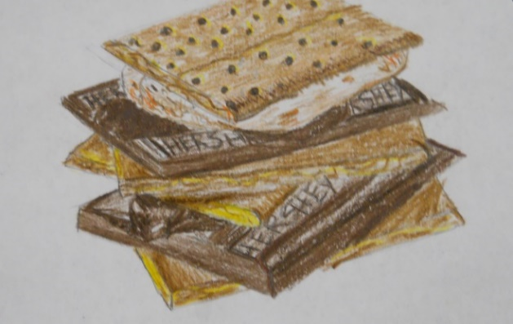
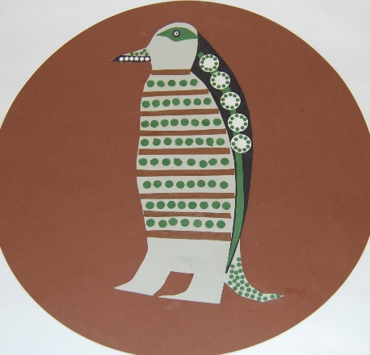
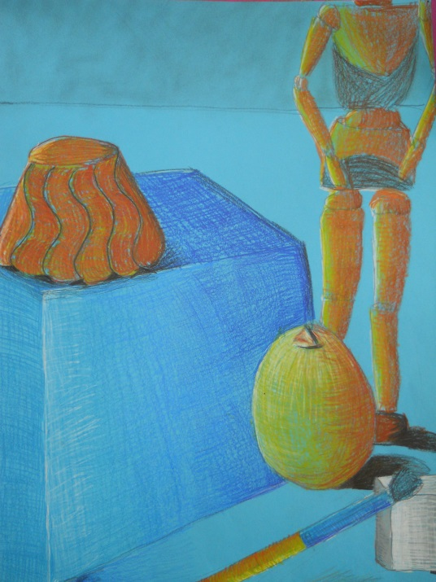
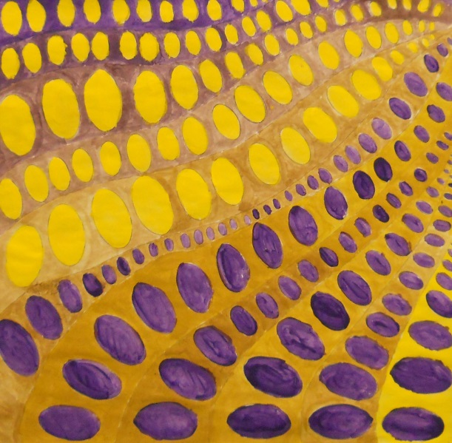
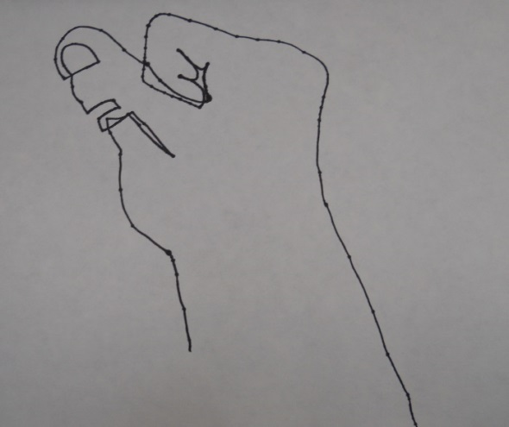
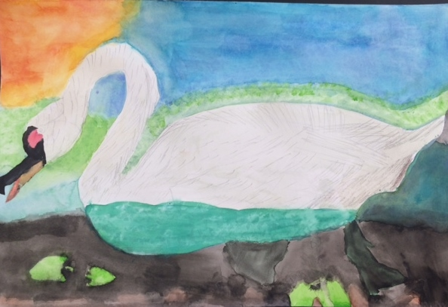
2-D Art and Design
This course explores two dimensional art processes including drawing, painting, printmaking, and collage. Students will build upon common vocabulary and foundation skills and refine ideas with student input to personalize projects.
Units of Study
Elements & Principles of Art
Realism
Abstraction/Non-Objective Art

Slide 3
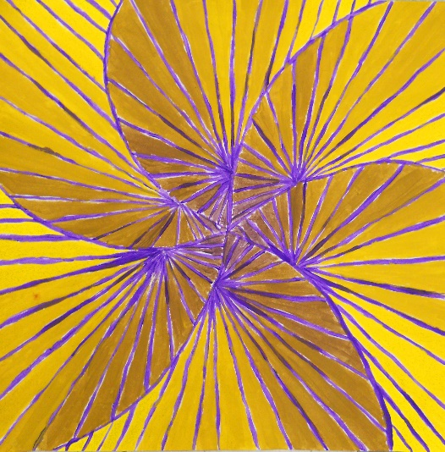
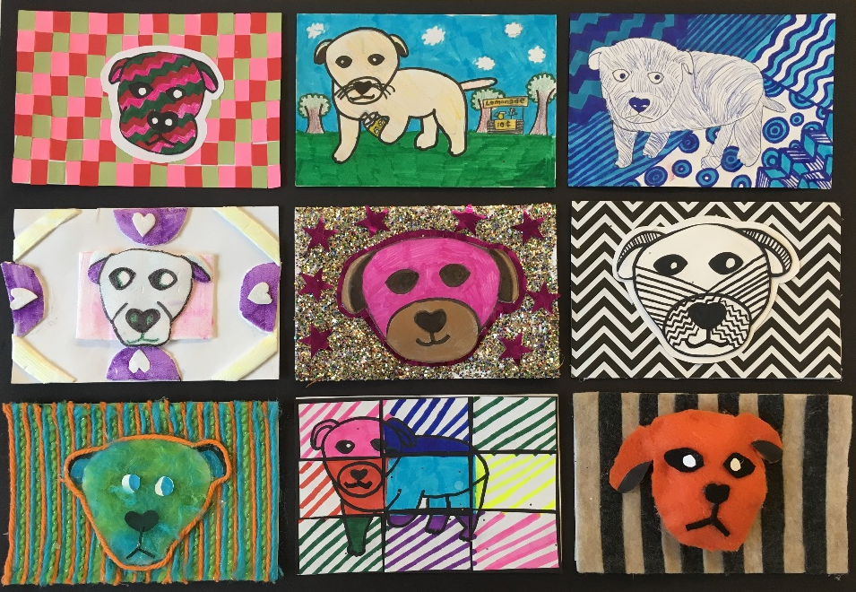
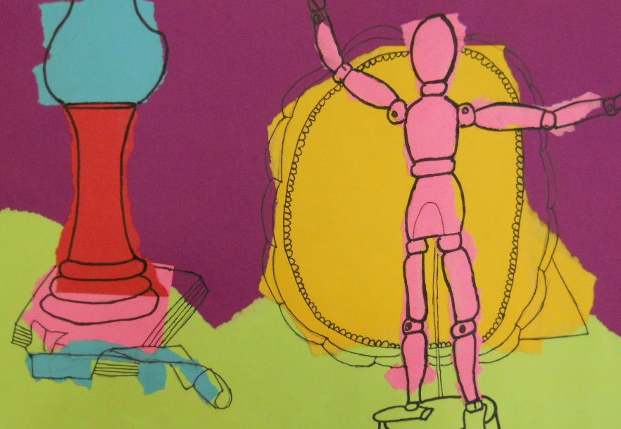
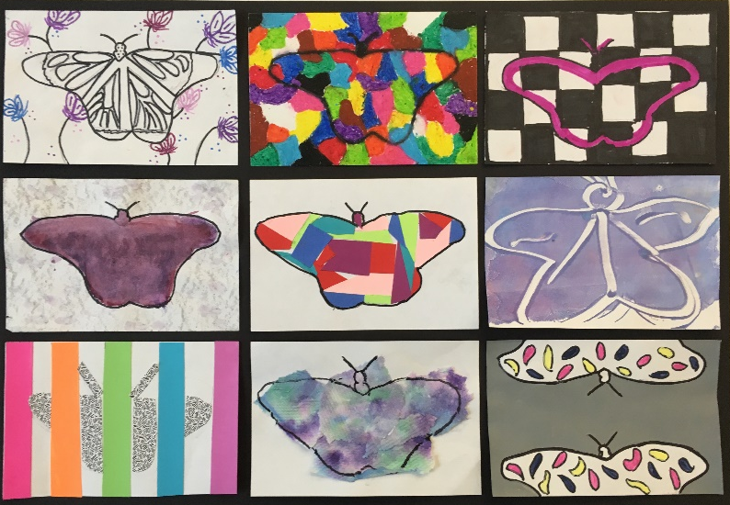
2-D Art and Design
Elements and Principles of Art
This unit will strengthen students' understanding of the elements and principles of art. Students will create artwork using varied art styles and materials.

Slide 4
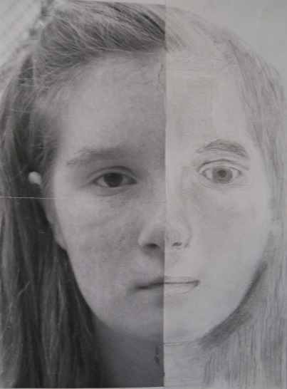
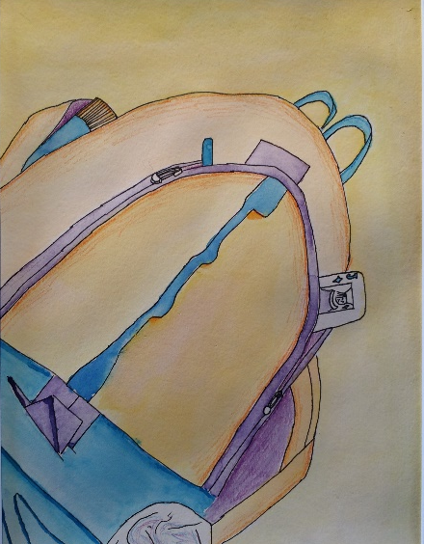
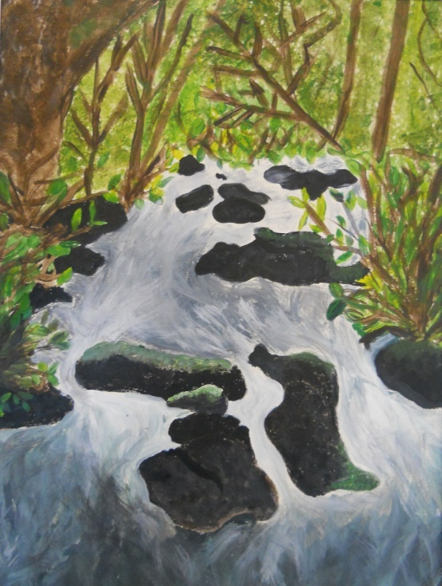
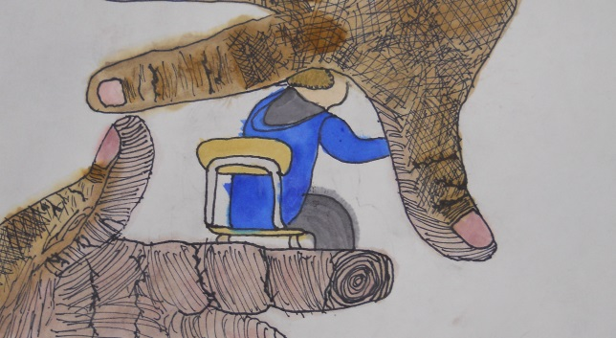
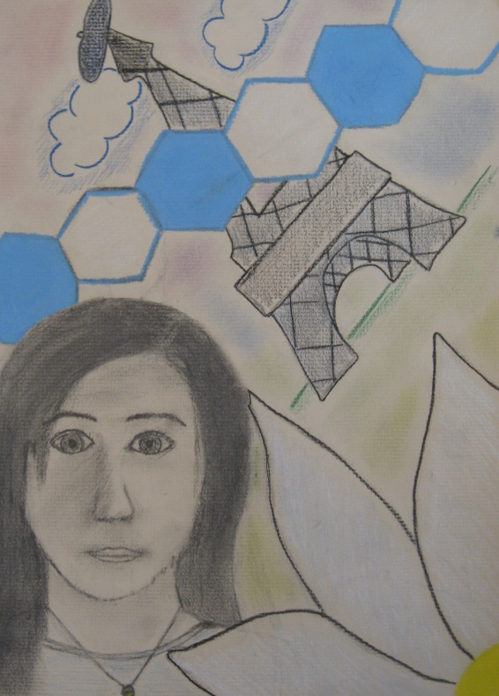
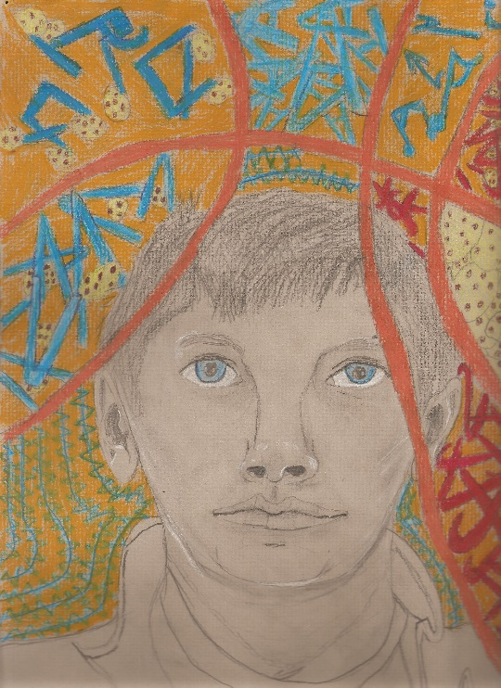
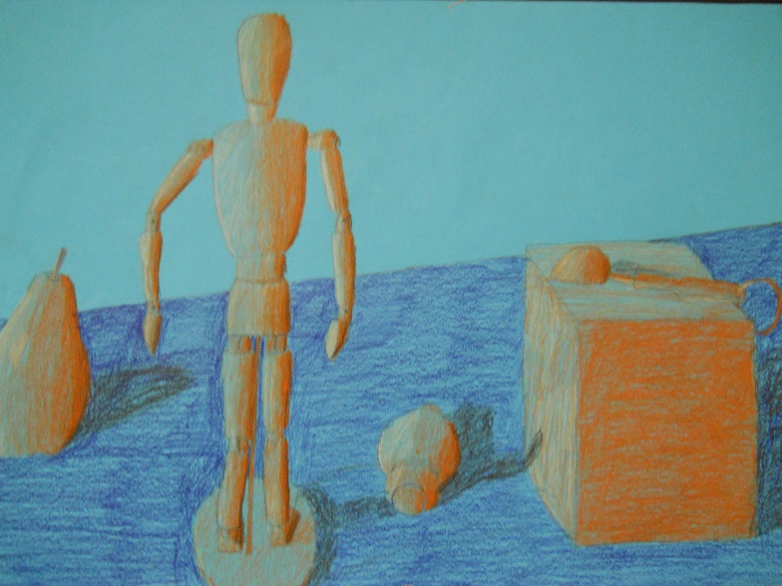
2-D Art and Design
Realism
This unit will teach students how to create realistic works of art using varied techniques.

Slide 5
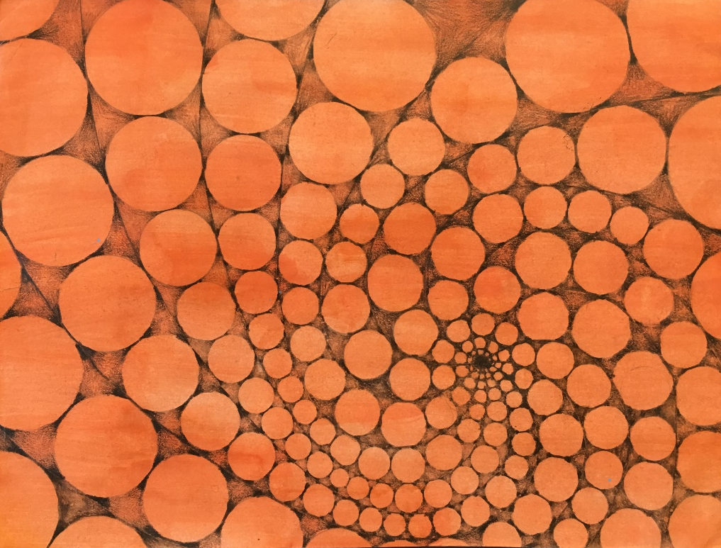
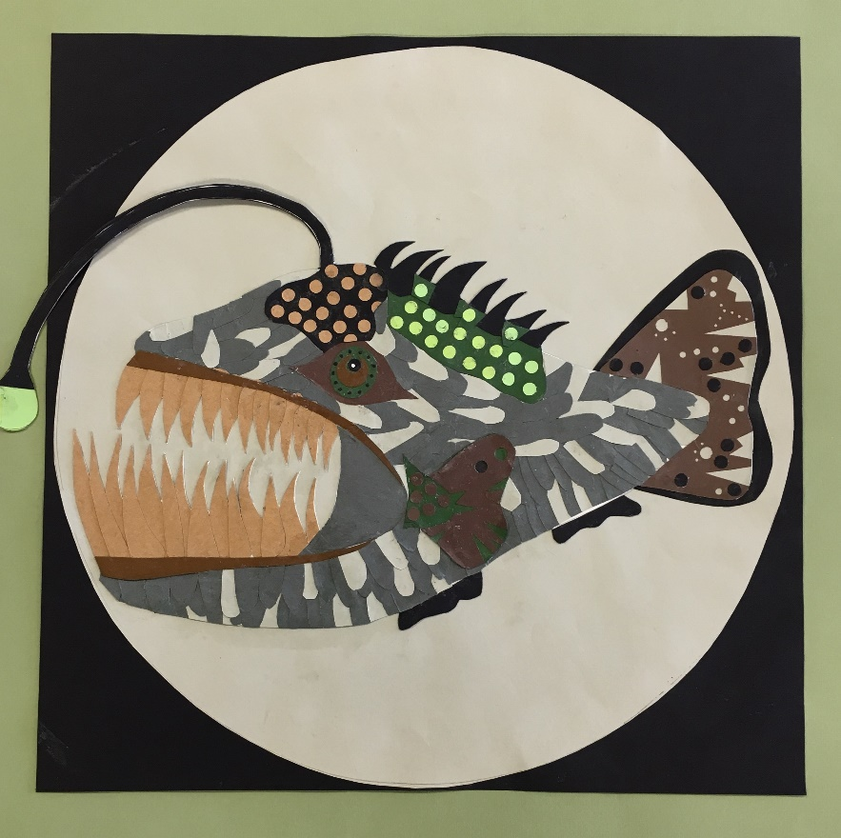
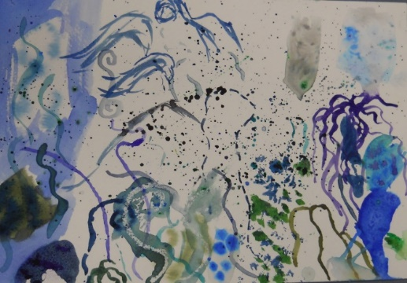
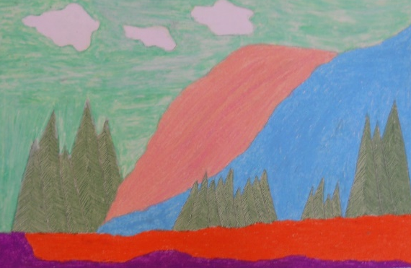
2-D Art and Design
Abstraction/Non-Objective Art
In this unit students will learn why artists choose to create artwork in these styles of art as opposed to realism. Students will learn varied techniques in creating abstract and non-objective art. Students will use several different media to express their ideas.

Slide 6
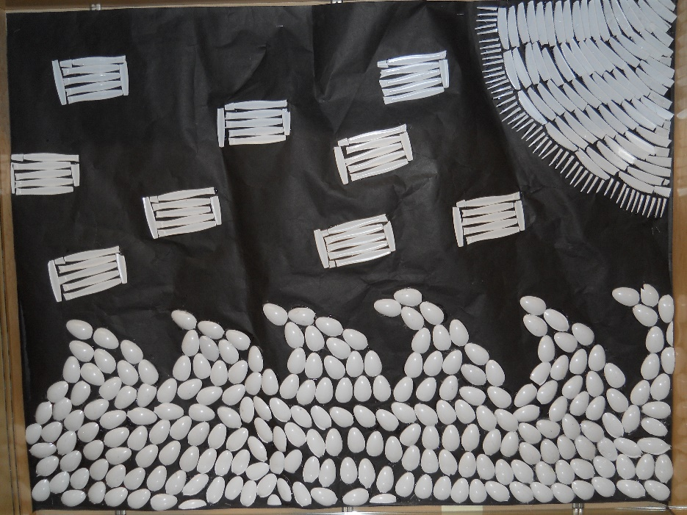
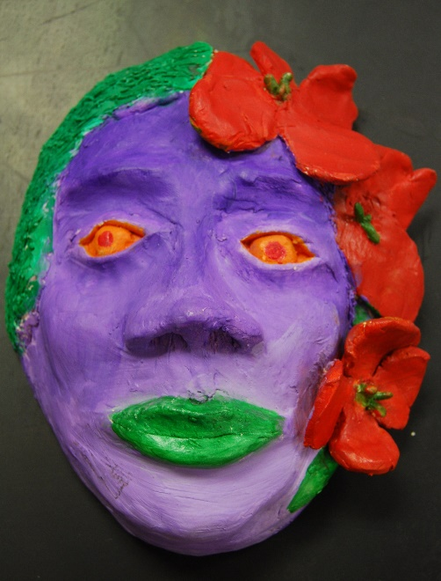
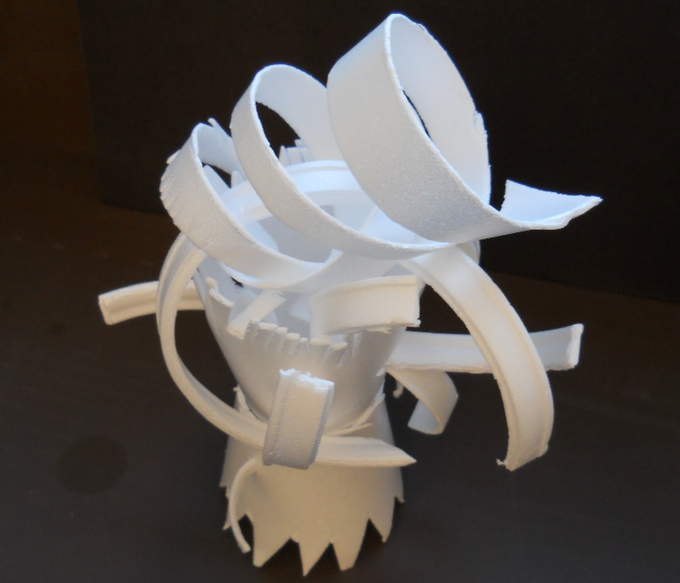
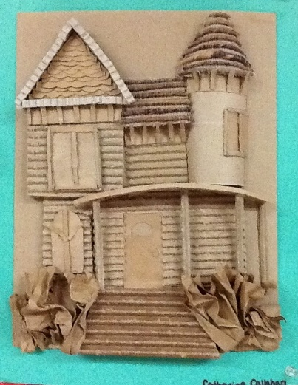
3-D Art and Design
This course offers students the experience to work with a wide variety of 3D materials such as cardboard, repurposed objects, and clay. Students will create original artwork, both individually and in groups. Students will learn sculptural vocabulary and techniques. References for ideas will be drawn from multiple sources including images from art history and contemporary art.
Units of Study
Installations
Low Relief vs. In the Round
Functional vs. Decorative Art

Slide 7
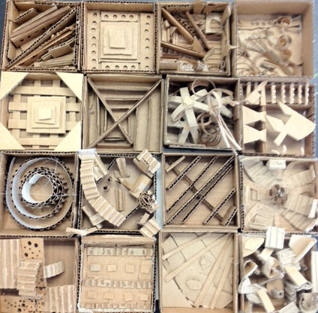
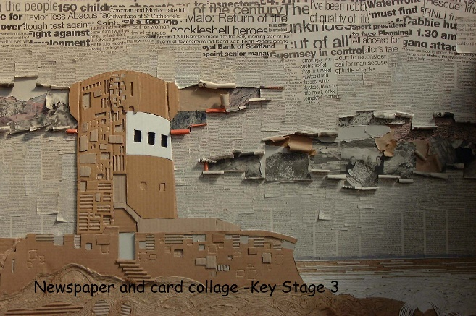
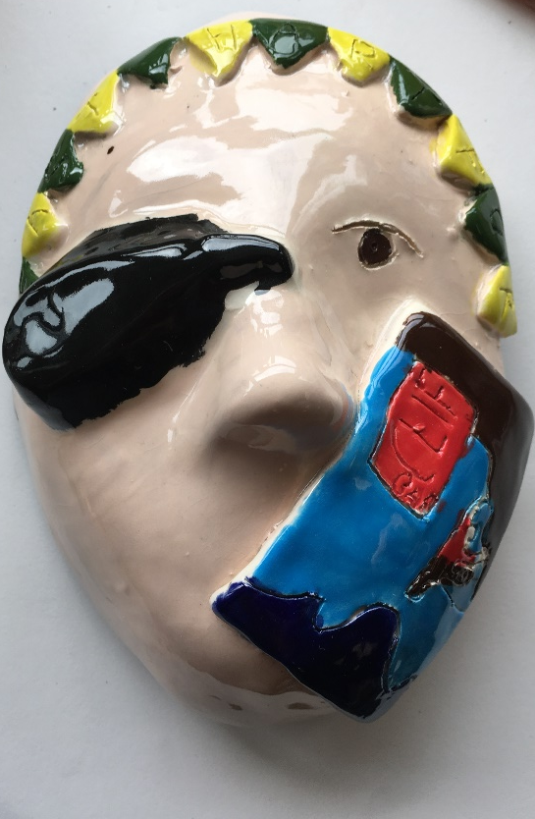
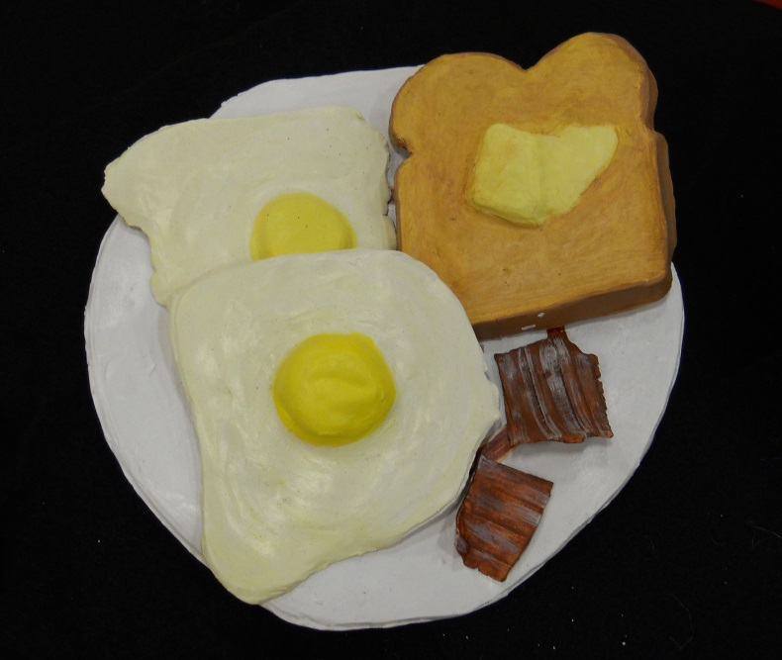
3-D Art and Design
Low Relief vs. In the Round
In this unit, students will learn about different forms of sculpture. Students will use varied media including clay and recycled materials.

Slide 8
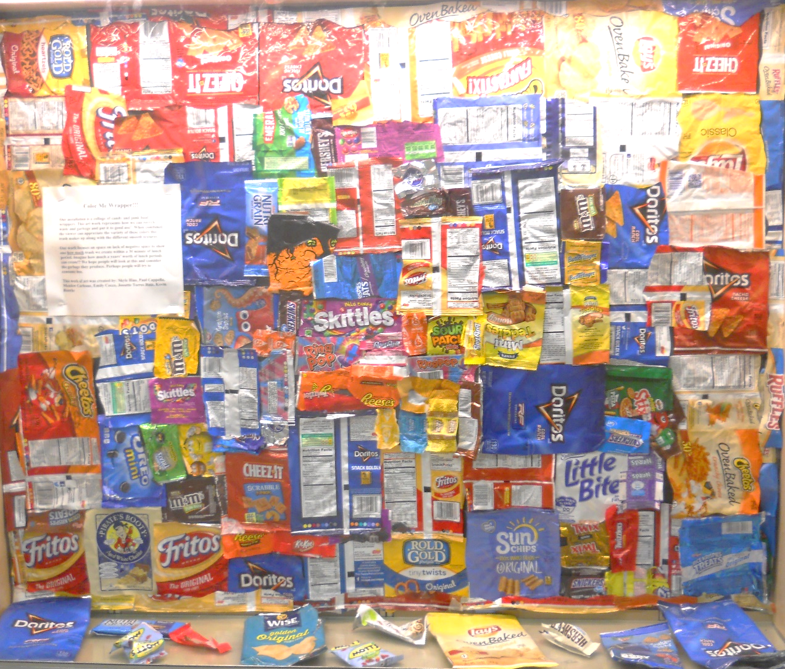
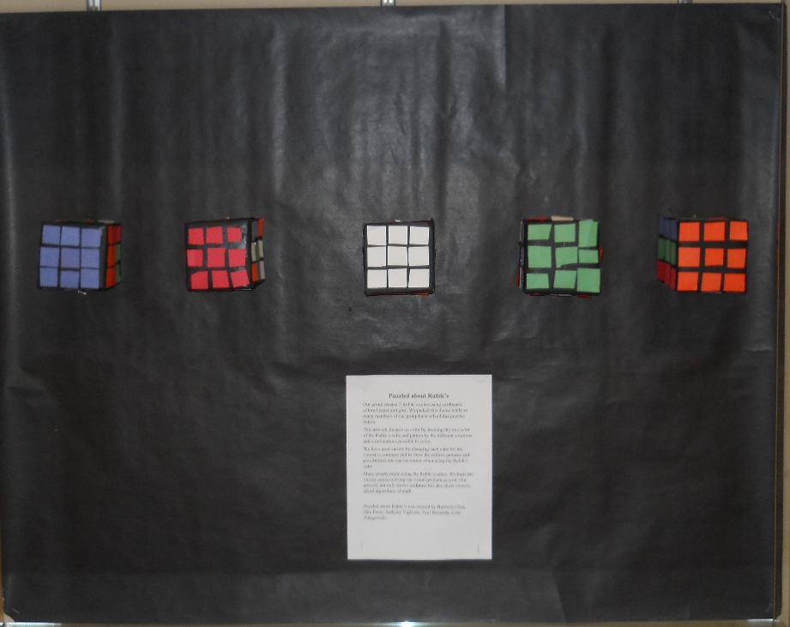
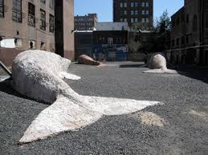
In this unit, students will learn what installations are and why artists choose to communicate via this form of art. Students will work collaboratively and individually to create artwork using varied materials.
3-D Art and Design
Installations

Slide 9
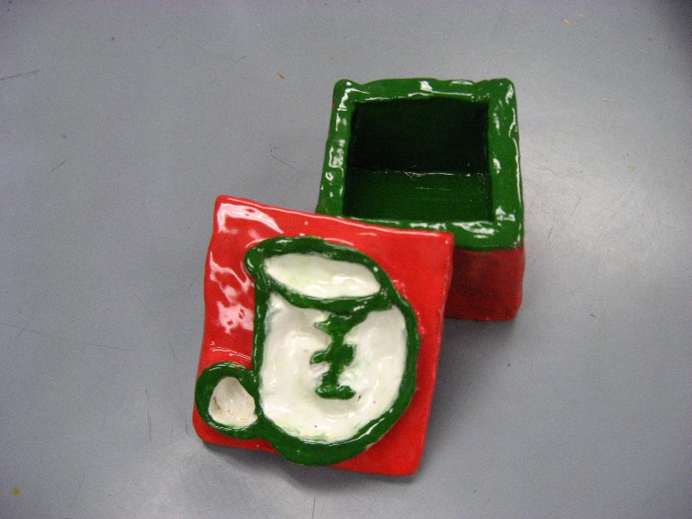
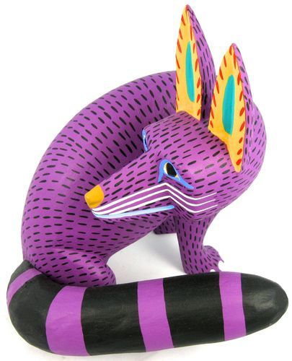
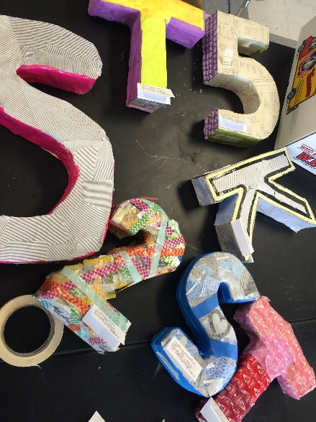
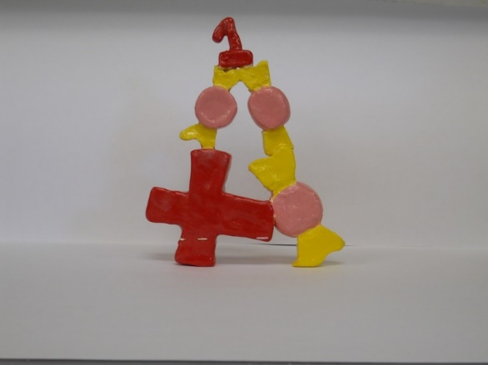
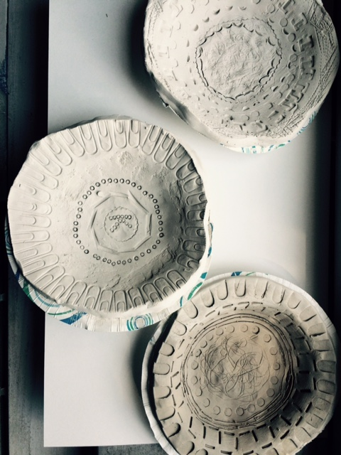
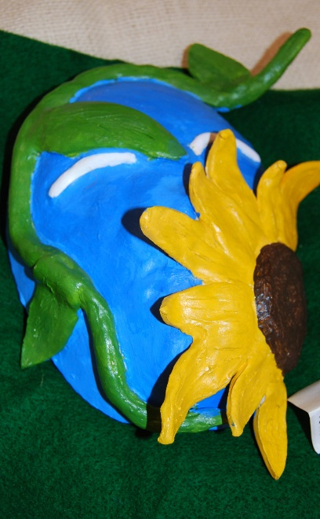
In this unit, students will learn about the different purposes of sculpture. Students will create both functional and decorative pieces of art.
Oaxacan Wood Carving
3-D Art and Design
Functional vs. Fine Art

Slide 10
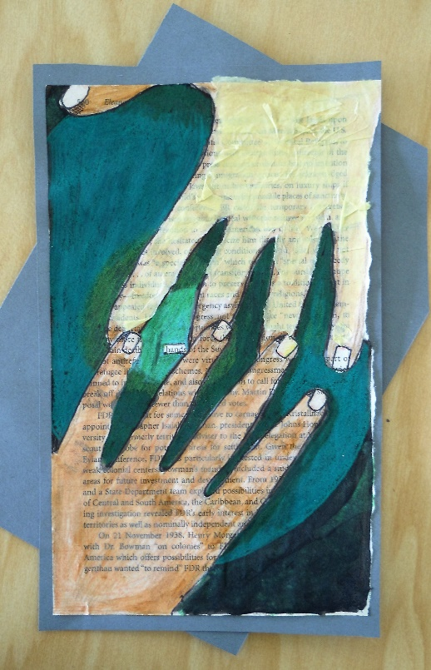
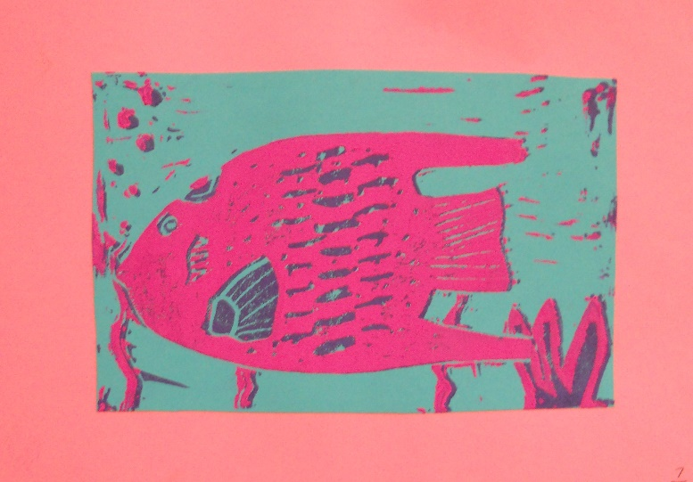
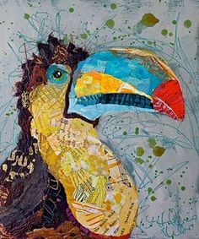
Digital Art and Mixed Media
Students will combine a variety of art media that will allow them to explore and refine use of varied materials and processes such as printmaking, collage, assemblage, Microsoft Paint, Adobe Photoshop and other digital media.
Units of Study
Mixed Media
Printmaking
Digital

Slide 11
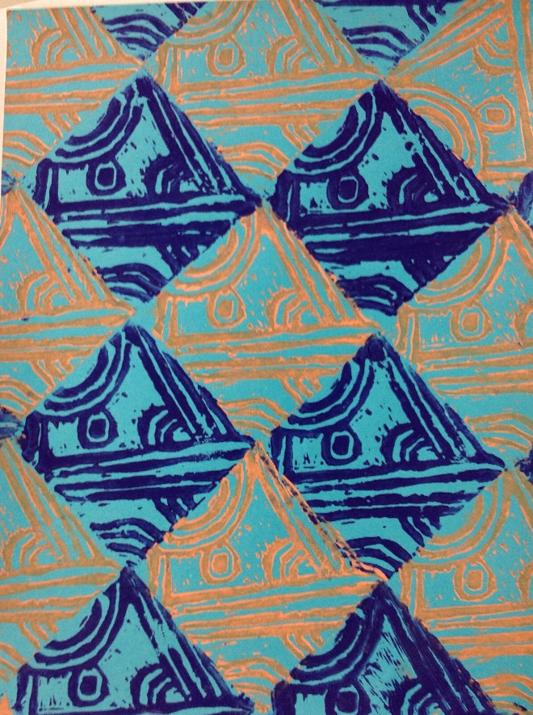
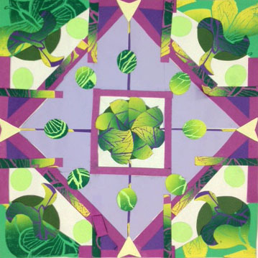
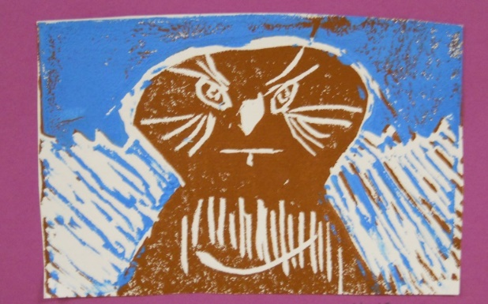
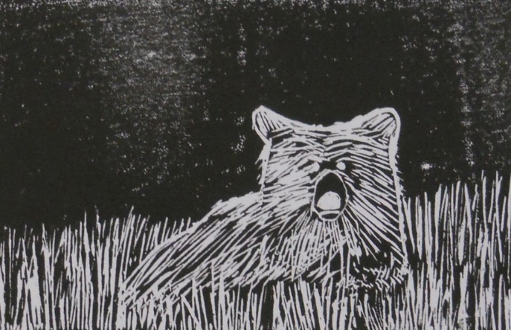
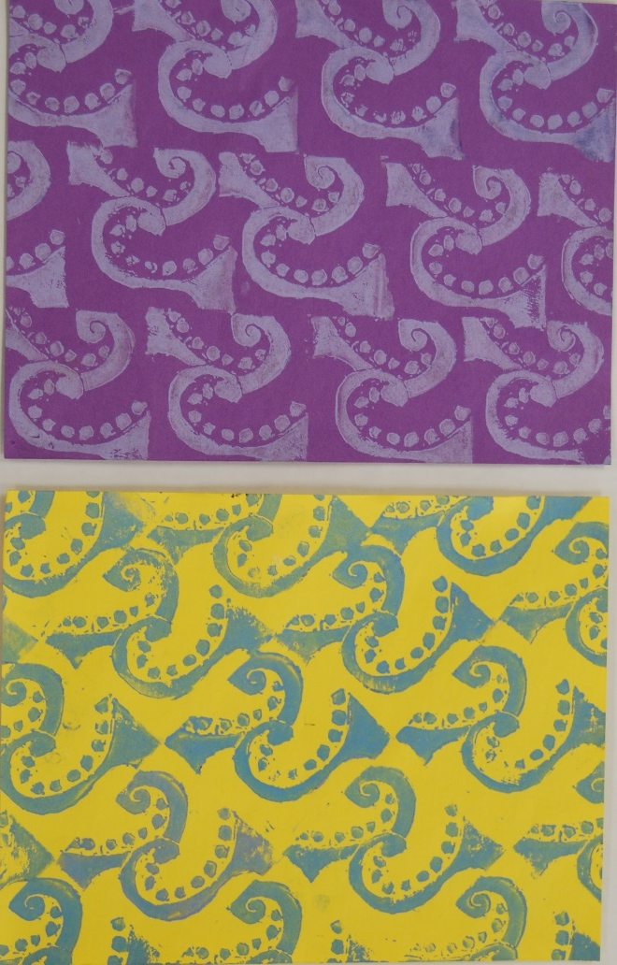
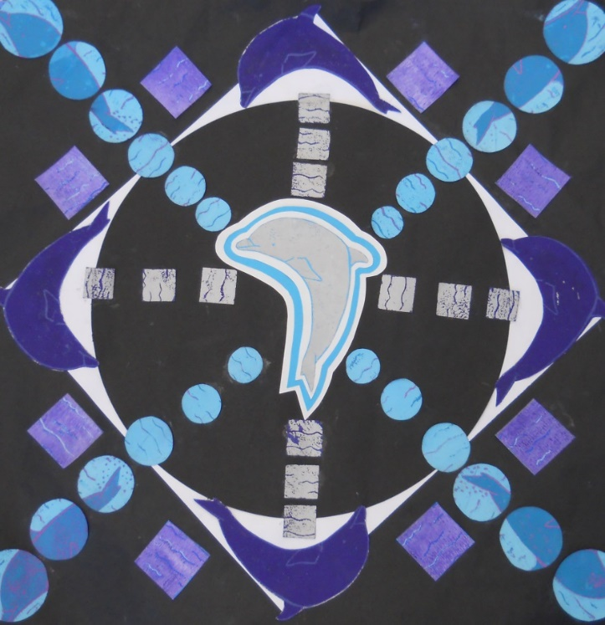
Digital and Mixed Media
Printmaking
In this unit, students will learn how to create artwork using relief printmaking. Students will learn how to safely and properly carve linoleum blocks. Students will use their prints to create multiple works of art.

Slide 12
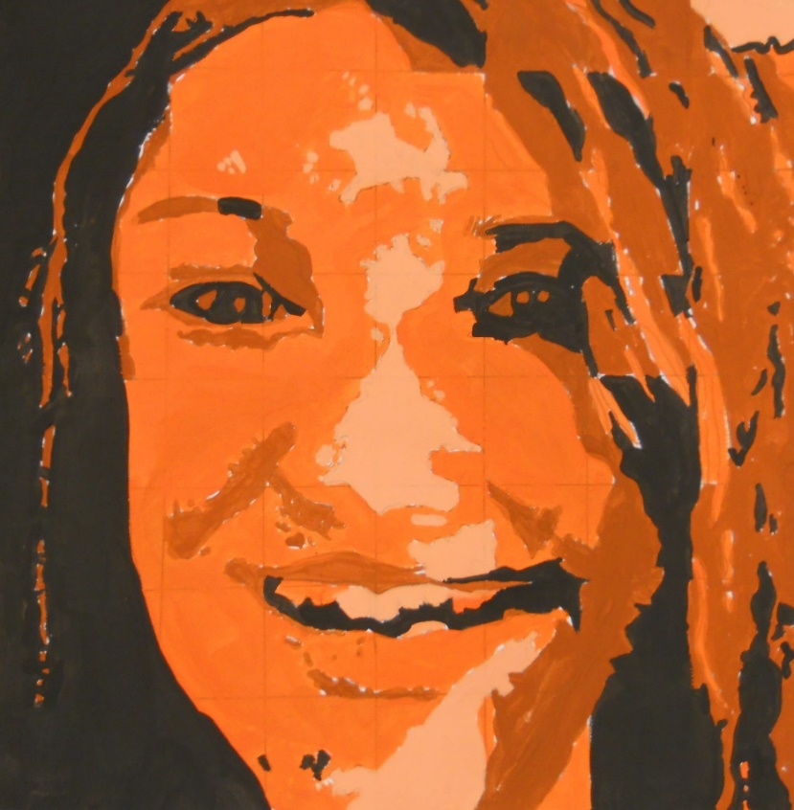
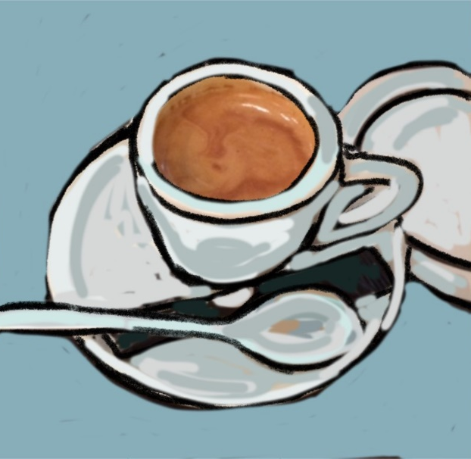
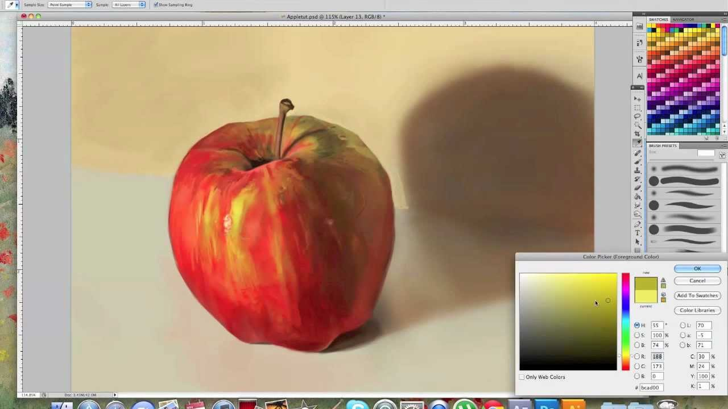
Digital and Mixed Media:
Digital
In this unit, students will use Photoshop as a tool to create artwork. Students will learn how to manipulate images and to apply text to create meaning in their artwork. Students will also use Movie Maker to create a presentation.

Slide 13
Digital and Mixed Media
Mixed Media
In this unit, students will use varied media within each artwork. Students will learn how to determine the most effective vehicle in creating meaning in their artwork.
Laura Heilman

Slide 14
Students have Art for forty-five minutes, every other day for a total of 90 days throughout the school year.

