Slide 1
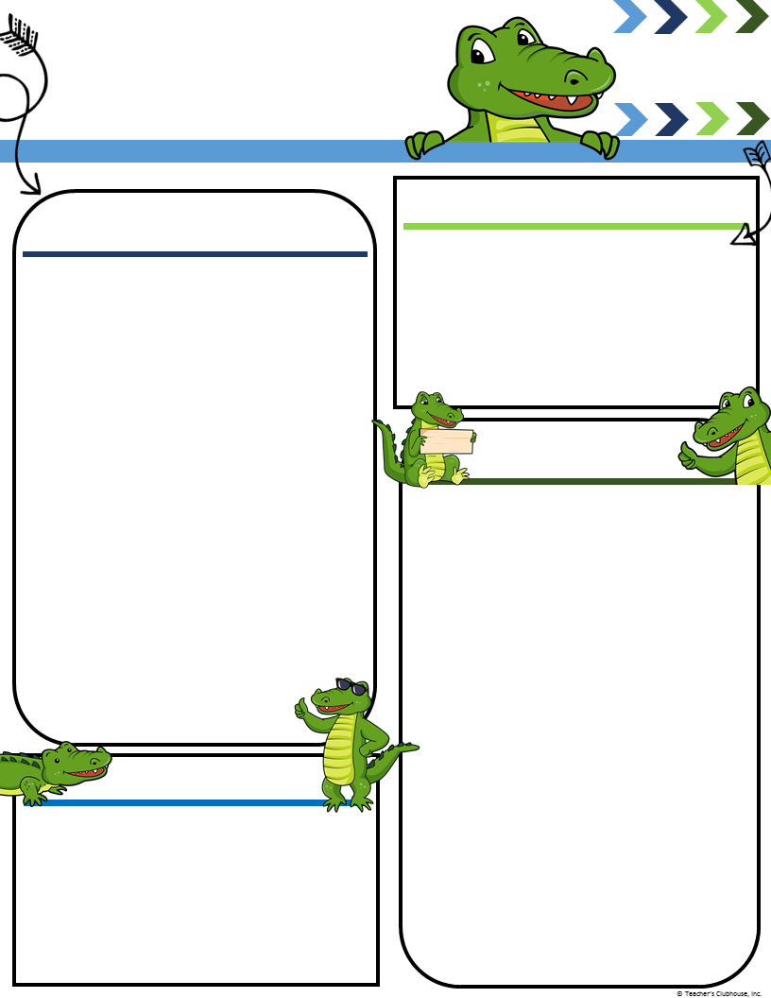
Mrs. Sharon’s
Pre-K
863-494-9303
Ecc.desotoschools.com
Little Gators’ Newsletter
Week of Jan. 15 – Jan. 19
Upcoming Events
A Peek at Our Week
January 15, 2018~No School; Dr. Martin Luther King Holiday
February 2, 2018~No School Professional Development Day
Monthly Theme Focus: Imagine It, Make It!
This Week’s Focus: Tools We Use
Alphabet Knowledge: Letter Nn
Oral Language: shares a personal experience, responds appropriately, requests help, follows oral directions, engages in conversation, takes turns speaking, uses describing words.
Math Concepts: Uses position words, Counts to 5, using 1:1 correspondence.
Character Development:
Initiative: Children learn how imagination and creativity shape our world.
Standards 5.C.3, 5.D.2-4
Monday:
No School
Tuesday:
Check folders daily..
Wednesday:
Check folders daily..
Thursday:
Check folders daily..
Friday:
Have a great weekend.
Reminders
Check out our New Facebook page “@desotoecc”

