Slide 1
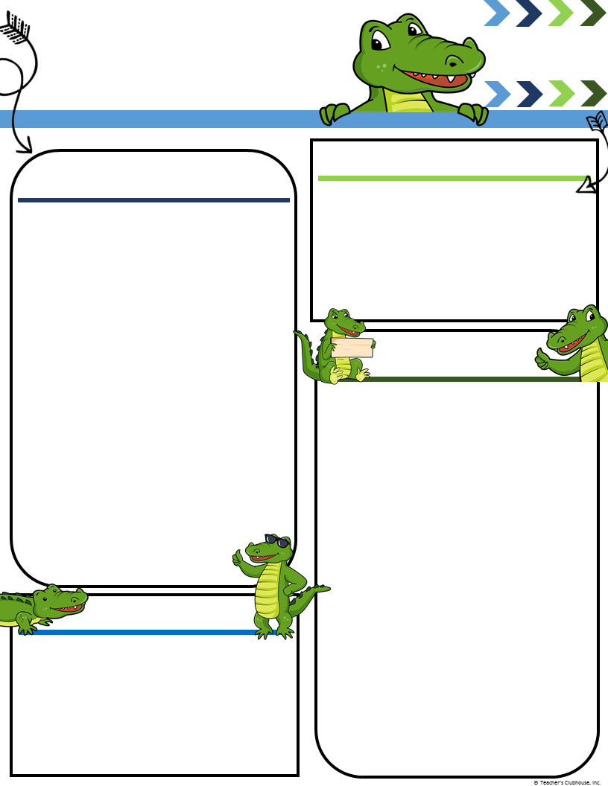
Mrs. Sharon’s
Pre-K
863-494-9303
Ecc.desotoschools.com
Little Gators’ Newsletter
Week of August 28 – Sept 1
Upcoming Events
A Peek at Our Week
September 4, 2017 No School ~Labor Day.
September 11, 2017 Picture Day
September 12, 2017 Boosters Meeting DECC Cafeteria 5:00 pm
Monthly Theme Focus: Ready for School
This Week’s Focus: Learning Together
Alphabet Knowledge: letter Aa
Oral Language: shares a personal experience, responds appropriately, requests help, follows oral directions, engages in conversation, takes turns speaking, uses describing words.
Math Concepts: Uses position words, Counts to 5, using 1:1 correspondence .
Character Development:
Cooperation: children will focus on learning classroom rules and routines and playing cooperatively with others.
Standards 2.A.1, 2.B.1, 3.A.1-3, 3.B.1, 4.A.1-2
Monday:
Check folders daily..
Tuesday:
Check folders daily..
Wednesday:
Check folders daily..
Thursday:
Check folders daily..
Friday:
Have a great three day weekend.
Vocabulary Words:
learn partners together cuddly flag hide floppy nap wiggly longer taller shorter citizen country flag magnet
scientist Pledge of Allegiance
Reminders
Check out our Facebook page “New Horizons & DeSoto Early Childhood Center”

