Slide 1
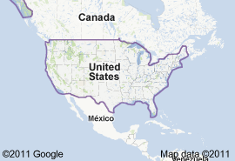
5th Grade Social Studies
Topic 1: Introduction to United States History & Geography

Slide 2
Topic 1: Introduction to United States History & Geography
LESSON: 1
Intro to U.S. Geography

Slide 3
Vocabulary
Compass Rose
Map Legend
Latitude
Longitude
Geographical feature

Slide 4
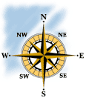
The Compass Rose
The compass rose is a design, often with decorations, to show direction. Usually, north is at the top, south is at the bottom, east is on the right, and west is on the left. The directions are commonly abbreviated to their first letters, for example "E" for "east.”

Slide 5
Compass Ross
The compass rose can be divided further to show more directions: northeast for the area between north and east; northwest for the area between north and west; southeast for the area between south and east; southwest for the area between south and west.

Slide 6
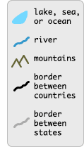
The Legend
The legend, or key, can be used to understand the symbols included on the map. Symbols such as lines, colors, or pictures are often used in maps to represent geographical features, such as lakes, rivers, or mountains. They can also be used to represent borders between countries, cities, capitals, and other manmade landmarks. Samples of common map symbols are shown in the legend at right

Slide 7
Latitude/Longitude
Longitude – The distance of a place east or west
Latitude – The distance of a place north or south

Slide 8
Geographical Features
Geographical features include
Mountains
Plateaus
Deserts
Bodies of water

Slide 9
Geographical Features of US
Colorado River
Missouri River
Columbia River
Rio Grande
Mississippi River
Ohio River
Hudson River
St. Lawrence River
Great Salt Lakes
Lake Superior
Lake Erie
Lake Michigan
Lake Huron
Lake Ontario

Slide 10
Cont.
Rocky Mountains
Appalachian Mountains
Great Plains

Slide 11
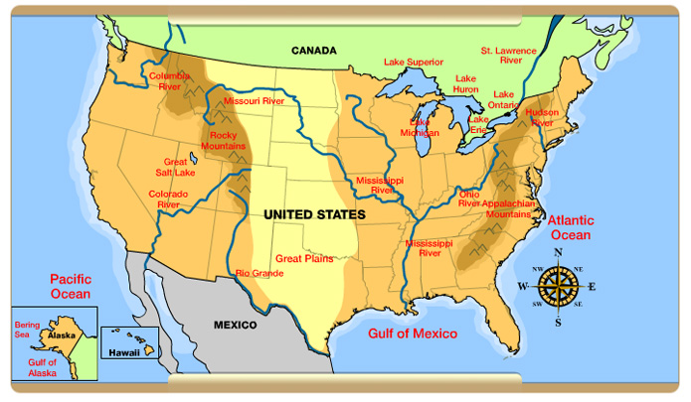
Physical Map of U.S.

Slide 12
Topic 1: Introduction to United States History & Geography
LESSON: 3
Regions of the US

Slide 13
Regions of the US
New England Region
Middle Atlantic Region
Appalachian Highlands
Southeast Region
Midwest Region
Great Plains or Heartland Region
South Central Region
Mountain West Region
Pacific West Region

Slide 14
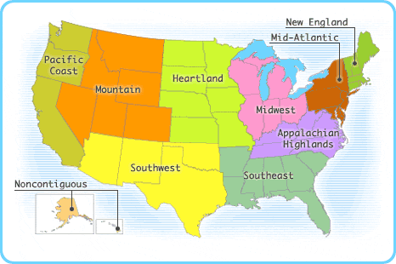
Regions of the US

Slide 15
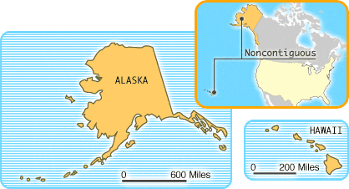
Noncontiguous States

Slide 16
New England
Made up of Connecticut, Maine, Massachusetts, New Hampshire, Vermont, and Rhode Island, New England is the easternmost region of the United States. The Atlantic Ocean shoreline in New England is dotted with many islands, bays, and coves. Some of the earliest and most successful English colonies were established here, giving the region its name.

Slide 17
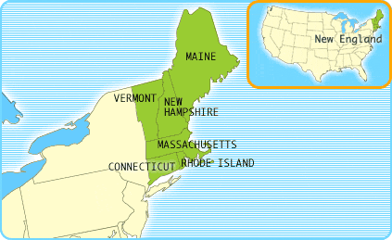
New England Region

Slide 18
The Mid-Atlantic States
The Mid-Atlantic region is comprised of the Appalachians and their foothills and Atlantic Coastal Plain. To the north and northwest, it is bordered by the easternmost Great Lakes. The region includes Delaware, Maryland, New Jersey, Pennsylvania, and New York, which is home to largest city in the United States, New York City.

Slide 19
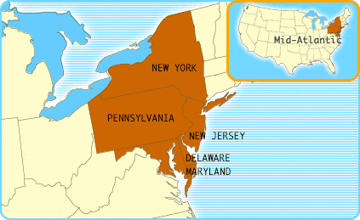

Slide 20
The Appalachian Highlands
Several mountain ranges make up the Appalachians, including:
the Blue Ridge Mountains and the Smokies.
Kentucky, North Carolina, Tennessee, Virginia, and West Virginia are the region's states, and along the Atlantic Ocean in North Carolina, a thin chain of islands called the Outer Banks protect the mainland from the sea

Slide 21
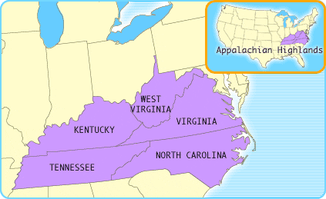

Slide 22
The Southwest
States such as Arizona and New Mexico, in the western portion of the region, have large expanses of desert as well as canyons, mesas
Grand Canyon, located in Arizona
States such as Oklahoma and Texas, in the eastern portion, are characterized by broad grasslands.

Slide 23
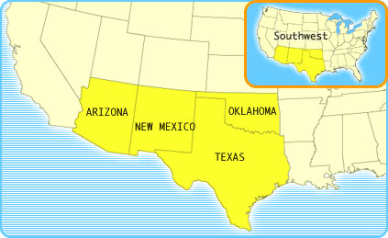

Slide 24
The Midwest
The states surrounding the Great Lakes make up the Midwest. Major cities and manufacturing centers — like Detroit, Michigan; Chicago, Illinois; and Cleveland, Ohio — border the lakes. Farther away from the lakes are agricultural areas, including a major center of dairy farming in Wisconsin and soybean production in Indiana.

Slide 25
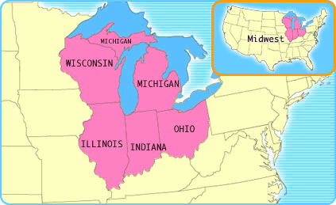

Slide 26
Mountain States
The Rocky Mountains are the dominant geographic feature of this region of the West. Colorado, Idaho, Montana, Nevada, Utah, and Wyoming are among the most sparsely populated states in the contiguous 48 and have a fairly dry climate. The eastern edge of this region levels off to broad, rolling prairies.

Slide 27
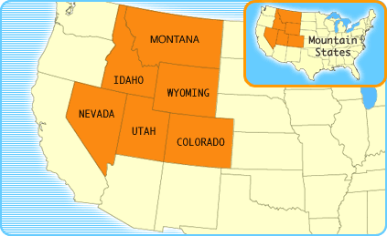

Slide 28
The Heartland
The dominant geographic feature of the Heartland is the broad expanse of the Great Plains. The states in the region — North Dakota , South Dakota , Nebraska , Kansas , Minnesota , Iowa , and Missouri — are considered to be the "breadbasket of America" and produce agricultural staples such as corn, wheat, milk, and cattle for the United States and the world.

Slide 29
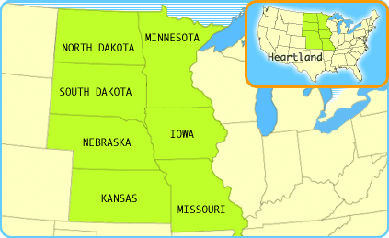

Slide 30
The Southeast
Many of the most low-lying areas in the United States are in the Southeast. The Mississippi River, which tracks the borders of Arkansas and Mississippi, empties into the Gulf of Mexico in Louisiana. States such as Alabama, South Carolina, and Georgia have piney forests and swamps, and Florida, a peninsula between the Atlantic Ocean and the Gulf of Mexico, has a tropical climate.

Slide 31
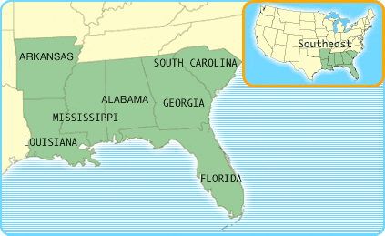

Slide 32
Pacific Coast States
The states of the contiguous 48 that border the Pacific Ocean include Washington, Oregon, and California. They are characterized by soaring, snow-capped mountains surrounded by fertile valleys and forests, and contain arid desert areas to the east. This region is also geologically active, with earthquake-prone areas and volcanoes.

Slide 33
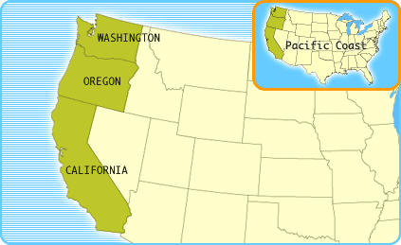
Pacific West Region

