Slide 1
Name:_______________________

Slide 2
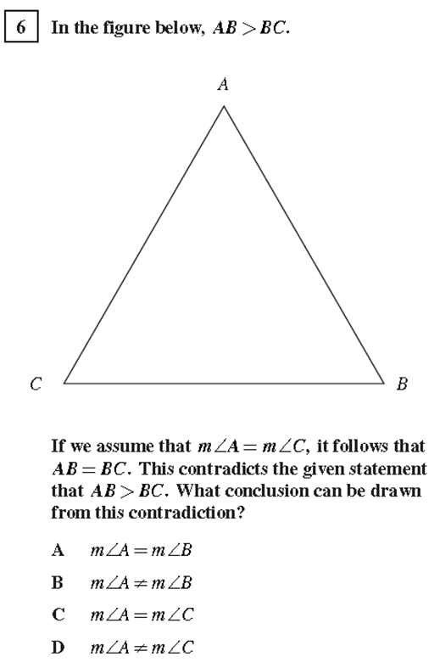

Slide 3
