Slide 1
LIBRARY BOOK CARE
By: Ms. B. Rollinson

Slide 2
How to take care of a book? The Do’s and the Don'ts. What can you do? Serious or minor damage.

Slide 3
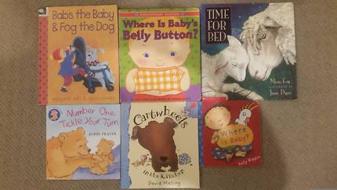
Good book

Slide 4
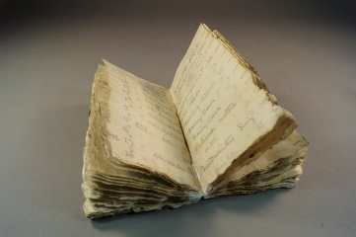
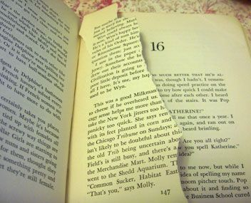
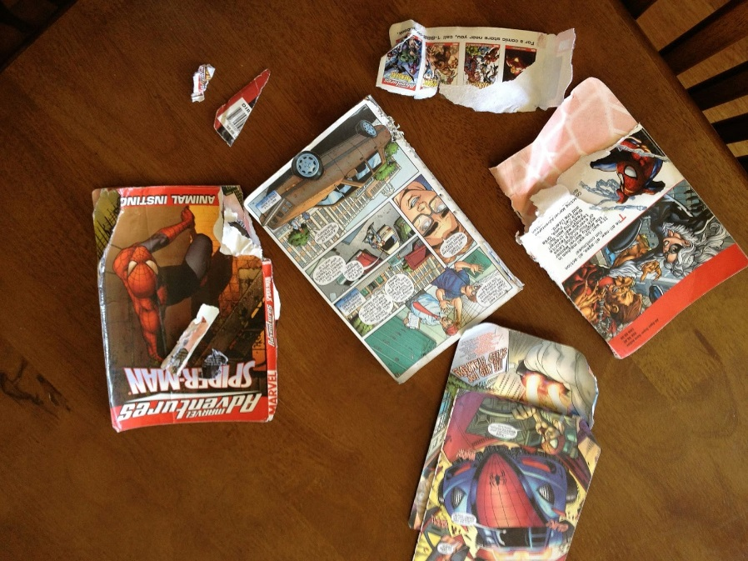
Damaged Books

Slide 5
Different kinds of damage

Slide 6
How to take care of a book?
Keep it in a safe and secure place when you’re not reading
Keep away from food and beverages
Do not give it to your pets or younger siblings.
Use a bookmark instead of bending the corners.
Turn pages carefully

Slide 7
Book Care
Do’s
Don’ts
Use bookmark
Keep in backpack
Keep away from snacks and drinks
Keep away from pets and younger siblings
Bend pages
Put books on floor or ground outside
Have food and water in books
Give book to pets and younger siblings
Can you think of more do’s and don’ts?

Slide 8
What do you if you find a damaged book?
Let Ms. Rollinson know IMMEDIATELY!!! While some books may be damaged very badly, there are a few things that are fixable.
Small tears
Sand and dirt
Cover peeling off
The sooner you notice the damage, the easier it may be to fix it

Slide 9
Each book in this library is for everyone. Each person who picks up and checks out a book is responsible not just because they want to read and enjoy the book but also because someone else may be able to enjoy it just as much.
For every good book, there is a good reader loving its pages.

