Slide 1
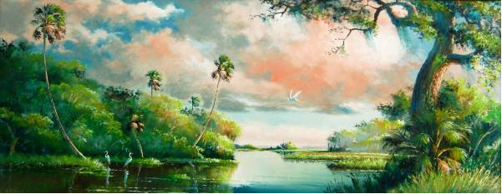
The Florida Highwaymen

Slide 2
Who Were They?
The Florida Highwaymen, are a group of 26 African-Americans, who broke with convention to paint beautiful iconic landscapes of Florida. They began paining in the mid 1950's, an era marked by racism and poverty, these self-taught entrepreneurs mentored each other while they painted on basic materials like Upson board for canvasses, and crown molding for frames. Local galleries shunned their work, so they peddled their art from car trunks along area roadways, hence their name. Their art freed them from work in citrus groves and labor camps, and they created a body of work that has become not only a timeless collection of a natural environment, but also a symbol of determination and belief in oneself.

Slide 3
Florida Highwaymen
The surviving Highwaymen, now in their sixties and seventies, are an important chapter in America’s culture and history, indeed, a National Treasure. Their self-determination in the face of adversity remains an important story of perseverance, inspiration and creativity. Their paintings now hang in galleries all over world and are worth thousands!

Slide 5
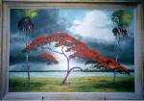
Alfred Hair

Slide 6
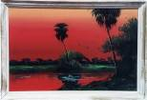
Alfred Hair

Slide 7
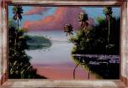
George Buckner

Slide 8
The Movie

