Slide 1
3rd Grade Pride Program Music

Slide 2
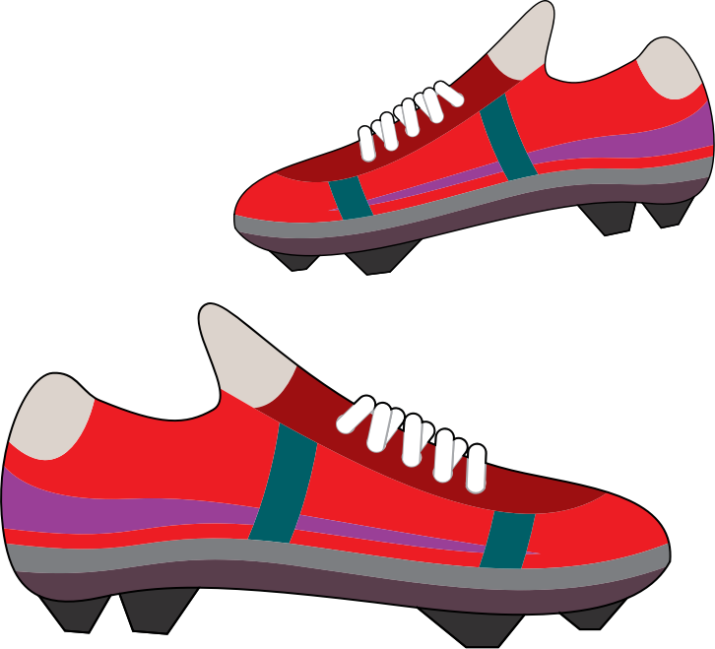
“Put on Your Shoes”

Slide 3
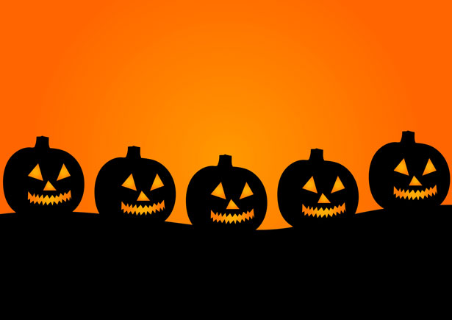
“The Pumpkin March”

Slide 4
“Hey Jack”

Slide 5
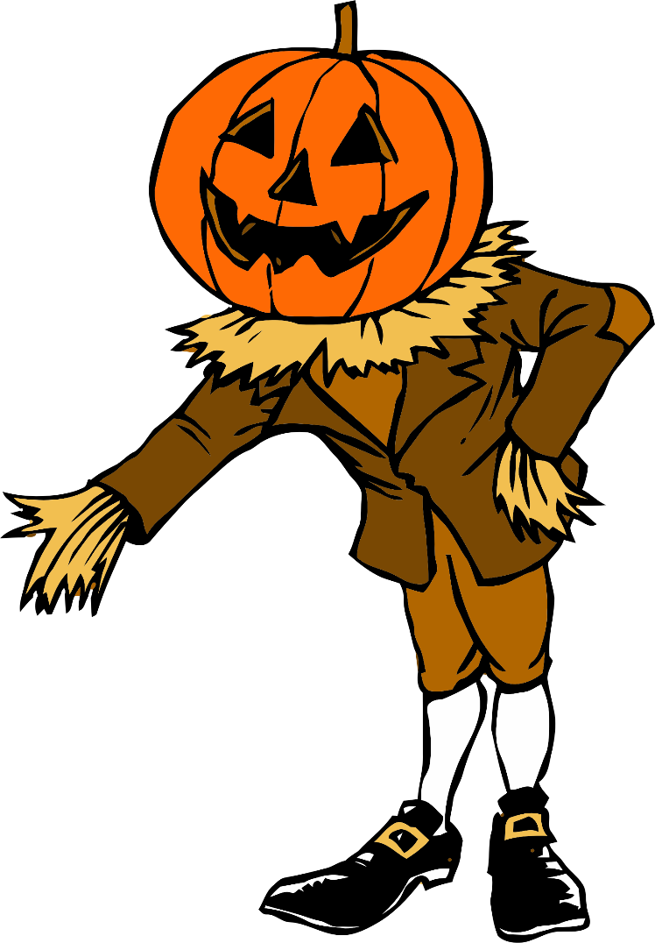
“Pumpkin Jack”

Slide 6
“Zombie Style”

