Slide 1
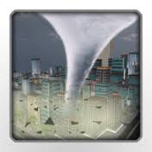
Hurricanes, Thunderstorms, & Tornadoes
S6E4
I can relate unequal heating of land and water surfaces to form tornados and thunderstorms.
I can relate how moisture evaporating from the oceans affects the weather patterns and events such as hurricanes.

Slide 2
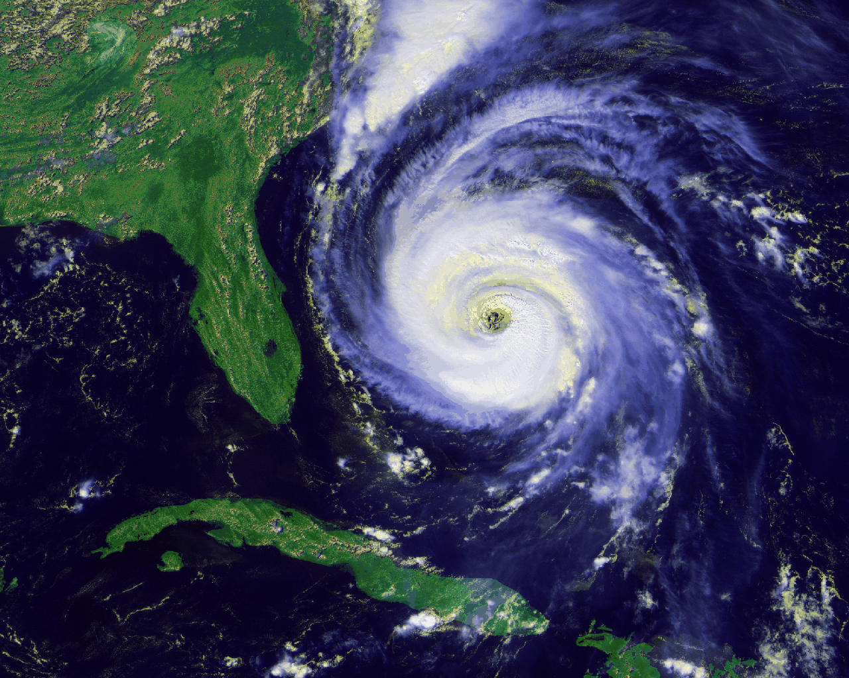
Hurricanes
Large, rotating, LOW AIR PRESSURE weather system that forms over the warm ocean waters near the equator.
Occur from summer through fall due to the oceans heating up.
Similar storms that form over the Indian & Pacific Oceans are called cyclones.
http://youtu.be/Cdh853PdVb0
4 min Hurricanes
http://www.youtube.com/watch?v=xWUegShRWs0&feature=share&list=PLjzOc3wmoa1i-8SzFQup3po5S4mtRPiFW
4 min What is a hurricane?

Slide 3
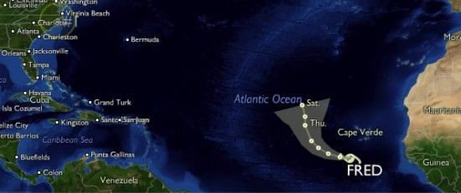
Hurricanes
http://youtu.be/Cdh853PdVb0
4 min Hurricanes
http://youtu.be/zP4rgvu4xDE
3 min Hurricanes
Begins as a low air pressure system – tropical storm or depression
Over warm, Atlantic Ocean water near Africa
Winds push it eastward
Gains energy from the warm, humid air just above the water
Increases wind speed and rotation
At wind speed of 75+ mph, it becomes a hurricane.

Slide 4
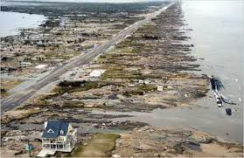
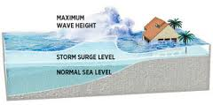
Hurricanes – when they reach land
Bring heavy rains and strong winds
Winds blow seawater toward land
The rise in water as it moves inland is called a storm surge.
Storm surges causes the most damage - flooding in the coastal areas

Slide 5
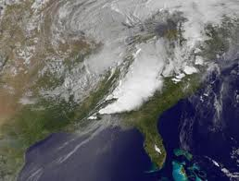
Hurricanes
A hurricane weakens as it moves inland or makes landfall.
WHY? Without the heat energy from the ocean, it loses energy quickly.
A huge weather storm that can last for days and even weeks.

Slide 6
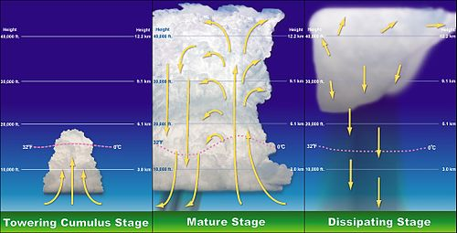
THUNDERSTORMS
http://youtu.be/exlVSEPEXKc
1 min thunderstorm formation
http://youtu.be/NxWbR60tFlg
1 ½ min The Thunderstorm Recipe
LOW AIR PRESSURE weather system
Heavy rainstorm that includes lightning as well as thunder
Form when there is unstable air and moisture
Common on hot, humid days, especially on summer afternoons
Small compared to hurricanes, but can be deadly.
Short-lived
http://youtu.be/7nZlGg59MRw
3 ½ min Thunderstorm song Mr. Parr

Slide 7
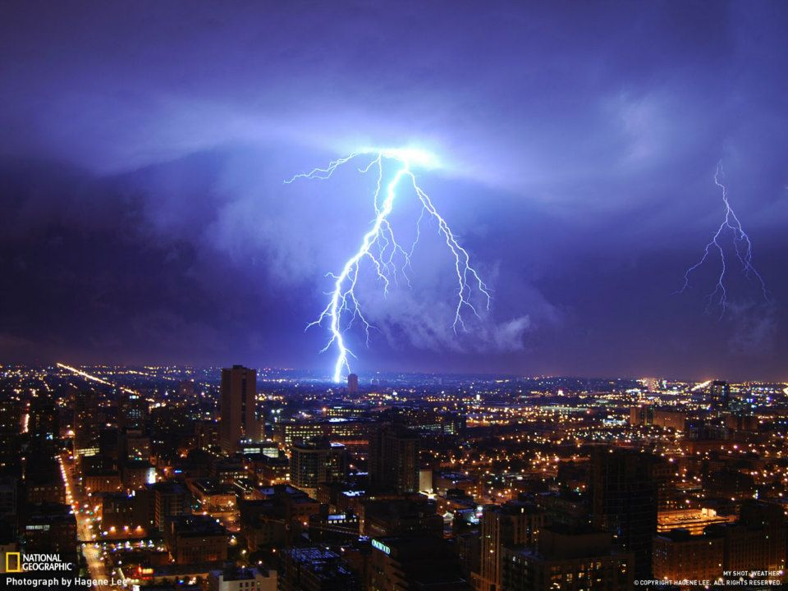
THUNDERSTORMS
http://youtu.be/RDDfkKEa2ls
2 min upward lightning
http://youtu.be/RLWIBrweSU8
3 min lightning
http://youtu.be/jM8h60S1GsM
2 min explains lightning
Winds inside the thunderstorm cause electrical charges to build up.
When charges move from cloud to cloud, or to ground, this is called lightning.
Lightning heats the air, causing the air to expand.
Which causes a shock wave or thunder.

Slide 8
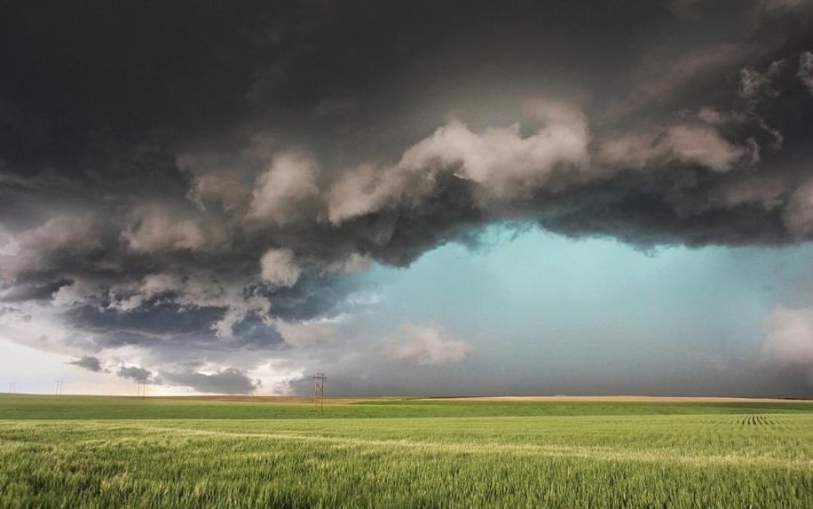
THUNDERSTORMS
The SUN heats the Earth’s surface.
The surface heats the air above it.
This produces convection currents – warm air rises and cool air sinks in to replace it.
Tall clouds called thunderheads are formed.

Slide 9
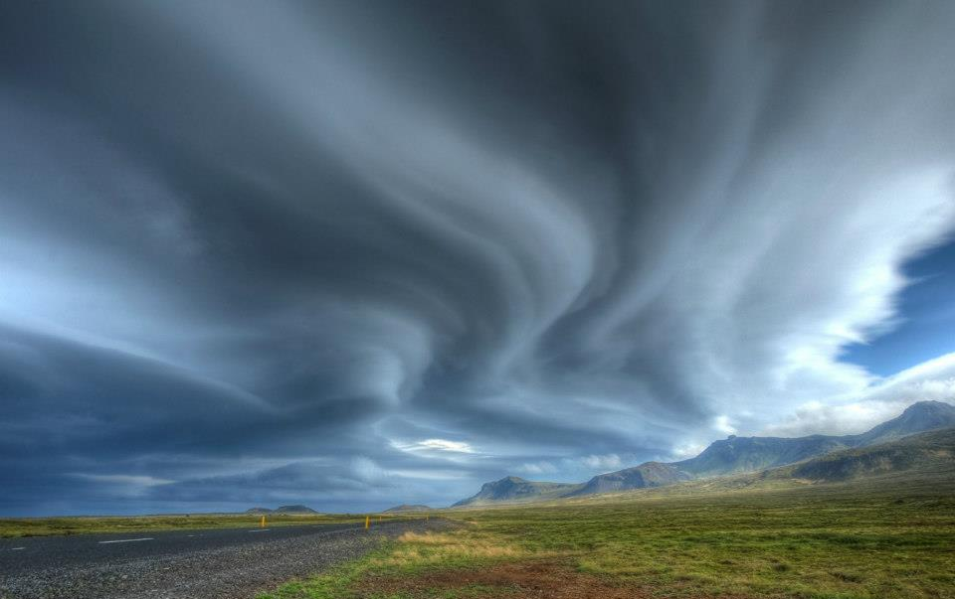
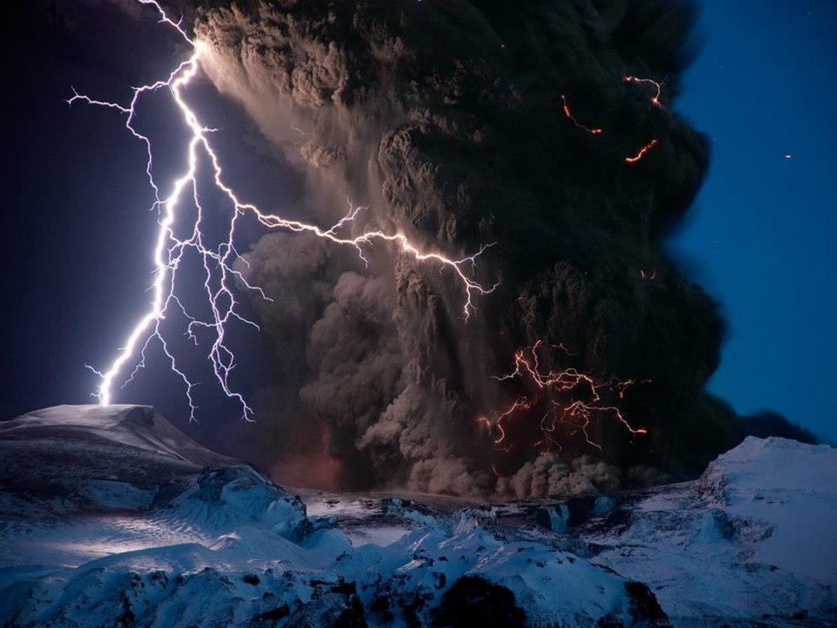
CLOUDS
http://youtu.be/ur0k7UDrrvg
4 min cloud types with music
A cloud is a collection of millions of tiny water droplets.
Remember the WATER CYCLE –
→HEAT (Sun)
EVAPORATION →water vapor
cool air
→CONDENSATION →water droplets
cloud formation
PRECIPITATION (rain, snow, sleet or hail)

Slide 10
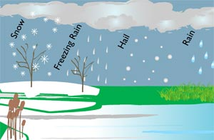
Precipitation
Precipitation is any form of water falling to Earth – rain, sleet, snow or hail.
  Rain is the most common form.
  Sleet starts out as rain and then freezes.
  Snow forms from a gas (water vapor) into a solid.
  Hail is very damaging because it is balls of ice.

Slide 11
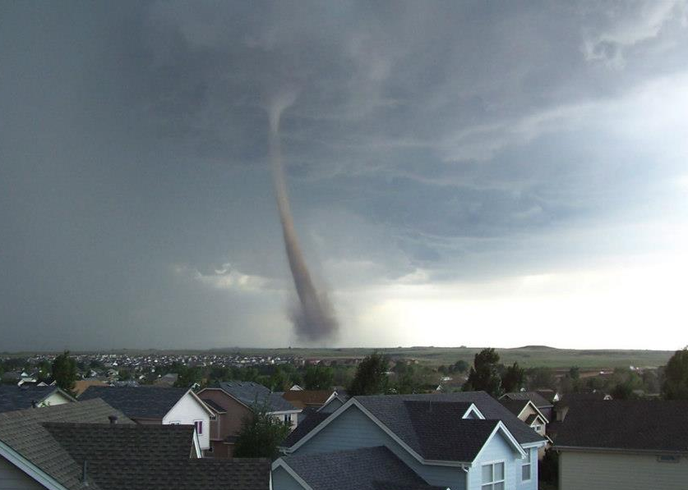
TORNADOES
http://youtu.be/MRykm-xjPsk
1 min The Anatomy of a tornado
http://youtu.be/006guBgSf14
2 ½ min Actual footage of a forming tornado
A tornado is a high-speed, spinning (rotating) column of air
It is a LOW AIR PRESSURE weather system.
Tornadoes produces Earth’s most powerful winds.
Small compared to hurricanes but still deadly
Short-lived

Slide 12
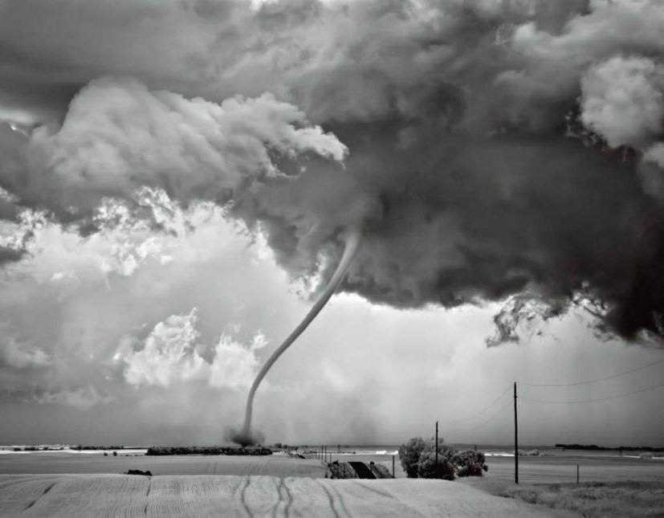
TORNADOES
Begins as a funnel-shaped cloud that is rotating.
When the funnel cloud touches the Earth’s surface, it picks up dust and debris.
The flying debris causes the most damage to property and buildings, and to the people inside the buildings.

