Slide 1
Meet Your School Counselors
Mrs. Akridge and Mrs. Hunt

Slide 2
What is a School Counselor?
School Counselors can be seen all around school helping where they can.
WHAT DO THEY DO ALL DAY?
School Counselors listen and talk to students about school, friends, family, feelings & more.
They also help adults, talk with parents, and organize fun programs.

Slide 3

Fun facts about mrs. Akridge
She’s a book worm.
Works Mondays, Wednesdays, every other Friday.
She enjoys bike-riding
& walking for exercise.
She has 2 dogs,
Buddy & Tippy.
She has 2 grand-cats,
Lucy & Lily.

Slide 4

Fun facts about mrs. hunt
Works Tuesdays, Thursdays, every other Friday.
She has a dog, Mack (like a Mack truck)… a cat, Myrtle May… and a stray cat she calls “other cat.”
She loves to read.
She has 2 kids, a 1st grader and
a 4th grader.
She loves community sports!
Her husband graduated from Lakeview High School.

Slide 5
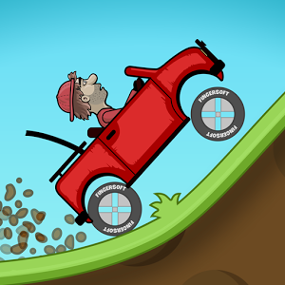








How Do school counselors help students?
Goals
Anger
Fear & Anxiety
Building up others
Self Image
Study Skills
Speaking Up
Family & Friends
Future Jobs

Slide 6
How to talk to a school counselor
Classroom Lessons
Small Groups
Just you and counselor
Stop by her office.
Tell your teacher. When the time is appropriate, she will let you go or let the counselor know.

Slide 7
Your counselors are Secret keepers…
Unless you or someone else is in danger
unless you and the counselor agree together that something is important for another adult -like your parent - to know

Slide 8
Quiz
Your school counselors are Mrs. Akridge and …
A. Mrs. Tree B. Mrs. Hunt
What do you do if you want to speak to the counselor?
A. Tell your teacher B. Lay your head down
Raise your hand if you remember something your school counselor can help you with.

Slide 9
Let’s have a great year at cloud springs elementary and reach toward our goals!

