Slide 1
The CHS Theatre Wing
2014-2015 Season

Slide 2
The 39 Steps
Fall 2014

Slide 15
Georgia Theatre Conference Champions

Slide 16
Region 1-AAAA Champions

Slide 17
Thankoooo!

Slide 18
Drama Class Shenanigans

Slide 23
It’s a Wonderful Life
Winter ‘14-’15

Slide 40
CHS Literary Team
Second Place in Region 1AAAA!

Slide 41
Second Place Girls Dramatic Interpretation Class AAAA

Slide 42
Spoon River Anthology

Slide 45
Eurydice

Slide 59
ASU Champions 2015!

Slide 60
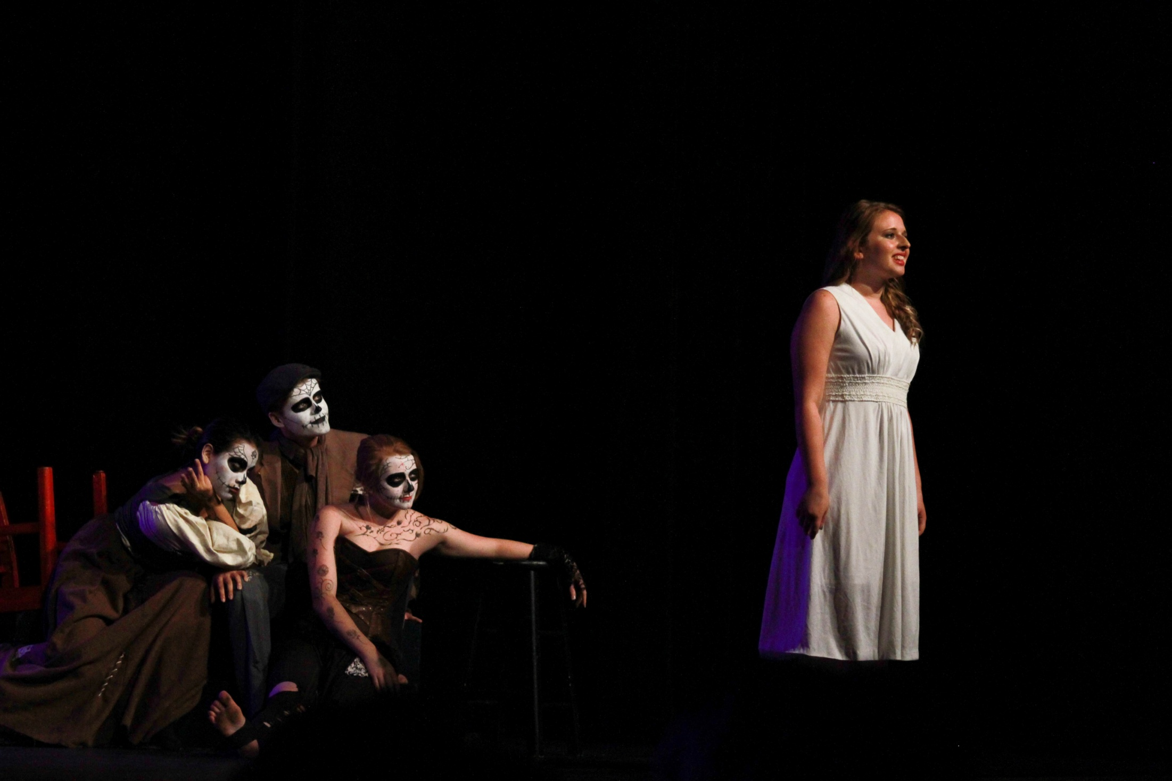
Thanks for an amazing season!

