Slide 1
AQUATIC ECOSYSTEMS
Determined by the salinity of water
2 types:
Freshwater & Marine

Slide 2
CHARACTERISTICS
TEMPERATURE
SUNLIGHT
OXYGEN
NUTRIENTS
Determines which organisms live where

Slide 3
Three types of organisms based on location & adaptations
Plankton
Phytonplankton
zooplankton
Nekton
Benthos

Slide 4
Plankton – microscopic drifters

Slide 5
Nekton – free-swimming

Slide 6
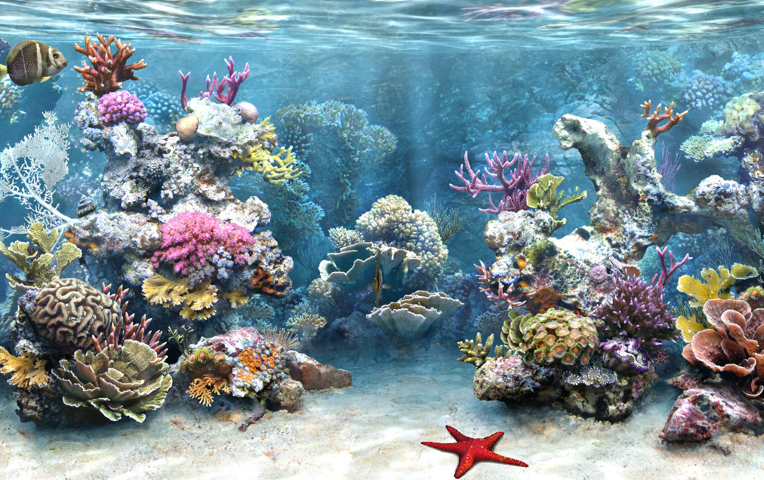
Benthos – bottom dwelling

Slide 7
FRESH WATER
LAKES, PONDS, RIVERS, STREAMS, & WETLANDS
Littoral zone = nutrient rich, near shore
diverse & abundant life.
Plants rooted here with leaves that float or extend above water
Open water = no rooted plants. Phytoplankton
Benthic zone = bottom. Decomposers , may be little light

Slide 8
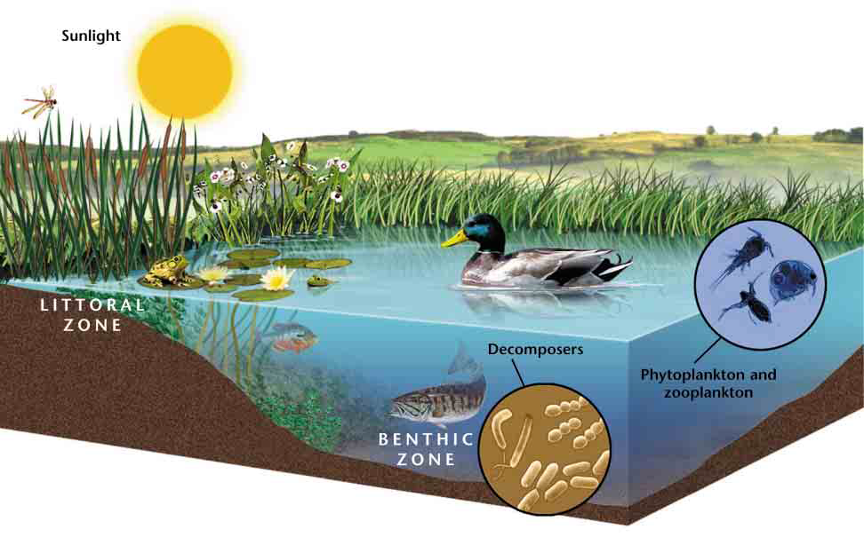

Slide 9
How nutrients affect lakes
Eutrophication= an increase in the amount of nutrients in an aquatic ecosystem.
Plants & algae grow
Bacteria feeding on decaying plants grow
Bacteria use oxygen in water
Reduced oxygen levels kills fish
Run-off increase nutrients

Slide 10
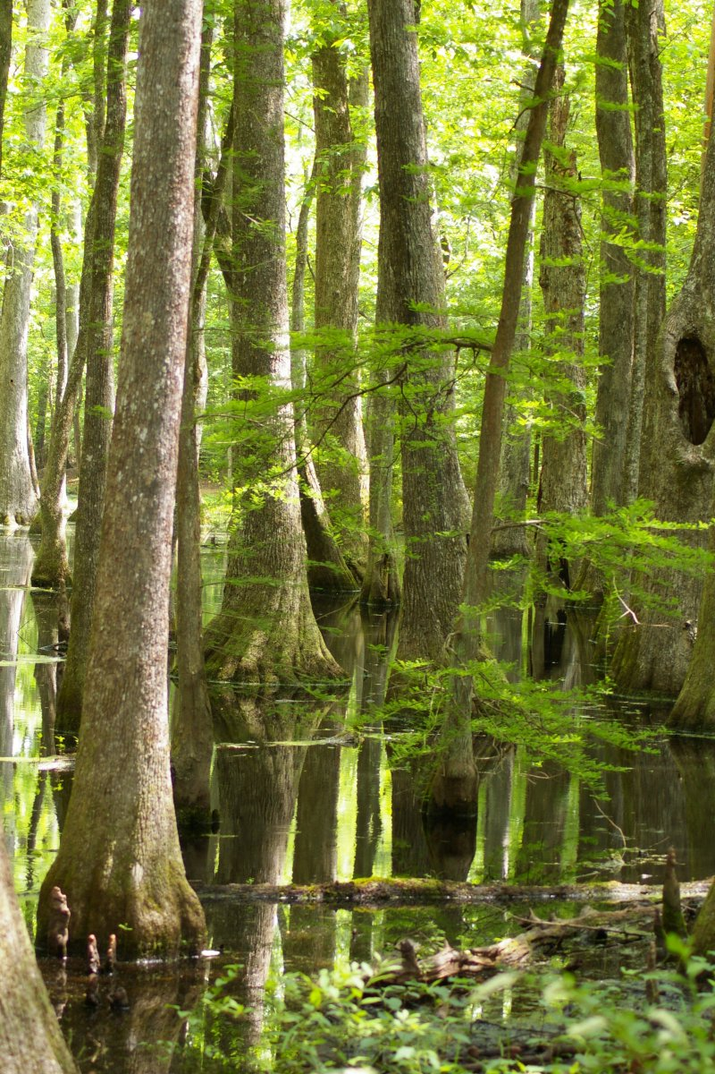
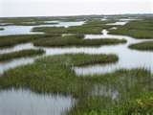
Freshwater Wetlands
Swamps – woody plants
Poorly drained land, near streams
Marshes – non-woody
plants (cattails, grasses)
Little water movement

Slide 11
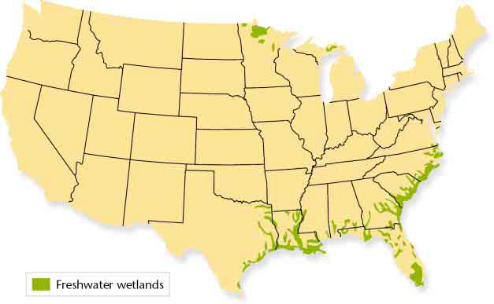

Slide 12
Function of Wetlands
Trap & filter sediments, nutrients, pollutants
Reduce flooding
Buffer shoreline against erosion
Spawning grounds & habitat for fish & shellfish
Provide habitat for rare, threatened, endangered species
Recreation

Slide 13
Human Impact
Considered wasteland & breeders of disease carrying insects. Drained, cleared & developed.
Now we recognize importance as water purifiers & flood prevention.

Slide 14
Rivers
Headwaters – origin may be snowmelt or rain
Full of oxygen, runs swiftly through shallow riverbed
Becomes wider, warmer, slower, contains more vegetation & less oxygen
Communities & industries affect health of rivers.

Slide 15
MARINE ECOSYSTEMS

Slide 16
Coastal Wetlands
6% of land surface covered by wetland
Land covered by saltwater for all or part time
Provide habitat & nesting areas for fish & wildlife
Absorb excess rain to prevent flooding, filters pollutants & sediments, & provides recreation
Prevents coastal erosion

Slide 17
Estuaries
An area where fresh water from a river mixes with salt water
Becomes a nutrient trap- are very productive because receives constant supply of nutrients
Support many marine organisms due to large supply of light for photosynthesis & nutrients
Provide protected harbors & access to rivers

Slide 18
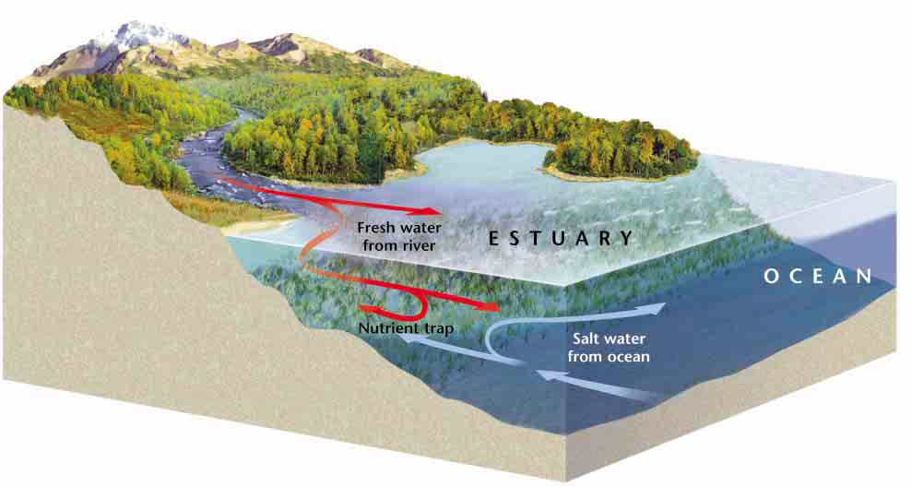

Slide 19
Threats to Estuaries
Used as solid waste landfills
Used as building sites
Traps run-off from land and industry

Slide 20
OCEANS

Slide 21
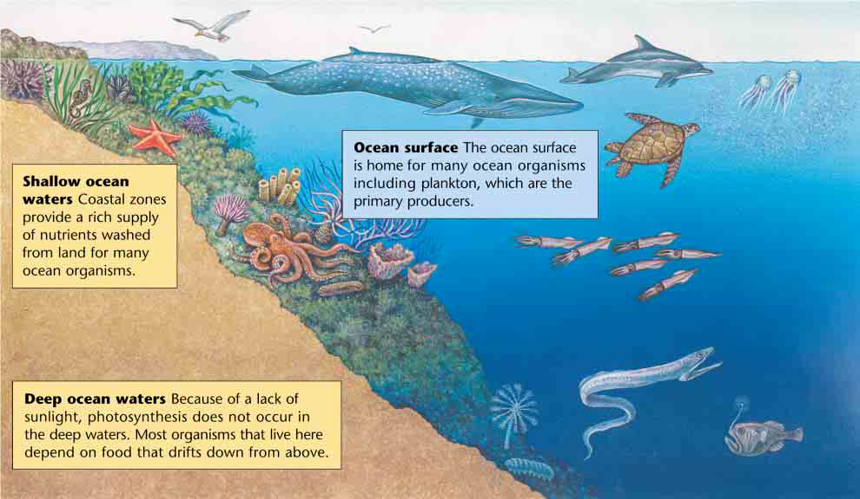

Slide 22
