Slide 2
10-2 Heat
S8P2. Students will be familiar with the forms and transformations of energy.
d. Describe how heat can be transferred through matter by the collisions of atoms (conduction) or through space (radiation). In a liquid or gas, currents will facilitate the transfer of heat (convection).
E.Q. How is heat transferred in conduction, radiation, and convection?

Slide 3
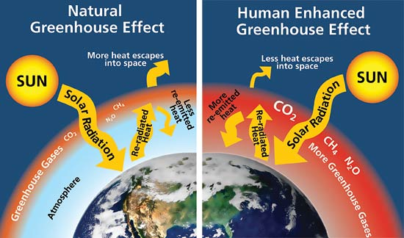

Slide 4
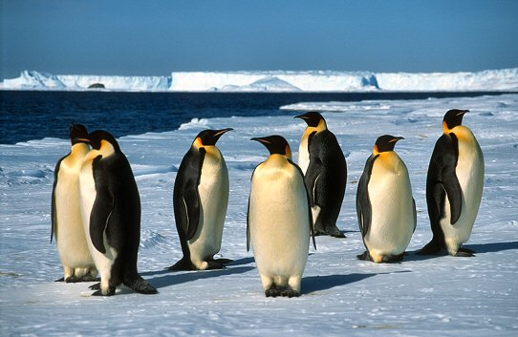

Slide 5
http://www.youtube.com/watch?v=ZrgqRKRvmsE&list=PLF0082F087C754EA2&index=8
http://www.youtube.com/watch?v=GLInXt9RS9E
http://www.youtube.com/watch?v=8ANQEoJP2K0
http://www.youtube.com/watch?v=QZrYnSGz2p8
http://www.youtube.com/watch?v=SkY03n0_sD8

Slide 6
Heat—energy that is transferred between objects that are different temperatures
**Heat energy always moves from higher temperatures to lower temperatures until both objects are the same temperature**
25º C
45º C
10º C

Slide 7
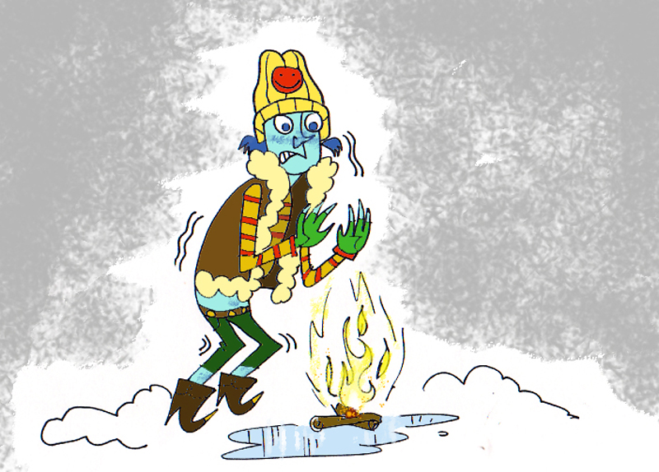
Methods of heat transfer
Conduction
Convection
Radiation

Slide 8
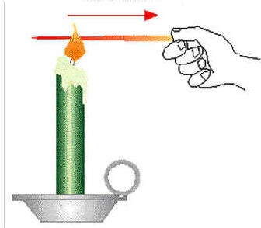
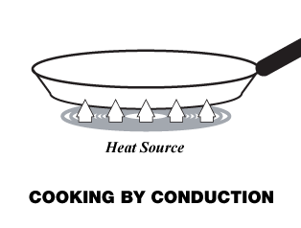
Conduction is the transfer of energy through matter from particle to particle as they touch.
Transfer of heat energy from atom to atom
Most effective in solids.
Heat moves from warmer substances to cooler substances.

Slide 10
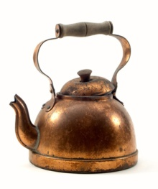
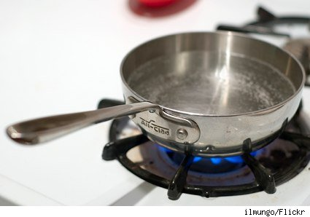
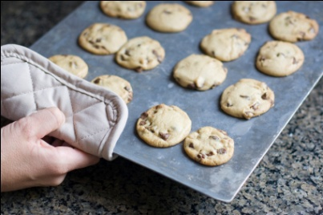
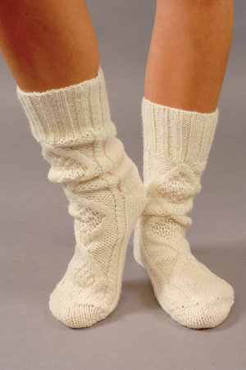
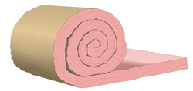
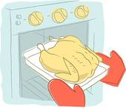
Thermal Conductor—a substance that transfers heat well
Ex. copper, aluminum, gold, silver
Thermal Insulator—a substance that does not transfer heat well
Ex. glass, porcelain, plastic, rubber, wood, air

Slide 11
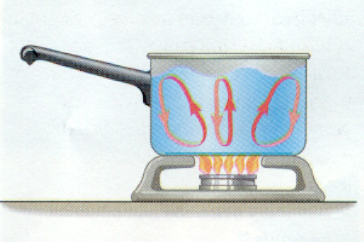
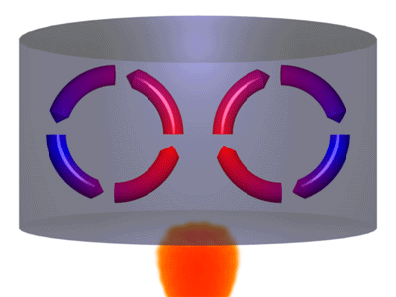
Convection
the transfer of thermal energy by the movement of a gas or liquid (a medium).
The circular motion caused by density differences that result from temperature differences are called convection currents.

Slide 13
Radiation
the transfer of thermal energy by
electromagnetic waves such as visible light
and infrared waves. (See p. 636-637).
This energy can be transferred through
particles of matter OR empty space!
Examples
Energy from the sun
Microwaves use radiation

Slide 16
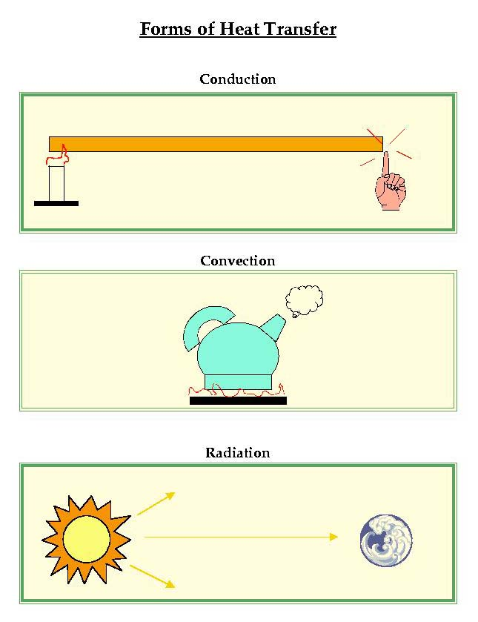
Review

Slide 17
Review

Slide 18
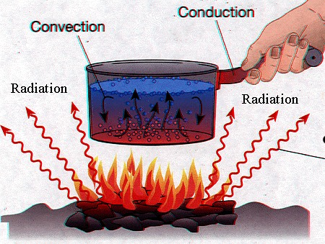

Slide 21
How does heat move?
Heat moves from the ____________ object
to the _____________ object.

Slide 22
How does heat move?
Heat moves from the warmer object
to the cooler object.

Slide 23
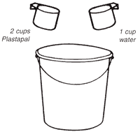
What happens to the temperature of two objects as heat is transferred from one to the other?
The hotter object becomes ________ while the cooler object becomes ________ until both objects are the same temperature. They are said to reach equilibrium.
Hot water
at 70 degrees
Cool water
at 30 degrees
What will be the new temperature?

Slide 24
What happens to the temperature of two objects as heat is transferred from one to the other?
The hotter object becomes cooler while the cooler object becomes warmer
until both objects are the same temperature. They are said to reach equilibrium.
Hot water
at 70 degrees
Cool water
at 30 degrees
What will be the new temperature?
*If there are equal amounts of water,
add the two cups and divide by 2.

