Slide 1
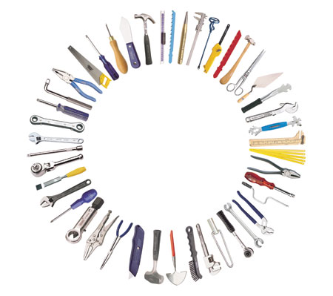
Hand tools

Slide 2
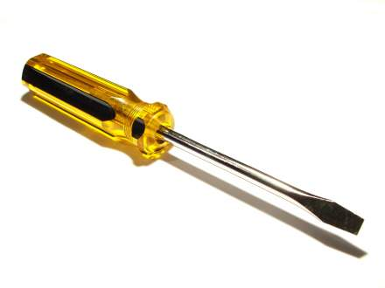
Standard Head Screw Driver
Used to tighten or loosen flat head screws.

Slide 3
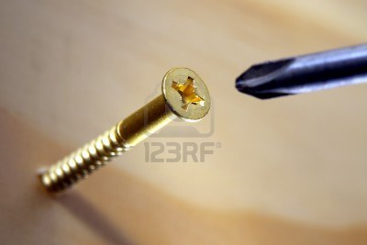
Phillips Head Screw Driver
Used to tighten or loosen Phillips head screws.

Slide 4
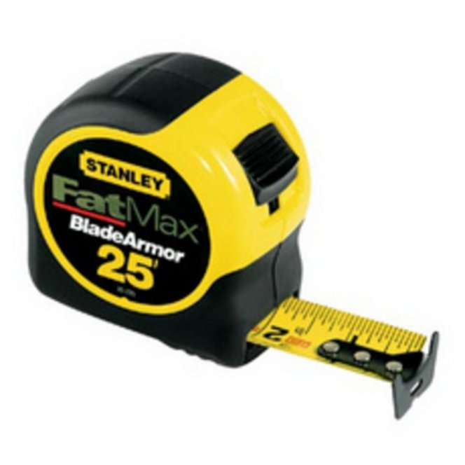
Measuring Tape
Used to measure distances or lengths of wood.

Slide 5
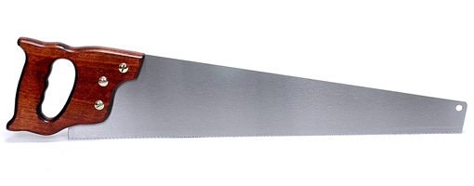
Cross Cut Saw
Used to cut across the grain of wood.

Slide 6
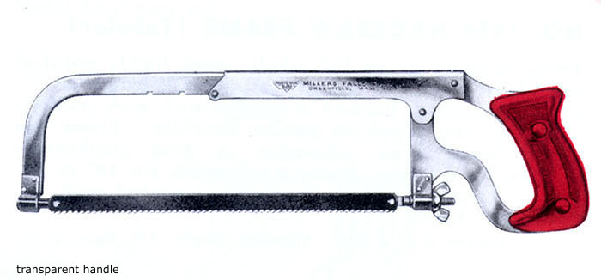
Hack Saw
Used to cut a variety of materials. Has removable blades to change for the desired material.

Slide 7
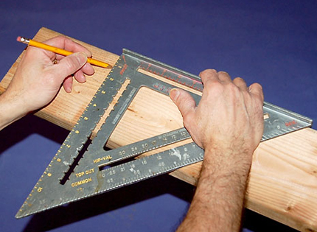
Speed Square
Used to draw straight lines and angles.

Slide 8
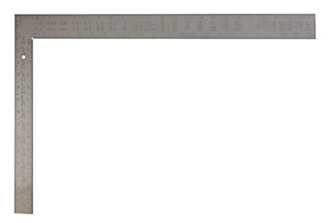
Framing Square
Used to measure and draw right angles.

Slide 9
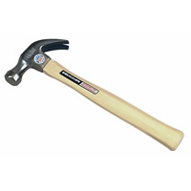
Curved Claw Hammer
Used to drive nails and pull nails.

Slide 10
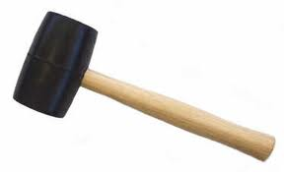
Rubber Mallet
Used to hammer fragile objects.

Slide 11
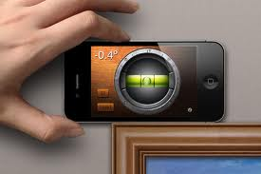
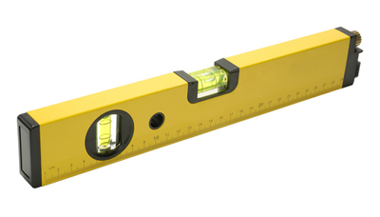
Level
Used to check the levelness of an object.

Slide 12
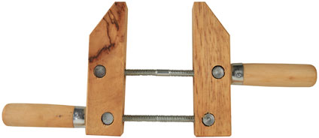
Wood Clamp
Used to clamp wood for gluing or to hold wood in place for cutting.

Slide 13
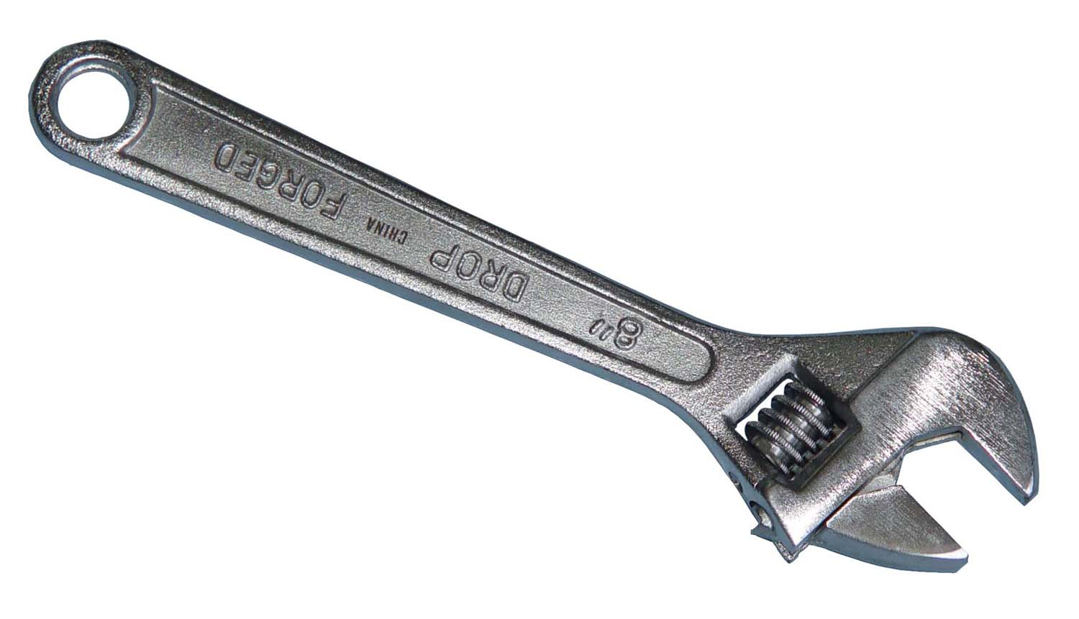
Adjustable Wrench
Used to tighten or loosen bolts of various sizes

Slide 14
Pipe Wrench
Used to tighten or loosen pipes and pipe fittings.

Slide 15
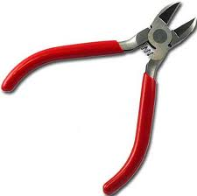
Wire Cutters
Used to cut wire and other small items.

Slide 16
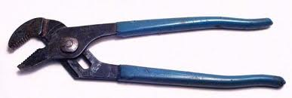
Adjustable Pliers
Used to tighten or loosen a variety of items.

