Slide 1
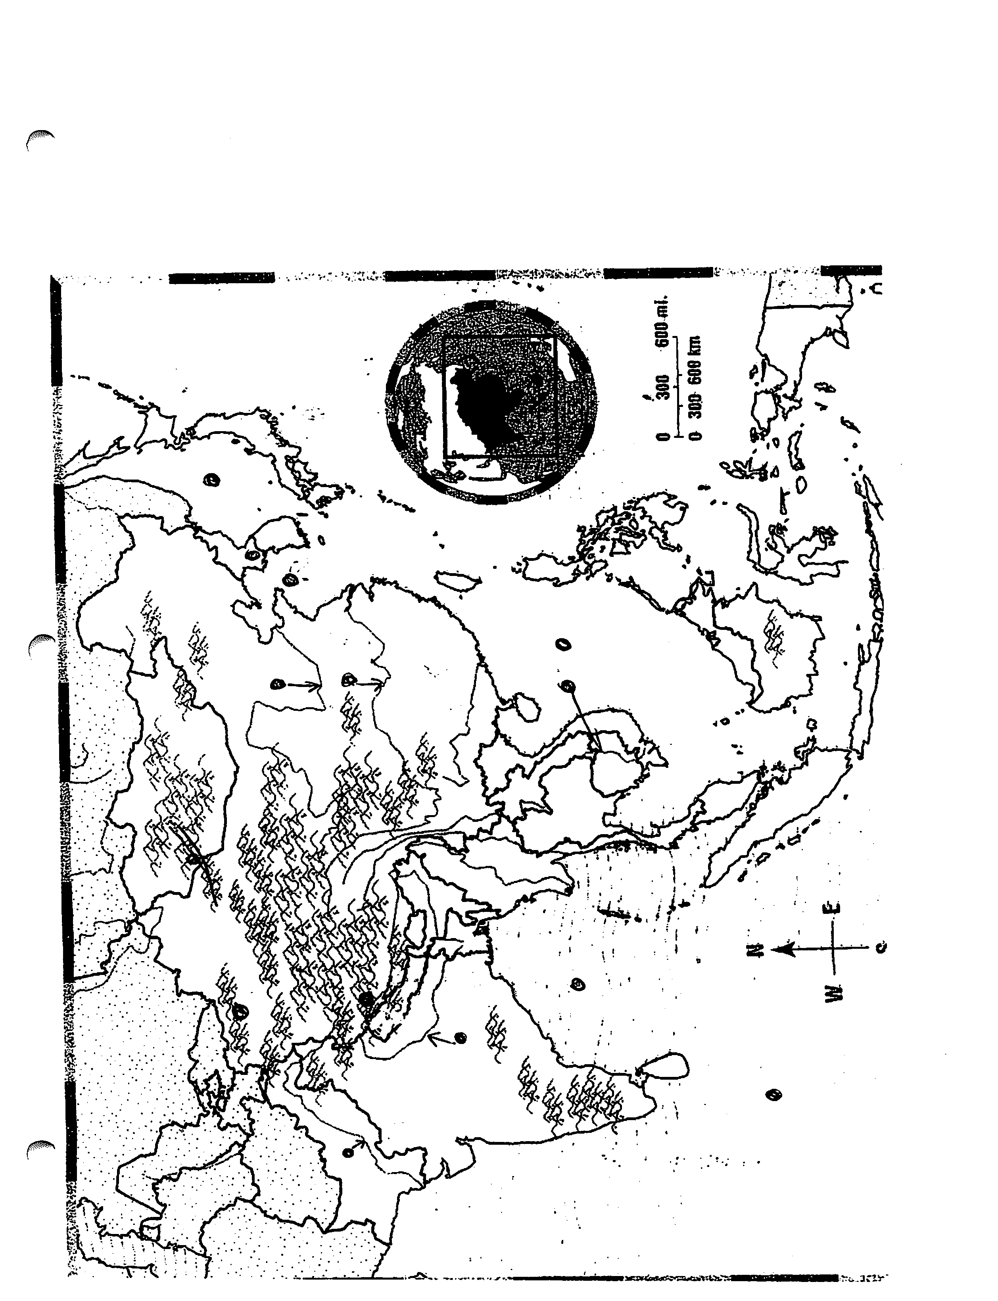

Slide 2
India Part 2:
SS7G11: The student will explain the impact of location, climate, physical characteristics, distribution of natural resources, and population distribution on Southern and Eastern Asian countries.
Describe the impact climate and location has on population distribution in South Asia.
B. Describe how the mountain, desert, and water features of South Asia have affected the population in terms of where people live, the type of work they do, and how they travel.
Pages 196-199.

Slide 3
IMPACT OF CLIMATE AND LOCATION ON TRADE, AGRICULTURE, AND INDUSTRY in INDIA:
Since India has a large area surrounded by water, trade ships use the waters surrounding India as an easy way to access the country as they have in the past. India is the 12th largest economy in the world today because of trade and industries. In Asia their GDP is third behind Japan and China. GDP or Gross domestic product is the market value of all goods and services a country produces. Industries also use the easy access to water and transportation along India’s coast.
Climate in India varies. It varies from alpine to temperate, and even to subtropical monsoons. (Alpine climate is cold and exists in areas in the Himalayan Mts.) The monsoon is a pattern of wind that returns each year from June to September. The monsoon brings with it 80 % of Indian’s rain for crops. Since most Indian are dependent on agriculture, summer monsoons bring a good growing season. Most of India’s people are farmers involved in agriculture.

Slide 4
Most trading partner from abroad access India by using:
Cars 2. planes 3 trains 4. ships.
Heavy rains are blown into India during the growing season by winds called:
Monsoons 2. Hurricanes 2. Cyclones
India’s climate varies because of its size and land features. 1. True 2. False

Slide 5
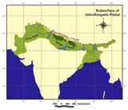
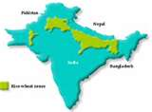

Slide 6
Population distribution in India is highest in places like the
Indo-Gangetic Plain. It lies between the Himalayan Mountains and the Deccan Plateau. It benefits from three large rivers, two being the Ganges River and the Indus River. These rivers and their tributaries carry silt from the mountains to the farmland on the plains. Rivers also provide a source for irrigation. The Indo-Gangetic Plain also has a long growing season and is densely populated because it is a good place to live and work.
Transportation in the Indo-Gangetic Plain is easier than in the mountains. Level land make building and maintaining roads easier.

Slide 7
Population distribution in India is highest in places like the
Indo-Gangetic Plain because it benefits from the Ganges River and the Indus River. These rivers and their tributaries carry silt from the mountains to the farmland on the plains to benefit the growth of plants.
1. True 2. False

Slide 8
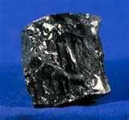
India: Compared to its neighbors, India has an abundance of natural resources.
Coal, iron ore, diamonds, crude oil, and metals are a few of India’s many natural resources.
India is a developing country. It used such natural resources as crude oil and coal in factory production.

Slide 9
Pakistan:
Pakistan is India’s neighbor and was once part of India. The Indus River is in Pakistan, and its population is mainly in the Indus River Valley where there is plenty of water for farming.
42 % of Pakistan’s people are farmers with the majority of the population living along the Indus River.
Climate in Pakistan varies. Areas along the Himalayan Mts. and Hindu Kush tend to be alpine or harsh and cold while other areas again are temperate.
Most in Pakistan are poor as it is a young nation compared to India. It exports mainly to the United States and imports mainly from China because of cheap prices. Trade is limited but growing.
It is a developing country, not a developed country like the United States.

Slide 10
Pakistan does not have as many natural resources as India, but does have petroleum and natural gas as well as coal. It’s industry is helped by having oil, natural gas, and coal.
Population distribution will be limited in the mountains such as the Hindu Kush and Himalayan Mountains as the land is hard to journey through. There is however an important mountain pass in the Hindu Kush called the Khyber Pass. It has been used for centuries and was how the invaders first entered South Asia.
In Pakistan the majority of the people would live along the Indus River for water, fertile soil, transportation, and farming.

Slide 11
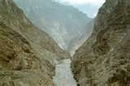
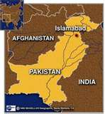
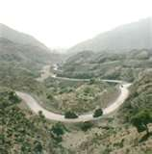
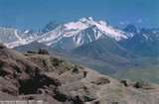
Indus River Valley
Hindu Kush
Khyber Pass

Slide 12
Bangladesh is a low lying areas on the east coast of India. It is highly populated with a very poor uneducated population. The climate is temperate. The land often floods and many a cyclone or hurricane in the Indian Ocean have killed countless people coming on shore to Bangladesh. The people are mainly farmers with little industry, but their natural resources include fertile soil, water, and natural gas.
Pakistan and Bangladesh are both poor developing countries.
True 2. False
It is better to be a developed country than a developing country.
1. True 2. False

Slide 13
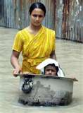
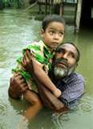
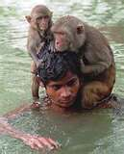
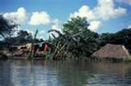

Slide 14
StandardSS7G10:The student will discuss environmental issues of South and Eastern Asia.
Describe the cause and effect of pollution of the Ganges River such as overpopulation
Describe the cause and effect of air pollution and flooding in India. Page 202-204.

Slide 15
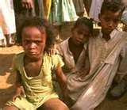
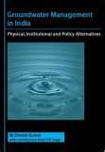
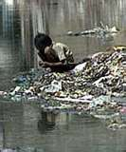
ENVIRONMENTAL IMPACTS
INDIA:
With a population estimated at 1.6 billion by 2050, India’s main environmental concern is overpopulation.
What type of environmental problems could 1.6 billion people create?

Slide 16
India’s main environmental problem is too many people.
1. True 2. False

Slide 17
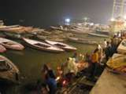
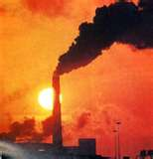
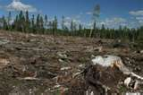
1.Feeding all the people 2. Fertilizer from farming getting into the drinking water 3. Enough clean water to drink and use for farming (water wars like big cities Atlanta taking water from other places like Bainbridge) 4. Toxic waste from increased industry getting in the Ganges and other rivers 5. Air pollution 6. Deforestation as people burn trees for fuel.

Slide 18
South Asia has many rivers. In India the main river in the hearts of the people is the Ganges River. . The Ganges River is considered holy to the Hindu. Faithful Hindu come from far and wide to bathe in this river. Since it is sacred, one might be healed by bathing there. Devout Hindus are reluctant to believe that the Ganges is polluted, but it is. People do laundry in the waters. They wash their dishes there. They wash themselves there. Some interested in the environment try to be more politically correct when speaking to the Hindu about their river. They say, “Mother Ganges is suffering.”
Artificial fertilizers are used on crops and seep into the Ganges River. Toxic waste from industry along the river, boats, and vehicles pollute the water and the air. People bathe and wash clothes and dishes there.

Slide 19
Artificial fertilizers are used on crops and seep into the Ganges River. Toxic waste from industry along the river, boats, and vehicles pollute the water and the air. People bathe and wash clothes and dishes there.
The Ganges River is about to recover from being polluted.
1. True 2. False

Slide 20
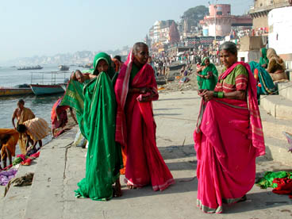
They cook, bathe, do dishes, and wash in the Ganges River. No wonder it is polluted.

Slide 21
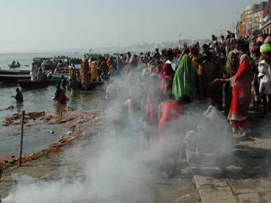
Funeral ghats along the Ganges River

Slide 22
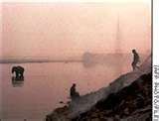
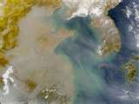
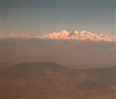
Asian Brown Cloud:
This affects all of South and East Asia. It is a brown haze that effects areas differently. It is a direct result from people burning wood for cooking and heat, toxic waste from factories , and forest fires. It alters monsoon patterns which can cause drought, reduces photosynthesis, increases human respiratory problems, and reduces solar radiation.

Slide 23
Thick brown clouds of soot, particles and chemicals stretching from the Persian Gulf to Asia threaten health and food supplies in the world, the U.N. reported Thursday, citing what it called the newest threat to the global environment.
The regional haze, known as atmospheric brown clouds, contributes to glacial melting, reduces sunlight and helps create extreme weather conditions that impact agricultural production, according to the report commissioned by the U.N. Environment Program.
The huge plumes have darkened 13 megacities in Asia — including Beijing, Shanghai, Bangkok, Cairo, Mumbai and New Delhi — sharply "dimming" the amount of light by as much as 25 percent in some places.
Caused by the burning of fossil fuels, wood and plants, the brown clouds also play a significant role in exacerbating the effects of greenhouse gases in warming up the earth's atmosphere, the report said.

Slide 24
The Asian Brown Cloud does which:
Alters monsoon pattern leading to drought
Reduces photosynthesis because of the haze
Increases human respiratory problems
Reduces solar radiation.
All of the above.
Which is not a reason for the Asian Brown Cloud:
Burning wood for fires
Battery powered cars
Toxic waste from factories
4. Forest Fires

Slide 25
.) The monsoon is a pattern of wind that returns each year from June to September. The monsoon brings with it 80 per cent of Indian’s rain for crops
Bangladesh is a low lying areas on the east coast of India. It is highly populated with a very poor uneducated population. The climate is temperate. The land often floods and many a cyclone or hurricane in the Indian Ocean have killed countless people coming on shore to Bangladesh. The people are mainly farmers with little industry, but their natural resources include fertile soil, water, and natural gas.

Slide 26
SS7G12: The student will analyze the diverse cultures of the people who live in Southern and Eastern Asia:
B. Evaluate the effects of the literacy rate on the standard of living in Southern Asia.
Pages 208

Slide 27
Literacy in India is 65 percent. Many poor women still do not go to school. India is growing quickly due to outsourcing from the United States. Places with higher literacy advance quicker in sciences. This helps a nation to be successful. It also makes lower rates of unemployment.
Outsourcing-American jobs going overseas where the people work for less than in the United States.

Slide 28
Out sourcing is helping India grow. 1. True 2. False
Out sourcing is where jobs from wealthy countries go over seas to places like India where wages are cheap and people have the right amount of education.
True 2. False
If you can not read or write you are said to be literate.
1. True 2. False

Slide 29
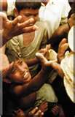
Literacy rates:
The countries with the highest literacy rate are the most developed. China has 91 % and Japan has 99 per cent for literacy rates. These countries advance quicker in the sciences. This helps nations to be successful. Countries with higher literacy rates have lower unemployment. Why?

Slide 30
SS7CG7: The student will demonstrate an understanding of national governments of South and Eastern Asia.
A. Compare and contrast the federal republic of India, the communist state of the People’s Republic of China, and the constitutional monarchy of Japan, distinguishing the form of leadership and the role of citizens in terms of voting rights and personal freedom.
SS7E8 The student will analyze different economic systems.
A. Compare how traditional, command, and market economies answer the economic questions (What to produce? How to produce? For whom to produce?)
B. Explain how countries have mixed economies located on a continuum between pure market and pure command.
C. Compare and contrast the economic systems in India, China, Japan, and North Korea.

Slide 31
SS7E10: The student will describe the factors that influence economic growth and examine their presence or absence in India, China, and Japan.
Explain the relationship between investment in human capital(health, education, and training of people) and the gross domestic product
Explain the relationship between investment in capital goods( factories, machinery, and new technology) and gross domestic product GDP
C. Describe the role of natural resources in a countries economy.
Describe the role of entrepreneurs who take the risks of organizing productive resources.
Pages 212-218

Slide 32
Governments of South and Eastern Asia:
1. India:
Federal Republic or Parliamentary Democracy. In a federal republic or democracy the people vote on leadership and have a say so in what is produced in that country.
It has 3 branches with a bicameral parliament, a president whose duties are mainly ceremonial, and a judicial branch. (Federation) (Parliamentary Democracy)
People join political parties based on religion, castes, and language. Since most people are poor villagers, the state is trying to bring back village councils.

Slide 33
2. China:
China is a communist /oligarchycountry controlled by three branches of government. Communist Party members is the only real political party that matters in China. The National Peoples Congress controls the legislative branch of government with its unicameral house. Their meetings are not open to the public. The leadership of China comes from the NPC.
The one real check on the Communist Party is the fact that they must somewhat keep the people happy there. The people have no say so, but are controlled by the some group at the top of the communist government which decides how the government will be run and what is produced.
Unitary/oligarchic

Slide 34
Japan:
Constitutional Monarchy (weak emperor/strong Prime Minister).
In a constitutional monarchy there is a weak emperor or king who is not elected. Power is in the hands of the Prime Minister who leads the legislative branch and the government. The people have a part in who the Prime Minister is through their vote.
Their legislature is called a Diet. It also is bicameral or has two houses. Japan has 47 prefectures or government districts.
(Federation/parliamentary democracy)

Slide 35
Japan
India
China
Government types
Communist and oligarchic
Parliamentary Democracy
Absolute or Hereditary Monarchy
Presidential Demcracy

Slide 36
Four economic systems.
Market economy—the people decide what is made by factories based on what they buy. Factories do not make goods no one will buy. (Consumer goods are made.)
Command economy—the government –not the people decide what will be produced. Usually military goods or building products.
Traditional economy—things are bought and sold as they have always been bought and sold in the past.
Mixed economy---combination of two different economies usually market and command. Most economies are mixed today.
Compare the economies of India, China, Japan, and North Korea

Slide 37
India
Economy: Mixed ( market) the government makes some economic decisions and the businesses and individuals make other decisions.
65 literacy rate
A portion is well educated. The major souce of India’s economic growth is the service sector. India’s labor force thrives because of outsourcing US companies send jobs there because labor is so much cheaper. In other words that can hire people there to do the same job as Americans for less money.
A large portion of the population is still involved in agriculture. Indian infrastructure includes communication, transportation, education (schools), and power lines.
Government does invest in capital goods such as factories, technology, and machinery as well as human capital such as schools. Because of investment and outsourcing India’s Gross Domestic Product is on the rise.

Slide 38
China’s economy is mixed (command )
Since the death of Mao, his successors have focused on developing a market oriented economy. China will be a great competitor to the US someday. They have many entrepreneurs (business people willing to take risks).
Because China has started developing a more market oriented economy and invested in capital goods and human capital their gross national product has quadrupled. China also produced cheap products due to cheap labor which gives China the third largest Gross Domestic Product in the world behind the United States and Japan.

Slide 39
Japan mixed –market economy where the people decide what is bought and sold through what they buy. Japan has invested in human capital and capital goods. They produce high quality products at inexpensive prices. This gives Japan the second largest Gross Domestic Product in the world behind the United States.
China , Japan, India
Mixed market
2. Mixed command

Slide 40
Japan and International Trade:
Japan is an international exporter of many manufactured goods. It has few natural resources so imports food and raw materials needed in manufacturing. It then makes computer, cars, and other technology and sell it abroad. Japan sells more than it buys from other countries and has a favorable balance of trade and stable economy.
Since it makes more than it spends( or exports more than it imports) Japan has a trade surplus. Japan takes the extra money and invests it in stocks, bonds, real estate, and businesses that make it even richer.

Slide 41
4. North Korea economy is controlled by one dictator so it is mostly command.

Slide 42
SS7E9: The student will explain how voluntary trade benefits buyers and sellers in South Asia.
A. Explain how specialization encourages trade between countries.
B. Compare and contrast different types of trade barriers such as tariffs, quotas, and embargos.
C. Explain why international trade requires a system for exchanging currency between nations.
Page 220-222.
High populations which work for much less than people in other parts of the world and outsourcing are significant reasons for international trade. Corporations must make a profit if they can hire a worker who can do the same job—one for 50.00 an hour or one for 5 dollars and hour—who are they going to hire and why?
Also, if they can build the same factory with or without expensive government regulations and benefits to employees such as healthcare, which are they going to pick?

Slide 43
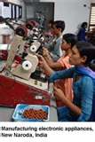
India:
India’s labor force thrives because of outsourcing US companies send jobs there because labor is so much cheaper. India has also reduced tariffs or taxes charged o goods entering the country (imports). This has led to increased trade and investment in India.

Slide 44
Compare and contrast your thoughts on outsourcing if you are
An American whose job left the US and went to a new factory in India.
2. You are an Indian who just got a new job in an outsourced factory in India.

Slide 45
American who lost his job:
Outsourcing takes jobs away from America and hurts America.
It hurts American workers who can’t find a job and can’t pay their bills.
Other Americans not affected.
Cheaper prices
Indians who are hired.
More jobs and opportunities for a better life.

Slide 46
Political Trade Barriers: government using political influence to punish trading partners.
Tariffs are taxes on goods coming in or imports. The average tariff (duty) or tax is small unless the government is trying to discourage trade. They do this either to punish political enemies or to keep profits from goods they already make in their own country. Protective tariffs are high taxes made to discourage trade for one of those reasons.
B. Quotas is another kind of way to discourage trade by limiting the amount a product that can come into a country.
C. Embargos is a prohibition of commerce or trade altogether.
In the Sudan the US has an embargo on trade because of the unstable government and the humanitarian crisis in Darfur.

Slide 47
Tariff, quota, embargo
Limiting the number of goods allowed into a country
Stopping or halting trade to punish a trading partner for something they are doing that you do not like.
3. A tax on an import to help your businesses or farmers products from being hurt by foreign competition.

Slide 48
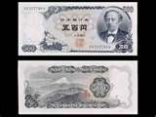
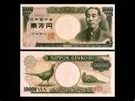
Currency Exchange:
An exchange rate is set so countries can buy and sell goods in different countries.
India: Rupee -- one US dollar is about 45 rupees
Chinas: Yuan --one US dollar was 7.8 Yuan
Japan: Yen—one US dollar was 118 yen

Slide 49
China, Japan, India
1.Rupee
2. Yuan
3. Yen

