Slide 1
Modern Civil Rights Movement
Georgia Studies

Slide 2
Standards
SS8H11 The student will evaluate the role of Georgia in the modern civil rights movement.
a. Describe major developments in civil rights and Georgia’s role during the 1940s and 1950s; include the roles of Herman Talmadge, Benjamin Mays, the 1946 governor’s race and the end of the white primary, Brown v. Board of Education, Martin Luther King, Jr., and the 1956 state flag.
b. Analyze the role Georgia and prominent Georgians played in the Civil Rights Movement of the 1960s and 1970s; include such events as the founding of the Student Non-Violent Coordinating Committee (SNCC), Sibley Commission, admission of Hamilton Holmes and Charlayne Hunter to the University of Georgia, Albany Movement, March on Washington, Civil Rights Act, the election of Maynard Jackson as mayor of Atlanta, and the role of Lester Maddox
c. Discuss the impact of Andrew Young on Georgia.

Slide 3
Segregation
From its founding in 1733 until 1865, Georgia was dependent on slavery for the economic stability of the state. Change came slowly to the state. In the 1940s and 1950s, Georgia saw a great deal of social change. These changes set the stage for the modern civil rights movement

Slide 4
Reverend Dr. Benjamin E. Mays
A distinguished African American minister, educator, scholar, and social activist
Best known as the president of Morehouse College in Atlanta, Georgia

Slide 5
Civil Rights Movement
Herman Talmadge was governor of GA from 1948 – 1951
Resisted the desegregation of public schools
Started 1st sales tax in the state; used money to improve the public school system
Served four terms as Senator

Slide 6
Brown v. Board of Education
In 1954, the U.S. Supreme Court ruled against the Board of Education of Topeka, Kansas
The court ruled that schools must be desegregated
Supreme Court decided that segregation denied equal opportunity to all groups in the U.S.
Took many years for segregation and discrimination to end

Slide 7
1956 Georgia Flag
In 1955, GA’s Democratic Party Leader, John Sammons Bell, raised the issue of changing the state flag
Wanted the new flag to contain the Confederate battle flag’s symbols of stars and bars
The General Assembly of Georgia voted to change Georgia state flag in 1956

Slide 8
Dr. Martin Luther King, Jr.
A principal leader of the U. S. civil rights movement
A clergyman and an advocate of nonviolent protest
Entered Morehouse College at the age of 15
Was instrumental in the social and political advancement of African Americans
Career in the civil rights movement began in December of 1955 after the arrest of Rosa Parks
In April 1968, Dr. King was assassinated in Memphis, Tennessee

Slide 9
Summary Questions
1. Why was the Georgia flag changed in 1956? (to include what)
2. Who influenced and helped shape the ideas of Dr. Martin Luther King, Jr.?
3. After serving a governor, Herman Talmadge served four terms as what?
4. What brought about change in the way children are educated in the U. S.?

Slide 10
The Civil Rights Movement
Even though the U.S. Congress had passed laws that protested civil rights in 1964 and 1965, the struggle for civil rights continued well into the 1970s.

Slide 11
The SNCC
The Student Nonviolent Coordination Committee or SNCC (called “Snick”) was one of the main groups fighting for civil rights in the 1970s
Formed in April 1960 after meeting Ella Baker, the executive secretary of the Southern Christian Leadership Conference
Helped planned the 1963 March on Washington

Slide 12
Sibley Commission
A.k.a the General Assembly Committee on Schools
Formed in 1960
Used to survey how Georgians felt about desegregation of schools; it slowed the process
Desegregation of schools began in GA in the late 1960s
Hamilton Holmes and Charlayne Hunter were the first African American students to go to the UGA (in 1961)

Slide 13
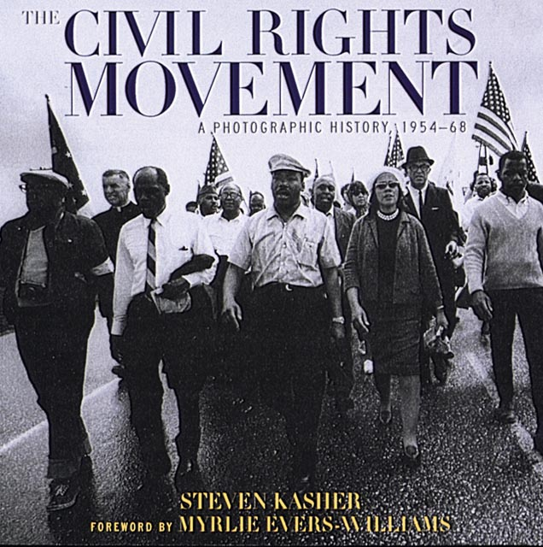
Albany Movement
The goal of the Albany Movement was to desegregate the Albany, Georgia region
Began in 1961

Slide 14
March on Washington
Took place on August 28, 1963; first one took place in 1941
Dr. King gave the “I Have A Dream” speech
Goals
Meaningful civil rights laws
Massive federal works program
Full and fair employment
Decent housing, the right to vote
Adequate integrated education

Slide 15
Civil Rights Act
Goals from March on Washington came together in the Civil Rights Act of 1964
Guaranteed equal voting rights, prohibited segregation in public places, banned segregation by trade unions, schools, and employers that were involved in interstate commerce or do business with the federal gov’t, called for the desegregation of public schools, and assured nondiscrimination in the distribution of federal funds
In 1972, an amendment called the Equal Employment Opportunity was added to this law, to extend protection against discrimination to women in the work place.
BrainPop – Civil Rights

Slide 16
Lester Maddox
Became the governor of GA in 1967
Governor of GA during the March on Washington
Strongly supported segregation

Slide 17
African Americans in Office
Maynard Jackson
Elected mayor of Atlanta in 1973
1st African American mayor of a major southern city
Mayor from 1974 to 1982 and was elected again in 1990
Andrew Young
An aide to Dr. Martin Luther King, Jr.
Executive director of the SCLC
In 1972, won GA’s Fifth District seat in the U.S. House of Representatives
1st African American from GA to be elected to Congress since the 1860s

