Slide 1
S8P1f Recognize there are more than 100 elements and some have similar properties as shown on the periodic table of elements. EQ: Just WHERE are these elements with similar properties?

Slide 2
Wake Up! Sing along (if you’d like!)
Song: Day 1 on the periodic table
Song: Day 2 with pictures
Song: Day 3 with the words

Slide 3
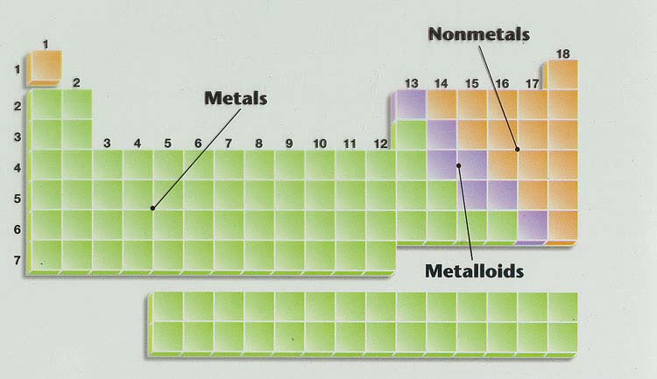
Where are they located on the Periodic Table of Elements?
Look in your book (p. 338-339) for the zigzag line!

Slide 4
What are the properties of metals, nonmetals, and metalloids?

Slide 5
Use a Venn diagram to compare their properties
metals
nonmetals
metalloids
Try it: Sort your cards into the correct circle.
Use your book (pages 340-341) to help you.

Slide 6
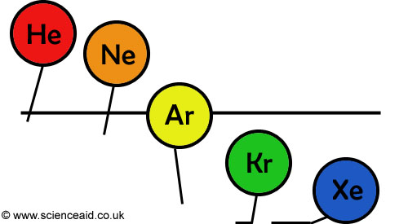
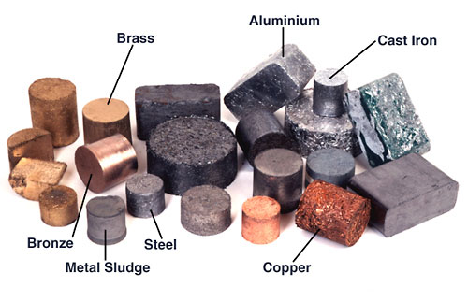
metals ---- nonmetals
Solids at room temp. (except mercury)
Most are gases

Slide 7
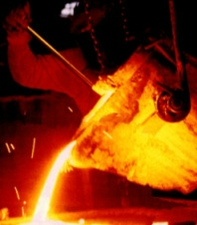
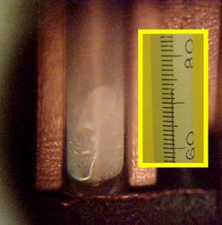
metals ----- nonmetals
higher melting points
lower melting points

Slide 8
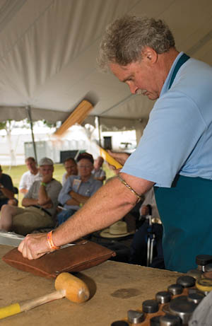
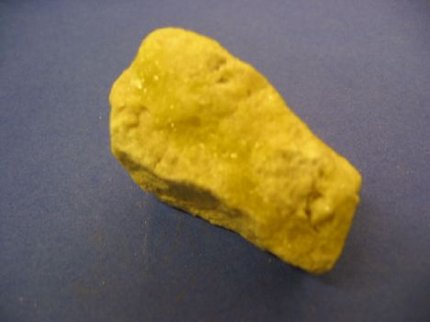
metals ---- nonmetals
malleable
(can be pounded & shaped)
harder
brittle (break easily)
Softer than metals

Slide 9
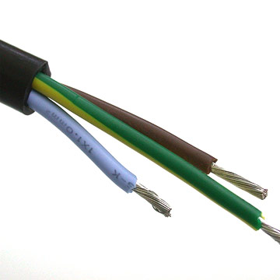
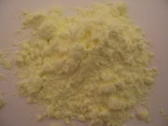
metals ---- nonmetals
Ductile
(can be drawn into wire)
Not ductile

Slide 10
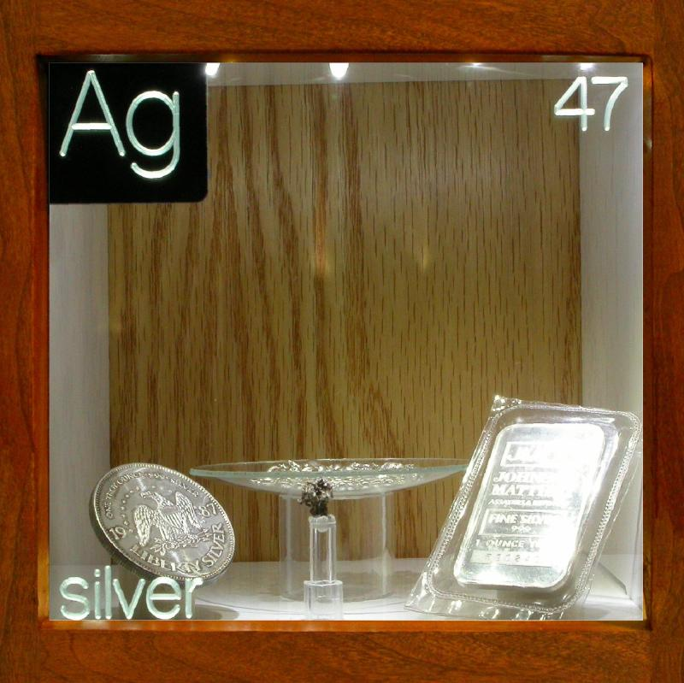
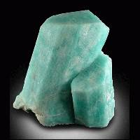
metals ---- nonmetals
lustrous (shiny)
dull

Slide 11
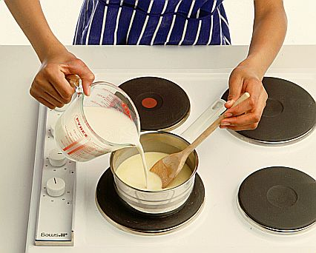
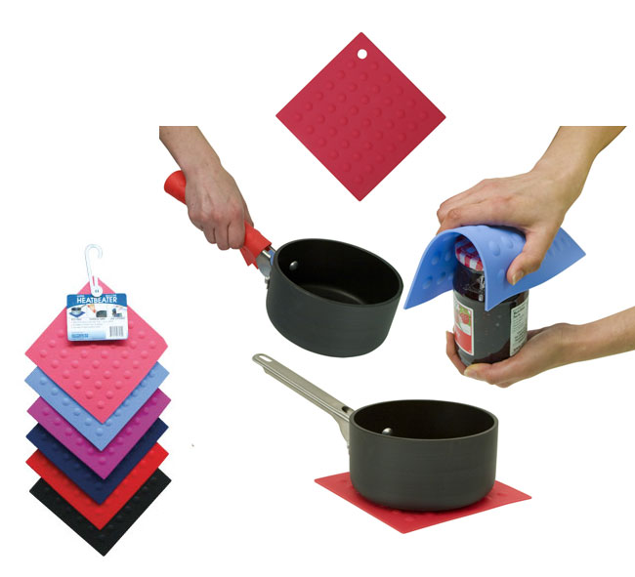
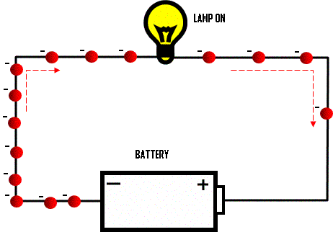
metals ---- nonmetals
Good conductors of heat and electricity
Poor conductors
(good insulators)

Slide 12
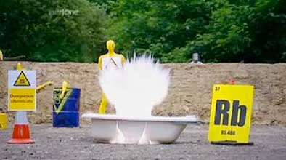
metals ---- nonmetals
Includes the most reactive group (1)
(alkali metals)
Includes the least reactive group (18)
(noble gases)
*most stable
Brainiac Video (no commercials)
Backup copy on teachertube--with commercials

Slide 13
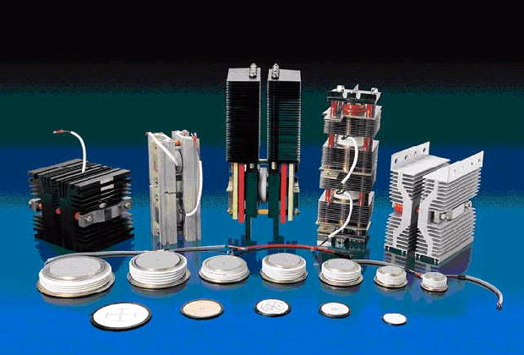
Metalloids
Have some of the properties of metals and some of the properties of nonmetals
Include semiconductors (Used in electronics)

Slide 14
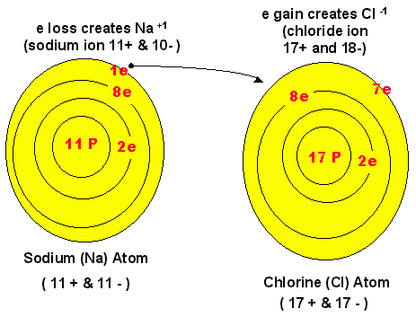
metals ---- nonmetals
Tend to lose electrons (form positive ions +)
Tend to gain electrons (form negative ions -)

