Slide 1
REVIEW FOR THE U.S. HISTORY PROGRESSIVES & WWI and 1920s TEST
INSTRUCTIONS:
Go through the slides and answer each question in the packet; the slide numbers are listed for each question

Slide 2
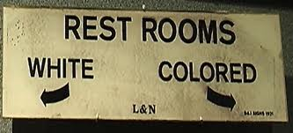
The decision in the Supreme Court case Plessy v Ferguson of 1896 stated that segregation does not violate the 14th Amendment and can be used as long as separate facilities are equal (“separate but equal”)

Slide 3
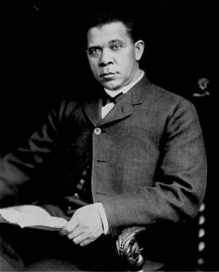
Booker T. Washington was a Black leader who was a Harvard graduate and President of the Tuskegee Institute (a college)
Booker T. Washington believed that education was the key to African-Americans becoming social equals to Whites

Slide 4
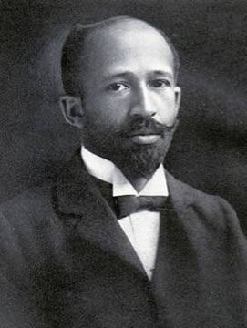
W.E.B. DuBois was also a Black leader for civil rights and reform
DuBois differed from Booker T. Washington in that DuBois felt that aggressive action would be necessary to gain civil rights for African-Americans

Slide 5
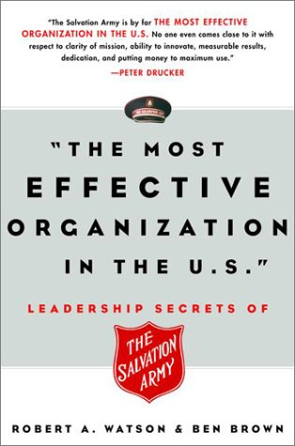
FOUR MAIN GOALS OF THE PROGRESSIVE REFORMERS
GOAL #1: Protecting social welfare to relieve urban problems; this was done by organizations such as the YMCA and Salvation Army

Slide 6
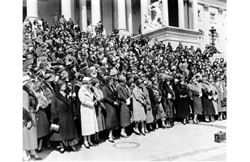
FOUR MAIN GOALS OF THE PROGRESSIVE REFORMERS
GOAL #2: Promoting moral reform by improving personal behavior (the “Anti-Saloon League” pushed for the 18th Amendment, which prohibited alcohol

Slide 7
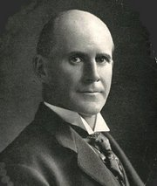
FOUR MAIN GOALS OF THE PROGRESSIVE REFORMERS
GOAL #3: Creating economic reforms (like stopping monopolies) and eliminating political corruption; for example, Eugene Debs started the American Socialist Party in an attempt at economic reform

Slide 8
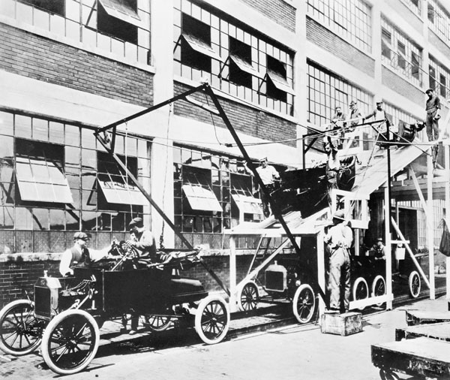
FOUR MAIN GOALS OF THE PROGRESSIVE REFORMERS
GOAL #4: Fostering efficiency in American society and the economy, such as the scientific management of Henry Ford’s assembly line

Slide 9
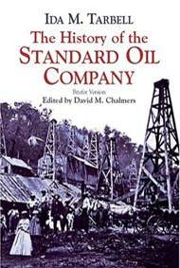
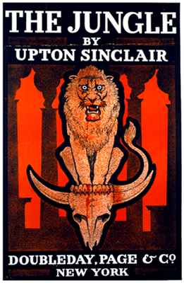
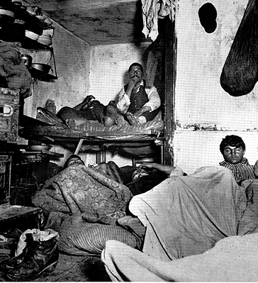
“Muckrakers” were journalists who wrote about and exposed problems such as poverty, corruption, and monopolies
Jacob Riis, Upton Sinclair, and Ida Tarbell are examples of muckrakers

Slide 10
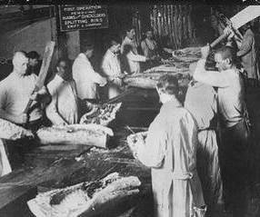
What did Upton Sinclair’s The Jungle (1906) expose?
Upton Sinclair’s book The Jungle revealed the unsanitary conditions of slaughterhouses and led to government regulation of food industries, such as the Meat Inspection Act

Slide 11
PROGRESSIVE AMENDMENTS
16th Amendment created the 1st income tax in U.S. history
17th Amendment allowed for the direct-election of U.S. Senators
18th Amendment outlawed alcohol (prohibition)
19th Amendment granted women the right to vote (suffrage)
“Progressive Amendments”
Notes:
(1913) was;

Slide 12
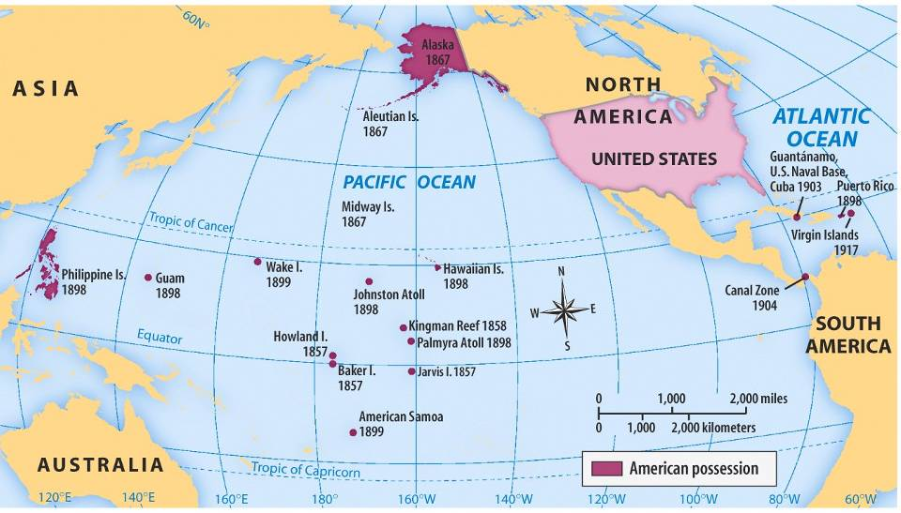
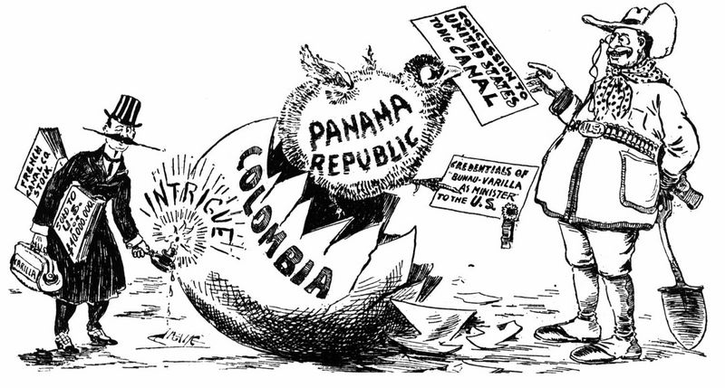
U.S. Imperialism: PANAMA
Roosevelt gained control of the land the U.S. needed to build the Panama Canal by encouraging and supporting the Panamanians to break away from Colombia

Slide 13
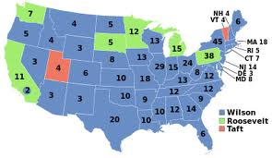
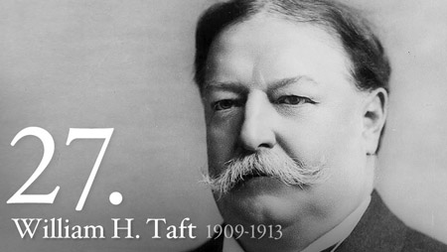
Taft failed to unify the Republican Party and Roosevelt ran against him as a member of his own Progressive Party
Taft and Roosevelt split up the Republican vote, which paved the way for Democrat Woodrow Wilson to easily win the 1912 election

Slide 14
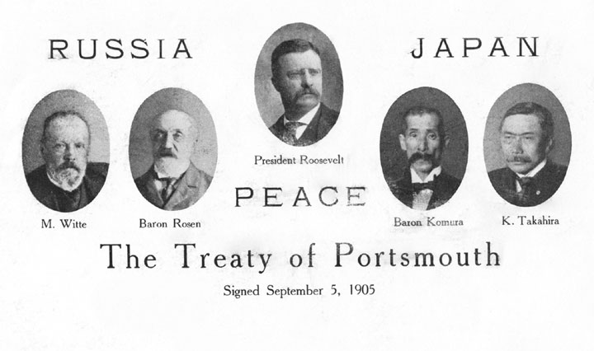
Theodore Roosevelt won the Nobel Peace Prize in 1906 for negotiating an end to the war between Russia and Japan

Slide 15
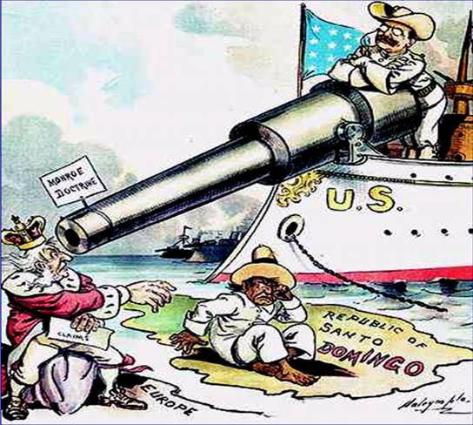
Roosevelt’s foreign policy could be summed up by the old proverb, “Speak softly and carry a big stick”, which meant that his negotiations were always backed up by the threat of military force

Slide 16
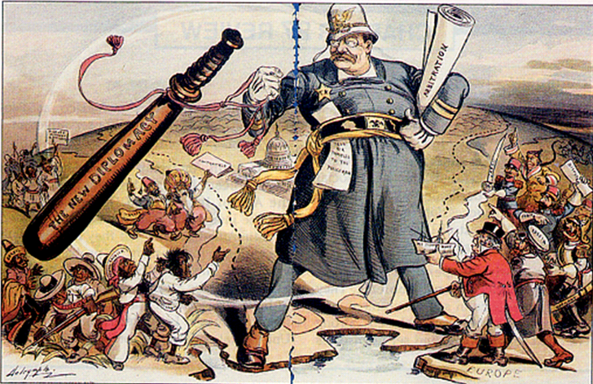
This political cartoon illustrates the “Roosevelt Corollary”, which was an addition to the Monroe Doctrine; the Monroe Doctrine told Europeans to stay out of Latin America, but the Roosevelt Corollary stated that the U.S. military would intervene in any dispute involving any Latin American country

Slide 17
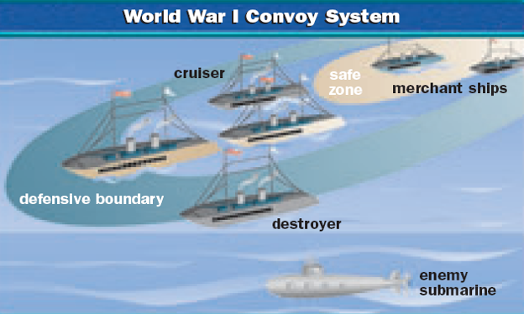
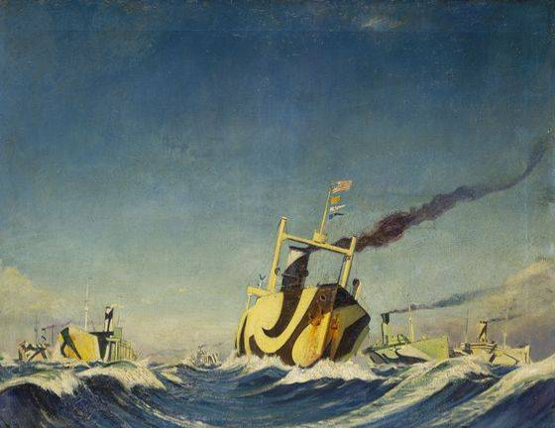
With the military & economy mobilized for war, the 1st U.S. troops began fighting in 1918
To combat German u-boats, the USA used a convey system to deliver soldiers & supplies to Europe
Notes:
via convoy in June 1917 but did not see action until early 1918

Slide 18
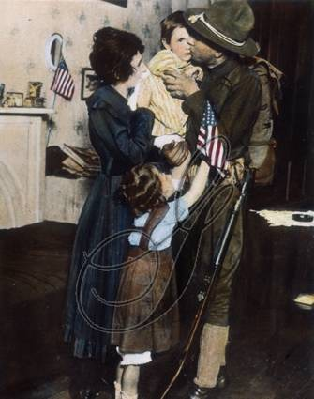
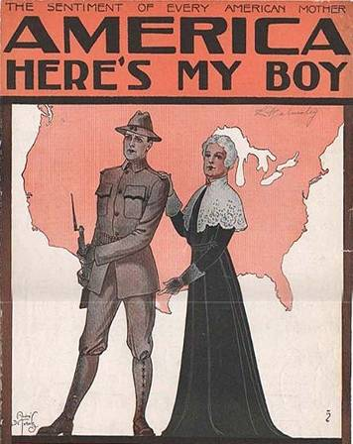
Mobilization: The Military
To mobilize the military, President Wilson & Congress created:
The Selective Service Act to draft men between the ages of 18 & 45 into the army
2.8 million were drafted to fight
Black soldiers were placed into segregated units
Notes:
15

Slide 19
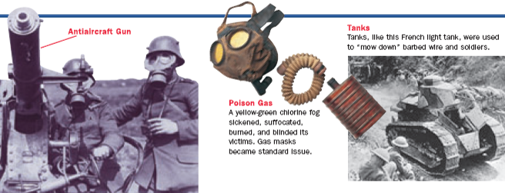
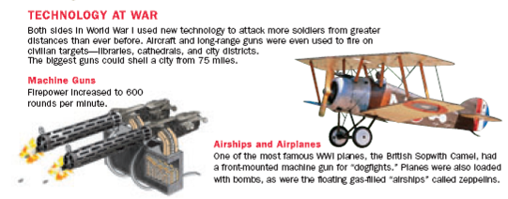
Total War
New weapons were introduced, such as machine guns, tanks, airplanes, flame throwers, poison gas, blimps, heavy artillery, & submarines
To protect soldiers from enemy fire, both the Allies & Central Powers built trenches
But, trench warfare made it difficult for either side to gain an advantage

Slide 20
The Debate over the League of Nations
²/3 of the Senate was needed to ratify the treaty & join the League:
Internationalists supported Wilson & saw the League was a way to guarantee world peace in the future
Strong reservationists led by Henry Cabot Lodge wanted major changes to Article 10
Irreconcilables led by William Borah wanted isolationism & refused join the League under any circumstances
Notes:
22

Slide 21
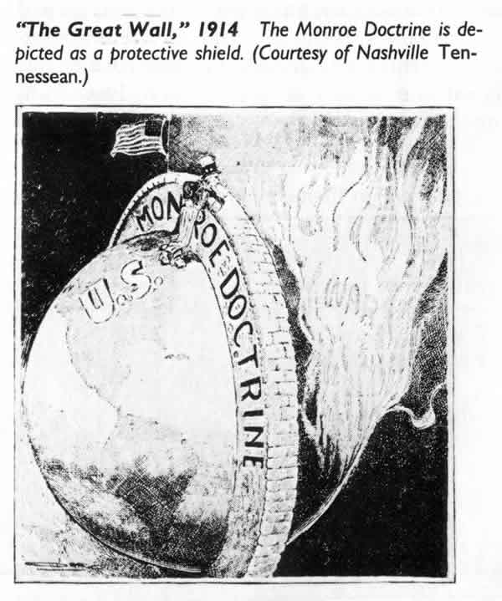
American Neutrality
When World War I began in 1914, President Woodrow Wilson declared U.S. neutrality
But by 1917, the USA entered WWI as an Allied Power… WHY?
Notes:
10

Slide 22
The Treaty of Versailles, 1919
But, President Wilson could not sign the treaty because Article I of the Constitution gives the Senate the power to ratify all treaties
On June 28, 1919, the Treaty of Versailles was signed by Germany & officially ended WWI
But, many U.S. Senators did not like the treaty because of the League of Nations

Slide 23
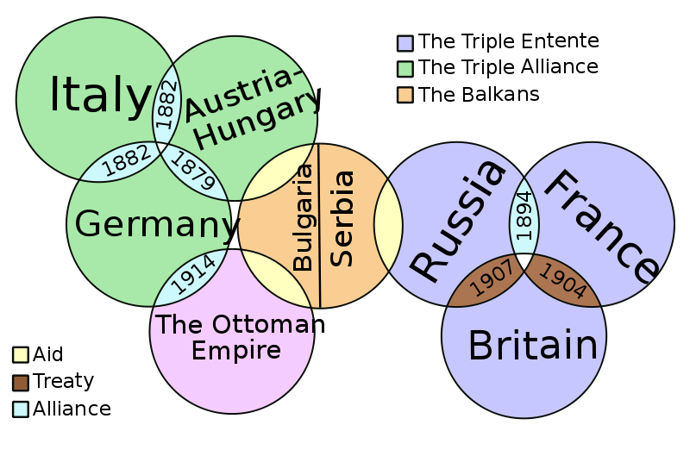
Pre-War Alliance Network

Slide 24
Civil Liberties During WWI: Document A
President Wilson warned that WWI would require a redefinition of national loyalty, claiming "millions of [Germans] with native sympathies live amongst us.“
Congress passed the Espionage and Sedition Acts
Under these laws, a person could be fined up to $10,000 and jailed up to 20 years for interfering with or saying anything disloyal about the war effort. These laws clearly violated the First Amendment, guaranteeing freedom of speech.
Over 2,000 people were prosecuted, including newspaper editors, Socialists, anarchists, union leaders, & citizens who protested the draft
Notes:
The Espionage and Sedition Acts targeted socialists and labor leaders. Eugene V. Debs was handed a ten-year prison sentence for speaking out against the war and the draft. The anarchist Emma Goldman received a two-year prison sentence and a $10,000 fine for organizing the No Conscription League. When she left jail, the authorities deported her to Russia. “Big Bill” Haywood and other leaders of the Industrial Workers of the World (IWW) were accused of sabotaging the war effort because they urged workers to strike for better conditions and higher pay. Haywood was sentenced to a long prison term. (He later skipped bail and fled to Russia.) Under such federal pressure, the IWW faded away

Slide 25
Workers
The Espionage and Sedition Acts targeted socialists and labor leaders. Eugene V. Debs was handed a ten-year prison sentence for speaking out against the war and the draft. The anarchist Emma Goldman received a two-year prison sentence and a $10,000 fine for organizing the No Conscription League. When she left jail, the authorities deported her to Russia. “Big Bill” Haywood and other leaders of the Industrial Workers of the World (IWW) were accused of sabotaging the war effort because they urged workers to strike for better conditions and higher pay. Haywood was sentenced to a long prison term. (He later skipped bail and fled to Russia.) Under such federal pressure, the IWW faded away

Slide 26
Sacco & Vanzetti
During the Red Scare, suspected immigrants were under attack:
In 1920, two Italian immigrants named Sacco & Vanzetti were arrested & charged with murder
Sacco & Vanzetti were anarchists (believed in no gov’t) but claimed to be innocent of the crime
With only circumstantial evidence, they were found guilty & executed

Slide 27
Immigration Restrictions
In 1921 & 1924, the gov’t passed new laws restricting immigration:
These laws created quotas that placed a maximum number on how many immigrants could enter the United States
The laws discriminated against Southern & Eastern European immigrants & Asian immigrants

Slide 28
Palmer Raids
The Palmer Raids were attempts by the United States Department of Justice to arrest and deport radical leftists, especially anarchists, from the United States. The raids and arrests occurred in November 1919 and January 1920 under the leadership of Attorney General A. Mitchell Palmer. Though more than 500 foreign citizens were deported, including a number of prominent leftist leaders, Palmer's efforts were largely frustrated by officials at the U.S. Department of Labor who had responsibility for deportations and who objected to Palmer's methods. The Palmer Raids occurred in the larger context of the Red Scare, the term given to fear of and reaction against political radicals in the U.S. in the years immediately followingWorld War I.

Slide 29
Teapot Dome Scandal
The Teapot-dome Scandal was a bribery incident that took place in the United States from 1920–1923, during the administration ofPresident Warren G. Harding. Secretary of the Interior Albert B.Fall leased Navy petroleum reserves at Teapot Dome and two other locations to private oil companies at low rates without competitive bidding. In 1922 and 1923, the leases became the subject of a sensational investigation by Senator Thomas J. Walsh. Fall was later convicted of accepting bribes from the oil companies.

Slide 30
Kellogg-Briand Pact
The Kellogg-Briand Pact failed because it did not include any enforcement mechanism. It failed to halt aggression in the 1930s-by Japan in Manchuria (1931) and by Italy in Ethiopia (1935)-and was thus discredited by the time World War II broke out. It was not strong enough

Slide 31
Prohibition
But, many urban Americans resisted prohibition:
Most immigrants considered drinking part of socializing
Wealthy urban Americans wanted to enjoy themselves
Bootleggers made illegal alcohol & rum runners smuggled foreign alcohol into the country
Secret saloons (speakeasies) were created to sell booze
Notes:
Eventually, Prohibition’s fate was sealed by the government, which failed to budget enough money to enforce the law. The Volstead Act established a Prohibition Bureau in the Treasury Department in 1919, but the agency was underfunded. The job of enforcement involved patrolling 18,700 miles of coastline as well as inland borders, tracking down illegal stills (equipment or distilling liquor), monitoring highways for truckloads of illegal alcohol, and overseeing all the industries that legally used alcohol to be sure none was siphoned off for illegal purposes. The task fell to approximately 1,500 poorly paid federal agents and local police—clearly an impossible job.
SPEAKEASIES AND BOOTLEGGERS To obtain liquor illegally, drinkers went underground to hidden saloons and nightclubs known as speakeasies—so called because when inside, one spoke quietly, or “easily,” to avoid detection. Speakeasies could be found everywhere—in penthouses, cellars, office buildings, rooming houses, tenements, hardware stores, and tearooms. To be admitted to a speakeasy, one had to present a card or use a password. Inside, one would find a mix of fashionable middle-class and upper-middle-class men and women. Before long, people grew bolder in getting around t he law. They learned to distill alcohol and built their own stills. Since alcohol was allowed for medicinal and religious purposes, prescriptions for alcohol and sales of sacramental wine (intended for church services) skyrocketed. People also bought liquor from bootleggers (named for a smuggler’s practice of carrying liquor in the legs of boots), who smuggled it in from Canada, Cuba, and the West Indies. “The business of evading [the law] and making a mock of it has ceased to wear any aspects of crime and has become a sort of national sport,” wrote the journalist H. L. Mencken.
ORGANIZED CRIME Prohibition not only generated disrespect for the law, it also contributed to organized crime in nearly every major city. Chicago became notorious as the home of Al Capone, a gangster whose bootlegging empire netted over $60 million a year. Capone took control of the Chicago liquor business by killing off his competition. During the 1920s, headlines reported 522 bloody gang killings and made the image of flashy Al Capone part of the folklore of the period. In 1940, the writer Herbert Asbury
recalled the Capone era in Chicago. By the mid-1920s, only 19 percent of Americans supported Prohibition. The rest, who wanted the amendment changed or repealed, believed that Prohibition caused worse effects than the initial problem. Rural Protestant
Americans, however, defended a law that they felt strengthened moral values. The Eighteenth Amendment remained in force until 1933, when it was repealed by the Twenty-first Amendment.

Slide 32
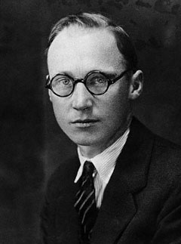
Religious Fundamentalism
In 1925, teacher John Scopes was arrested in Dayton, TN for teaching evolution in his biology class
Notes:
The Scopes trial was a fight over evolution and the role of science and religion in public schools and in American society. The trial opened on July 10, 1925, and almost overnight became a national sensation. Darrow called Bryan as an expert on the Bible—the contest that everyone had been waiting for. To handle the throngs of Bryan supporters, Judge Raulston moved the court outside, to a platform built under the maple trees. There, before a crowd of several thousand, Darrow relentlessly questioned Bryan about his beliefs. Bryan stood firm, a smile on his face. Darrow asked Bryan if he agreed with Bishop James Ussher’s calculation that, according to the Bible, Creation happened in 4004 B.C. Had every living thing on earth appeared since that time? Did Bryan know that ancient civilizations had thrived before 4004 B.C.? Did he know the age of the earth? Bryan grew edgy but stuck to his guns. Finally, Darrow asked Bryan, “Do you think the earth was made in six days?” Bryan answered, “Not six days of 24 hours.” People sitting on the lawn gasped. With this answer, Bryan admitted that the Bible might be interpreted in different ways. But in spite of this admission, Scopes was found guilty and fined $100. The Tennessee Supreme Court later changed the verdict on a technicality, but the law outlawing the teaching of evolution remained in effect. This clash over evolution, the Prohibition experiment, and the emerging urban scene all were evidence of the changes and conflicts occurring during the 1920s. During that period, women also experienced conflict as they redefined their roles and pursued new lifestyles

Slide 33
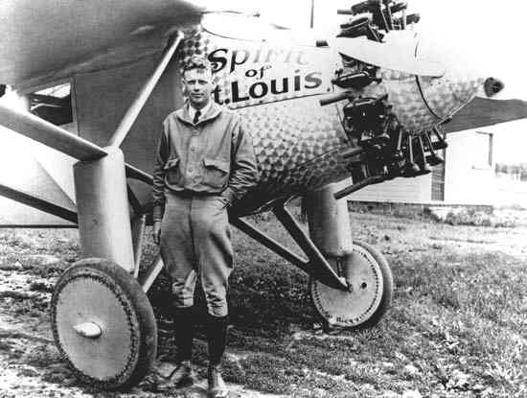
Improved Transportation
Airplanes captured the attention of Americans in the 1920s
In 1927, Charles Lindbergh made the 1st trans- Atlantic solo flight, becoming the biggest celebrity of the 1920s

Slide 34
Harlem Renaissance
The Great Migration during WWI led to a concentration of African Americans in northern cities
The Harlem Renaissance was the flourishing of black culture:
Jazz blended African & European musical traditions into a distinctly “American” style of music
Louis Armstrong & Duke Ellington were popular jazz musicians

Slide 35
Literature
The 1920s produced some of America’s most important literature
Authors F. Scott Fitzgerald & Sinclair Lewis were critical of 1920s consumerism & conformity
Some authors became part of a the “Lost Generation” who rejected war & were very critical of American society
Notes:
Literature of the 1920s
The 1920s brought an outpouring of fresh and insightful writing, making it one of the richest eras in the country’s literary history.
Sinclair Lewis, the first American to win a Nobel Prize in literature, was among the era’s most outspoken critics. In his novel Babbitt, Lewis used the main character of George F. Babbitt to ridicule Americans for their conformity and materialism.
It was F. Scott Fitzgerald who coined the term “Jazz Age” to describe the 1920s. In This Side of Paradise and The Great Gatsby, he revealed the negative side of the period’s gaiety and freedom, portraying wealthy and attractive people leading imperiled lives in gilded surroundings. In New York City, a brilliant group of writers routinely lunched together at the Algonquin Hotel’s “Round Table.” Among the best known of them was Dorothy Parker, a short story writer, poet, and essayist. Parker was famous for her wisecracking wit, expressed in such lines as “I was the toast of two continents—Greenland and Australia.”
Many writers also met important issues head on. In The Age of Innocence, Edith Wharton dramatized the clash between traditional and modern values that had undermined high society 50 years earlier. Willa Cather celebrated the simple, dignified lives of people such as the immigrant farmers of Nebraska in My Ántonia, while Edna St. Vincent Millay wrote poems celebrating youth and a life of independence and freedom from traditional constraints.
Some writers such as Fitzgerald, Ernest Hemingway, and John Dos Passos were so soured by American culture that they chose to settle in Europe, mainly in Paris. Socializing in the city’s cafes, they formed a group that the writer Gertrude Stein called the “Lost Generation”. They joined other American writers already in Europe such as the poets Ezra Pound and T. S. Eliot, whose poem The Waste Land presented an agonized view of a society that seemed stripped of humanity.
Several writers saw action in World War I, and their early books denounced war. Dos Passos’s novel Three Soldiers attacked war as a machine designed to crush human freedom. Later, he turned to social and political themes, using modern techniques to capture the mood of city life and the losses that came with success. Ernest Hemingway, wounded in World War I, became the best-known expatriate author. In his novels The Sun Also Rises and A Farewell to Arms, he criticized the glorification of war. He also introduced a tough, simplified style of writing that set a new literary standard, using sentences a Time reporter compared to “round stones polished by rain and wind.”

Slide 36
Consumerism
The 1920s saw a burst of personal prosperity & consumer spending
Mass production led to a huge number of new products: Cars, electric appliances, new fashions
Advertising boomed to convince people to spend their money
Companies offered ways for consumers to buy on credit through monthly installment plans
Notes:
Alongside the automobile, the telephone and electricity also became emblems of the consumer economy. By 1930, two-thirds of all American households had electricity, and half of American households had telephones. As more and more of America's homes received electricity, new appliances followed: refrigerators, washing machines, vacuum cleaners, and toasters quickly took hold. Advertisers claimed that "labor saving" appliances would ease the sheer physical drudgery of housework, but they did not shorten the average housewife's work week. Women had to do more because standards of cleanliness kept rising. Sheets had to be changed weekly; the house had to be vacuumed daily. In short, social pressure expanded household chores to keep pace with the new technology. Far from liberating women, appliances imposed new standards of cleanliness.

Slide 37
Sports Mania
New forms of entertainment emerged in the 1920s as Americans gained more leisure time & personal income
Baseball, boxing, & football were popular sports
Radio broadcasts brought sporting events to national audiences
Sports gave Americans a new generation of heroes

