Slide 1
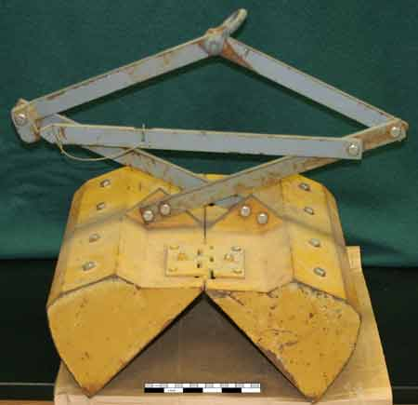
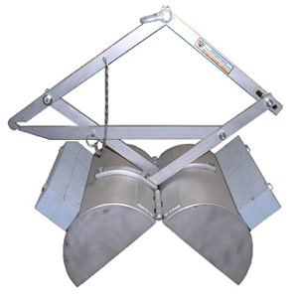
Peterson Grabber
Bottom seeker that gets items off the ocean floor
Notes:
Joseph Fulton
http://quizlet.com/2641294/marine-bio-terms-flash-cards/
https://www.google.com/search?q=peterson+grabber+in+ocean&source=lnms&tbm=isch&sa=X&ei=hOglUoLSGumhsATgjYH4Bg&ved=0CAcQ_AUoAQ&biw=1034&bih=751#q=peterson+grabber&tbm=isch&imgdii=_

Slide 2
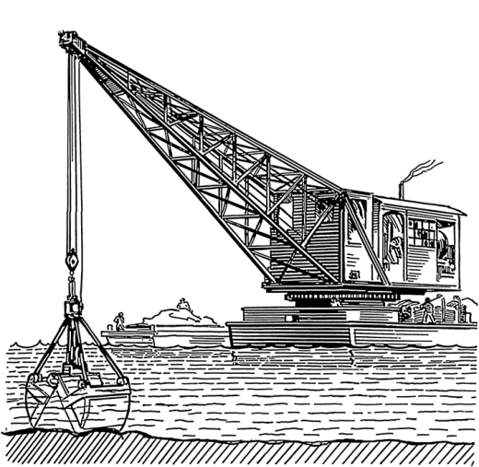
Peterson Grabber
The Peterson grabber is used to gather sediment towards a deep body of water. Made in the 1930’s, at the time used for collecting microscopic fauna out of sand, gravel, marl, and clay.

Slide 3
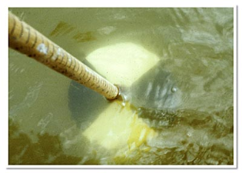
Secchi Disk
A Secchi Disk is a black and white disk that is lowered by hand into the water to the depth at which it vanishes from sight.
A Secchi Disk is used to measure water clarity.
Notes:
http://water.epa.gov/type/rsl/monitoring/155.cfm

Slide 4
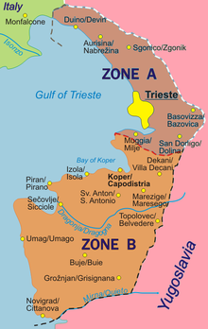
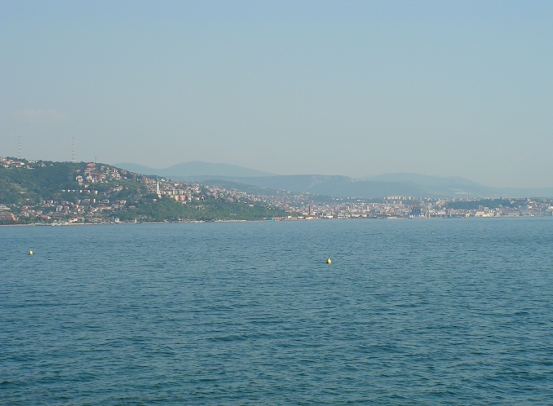
Trieste
Trieste is a city and seaport in northeastern Italy. It is situated towards the end of a narrow strip of Italian territory lying between the Adriatic Sea and Slovenia, which lies almost immediately south and east of the city.
Notes:
http://www.lonelyplanet.com/italy/friuli-venezia-giulia/trieste

Slide 5
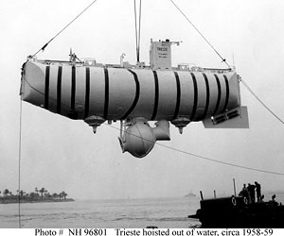
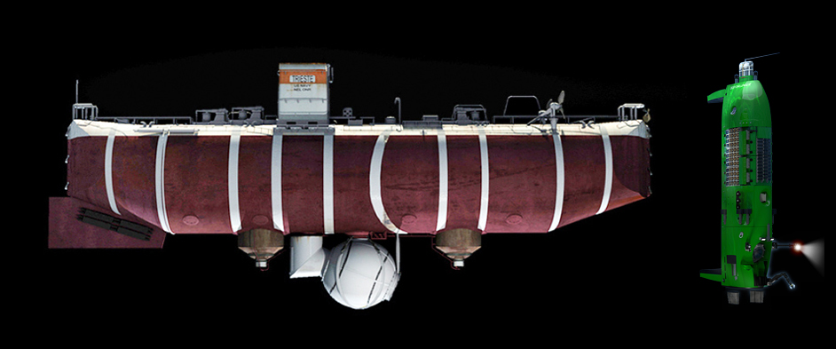
Trieste
Designed by Swiss scientist Auguste Piccard.
Bathyscaphe or deep diving boat that was over 50 feet long.
Consisted of gasoline which made it buoyant.
Dove 37,000 feet into the Mariana Trench of the Pacific Ocean into the Challenger Deep.
Notes:
Information:
http://www.pbs.org/wnet/savageseas/deep-side-journey.html
http://www.enotes.com/1960-science-technology-american-decades/oceanography-trieste
http://www.expeditions.udel.edu/extreme08/tools/trieste.html
Pictures:
http://www.google.com/imgres?q=trieste+used+in+oceanography&safe=strict&hl=en&biw=1440&bih=719&tbm=isch&tbnid=kmkMsa9t3vLuRM:&imgrefurl=http://marinebio.org/oceans/history-of-marine-biology
http://www.google.com/imgres?q=trieste+used+in+oceanography&safe=strict&hl=en&biw=1440&bih=719&tbm=isch&tbnid=L2z9wwTbckOlNM:&imgrefurl=http://deepseachallenge.com/the-sub/then-and-now

Slide 6
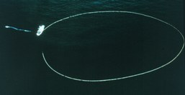
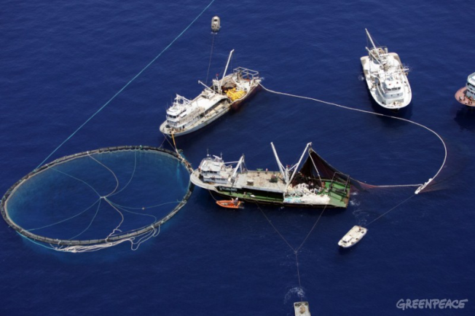
Purse Seine Net By: Danny Ly
Basically the purse seine net catch a lot of fish by going in a circle and the net makes a wall of netting. An it capture other types of fish that feed on those type of fishes too.
Notes:
Definition- http://oceana.org/en/category/blog-free-tags/purse-seine-nets
Picture 1- http://www.greenpeace.org/international/ReSizes/OriginalWatermarked/Global/international/planet-2/image/2006/6/medtuna.jpg
Picture 2- http://bycatch.nicholas.duke.edu/spiffs/purseseine2/spiffimage

Slide 7
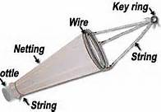
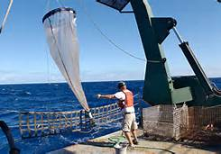
Plankton Net
The fine mesh of this plankton net allows us to capture the smallest of marine organisms including marine algae, larval fish and invertebrates.
Notes:
http://oceanexplorer.noaa.gov/explorations/02sab/logs/aug07/media/plnet.html

Slide 8
Plankton Net
Plankton Nets are a modification on the standard trawl used to collect planktonic organisms, of nearly any size, intact.
Christian Zapata
Notes:
http://www.bigelow.org/foodweb/satellite2.html & http://earthobservatory.nasa.gov/Features/Phytoplankton/page3.php

Slide 9
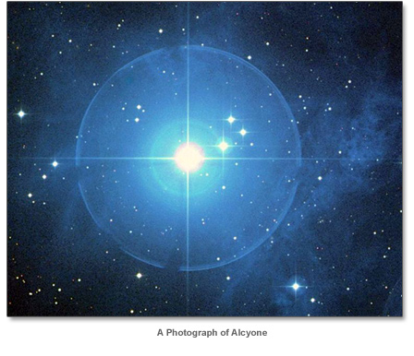
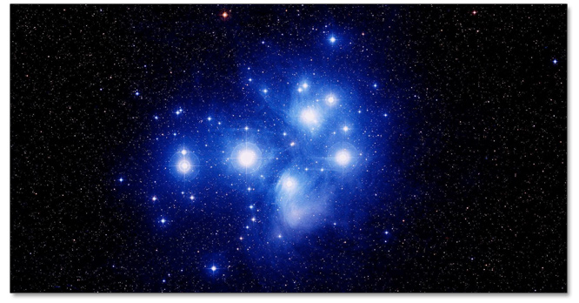
Alcyone
One of the main star of the Pleiades cluster
The center of seven solar system
It is one of the nearest galactic cluster to earth
The brightest star and the most familiar star cluster to mankind
Notes:
http://gnosticteachings.org/the-teachings-of-gnosis/lectures-by-samael-aun-weor/35-alcyone-and-negative-emotions.html
http://www.alcyonecodesmith.com/alcyone.shtml

Slide 10
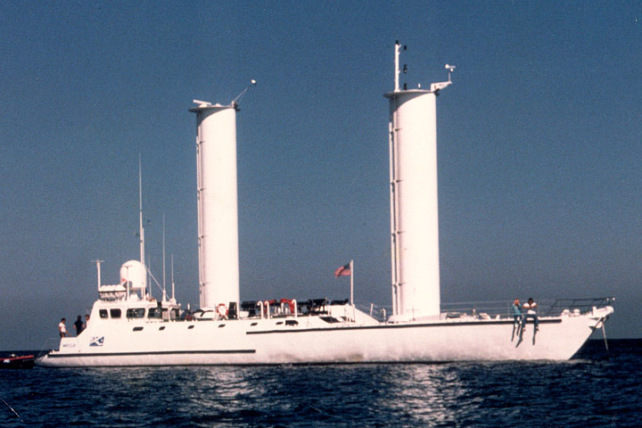
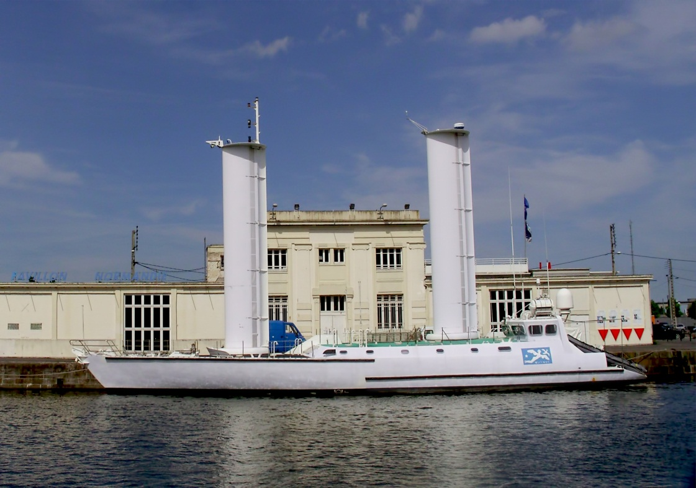
The Alcyone , is a oceanographic ship registered in France. Brianna McCants

Slide 11
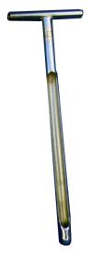
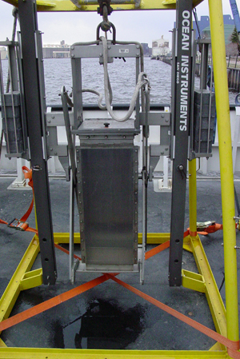
Core Sampler
Used to collect a sediment sample from the bottom of the lake without disturbing the surface.
Belmin Vatres 3rd
Notes:
http://www.epa.gov/greatlakes/monitoring/guard/equipment.html http://www.turf-tec.com/TSS1lit.html

Slide 12
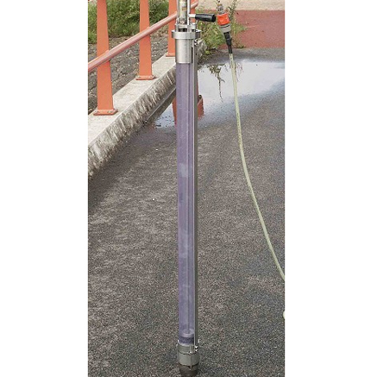
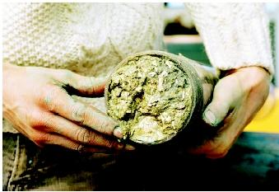
Core Sampler
A core sample is a specimen of mud, soil, rock, in the form of a cylindrical block, preserving the arrangement of its contents inside.
Notes:
http://www.wisegeek.com/what-is-a-core-sample.htm

Slide 13
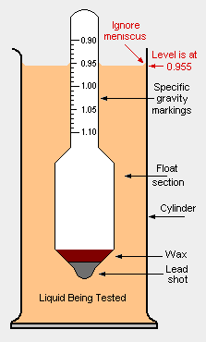
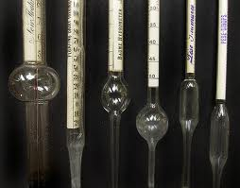
Hydrometer
A hydrometer is an instrument typically used to measure the specific gravity (or relative density) of liquids.
It is usually made of glass and consists of a small diameter cylindrical stem and a larger diameter float section weighted with mercury to make it float upright.
Notes:
http://en.citizendium.org/wiki/Hydrometer http://melissaeastondesign.com/blog/?p=6552

Slide 14
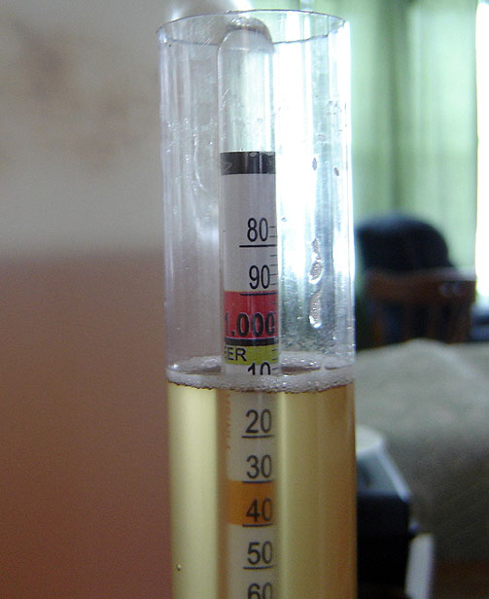
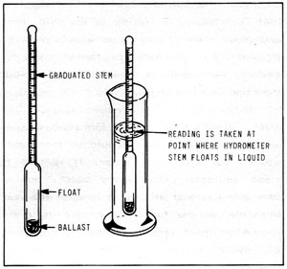
Hydrometer
A hydrometer is used to determine specific gravity.
The specific gravity of the sample liquid is indicated when the level of the sample liquid in the jar aligns with a point on the the hydrometer scale
Divine Neely
Notes:
-http://www.benmeadows.com/refinfo/techfacts/hydrometers-introduction-function-use-117.htm

Slide 15
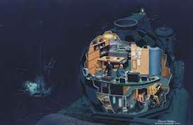
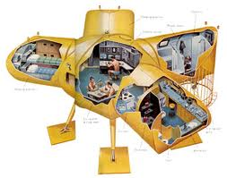
Conshelf
an attempt at creating an environment in which men could live and work on the sea floor.
By Ashley Rodriguez
Notes:
-http://www.ask.com/wiki/Continental_Shelf_Station_Two&adt=0
-www.boaterexam.com
-www.christies.com

Slide 16
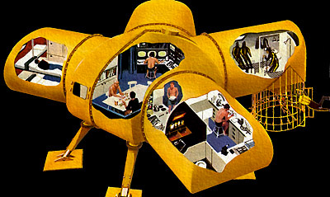
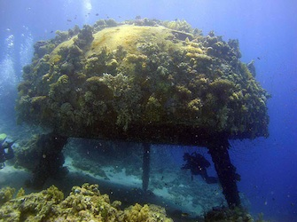
Conshelf
A conshelf is an underwater habitat designed to allow people to live and work underwater on the sea floor.
The conshelf could shelter people for only weeks, due to the fact that humans were not made to live in an environment without sunlight.
Notes:
http://www.seao2.com/undersea/
http://m1sterling.blogspot.com/2008/02/living-undersea-dreams-of-living.html
http://www.cousteau.org/technology/conshelf

Slide 17
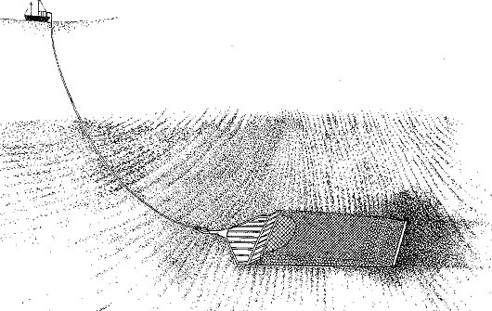
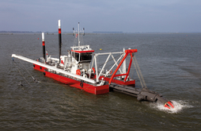
Dredge
A Machine for digging underwater a machine equipped with continuous revolving chain of buckets, a scoop , or a suction device for digging out and removing material from underwater .

Slide 18
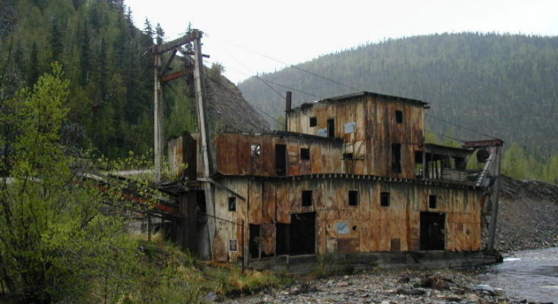
DREDGE http://www.merriam-webster.com/dictionary/dredge
A dredge is a device used to clean out the beds of rivers, harbors, or any other watery area by scooping out the mud, weeds, and rubbish
Y Yasean Doghaimat

Slide 19
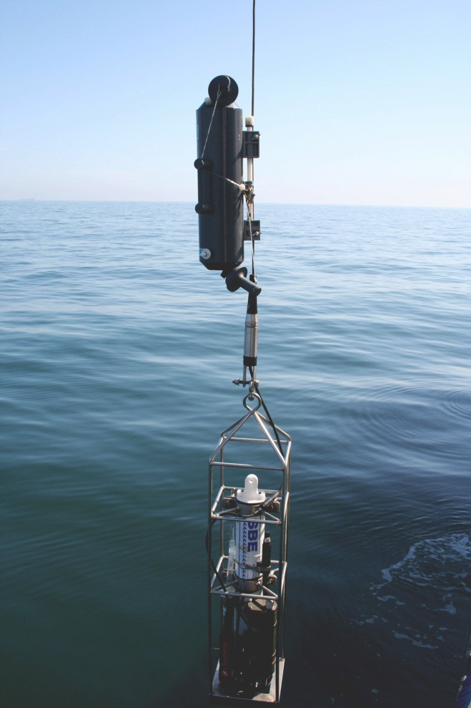
Water Collecting Bottle
Water collecting is use for collecting samples such
as the animals food source, or exposure the pollutants . It also is use to measure temperature , salinity ,physical , chemical, and biological . Its also called rosette.
Cindy Penate
Notes:
http://www.whoi.edu/page.do?pid=8415&tid=3622&cid=11371

Slide 20
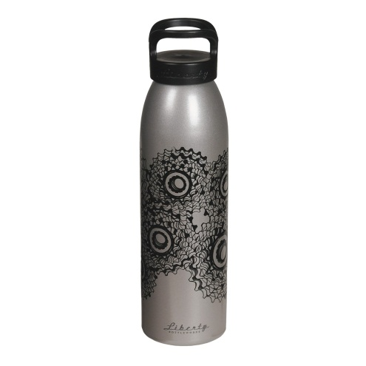
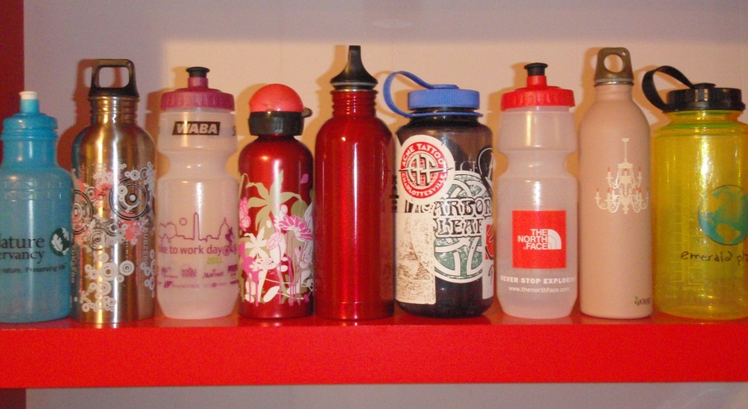
Water Collection Bottle
Function
Water collection bottles are used to collect samples of pH alkalinity and in glass bottles
Notes:
http://www.uri.edu/ce/wq/ww/Publications/WaterSamplers.pdf

Slide 21
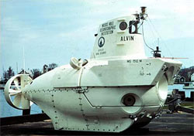
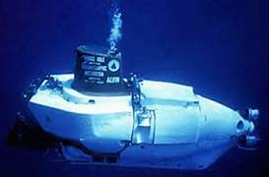
Alvin
A submarine to explore the depths of underwater.
http://www.whoi.edu/page.do?pid=10737
Notes:
2 pictures what it does

Slide 22
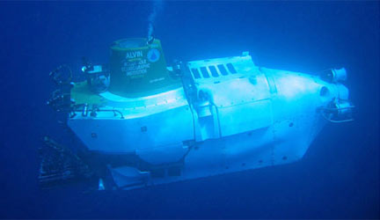
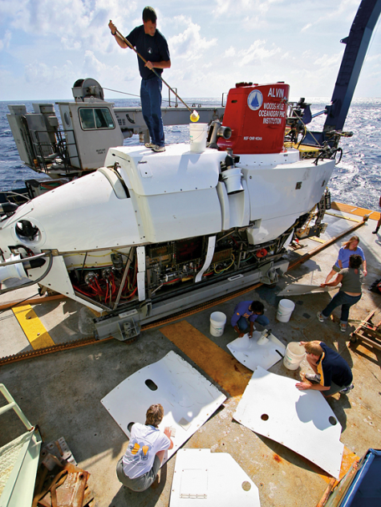
Alvin
The world’s first deep-sea submersible, built in 1964.
This submersible made about 4,400 dives and can reach 63% of the ocean floor.
Notes:
http://www.whoi.edu/page.do?pid=8422

Slide 23
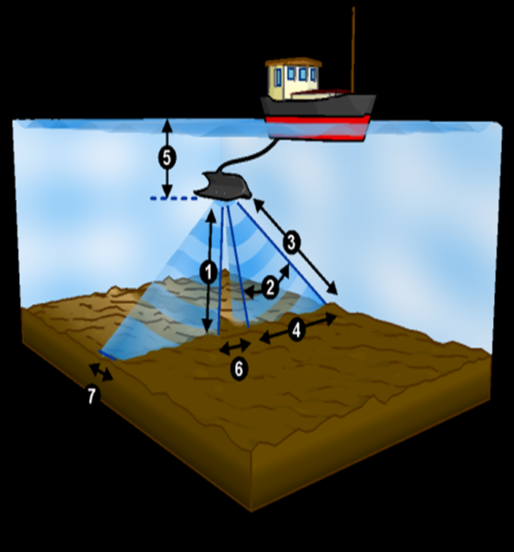
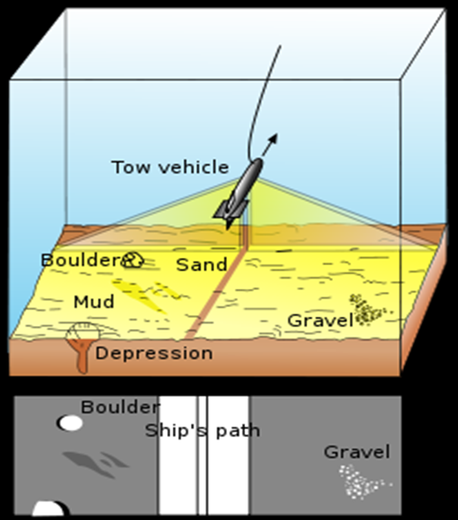
Definition- A sideways-looking acoustic-survey system which uses the reflection of high-frequency (30–110 kHz) sound waves from a surface to map the texture of that surface. Function- Oceanographer use side scan sonar to map out the ocean floor by scanning the ocean geological landscape
Huy chiem Period 3
Side-scan sonar

Slide 24
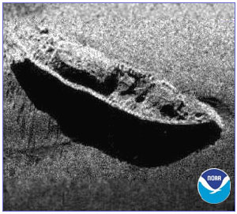
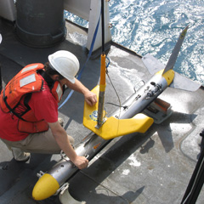
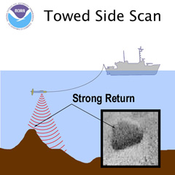
Side-Scan Sonar
The Side scan sonar is a remote sensing tool used in underwater archaeology to create black-and-white Images and identify items found on the sea floor.
Notes:
Images and identify items found on the sea floor. An acoustic emitter sending out sound waves in a fan-shaped beam is towed behind a vessel. The sound waves reflected from the sea-bed are detected by a transducer on the vessel and recorded on a rotating drum. The time taken by the sound to reach the transducer depends on the distance travelled and thus a three-dimensional plot of the sea-bed surface can be produced. It measures the strength of how "loud" the return echo is, and paints a picture.
Hard areas of the sea floor like rocks reflect more sound and have a stonger or louder return signal than softer areas like sand. Areas with loud echoes are darker than areas with quiet echoes. Objects or features that rise above the sea floor also cast shadows in the sonar image where no sound hit. The size of the shadow can be used to guess the size of the feature.
Read more: http://www.answers.com/topic/side-scan-sonar-1#ixzz2dpz34avW

Slide 25
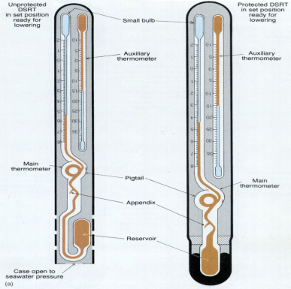
Reversing Thermometer
It protects the thermometer from the ocean’s pressure. If high pressure occurs, then mercury into a capillary.
The definition of the reversing thermometer is a thermometer that registers the temperature in deep waters.
Notes:
http://www.audioenglish.org/dictionary/reversing_thermometer.htm
http://oceanworld.tamu.edu/resources/ocng_textbook/chapter06/chapter06_06.htm
http://www2.ouc.edu.cn/cpeo/oceanography/ziyuan/tech/chapter5/5.htm

Slide 26
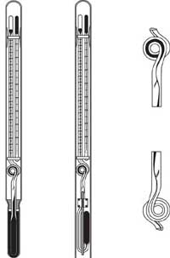
Reversing Thermometer
This thermometer is used to register the temperature in deep waters.
Notes:
http://oceanworld.tamu.edu/resources/ocng_textbook/chapter06/chapter06_06.htm ( Information )
Google.com ( Pictures )

Slide 27
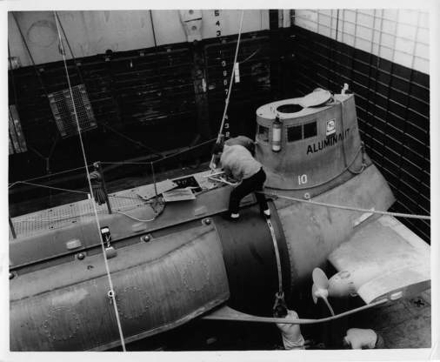
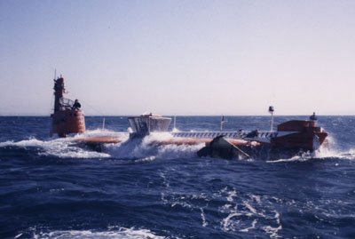
Aluminaut
By: Silling Man
Function
Aluminauts can film underwater.
This was a mass innovation during the time of its creation because there was nothing like it.
The Aluminaut was an experimental deep sea exploration submarine built in 1964.
The Aluminaut is credited with rescuing the DSV Alvin-2 in 1969 after it sank.
Helped to locate an atomic bomb lost off the coast of Palomares, Spain in 1966.
Notes:
http://archive.org/details/UssAluminautTheUnderseasExplorer
http://www.google.com/imgres?imgurl=http://www.deep-submersible-pilots-association.org/images/photos/Aluminaut.jpg&imgrefurl=http://www.deep-submersible-pilots-association.org/&h=269&w=400&sz=42&tbnid=_Ql5Mn9dFDzuWM:&tbnh=90&tbnw=134&zoom=1&usg=__IvZTvfgxnQLSFKbWnlfqukenoKw=&docid=Wk3wkQltGRO7oM&sa=X&ei=KeclUvDgFcLDsAT5sYH4Bw&ved=0CD8Q9QEwBA&dur=326
https://www.google.com/search?q=aluminaut&source=lnms&tbm=isch&sa=X&ei=KeclUvDgFcLDsAT5sYH4Bw&ved=0CAkQ_AUoAQ&biw=1440&bih=799#facrc=_&imgdii=_&imgrc=D0obXjmVW853TM%3A%3B9GUDSgaCM-fDSM%3Bhttp%253A%252F%252Fwww.writtenbybarbaramoran.com%252Fimages%252Fgallery%252Fmachines%252F2.jpg%3Bhttp%253A%252F%252Fwww.writtenbybarbaramoran.com%252Fgallery_machines.php%3B1028%3B845

Slide 28
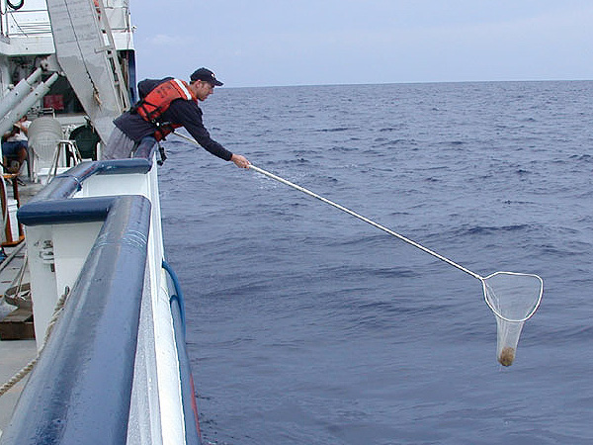
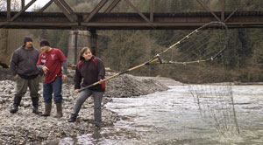
Dip Net
-A Dip Net is a bag net with a handle that is used especially to scoop fish from the water.
-This tool helps humans catch and gather fish more easily.
Notes:
Picture#1: oceanexplorer.noaa.gov, nwifc.org, http://www.merriam-webster.com/dictionary/dip%20net,

Slide 29
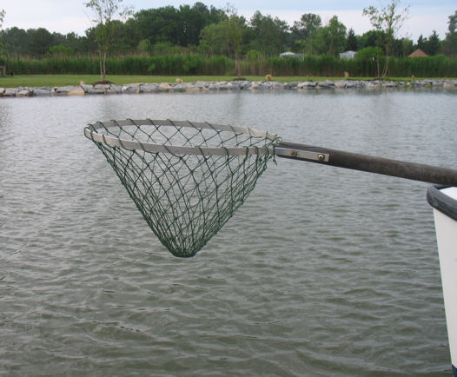
DIP NET
Dip netting is one of the main fishing techniques used to catch enormous quantities of salmon
N
Notes:
http://www.sfu.museum/time/en/panoramas/beach/dip-netting/

Slide 30
Current Meter
A current meter is used to measure the water velocity or current in a river.
By: Queen-Asya
Notes:
http://www.srh.noaa.gov/jetstream/append/glossary_c.htm
gallery.usgs.gov
valeport.co.uk

Slide 31
Current meter
Device used to measure the water velocity or current in a river by. Ashley Davis
Notes:
pkd.eijkelkamp.com
serc.carleton.edu
http://www.srh.noaa.gov/jetstream/append/glossary_c.htm

Slide 32
Flip
FLIP (Floating Instrument Platform) is the US Navy's oldest research vessel.
It is a 355ft long, spoon-shaped buoy which can be flipped from horizontal to a vertical position.
Because of the potential interference with the acoustic instruments, FLIP has no engines or other means of propulsion

Slide 33
Flip
A Flip or Floating Instrument Platform is a research vessel that gives oceanographers a place to research.
Notes:
http://www-mpl.ucsd.edu/resources/flip.intro.html
http://www.onr.navy.mil/focus/ocean/vessels/surface1.htm (picture on right)
http://blog.andthensome.nl/2005/11/14/ship-thatll-flip-you-the-bird/ (picture on left)

Slide 34
Nansen Bottle
the cylindrical container that samples sea temperature
and salinity
Notes:
http://oceanworld.tamu.edu/students/satellites/satellite2.htm

Slide 35
Nansen Bottle
Edhem Agic
A waterproof container that obtains samples of seawater at a specific depth. The Nansen bottle was invented in 1910.
Notes:
http://dictionary.reference.com/browse/nansen+bottle

Slide 36
Underwater camera
Takes pictures underwater
Notes:
http://www.google.com/imgres?sa=X&biw=1440&bih=719&tbm=isch&tbnid=DQMRR54R5rVl4M:&imgrefurl=http://divescover.com/blog/buying-your-own-equipment-accessories/&docid=QtMN-j6KaF4Y_M&imgurl=http://divescover.com/blog/wp-content/uploads/2012/09/ikelite-nikon-underwater-cameras.jpeg&w=320&h=320&ei=EeglUuzILKfRsASyk4GgAg&zoom=1&iact=hc&vpx=1168&vpy=375&dur=1934&hovh=225&hovw=225&tx=159&ty=150&page=2&tbnh=137&tbnw=146&start=28&ndsp=37&ved=1t:429,r:64,s:0,i:285
http://www.google.com/imgres?sa=X&biw=1440&bih=719&tbm=isch&tbnid=KZxWnpx6muB4mM:&imgrefurl=http://nikonp500review.net/what-can-i-do-with-a-waterproof-camera/&docid=BhI-_UNvX90lXM&imgurl=http://nikonp500review.net/wp-content/uploads/2012/08/Underwater-Cameras.jpg&w=600&h=450&ei=EeglUuzILKfRsASyk4GgAg&zoom=1&iact=rc&dur=78&page=1&tbnh=147&tbnw=206&start=0&ndsp=28&ved=1t:429,r:3,s:0,i:97&tx=93&ty=39

Slide 37
Underwater Camera
Maria Flores
Camera designed for use under the surface of the water
Notes:
http://science.discovery.com/search.htm?terms=underwater+cameras
http://encyclopedia2.thefreedictionary.com/underwater+camera

