Slide 1
Ancient Greece Introduction
What do you know about Ancient Greece?
(Write on a sheet of Paper)

Slide 2
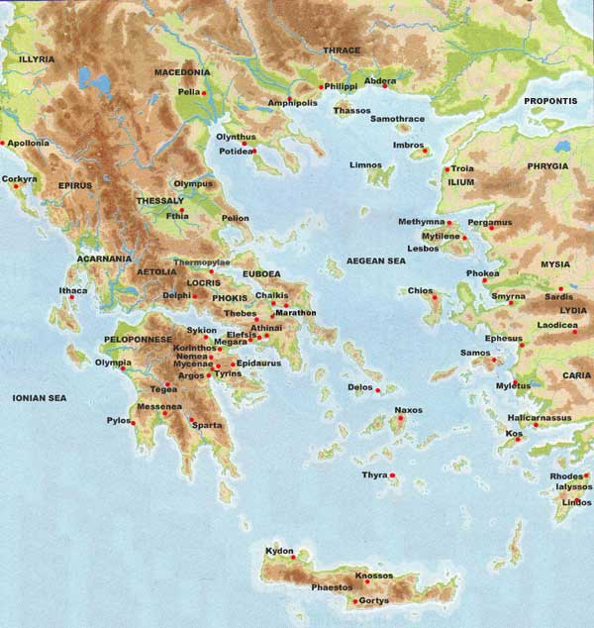
What does the map tell you about early Greek city-states or polis?

Slide 3
Greatest Greek Battles/Wars
Trojan War-1194-1184 B.C.E. or 1260-1240 B.C.E (Greeks v. Trojans)
Battle of Marathon-490 B.C.E (Athenians v. Persians)
Battle of Thermopylae-480 B.C.E (Spartans v. Persians)
Battle of Gaugamela-331 B.C.E (Macedonians v. Persians)

Slide 4
300
http://www.youtube.com/watch?v=QkWS9PiXekE
http://www.youtube.com/watch?v=PnxlhajOolw
http://www.youtube.com/watch?v=2kuna7sC5ek
http://www.youtube.com/watch?v=sFOl-QXpLc4

Slide 5
Troy
http://www.youtube.com/watch?v=CWLb2F0MEoY
http://www.youtube.com/watch?v=bpLtXIlkyYA
http://www.youtube.com/watch?v=hf4IoxEUmHM

Slide 6
Alexander
http://www.youtube.com/watch?v=1hh48WBGXK8&feature=related
http://www.youtube.com/watch?v=m3sCp9S24Co&feature=fvwrel

Slide 7
Political Make-Up of Ancient Greek City States
Polis-Greek city-state (city and surrounding land)-the political unit of Greece.
Acropolis-fortified hilltop where citizens gathered to discuss government

Slide 8
Many Governments Form in Greece
Monarchy-ruled by a single person (king)
Aristocracy-ruled by small group of noble, landowning families
Oligarchy-ruled by a few powerful people
Tyranny-ruled by a powerful individual who seizes control of the government by appealing to the common people.

Slide 9
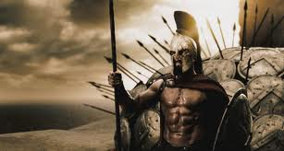
Sparta Builds a Military State
Cut off from the rest of Greece making it different.
Developed a military state, or society based around the army.
Had the most powerful army in Greece
Valued duty, strength, discipline; not intellectual thought or the arts.
Women held at high value.

Slide 10
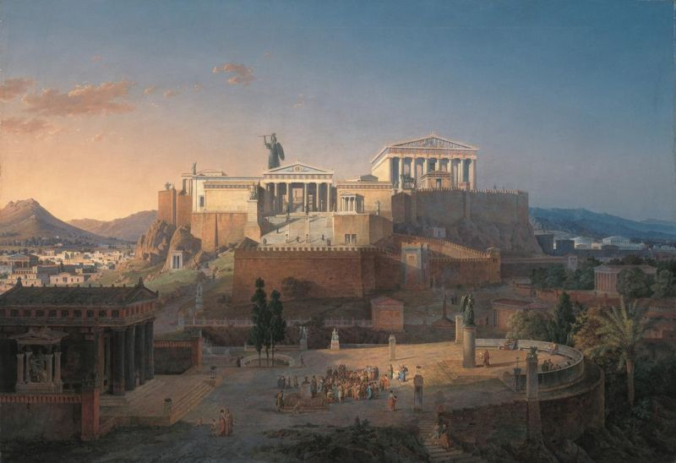
Athens Develops Democracy
Democracy-government ruled by the people
621-429 B.C.E Athens moved towards a democracy.
Nobility broken up
Assemblies created to vote on laws

Slide 11
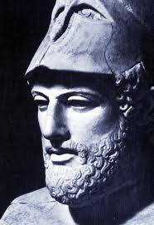
The Age of Pericles (461-429 B.C.E)
Athens’ “Golden Age”
Increased the number of citizens in public office
Introduced a Direct Democracy-citizens vote directly on issue with no representatives; majority rule
Created the Delian League
Went to war with Sparta in the Peloponnesian War and lost.

Slide 12
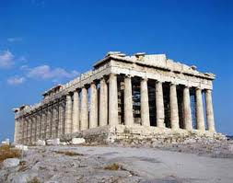
Classical Culture in Greece
Refers to a two hundred year time period in Greece (5th-4th Centuries B.C.E)
Glorified Greek art, architecture, philosophy, literature, and science (Athens)
This classical culture influenced the Roman Empire and later Western Civilizations such as the U.S.

Slide 13
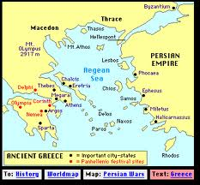
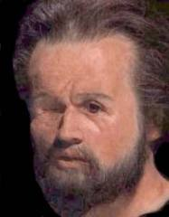
Philip of Macedon Unites Greece
Kingdom of Macedonia lay to the North of Greece
The King, Philip, wanted to take control of Greece and move against Persia
338 B.C.E-Philip invaded and took control of Greece

Slide 14
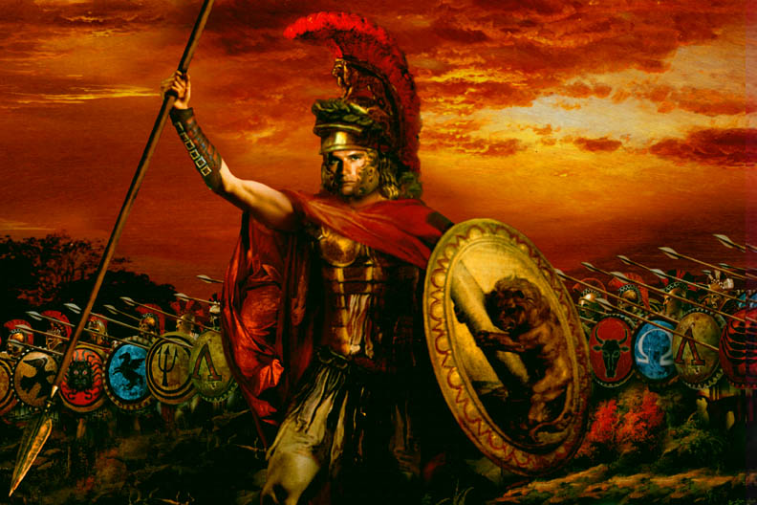
Alexander the Great (356-323 B.C.E.)
Son of Philip II
Became king at 20
Taught by Aristotle and idolized Achilles from the Trojan War.
Defeated the Persian Empire under Darius III
Created a Greek empire that stretched all the way to the Indus River
Developed Hellenistic Culture (Greek mixed with Egyptian, Persian, and Indian)
Alexandria, Egypt became the major city of commerce and Hellenism.

Slide 15
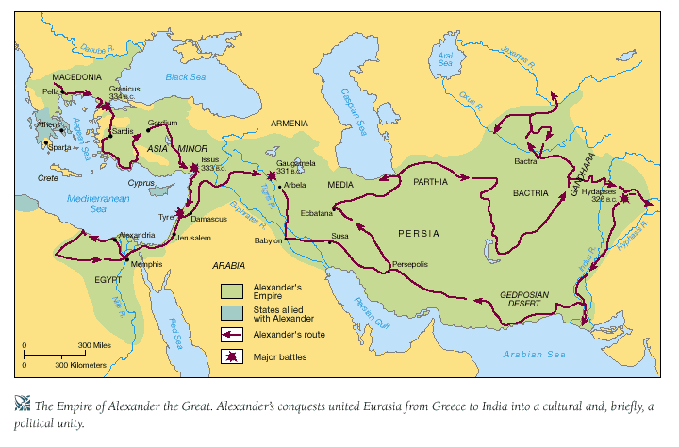
Alexander’s Empire 323 B.C.E

