Slide 1
Ch. 4
Local and Popular Culture

Slide 2
A. What are Local and Popular Cultures
Culture- group of belief systems, norms, and values practiced by a group of people
2 types of culture:
Folk Culture- small, incorporates homogeneous (all the same) population, typically rural, and cohesive in culture traits
Popular Culture- large, incorporates heterogeneous (different) populations, typically urban, cultural traits change quickly and rapidy
Some people use this as the ends of a continuum and most cultures fit in the middle:
Folk ----------------- ----------------- ---------------- Popular

Slide 3
Amish Settlements in the U.S.
Fig. 4-4: Amish settlements are distributed through the northeast U.S.

Slide 4
Origin of Country Music
Fig. 4-1: U.S. country music has four main hearths, or regions of origin: southern Appalachia, central Tennessee and Kentucky, the Ozark-Ouachita uplands, and north-central Texas.

Slide 5
Local Culture
Local Culture- replaces concept of Folk Culture-
defined as: group of people in a particular place who see themselves as a collective or a community, who share experiences, customs, traits, and work to preserve these traits and remain distinguished from others

Slide 6
Himalayan Folk Cultural Regions
Fig. 4-5: Cultural geographers have identified four distinct culture regions based on predominant religions in the Himalaya Mountains.

Slide 7
Parts of Local and Popular Culture:
Material Culture- things that are constructed like art, houses, clothes, sports, dance food
Nonmaterial Culture- beliefs, practices, aesthetics, and values of a group of people

Slide 8
Hog Production and Food Cultures
Fig. 4-6: Annual hog production is influenced by religious taboos against pork consumption in Islam and other religions. The highest production is in China, which is largely Buddhist.

Slide 9
Wine Production per Year
Fig. 4-13: The distribution of wine production shows the joint impact of the physical environment and social customs.

Slide 10
Local cultures stay the same, while popular cultures can change in a matter of days
Example: New Fashion (bodice dress) – originates in Milan Italy, seen in Paris within days, next found in Hollywood on celebrities, then in In Style Magazine, next upscale stores, and lastly- weeks later- knockoffs will be in department stores
This is Hierarchial Diffusion, hearth being NY, Paris, and Milan
Fashion in Local Cultures are passed down for generations, usually preserved by religion & family traditions

Slide 11
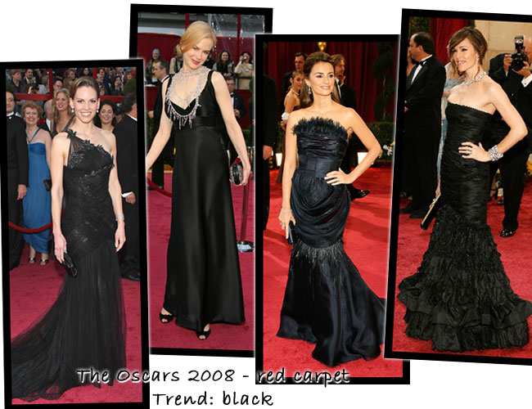
Originals on the red carpet seen above
Knock Off’s on the left and right

Slide 12
A Mental Map of Hip Hop
Fig. 4-3: This mental map places major hip hop performers near other similar performers and in the portion of the country where they performed.

Slide 13
B. How are Local Cultures Sustained?
During 1800’s and 1900’s USA- policy of assimilation- blend all cultures into one as migrants come
Today- opposite is seen, most cultures try to preserve customs (practice a culture routinely follows)
Local cultures have 2 goals:
1. Keep other cultures OUT
2. Keep their culture IN
To do this, they must avoid cultural appropriation- adopting and using other customs

Slide 14
How do cultural traits from local cultures become part of popular culture?
Madonna wearing a red string Kabbalah bracelet.

Slide 15
Rural Local Cultures:
Easier to preserve local culture in Rural Areas:
1. Less contact w/other cultures
2. Define your own space to create town, practice customs

Slide 16
The Makah American Indians
1990’s this local culture tried ot preserve ancient customs by reinstating whale hunting
Why?:
1. Return to the past
2. Solidify local culture
3. Understand their ancestors

Slide 17
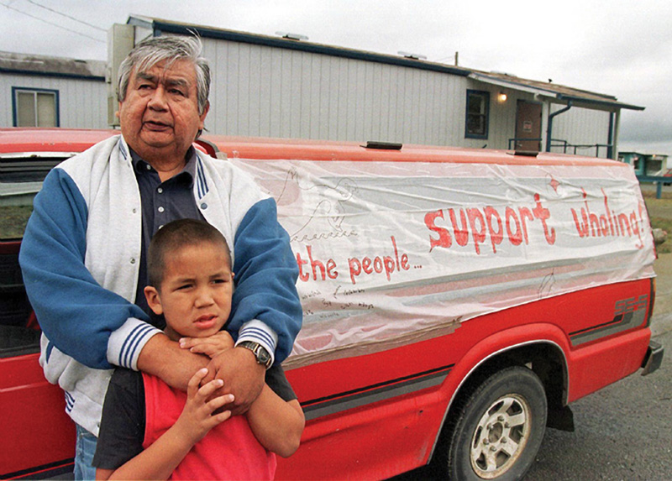
Local cultures are sustained by maintaining customs.
Custom:
a practice that a group of people routinely follows.

Slide 18
Went to court, backed by Bush administration
made legal to hunt, buy only with what popular culture deemed as humane (Green Peace, environmentalists said only using powerful guns so no suffering)

Slide 19
Little Sweden, USA
Little Sweden, USA
Lindsborg, Kansas- sell Swedish gifts to tourists & dress up in old Swedish clothes for parades
Neolocalism reinvigorating regional culture in response to uncertainty of the modern world
Similar to Helen, GA as well

Slide 20
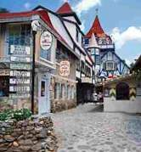
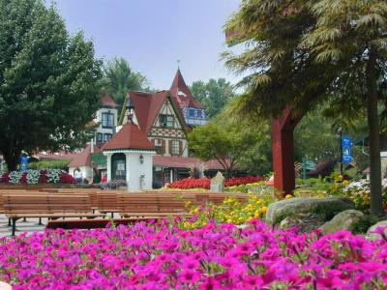
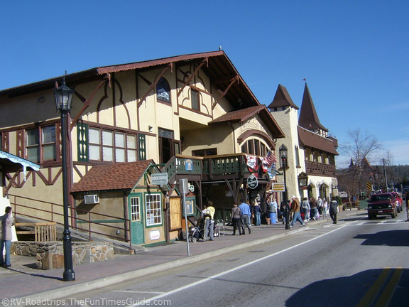
Helen, Georgia
Architectural styles seen in Helen, Georgia

Slide 21
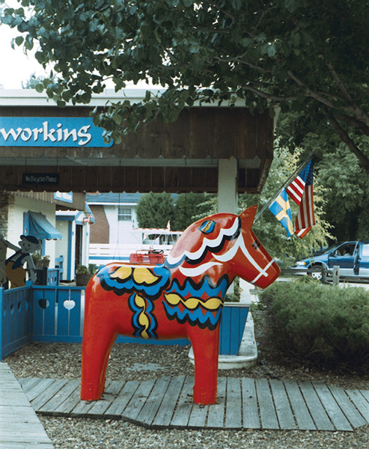
LittleSweden, USA (Lindsborg, Kansas): Is the Swedish Dala horse part of
material or nonmaterial culture?

Slide 22
Hutterites
Located in NW USA & SW Canada- local religion causes them to form their own schools, reject technology, dress in traditional clothes (much like Amish)
They adopt some technologies as long as it does not conflict w/their religion
Ex: use cooking devices (stoves, ovens) don’t use tv’s or radios (outside thought)

Slide 23
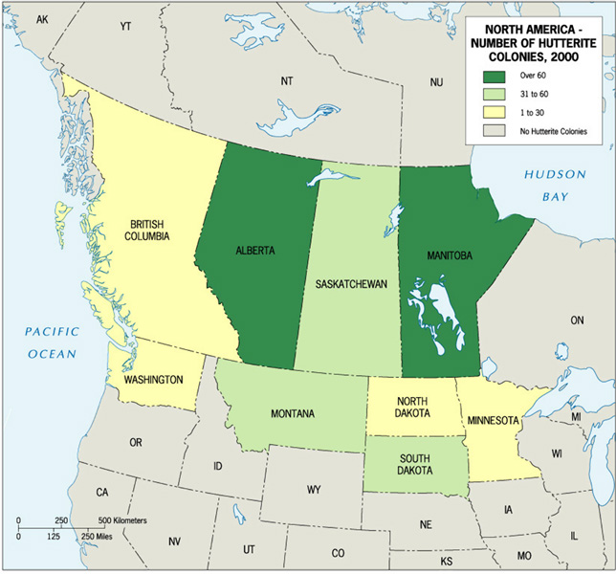
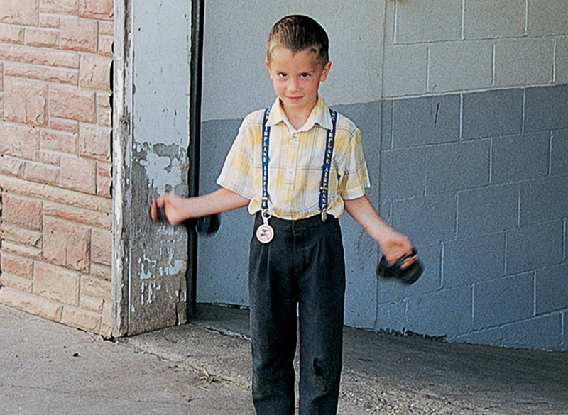
Hutterite Colonies
in North America
Are the Hutterites
an example of a
local culture?

Slide 24
Why are
Hutterite
colonies
located
where
they are?

Slide 25
Urban Local Cultures:
Usually found in tight knit ethnic neighborhoods- Italian Americans in the North End in Boston, Hasidic Jews in Brooklyn- able to maintain distinct local culture in urban environments
-migration of other groups to these cities is major threat to their local culture

Slide 26
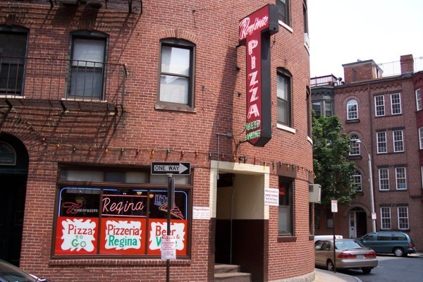
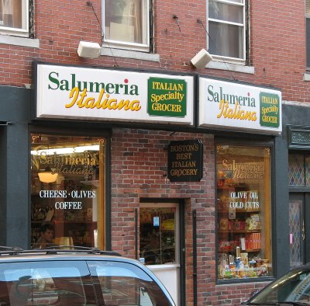
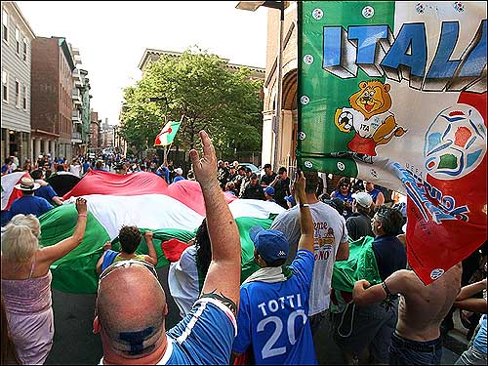
North End- Boston

Slide 27
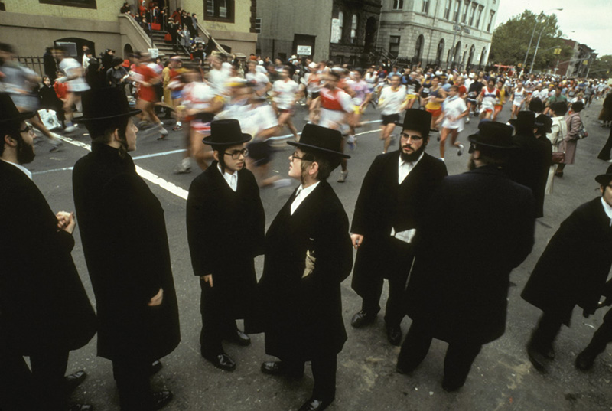
Runners of the NYC Marathon run through Williamsburg, (Brooklyn), NY

Slide 28
Local Cultures and Cultural Appropriation
Local cultures avoid giving their culture traits to others b/c often used for economic benefit for others
Commodification- something not thought of as being bought or sold becomes bought, sold, or traded
-go to ebay to get examples: person’s vote, toast looking like people
-other examples:
1. First sellers of food
2. An idea
3. Your body (prostitution)

Slide 29
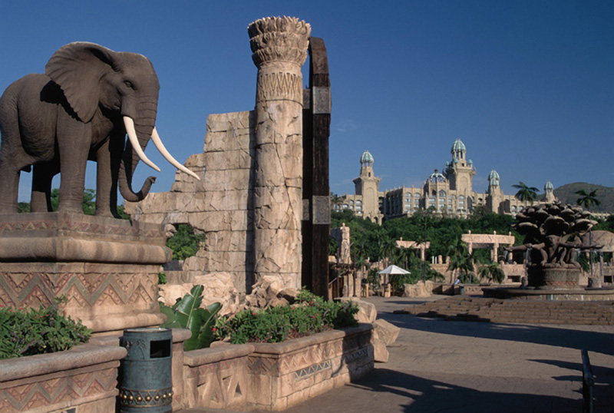
Commodification
How are aspects of local culture (material, non-material, place) commodified?
what is commodified?
who commodifies it?

Slide 30
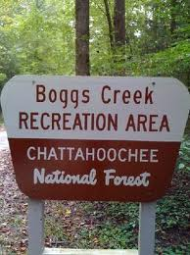
Authenticity of Places:
Authenticity- the originality of a place, lack of stereotypes, most desired by tourists
Ex: camping- want natural landscape, Boggs Creek- once totally natural landscape out in the woods – changed to paved sites w/hay for comfort and restrooms/showers provided, over fished- no longer authentic

Slide 31
Guinness and the Irish Pub:
Guinness was losing business, went global with Irish Pub Company
Created look of what a pub would look like 2000 years ago
Commodification froze local customs in time making the “authentic” pub culture something frozen in time, untouched by outside change or influence

Slide 32
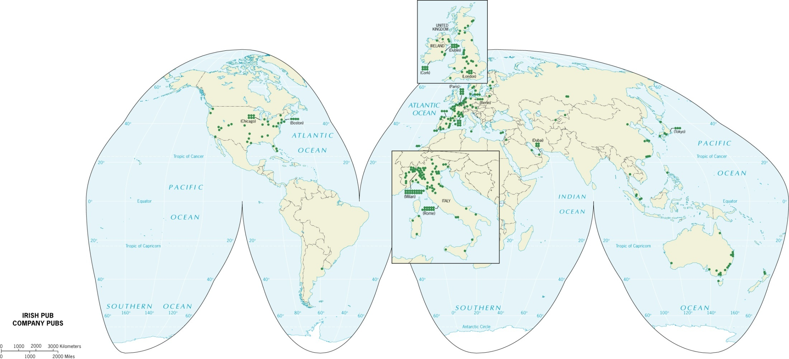
Irish Pub Company Pubs
Irish Pub Company and Guinness Brewing Company created 5 models of pubs and export them around the world.

Slide 33
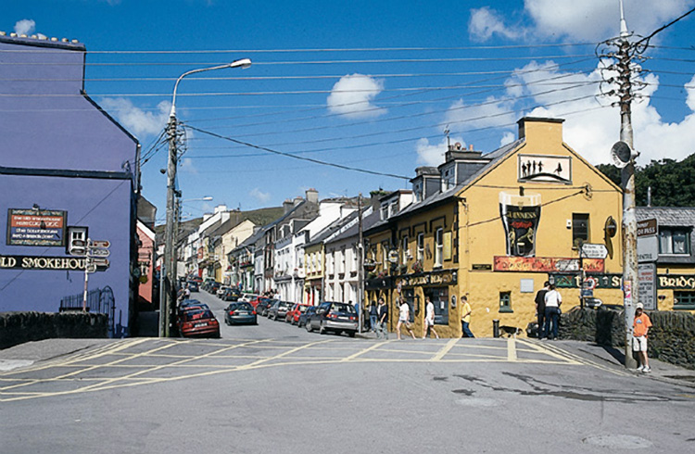
Little Bridge Pub in Dingle, Ireland (not an Irish Pub Company Pub)

Slide 34
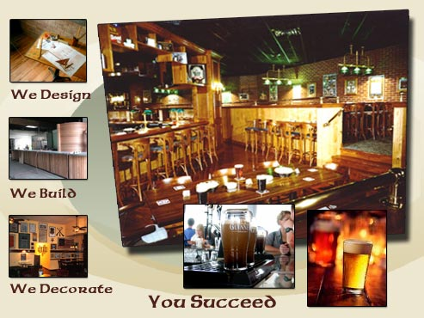
Irish Pub Company Decor

Slide 35
C. How is Popular Culture Diffused?
Transportation and communication devices have altered distance decay (further away from hearth, less chance of adoption)
This is replaced by time-space compression- interlinked places receive quickly, so less chance of adoption is with places w/out technology (fax machines, airplanes, email, telephone, etc) P. 113
Major world cities are closer while places that lack transportation and communication technologies are farther and less connected

Slide 36
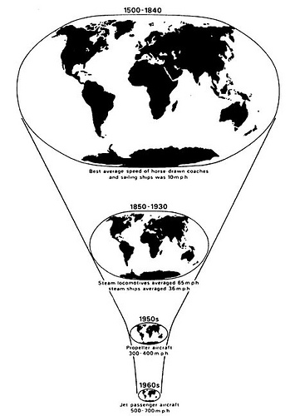
Effect of Innovations
Speed up diffusion
Transportation and communication have altered distance decay
Instead: Time-Space compression (see figures 4.11 top and bottom)
Internet, Twitter, Facebook, etc.
Major world cities are closer while places that lack transportation and communication technologies are farther and less connected

Slide 37
Diffusion of TV, 1954–1999
Fig. 4-14: Television has diffused widely since the 1950s, but some areas still have low numbers of TVs per population.

Slide 38
Distribution of Internet Hosts
Fig. 4-15: The U.S. had two-thirds of the world’s internet hosts in 2002. Diffusion of internet service is likely to follow the pattern of TV diffusion, but the rate of this diffusion may differ.

Slide 39
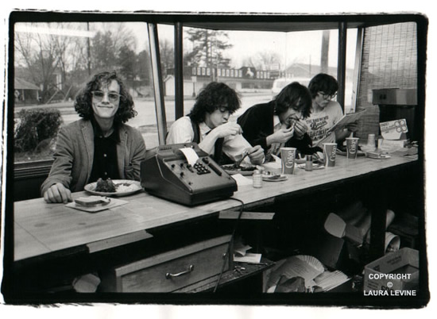
Hearths of Popular Culture
Diffuse hierarchically from hearth to interconnected places
Examples:
Bands: REM, Widespread Panic, Phish
Start in college towns, diffuse to other college towns, before going to larger cities
May also diffuse relocationally with fans
MTV, marketing agencies manufacture a hearth
“Merchants of Cool”

Slide 40
Manufacturing a Hearth
Sometimes localities practice reterritorialization or produce their own aspect of popular culture, making it their own
Ex: hip hop- began in inner cities of New York & LA
Terms used by US rappers are imported into the hip hop of other countries
Each country adapted hip hop and changed it to rap about different issues in their own countries

Slide 41
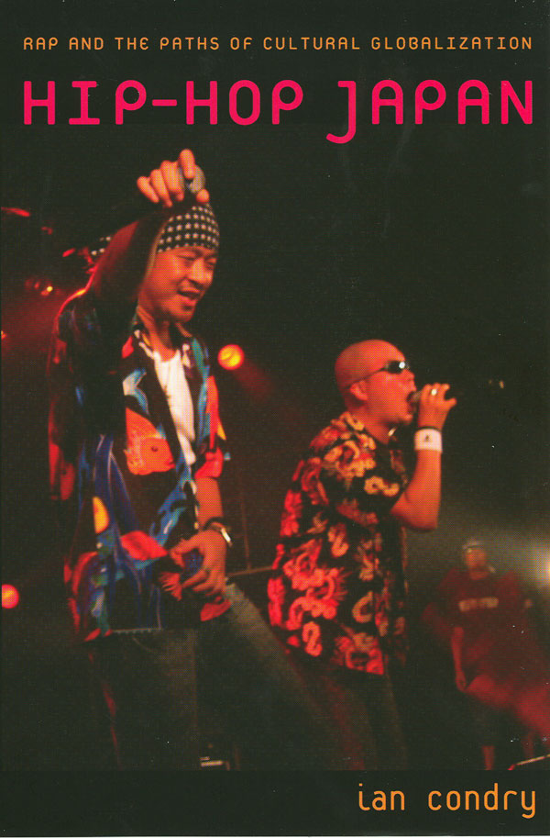
Reterritorialization
Definition?
Examples: Hip Hop in other areas
Listen to US hip hop from LA, Atlanta, NYC, Detroit, then create their own style – becomes another hearth
Also, German Rap

Slide 42
Replacing Old Hearths with New
Big 3 sports in US are : Football, Baseball, Basketball
b/c of popular culture shifts & video games (Tony Hawk), skateboarding beat out baseball for people under the age of 18

Slide 43
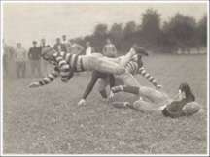
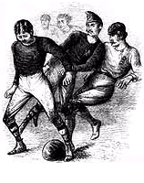
Replacing Old Hearths with New
Baseball, football & basketball
Diffused by transportation, communication & institutionalization
Railroad, telegraph, newspapers, electricity, organizations like NFL

Slide 44
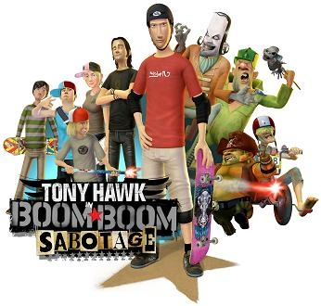
Replacing Old Hearths with New
Extreme sports (surfing, skateboarding, snowboarding)
Diffused through marketing, TV, Internet
Tony Hawk (icon) – ESPN, video games, Frito Lay (sponsors)

Slide 45
Losing the Local??
Concerns that USA, Japan, Britain may dominate world culture through cultural homogenization
Most tv programs, video games, sports, fast food, art, fashion come from these countries
French counter this by making laws:
40% of on air time must be French (radio)

Slide 46
D. How can Cultures be seen in Cultural Landscape?
Cultural Landscape- the visible imprint of human activity on the landscape
Reflects the values, norms, and resources of a people
Crosses on church, cemetery for buried dead represent Christians
Placelessness- loss of uniqueness of a place (all suburbs look the same)
North America towns & suburbs: big box stores, gas stations, restaurants
Global Local Continuum- notion that says what happens on one scale is not independent of what happens at other scales- McDonalds in every country??? How did that happen?

Slide 47
Housing can reveal much about a culture and a region:
Building materials available
Social and economic needs of occupants
Cultural traditions
The environment that the house must withstand
Style of the house can be regional
Function of the house can reveal social values and economic needs

Slide 48
House Types in Western China
Fig. 4-8: Four communities in western China all have distinctive house types.

Slide 49
Changing Residential Traditions
4 Categories:
1) Unchanged Traditional Dwelling
Houses whose layout, construction and appearance have not been altered by external influences over the past century
Examples:
Log houses with sod roofs in Scandinavia
Single story stone houses with thatched roofs in Ireland
In the US:
New England style- “saltbox”-wood frame similar to those in colonial times
Middle Atlantic Style- Log cabin with a fireplace
South “Southern Tidewater” one story with a porch

Slide 50
2) Modified- Traditional dwelling
New building materials used or additions that do not really alter their original structure or layout
Example:
Use of corrugated iron as roofing material instead of a thatched room
In African houses- adding windows so smoke from fire can escape
Raising the floor to decrease moisture in the building

Slide 51
3) modernized traditional dwellings
The modifications are more extreme, involving not only building materials but a floor plan and layout
Example-
Adding bathrooms, 2 car garage

Slide 52
4) Modern Dwellings
Most common in the US
Reflects advanced technology, wealth, practicality, comfort, hygiene, and suburbanization
Often not as stylish but modern conveniences make up for it
What are typical “modern” features in the US home?

Slide 53
U.S. House Types, 1945–1990
Fig. 4-11: Several variations of the “modern style” were dominant from the 1940s into the 1970s. Since then, “neo-eclectic” styles have become the dominant type of house construction in the U.S.

Slide 54
U.S. House Types by Region
Fig. 4-1-1: Small towns in different regions of the eastern U.S. have different combinations of five main house types.

Slide 55
Diffusion of House Types
When people move, they take with them ideas about how a home should be built
Depending on environmental conditions, changes may be made to develop a new style
Fred Kniffen- researched house types and their diffusion in North America
Ranch House developed in California and made its way back east across country
Draw and label the three house types on p. 121 & the diffusion route on p. 122

Slide 56
Diffusion of House Types in U.S.
Fig. 4-9: Distinct house types originated in three main source areas in the U.S. and then diffused into the interior as migrants moved west.

Slide 57
Diffusion of New England House Types
Fig. 4-10: Four main New England house types of the eighteenth and nineteenth centuries diffused westward as settlers migrated.

