Slide 1
Darwin’s Theory of Evolution

Slide 2
Important vocabulary
Evolution
change over time, the process by which modern organisms have descended from ancient organisms
Theory
well-supported testable explanation of phenomena that occur in the natural world

Slide 3
Who was Charles Darwin?
born on 12th February 1809
in Shrewsbury, England.
His observations and ideas helped to change the world
He studied a variety of life forms in an effort to explain how organisms change over time
* also known as the father of evolution

Slide 4
Darwin on the HMS Beagle
After completing college Darwin was invited to join the crew of the H.M.S. Beagle
Darwin’s role on the ship was as naturalist and companion to the captain
His job was to collect biological and geological specimens during the ship’s travel.

Slide 5
Galapagos Islands
Charles Darwin arrived in the Galapagos, a group of volcanic islands off the coast of Ecuador, South America in 1835.
The observations Darwin made during his visit were to be influential in the formation of his scientific theories.

Slide 6
The Galapagos Islands
Charles Darwin arrived in the Galapagos, a group of volcanic islands off the coast of Ecuador, South America on 15th September 1835.
The observations Darwin made during his visit were to be influential in the formation of his scientific theories.
Darwin began to collect mockingbirds, finches, and other animals on the four islands.
He noticed that the different islands seemed to have their own, slightly different varieties of animals.
As well his observations on the species on the islands, Darwin also wrote descriptions of the geography and geology of each island in his diary.

Slide 7
Darwin’s Observations
Almost every specimen that Darwin had collected on the islands was new to European scientists.

Slide 8
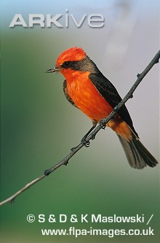
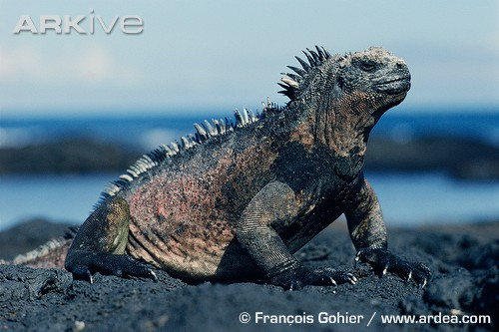
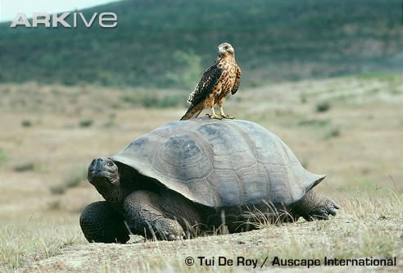
Variety is the spice of life
Vermillion flycatcher
Galapagos marine iguana Galapagos hawk perched on Galapagos giant tortoise
Galapagos marine iguana
Galapagos hawk perched on Galapagos giant tortoise
Vermillion flycatcher

Slide 9
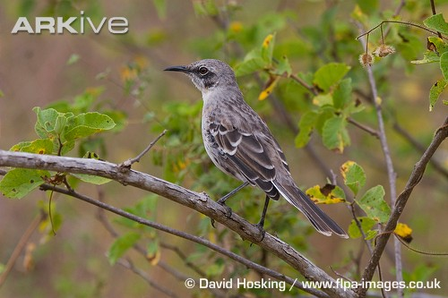
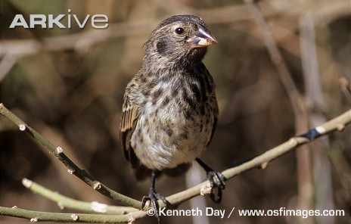
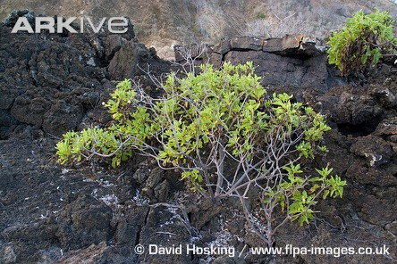
Darwin observed that each island had its own unique mixture of plants and animals. These were often adapted to survive in the different conditions found on each island.
San Cristobal mockingbird – only found on San Cristóbal
Medium tree-finch – only found on Floreana
Daisy tree Scalesia divisa – only found on San Cristóbal

Slide 10
Darwin’s Finches
Darwin’s finches
Darwin made detailed studies of one group of birds, the finches, because of their strong similarities and subtle differences.
He noticed that the different finch species varied in size, beak size and shape, and behaviour. He thought that these differences could be best explained if the finches had gradually become adapted to suit the conditions on the island they inhabited.
He presumed therefore that all 13 species of finch found on the islands must be closely related.
He also deduced that the individuals with the best set of adaptations for each island’s habitat would be most likely to survive and breed.

Slide 11
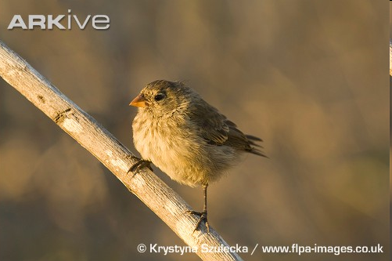
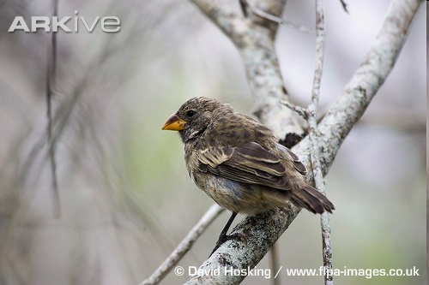
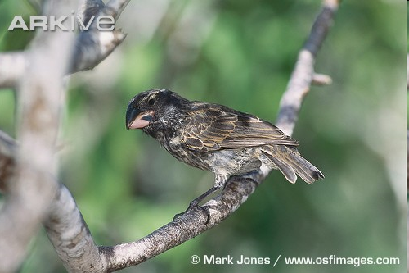
Darwin’s finches

Slide 12
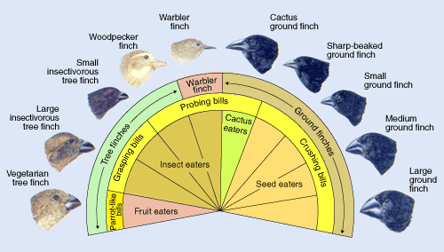

Slide 13
Evolution
Darwin Continued His Studies
Darwin hypothesized that new species could appear gradually through small changes in ancestral species.
Darwin inferred that if humans could change species by artificial selection, then perhaps the same process could work in nature.

Slide 14
Natural Selection
Evolution
The mechanism for change in populations
Individuals in a population show variations.
Variations can be inherited.
Organisms have more offspring than can survive on available resources.
Variations that increase reproductive success will have a greater chance of being passed on.

Slide 16
Evolution
Darwin’s theory of natural selection is not synonymous with evolution.
It is a means of explaining how evolution works.

Slide 17
Who influenced Darwin?
James Hutton (1785) – Proposed that Earth was shaped by geological forces that took place over extremely long periods of time. He estimated the Earth to be millions of years old. He wrote the "Theory of the Earth“.
Thomas Malthus (1798) – The human population was growing faster than the space and food needed to provide for it. Natural disasters and forces of nature would solve the problem.
Jean-Baptiste Lamarck (1809) – principle of use and disuse

Slide 18
Use and disuse in giraffe necks
Example:
A giraffe acquired its long neck because its ancestor stretched higher and higher into the trees to reach leaves, and that the animal’s increasingly lengthened neck was passed on to its offspring.

Slide 19
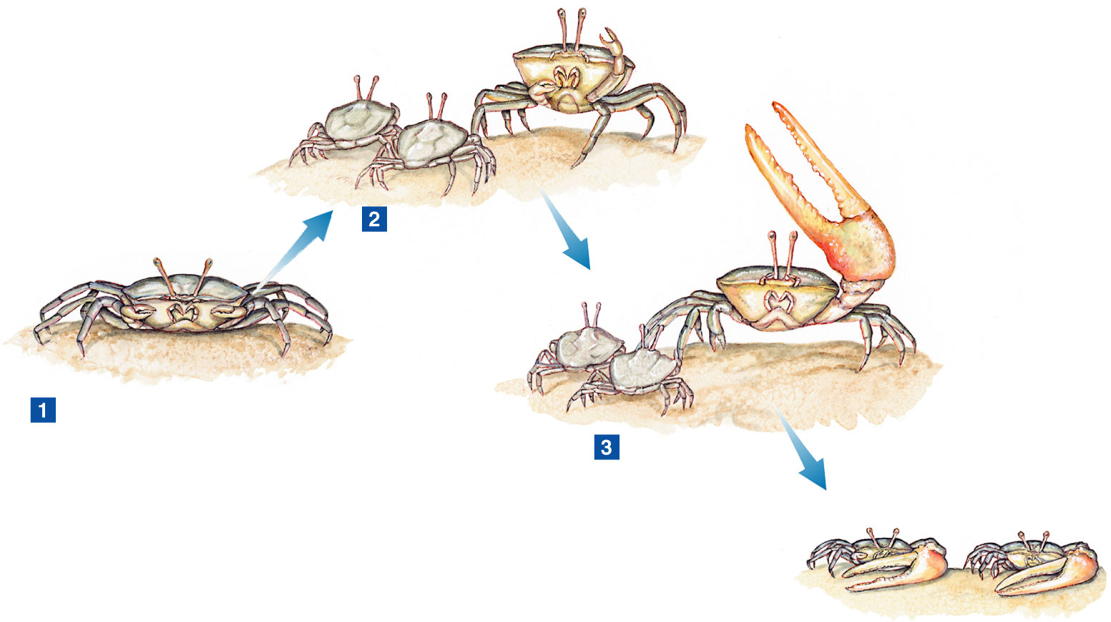
Structures will change and “grow”or disappear be simply using or dis-using them

Slide 20
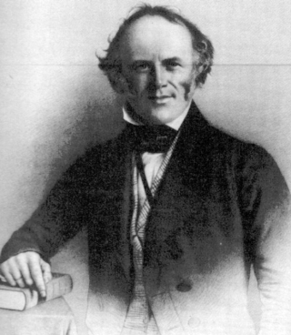
Who influenced Darwin?
Charles Lyell (1833) – Wrote Principles of Geology, made Darwin ask himself:
“If the earth can change over time, then why can’t the things on it?”
“ It must have taken life many, many years to change.”

Slide 21
Natural Selection
Charles Darwin developed his theory of evolution by natural selection using four important observations which led him to two deductions.
Observations:
1. All organisms produce more offspring than survive to adulthood
2. Populations remain more or less constant in numbers
3. Members of the same species show variation in characteristics
4. Some characteristics are inherited and so are passed on to the next generation
Deductions:
A. All organisms are involved in a struggle for survival and only the best adapted survive
B. Organisms that survive are more likely to reproduce, and therefore pass on their useful adaptations to their offspring

Slide 22
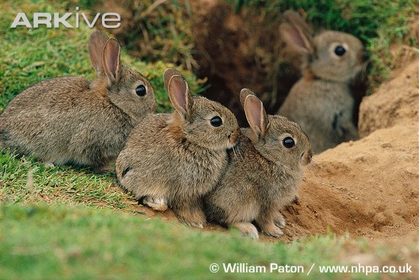
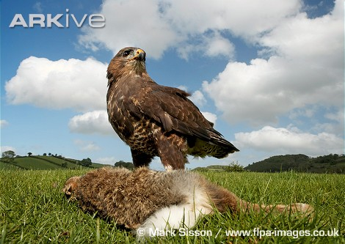
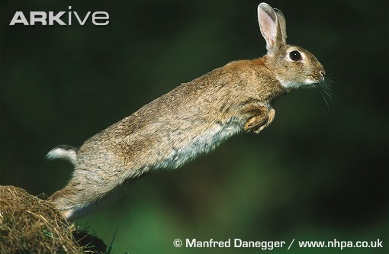
Observations
1. All organisms produce more offspring than survive to adulthood
One of Darwin’s first observations was that all living things are capable of producing more offspring than are needed to replace their parents. For example a female rabbit can produce up to seven kittens in a litter, but they don’t all survive to become adults.
Notes:
Could there be a series of questions relating to Darwin’s observations and conclusions, what could have led him to his conclusions?
What factors determine the number of organisms that survive to adulthood – predation, disease, competition etc

Slide 23
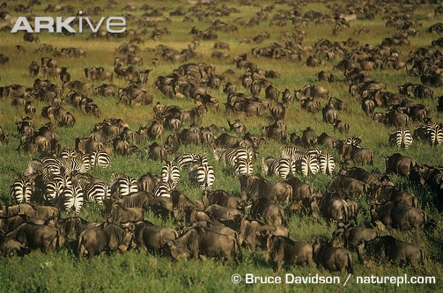
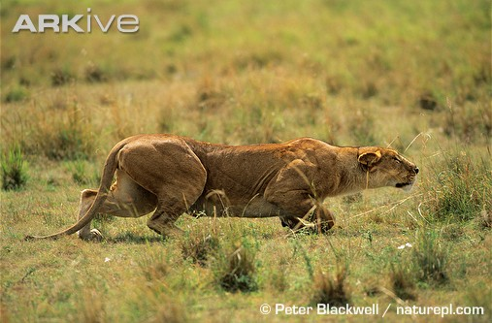
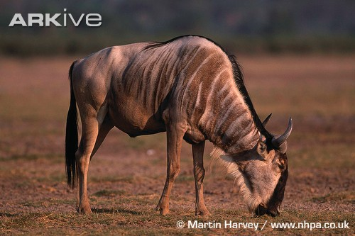
Observations
2. Populations remain more or less constant in numbers
Darwin’s second observation was that the numbers of many different species of animals and plants tend to stay fairly constant over long periods of time.
For example, herds of many animals live on the plains of Africa, wildebeest, zebra, gazelles etc. Each year many of the females give birth to young, but the overall population sizes of these species stay the same.
There are a number of factors which keep the population numbers stable, including competition for food, predation and disease

Slide 24
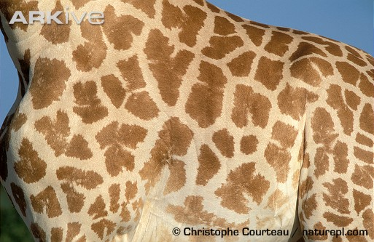
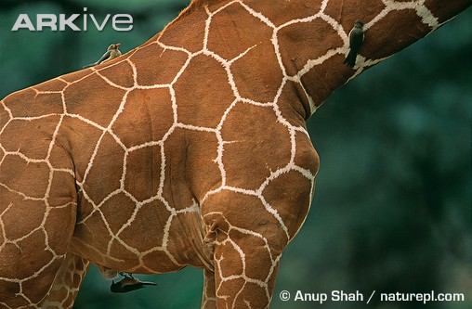
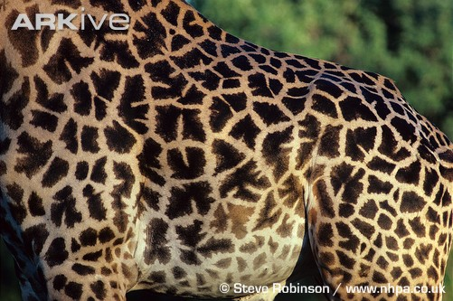
Observations
3. Members of the same species show variation in characteristics
Darwin’s third observation was that all living things vary slightly in colour, shape, size or behaviour.
Below are three different colourings and skin patterns found in the giraffe.
West African giraffe
Reticulated giraffe
Thornicroft’s giraffe
Notes:
Could have more examples of variation – if we can think of some

Slide 25
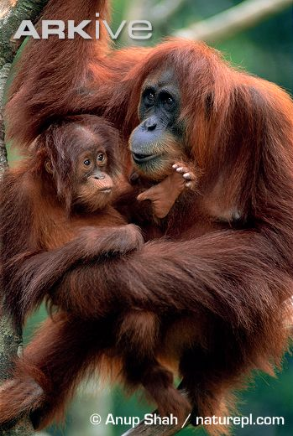
Observations
4. Some characteristics are inherited and so passed on to the next generation
Darwin’s fourth observation was that many features are passed on from parent to offspring.
Some inherited characteristics are quite easy to see in humans:
Eye color
Hair color
Some are not so easy to see:
Blood group

Slide 26
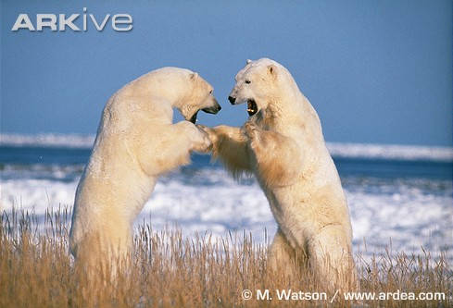
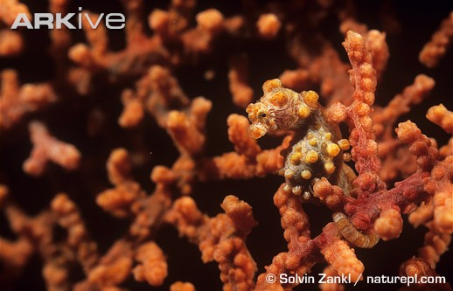
Conclusions
From his four observations Darwin was able to deduce two main conclusions.
A. All organisms are involved in a struggle for survival. B. Some individuals are better adapted to their environment than others.
Polar bears fighting
Pygmy seahorse camouflaged against fan coral

Slide 27
How Evolution Occurs Through Natural Selection?
Struggle for Existence - Members of each species compete regularly to obtain food, living space and other necessities of life.
Survival of the “Fittest” – Fitness results from adaptations that give an organism advantages for survival. The most “fit” organisms will survive and reproduce; passing along the advantageous characteristics to their offspring. These changes are usually only be seen after many generations!
Descent with Modification – As organisms change over time; they become different, resulting in many varied species. This illustrates “common descent.” All living things have a common ancestor.

Slide 28
Darwin's explanation of evolution…..
Natural Variation:
- differences among individuals of a species
- found in all types of organisms
Artificial Selection:
- selection by humans for breeding of useful traits from the natural variation among different organisms.
-

Slide 29
What makes an organism better fit then others in the population?
ADAPTATIONS
What is an adaptation?
An adaptation is an inherited trait that makes an organism better able to survive in a certain environment
There are three types of adaptations
Structural adaptations
Physiological adaptations
Behavioral adaptations

Slide 30
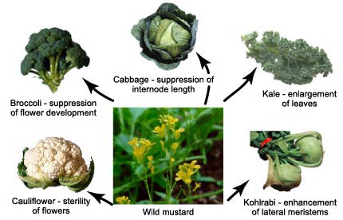

Slide 31
Structural Adaptations
Structural adaptations – structural traits that make an organism better able to live in a certain environment
Example: the shape and size of a bird’s beak, human hand opposable thumbs

Slide 32
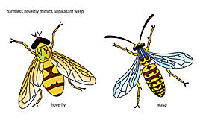
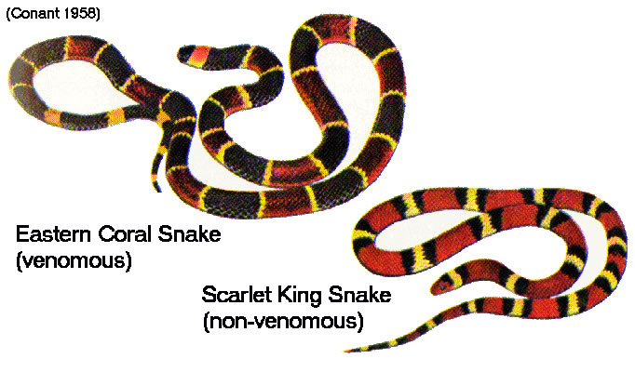
More Structural Adaptations…
Mimicry- a harmless species resembles a harmful one, predators learn to avoid both species

Slide 33
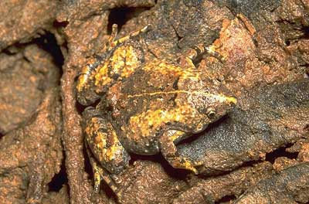
More Structural Adaptations…
Camouflage- species features blend in with the environment

Slide 34
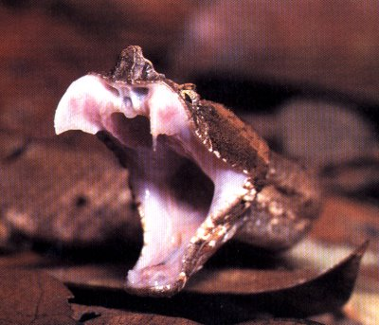
Types of Adaptations
Physiological adaptations – adaptations that involve the metabolic processes of an organism
Example: venom in snakes

Slide 35
More Physiological Adaptations
Octopus Ink

Slide 36
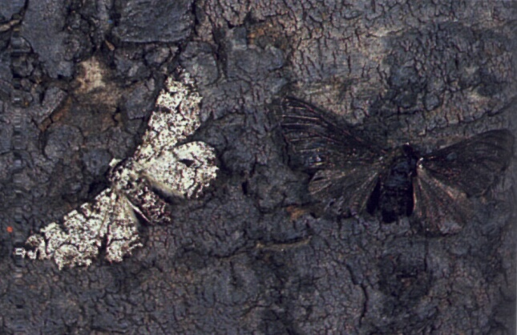
Peppered moths before & after the industrial revolution
This is an example of Industrial Melanism

Slide 37
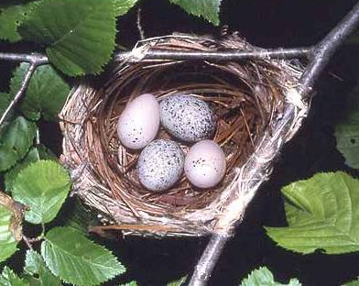
Types of Adaptations
Behavioral Adaptations – adaptations in responses to the environment
Example: nest building in birds

Slide 38
Behavioral Adaptations
Hibernation in the winter

Slide 39
What type of adaptation is this?

Slide 40
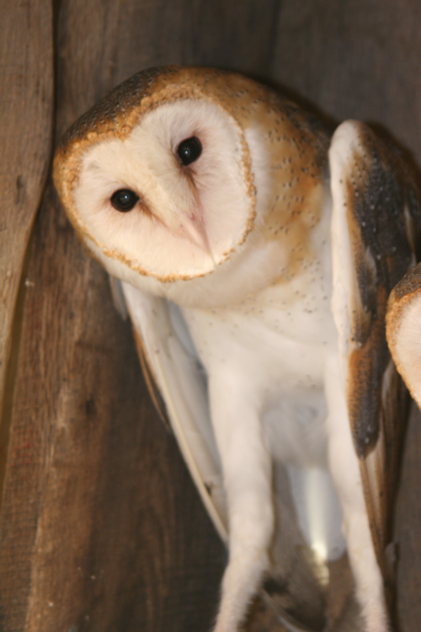
What type of adaptation is this?

Slide 41
What type of adaptation is this?

Slide 42
What type of adaptation is this?

Slide 43
What type of adaptation is this?

Slide 44
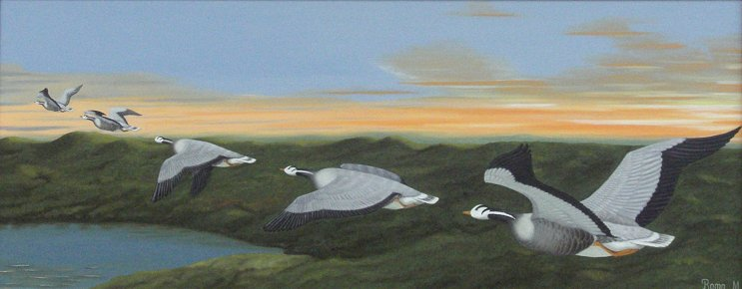
What type of adaptation is this?
Migration of Birds

Slide 45
Types of Natural Selection in a Population
Natural selection can affect the distribution of phenotypes in any of three ways.
1. Directional Selection
2. Stabilizing Selection
3. Disruptive Selection

Slide 46
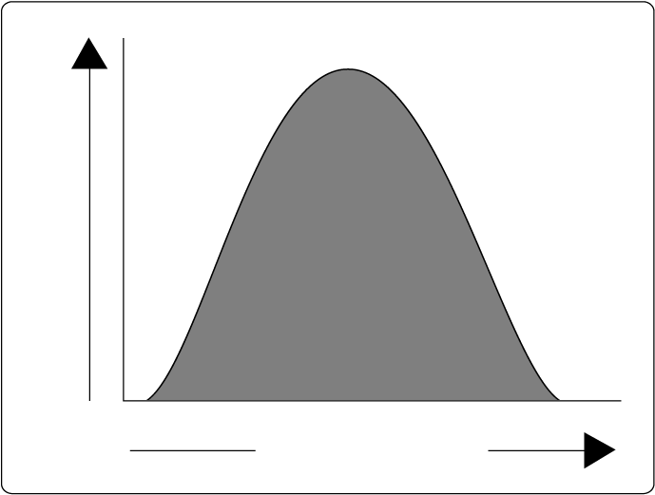
Normal Distribution of a Phenotype in a Population with random variation
Most of the population falls within the bell curve with some exhibiting the two extreme traits
Frequency of Phenotype
Phenotype (height)

Slide 47
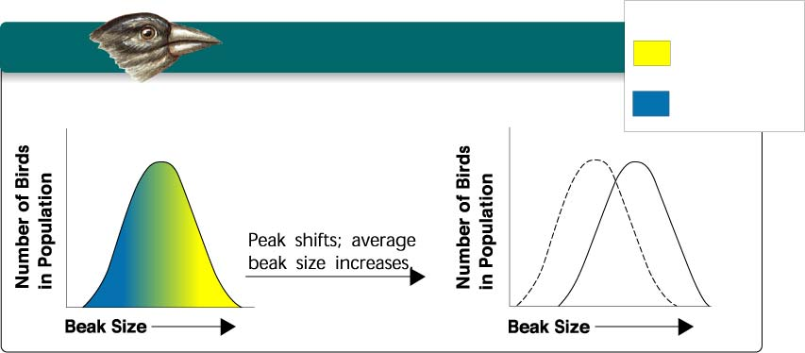
Directional Selection
Individuals at one end of the curve have higher fitness than individuals in the middle or at the other end.
Key
Directional Selection
Low mortality, high fitness
Food becomes scarce.
High mortality, low fitness

Slide 48
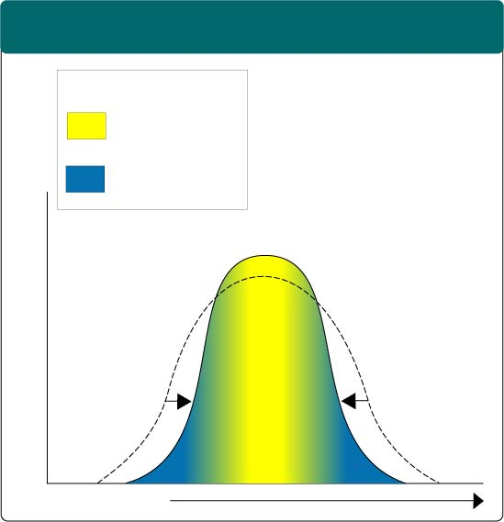
Stabilizing Selection
Individuals near the center of the curve have higher fitness than individuals at either end of the curve
Stabilizing Selection
Key
Low mortality, high fitness
High mortality, low fitness
Selection against both extremes keep curve narrow and in same place.
Percentage of Population
Birth Weight

Slide 49
Disruptive Selection
Individuals at the upper and lower ends of the curve have higher fitness than individuals near the middle.

Slide 50
Name the selection type

