Slide 1
THE ODYSSEY
BY
HOMER
The epic poem of a hero’s journey… yet to be rivaled by modern man!

Slide 2
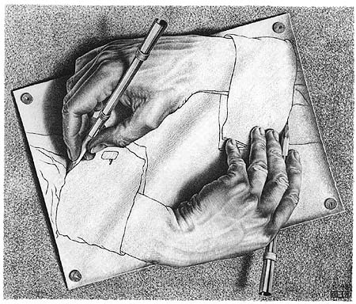
Archetype
Archetypes (Gk. arche = first + typos = mold) are universal, instinctive patterns or images from ancient myths and stories that are originals (prototypes) for all similar patterns and images since.
Archetypes exist in humans’ collective unconscious.
In literature, archetypes are symbols, settings, story structures, or character types that recur in different times and places, suggesting that they embody some universal human experience
Jung believed we can study archetypes to try to understand the human psyche.

Slide 3
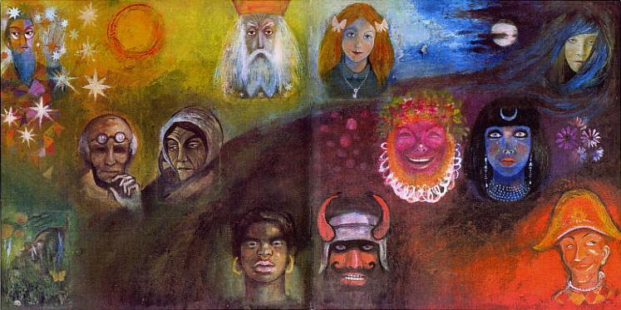
Examples of Character Archetypes
The temptress
The warrior
The trickster
The guide
The sage
The wicked stepmother
The embodiment of evil
The mother figure
The damsel in distress
The underdog
The innocent or naïve one
The villain

Slide 4
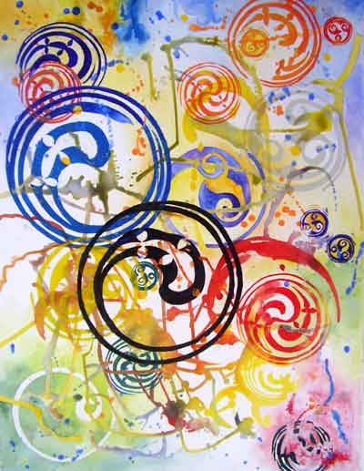
Examples of Pattern Archetypes
Hero’s quest
Journey to hell and back
Transformation from child to adult
Rags to riches
Triumph over evil
Guy gets girl
Fall from grace
Avoidance of temptation
  Etc.

Slide 5
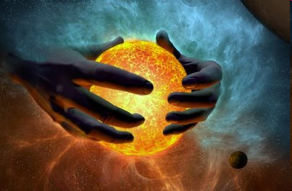
Archetype Example #1: The Creation Myth
One common archetype is the creation myth.
Creation myths are in every culture, throughout every time period.
Examples? Adam and Eve story, Greek beginning of the world, even the Big Bang Theory!
Creation myths share many commonalities.

Slide 6
What is the difference?
Myth: a story humans created in order to explain something, like how the earth was made, why rain falls, why there is evil, etc.
Legend: an exaggerated story about a real-life character or event.
Fairytale or Folktale: a magical, improbable story told for fun, mostly intended for children
** Almost all cultures contain all three archetypes!

Slide 7
Archetype Example #2: The Monomythic Cycle
The monomyth is an archetype found in numerous tales around the world.
The monomyth describes a journey, metaphorical or literal.
Countless stories, ancient and modern, follow the monomythic cycle, including everything from the life of Jesus Christ and the Harry Potter series to Cinderella and the Bible tale of Moses.
The monomythic cycle is divided into three main parts: Departure, Initiation / Struggle, and Return. Also, the character always returns with a gift in the end.

Slide 8
Archetype Example #3: The Epic
Before we talk about what an epic is, we need to get some background on the one we’ll read in class: The Odyssey.

Slide 9
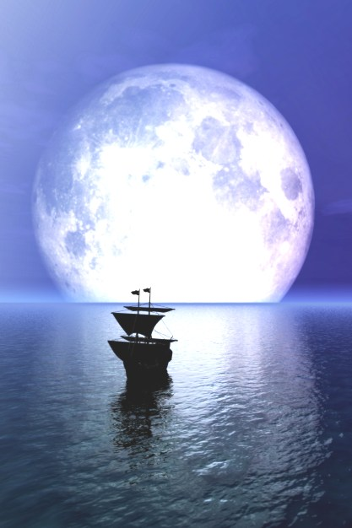
* The Epic
The Odyssey is an epic
Directions: as you listen to the oral definition of what an epic is, fill in the traits on the handout you have been given.
Actual Definition:
  Epic: A long narrative (story) that recounts the deeds of a larger-than-life hero who embodies the values of a particular society.

Slide 10
Some background . . .
After fighting in the Trojan War, the three great warriors Odysseus, Agamemnon, and Menelaus sailed home on different ships.
Agamemnon and Menelaus were brothers. They married two sisters: Klytemnestra and Helen (yes, the Helen that started the Trojan War).
When Agamemnon returned home, he was murdered by Agisthos, his wife Klytemnestra’s lover.
Agamemnon’s son, Orestes, then slew Agisthos.

Slide 11
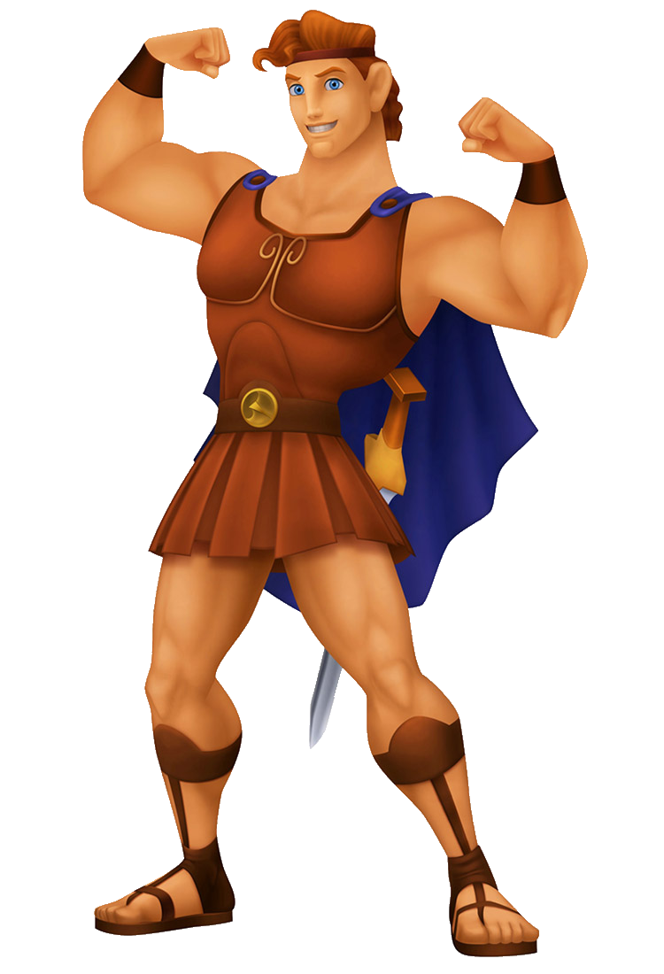
The Epic Hero
The Epic Hero:
a) has mysterious origins
b) has supernatural strength
c) is a mighty leader and superior
human
d) usually possesses a human
weakness
e) undergoes difficult challenges
but always conquers
f) represents the values of his or
her culture
* Not all traits match all epic heroes

Slide 12
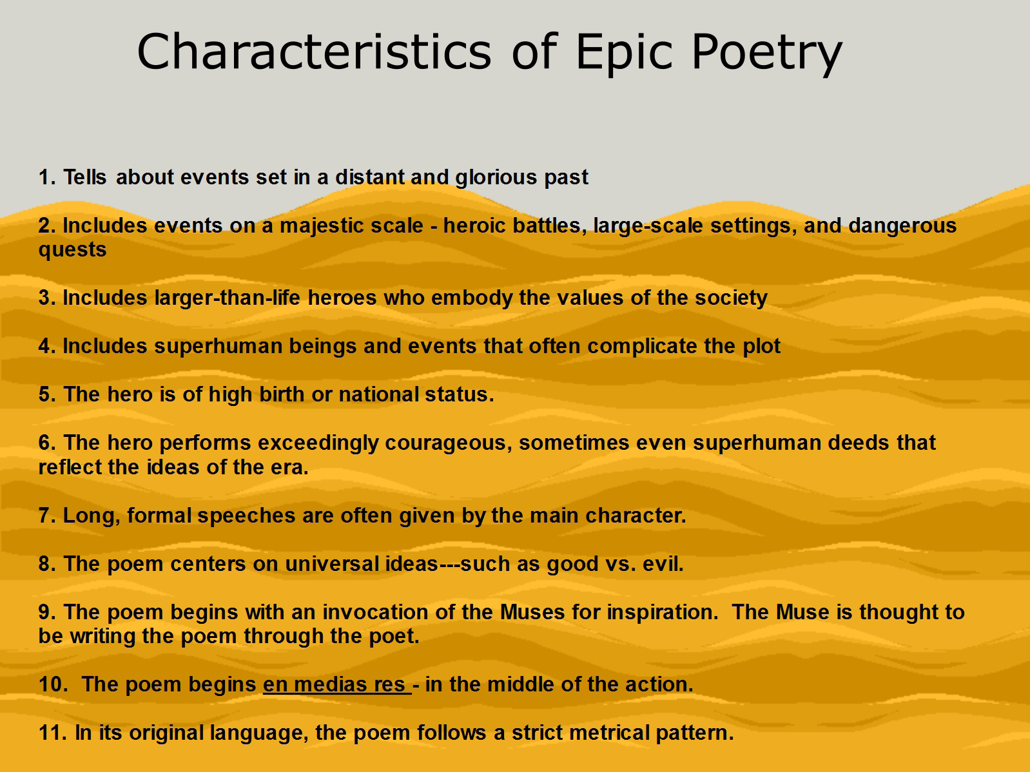

Slide 13
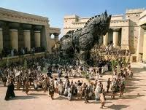
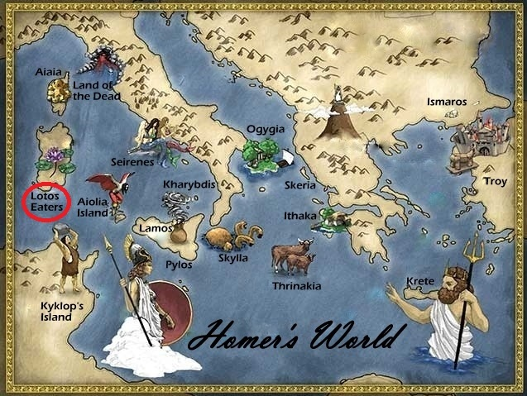
THE ODYSSEY COMES FROM HOMER’S
THE ILLIAD AND THE ODYSSEY
THE ILLIAD DEPICTS ODYSSEUS IN Troy during the TROJAN WAR …
THe ODYSSEY DEPICTS ODYSSEUS’ JOURNEY from Troy BACK HOME TO ITHACA

Slide 14
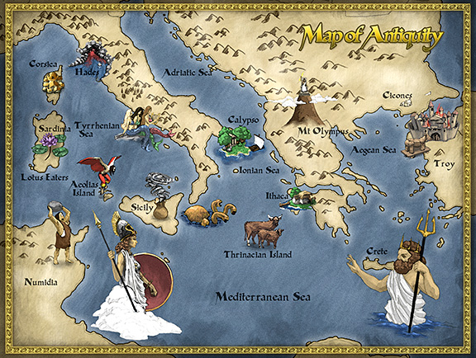

Slide 15
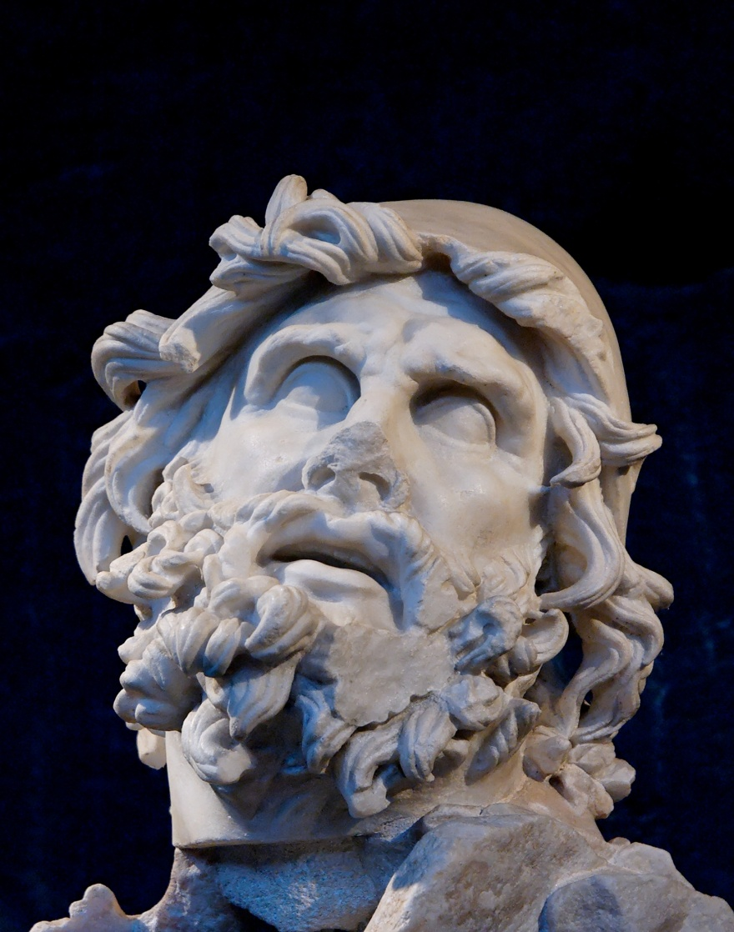
Style of The Odyssey
Tells the story of Odysseus on his nostos* (journey home).
Starts in medias res* (in the middle of things), different from ab ovo* (at the beginning), with Odysseus having been gone twenty years, leaving his wife and son to battle a bunch of suitors
* Latin or Greek term

Slide 16
* Pantheon of
Ancient Greece
Major Gods:
Zeus
Dionysus
Hermes
Poseidon
Apollo
Hephaestus
Ares
Hades
Major Goddesses:
Hera
Artemis
Aphrodite
Demeter
Athena

Slide 17
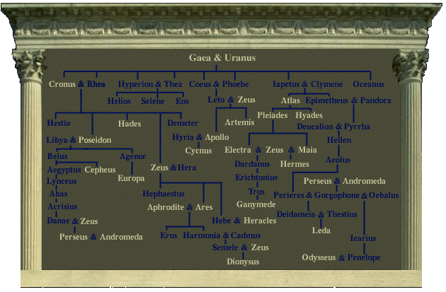

Slide 18
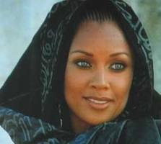
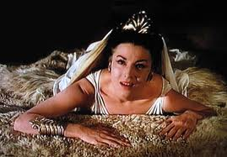
ODYSSEUS ENCOUNTERS …
CALYPSO – THE SEA GODDESS WHO LOVED him
CIRCE – THE WITCH THAT HELPED him

Slide 19
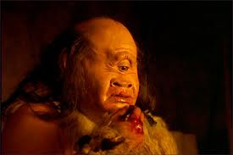
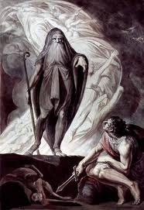
HE ALSO ENCOUNTERS…
THE CYCLOPS POLYPHEMUS … SON OF POSEIDON
THE BLIND PROPHET TIRESIAS IN THE LAND OF THE DEAD (HADES;HELL)

Slide 20
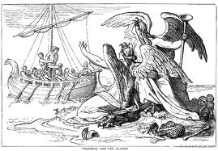
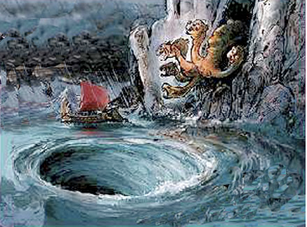
ODYSSEUS ENCOUNTERS …
THE SIRENS
SCYLLA AND CHARYBDIS

Slide 21
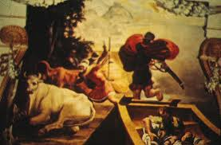
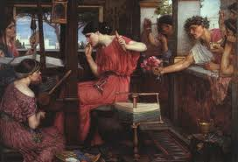
ODYSSEUS ENCOUNTERS
THE CATTLE OF THE SUN GOD (HELOIS)
PENELOPE’S SUITORS

Slide 22
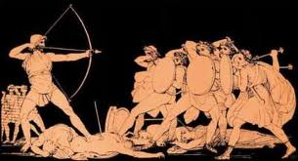
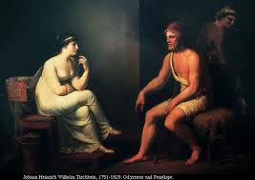
ODYSSEUS ENCOUNTERS
HIS REVENGE
AND, FINALLY PASSES PENELOPE’S TEST

Slide 23
* Literary Devices: Epithet
Epithet: a descriptive term accompanying or in place of a name.
  Examples from Book I:
    Lord of Olympos (I:81) = Zeus
    The gre-eyed goddess (I:221) = Athena
    The red-haired king at Sparta (I:330-331) = Menelaos
    The nymph with pretty braids (I:111) = Kalypso

Slide 24
* Foil
Foil: a foil character is one that contrasts specifically with another (often the protagonist) in order to highlight particular qualities of that person. Usually, the main antagonist is not a foil for a protagonist.
Examples:
  Watson is a foil for Sherlock Holmes
  Tom Sawyer and Huck Finn are foils for one another
  Can you think of others?

Slide 25
Literary Devices: * The Epic Simile
Simile: a comparison between two things, saying one thing is like or similar to another
  Example: Hermes flew like a bird to see Calypso.
Epic Simile: a simile that meets the above definition but that carries on for several lines, delineates how those two things are alike.
  Example: V:381, V:411, V:451, V:513
  Later Examples: X: 456, XII:324, XIII:39, XIII:100, XV: 214, XVI: 23, XVI: 253

Slide 26
* Literary Devices: Allusion
An allusion is a casual reference to something or someone from history or literature.
  There are so many allusions to mythological characters and events throughout The Odyssey that they are almost too difficult to count!
  For homework, complete the Allusion Phrases worksheet.

