Slide 1
NHS Advanced Classes: Advanced Preparation for the Future

Slide 2
Why has college admission become so competitive?
1995 2.5 million graduates
2015 3.2 million graduates
Numbers are projected to stay at or above 3.2 million at least until 2022.
Children of the Baby Boom generation known as the “echo boomers” or the Millennials, are part of the largest group of high school graduates ever.

Slide 3
Course Selection Factors
Goal #1—Graduate from High School
Goal #2—Admission to College of Choice
Goal #3—Earn College credit while still in high school
Strong GPA
Rigorous Course Selection
Well Rounded Student
Strong SAT or ACT Scores

Slide 4
Colleges are looking for more than a 4.0 when admitting students
University of Georgia’s Admissions Office:
“While GPA is the most important factor in the admissions process, rigor of curriculum is a close second. We expect students to take advantage of the most challenging courses offered at their high schools. It is possible that a student with a 4.0 GPA who has avoided the challenging courses offered at their high school may not be admitted while a student with a lower GPA who has attempted the most rigorous courses at their school is offered admission.”
Georgia Tech Admissions:
Considers GPA and rigor to be the top factors in determining admission and uses a weighted 4.0 grading scale. Awarding an extra .5 percentage points for each AP, IB, or college course a student has taken

Slide 5
What can a student do to earn an edge for college admissions?
Build a good academic record.
Hands down, the high-school record is most important element
Show the ability to earning high marks in demanding courses
Pursue competitive courses throughout high school.
Colleges/universities expect students to seek out a challenge co
All freshmen are expected to take an accelerated course
Be a serious student.
Good grades in demanding courses taken during the first semester of the senior year can make a vital difference
Do something that demonstrates leadership, creativity, initiative

Slide 6
How does UGA admissions office look at a student’s academic record?
GPA and rigor of curriculum weigh roughly three to two to standardized tests in predicting academic success
A student with a 4.0 GPA in a superior curriculum of Advanced Placement (AP) or International Baccalaureate (IB) courses might be admitted with an SAT score at or below 1000.
A student with a 3.0 GPA and an SAT score of 1400 might not be admitted, if the student opts for few if any Honors, AP or IB courses.
GPA's above a 4.00 include added weight for AP/IB grades.
94% of the 2015 freshmen completed either AP or IB classes
The average number of AP or IB courses taken by incoming freshmen were 6.

Slide 7
What is Georgia Tech looking for?
Average # of AP/IB/Dual Enrollment classes taken: 7-12

Slide 8
How pervasive are advanced classes at NHS?
School Year | AP/IB Courses | Sections | Total Student Seats
2012-13 | 54 | 123 | 2855
2013-14 | 42 | 152 | 2994
2014-15 | 50 | 179 | 3277
2015-16 | 50 | 227 | 4792

Slide 9
How many NHS students are currently taking advanced classes?
66%
50%
27%
7%

Slide 10
What do highly competitive colleges say about AP?
“One of the best standard predictors of academic success at Harvard is performance on Advanced Placement Examinations.”
—William R. Fitzsimmons Dean of Admissions, Harvard University
“AP Exams affirm the rigor of a student’s course work. Though admissions policies vary, if I were a student, I wouldn’t assume that the college of my dreams didn’t care about AP Exams in the admissions process.”
—Bruce Walker, Director of Admissions University of Texas at Austin

Slide 11
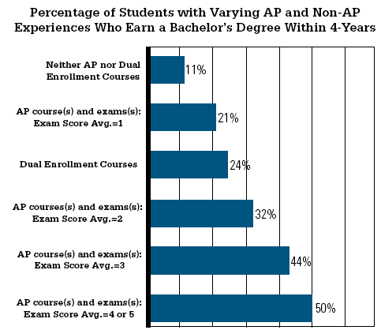
How is AP Beneficial?
AP courses help students acquire the skills and habits needed to be successful in college and life.
Students develop their study habits, organizational skills and academic discipline; time-management; conceptual, analytical, research, creative, and critical thinking skills; writing skills; and practical problem-solving abilities.
Notes:
Beginning course details and/or books/materials needed for a class/project.

Slide 12
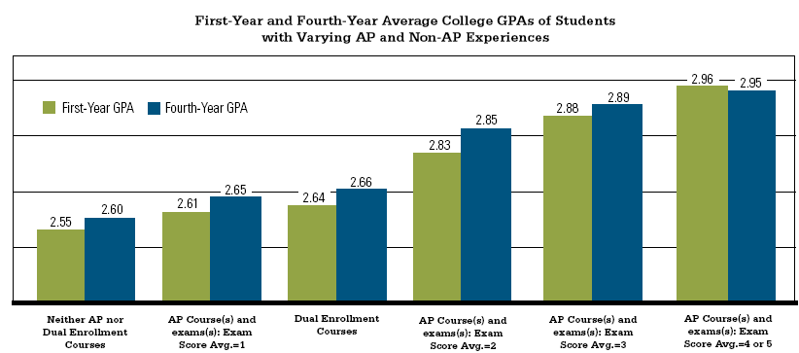
Prepares Students for College

Slide 13
What is an AP class like?
You don’t have to wait for college, because AP is college in a high school setting
You don’t just read about things, you get to learn how things really work
You not only learn by doing, but by sharing and speaking out
You’ll explore new ideas with your classmates and AP teachers
You find yourself doing things you never thought possible
http://apstudent.collegeboard.org/exploreap

Slide 14
What AP courses does NHS offer?
Language & Composition
Literature & Composition
Calculus AB
Calculus BC
Statistics
Biology
Chemistry
Computer Science
Physics I
Environmental Science
World History
US History
American Government
Macroeconomics
Psychology
French
Spanish
2D Design
3D Design
Drawing

Slide 15
How much does an AP exam cost?
There is an $92 fee for each AP Exam, which the College Board uses to:
1) develop, print, ship, and score the exams
2) subsidize teacher training
3) develop classroom resources
4) support educational initiatives
GCPS asks students to pay $10 for the first exam and $92 for each additional exam per year.

Slide 16
What is the IB Diploma Program?
Recognized as the “gold standard” for educational curriculum world-wide
Founded in 1968, IB Diploma Program now works with 3,968 schools in 147 countries
A high school diploma option that teaches the integration of knowledge, that expects community service, and seeks to instill an academic ethic

Slide 17
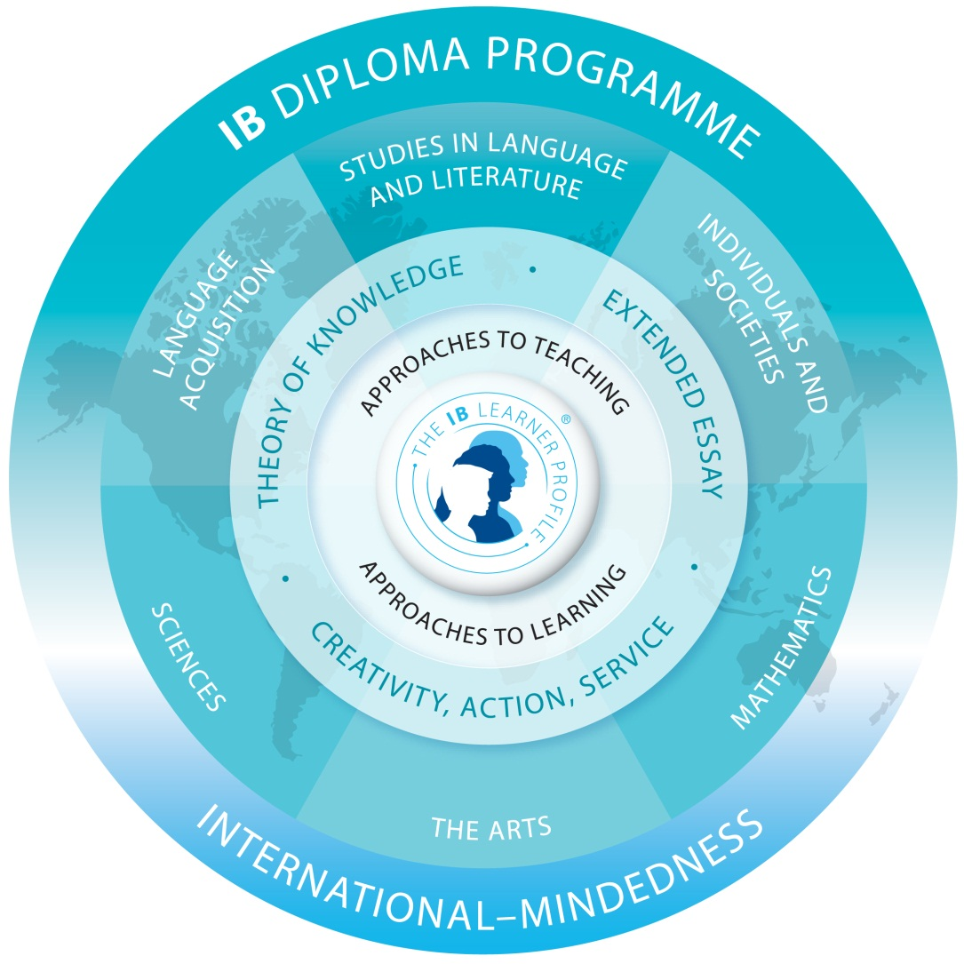
What is the IB Diploma curriculum?

Slide 18
What is an IB Course Candidate?
Student may choose to study in an area of strength only.
All IB requirements and assessments apply.
No Diploma is awarded, but an IB certificate is earned.
Course Candidates may take HL courses in the following areas: Language Arts, Modern and Classical Languages, History, Mathematics, Physics, and Visual Arts.

Slide 19
What IB courses are offered at NHS?
English Literature HL
Spanish HL/SL
French HL/SL
History of the Americas HL
Biology SL
Physics HL
Environmental Systems and Societies SL
Mathematics HL/SL
Visual Arts HL/SL
Music SL
Psychology SL
Sports Exercise and Health Science SL
Theory of Knowledge

Slide 20
The DP curriculum prepares students for college
A 2009 study looked at the standards for seven Diploma Programme courses and compared them to a set of standards for college-readiness.
Researchers found:
a high degree of alignment with college readiness standards in all subject areas
many individual IB standards were more advanced than those required for success in entry-level college courses
IB standards address key cognitive strategies (critical thinking, intellectual inquisitiveness and interpretation skills) that have been identified by college instructors as necessary for college success.

Slide 21
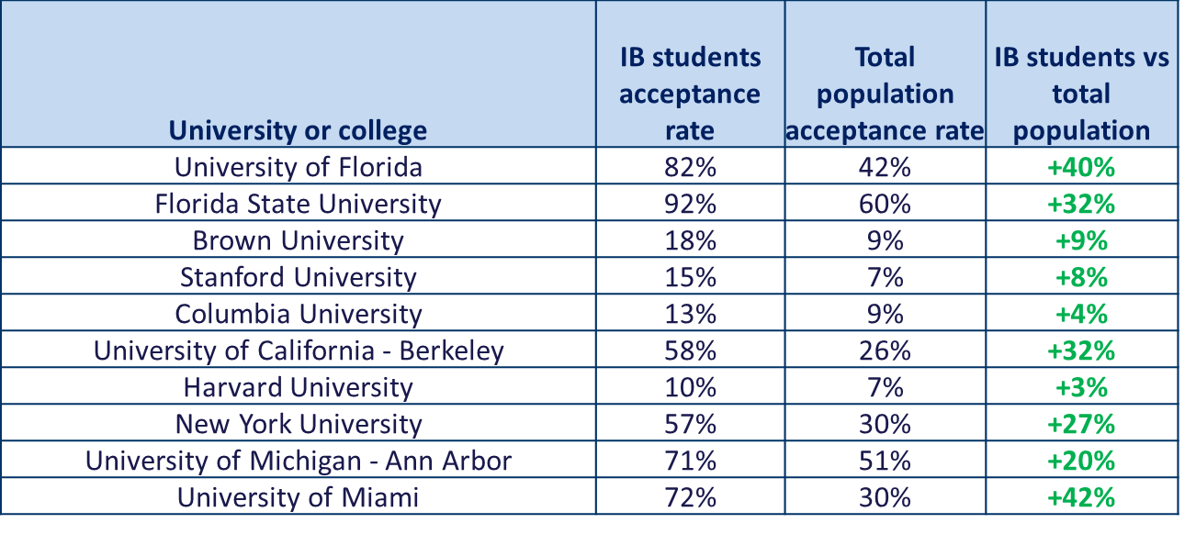
How does IB affect college acceptance rates?

Slide 22
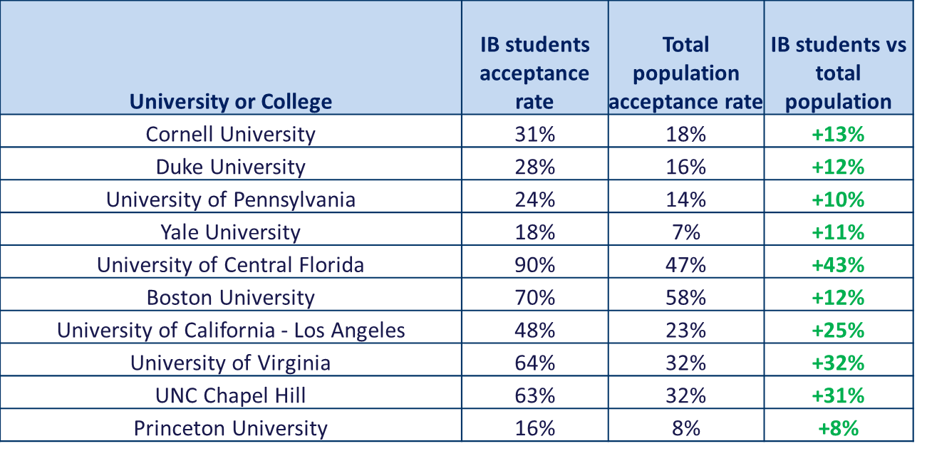
More IB acceptance rates . . .

Slide 23
Georgia Acceptance Rates
Georgia Tech accepted 32% of freshmen who applied in 2015.
The acceptance rate of IB students at Georgia Tech is 90%
The University of Georgia accepted 52.2% of freshmen who applied in 2015.
The acceptance rate of IB students at UGA is 82%

Slide 24
What do students report about IB and college preparation?
73% said writing skills developed in IB helped
60% said study skills developed in IB helped
47% said IB was harder than college
83% of respondents received advanced placement/credit
23 % received sophomore standing
36% of respondents who took AP tests took them with no preparation other than IB w/ 80% receiving >4 on AP tests
Analysis and Survey Design by Strategic Technology Solutions, Rich La Valley

Slide 25
How much does an IB course cost a student?
At this time, the costs for the IB program are a part of the GCPS budget for Norcross High School.
Future funding may involve a scale such as is currently in place with AP courses.

Slide 26
What do our recent graduates say about IB and AP?
“AP, and especially IB, have made college academics fairly easy for me. I’m able to produce work that is as high-quality as my peers, but in a shorter amount of time. I accredit that to IB”
“Once I got to UGA, the AP/IB classes that I had taken really started to pay off. I came into UGA with 28 credit hours…it meant that I started at UGA close to sophomore status.”
“The amazing thing about AP and IB classes is they give you a taste of what college is like and they challenge you, but there is also a lovely 10-point cushion!”
“Through IB, I gained skills that have proven useful to me in college. I took a course this semester that was similar to IB Lang,; in it, we read and analyzed and wrote about plays. It was easy for me to transfer my IB skills into this college setting.”

Slide 27
Why take the exam?
Taking an AP or IB course and exam sends a powerful message to colleges and universities that a student is ready for them, and can enable students to gain admission, college credit, and placement into advanced courses.
Exam is optional for AP courses, but is not optional for IB courses because all assessments are built into the course.
Colleges and universities take note of those who took the class and who did not follow through with the exam.

Slide 28
How do NHS students perform on AP and IB exams?
 | M15 Subject Registrations | NHS % Passing
AP | 1463 | (>3 of 5) 57% | National 57.5% Georgia 56.5%
IB | 729 | (> 4 of 7) 87.4% | World 79.94% National 68.49% Georgia 55.5%

Slide 29
How do colleges accept AP exam scores and IB course scores as college credit?
Colleges and universities vary in their policies for awarding credit for AP exam scores and IB course scores.
FOR AP: You can to go to the College Board website to get further information on a specific university’s policy.
www.collegeboard.com/ap/creditpolicy
FOR IB: Check the with the university for their specific policy

Slide 30
Why take the AP/IB challenge?
“ Intelligence is not how much you know or how fast you learn, but how you behave when you don’t know the answer.”
--Dr. Carole Morreale, Professor of Gifted Education, Northwestern University

Slide 31
AP or IB—which is better?
Neither program is "better" . . .
Both programs offer students academically challenging courses.
Both programs may enable students to take advantage of advanced placement opportunities offered by some colleges.
In both programs, it is the individual student's motivation and work ethic that will be the primary factors of a successful high school career.

Slide 32
International standard of excellence
Comprehensive curriculum of college level work with international focus
Integration among IB disciplines
Teachers are evaluated, monitored, given feedback
National standard of excellence
Encourages academically talented, highly motivated students
AP courses stand alone
No feedback to teachers other than test results

Slide 33
Six exams in six subject areas required, with two levels of mastery to accommodate strengths and weaknesses
Evaluation includes teacher’s assessment, submitted work, and oral exams
Exams are primarily essay.
Exams selected by student only in area of strength with one level of mastery
Evaluation is only by exam.
Exams also emphasize multiple choice.

Slide 34
A diploma with international recognition is issued.
Other requirements: CAS EE, ToK
Exams are marked internationally
School must be authorized.
No specific AP diploma.
No other requirements
Exams are marked by US educators
Schools are not authorized as AP schools

Slide 35
How do AP and IB Classes affect the Hope Scholarship?
Students may be tempted to avoid AP/IB classes in hopes of getting a higher GPA and enhancing HOPE eligibility
Students are better prepared for college and more likely to keep HOPE if they take the most challenging classes that they can. (50% lose Hope in the 1st year)
Students who are successful on AP and IB tests for college credit have fewer class hours to pay for in college!
Studies also show that a student who takes tough high school classes is more likely to finish college, and a college degree means extra money in the bank

Slide 36
How do I sign up?
Talk to your current subject area teacher about the AP CLASSES that you are interested in. Complete a NHS AP contract with the required signatures and present to the subject area teacher for registration.
IB CLASSES
DIPLOMA: Go to the NHS website (www.norcrosshigh.org) and download the application and submit to Mrs. Sanchez in the IB Office.
COURSE CANDIDATE: Talk to your current subject area teacher and then submit the application to Mrs. Sanchez
in the IB Office.
kathy_sanchez@gwinnett.k12.ga.us 770 453-2092

