Slide 1
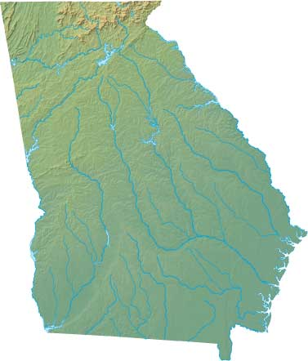
Georgia Habitats

Slide 2
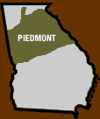
Georgia Piedmont Habitat
The Georgia Piedmont is between the mountains and the plains.
Known for weathered and nutrient poor soil.

Slide 3
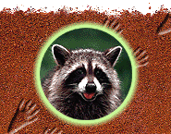
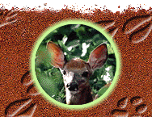
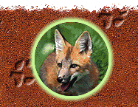
Piedmont Habitat Land Animals
The white tailed deer is the smallest deer in North America!
Raccoon
These nocturnal animals are found in urban, suburban, and rural habitats.
They are also found from the mountains to the coast!
This is the Red Fox.
It hunts alone or in small family groups!

Slide 4
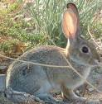
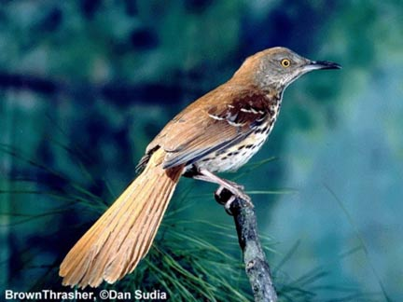
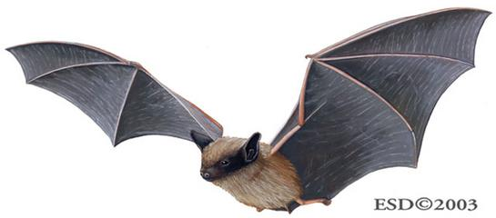
Piedmont Land Animals and Birds

Slide 5
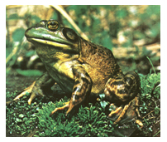
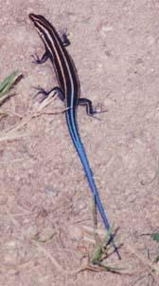
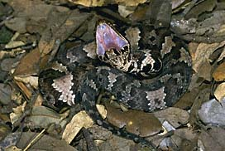
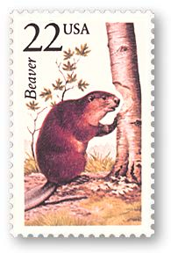
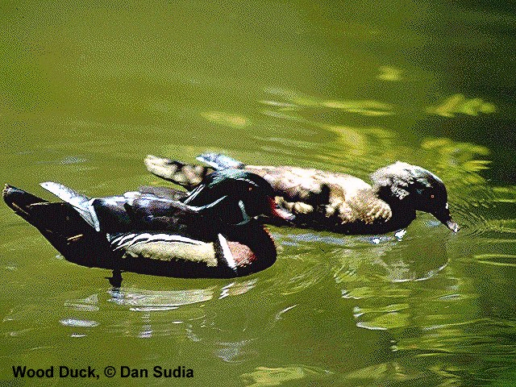
Piedmont Water Animals
Reptiles
Snakes, frogs, and lizards
Because they are reptiles, they like to be near water!
Cottonmouth – water moccasin

Slide 6
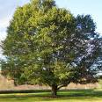
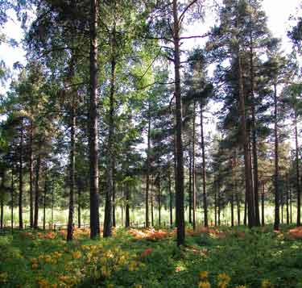
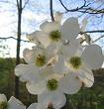
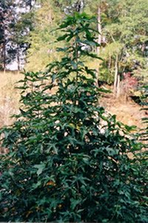
Piedmont Habitat – Trees
Dogwood
The Live Oak is Georgia’s state tree
Georgia Pine Trees
Sweet Gum

Slide 7
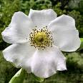
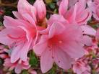
Piedmont Plants
Iris
Cherokee Rose
Azaleas

Slide 8
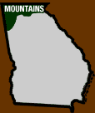
Georgia Mountains Habitat
The mountains in Georgia were formed over a billion years ago!
Brasstown Bald is in the Georgia mountains. It is the highest point in Georgia rising over 4,784 feet above sea level.

Slide 9
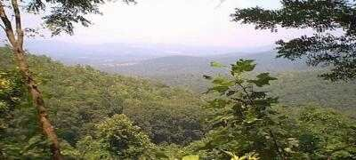
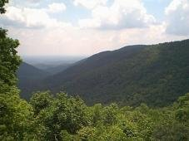
Mountain Habitat
The trees and plants in the mountain habitat are the same as the Piedmont!

Slide 10
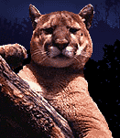
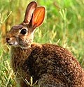
Mountain Habitat Land Animals
Bobcat
Eastern Cottontail Rabbit
Mountain Lions

Slide 11
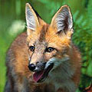
Mountain Habitat Land Animals
Black Bear
Red Fox

Slide 12
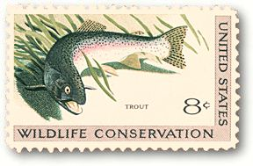
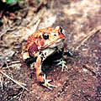
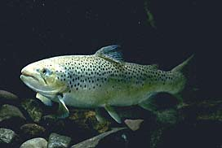
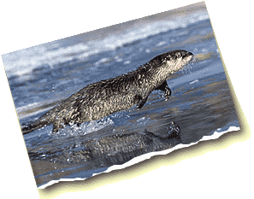
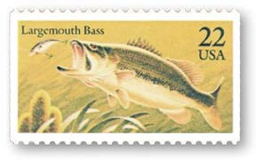
Mountain Habitat Water Animals
Brown trout
River Otters
American Toad
This frog prefers to be in rocky, mountainous places, but you can find it in lots of other habitats too!

Slide 13
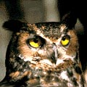
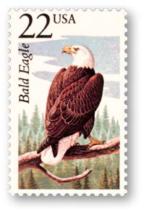
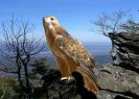
Mountain Animals Birds
Great Horned Owl

Slide 14
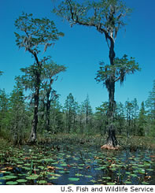
Marsh / Swamp Habitat
The Okefenokee Swamp is in the Georgia Plains region.
Okefenokee comes from the Indian word which means “Land of the Trembling Earth”

Slide 15
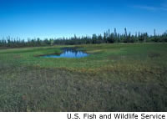
Marsh / Swamp Habitat
Not all of the Okefenokee is a swamp. Part of it is a bog which is a mossy wetland.
It is so boggy that you can shake trees by stomping on the ground!

Slide 16
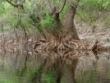
Marsh and Swamp Habitat Trees
Trees include giant tupelos and bald cypresses.
Tupelo Trees
Cypress Trees

Slide 17
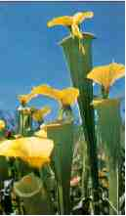
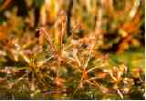
Marsh / Swamp Habitat Plants
Bladderworts live in shallow water and have small air sacs that catch small bugs, water fleas, and worms.
Pitcher Plants eat live bugs! The bugs are attracted to the smell and they crawl inside. Once inside, they are trapped. The flower has strong chemicals that immediately dissolve the bug.
The Sundew flower has sticky stuff on the plant.
When bugs land, they are stuck. Then the flower can eat the bug.

Slide 18
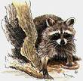
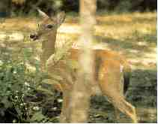
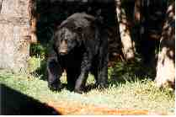
Marsh and Swamp Habitat Land Animals
White Tailed Deer
The black bear eats plants and animals.

Slide 19
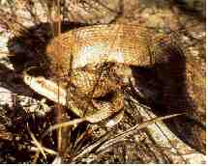
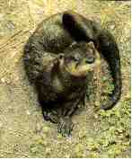
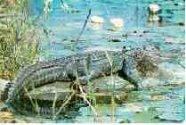
Marsh and Swamp Habitat Water Animals
River Otters
Water Moccasin
One of Georgia’s few venemous snakes.
It can coil, bite, and coil again in ½ second!
Did you know a full grown alligator can grow up to 15 feet and weigh 700 pounds?

Slide 20
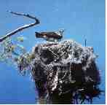
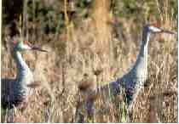
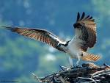
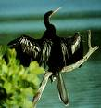
Swamp and Marsh Habitat Birds
The Sandhill Crane
Ospreys
Anhingas
These birds feed on small prey such as lizards, rats, and snakes.

Slide 21
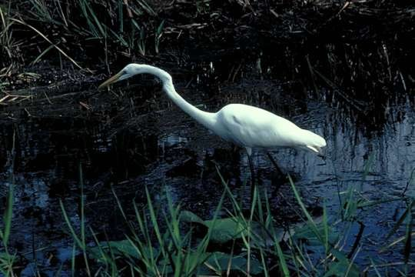
Swamp and Marsh Birds
Egret

Slide 22
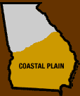
Coastal Plains Habitat
The coastal habitat is the southeastern portion of the Coastal Plains region of Georgia. It is the coastline that separates the plains from the sea.
You can see the coastal plains in the picture below.

Slide 23
Coastal Habitat Plants
Grasslands
Wire Grass
A variety of plants

Slide 24
Coastal Plains Habitat Trees
Spanish moss on a Live Oak tree

Slide 25
Coastal Plains Habitat Birds

Slide 26
Coastal Pliains Habitat Birds
Snowy Egret

Slide 27
Coastal Plains Habitat Animals

Slide 28
Atlantic Ocean Habitat
Every year Loggerhead sea turtles lay their eggs on the beach, but make their home in the ocean. That is why you found them in the Coastal Habitat as well!

Slide 29
Atlantic Ocean Habitat Marine Life
Right Whale
Crabs

Slide 30
Atlantic Ocean Habitat Marine Life
These dolphins were spotted just of the coast of Tybee Island

Slide 31
Changes in Habitats
Pollution
Deforestation
Forest Fires
Natural Disasters

Slide 32
Pollution
Pollution also is a major reason for the loss of habitat. When it rains, many chemicals and debris from roads, cars, lawns, construction sites and dumps - just to name a few - run into streams and finally into the estuaries and bays. When this habitat is destroyed by the chemicals, poor farming or building too close to streams - fish die. They die because their nesting and feeding areas are destroyed. These areas where fish can not survive are called "Dead Zones". One of these dead zones extends 7,000 miles into the Gulf of Mexica off Texas and Louisiana due to pollution.
*Courtesy of http://www.howard.k12.md.us/res/habitat/pollution.html

Slide 33
Effects of Pollution on Habitats
*Courtesy of http://www.howard.k12.md.us/res/habitat/pollution.html

Slide 34
Deforestation
After
Before

Slide 35
Forest Fires
http://www.borealforest.org/world/innova/images/burned_woods.jpg

Slide 36
Oil Spills
Oil water logs a bird's feathers so that it drowns, dies of cold or is poisoned by swallowing oil when trying to clean its plumage. Most oil pollution is accidental but some is deliberate, such as ships illegally washing out their tanks at sea.
http://www.rspb.org.uk/policy/marine/pollution/index.asp

Slide 37
Natural Disasters Hurricanes and Tornadoes
Hurricanes destroy a mangrove forest coastal habitat.

Slide 38
Natural Disasters Hurricanes and Tornadoes

