Slide 1
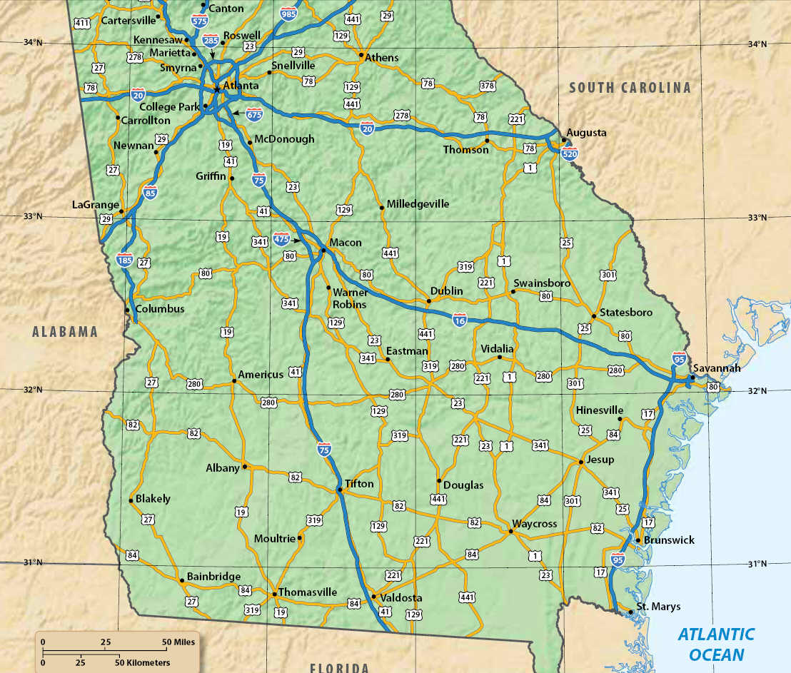
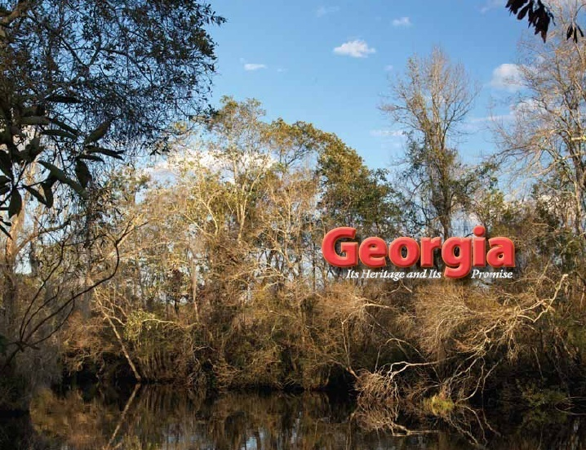
Chapter 17:
Reconstructing the State
STUDY PRESENTATION
© 2010 Clairmont Press

Slide 2
Section 1: Political Reconstruction
Section 2: Economic and Social Reconstruction

Slide 3
Section 1: Political Reconstruction
Essential Question
How did the Union and the former Confederacy recombine after the Civil War to become one nation?

Slide 4
Section 1: Political Reconstruction
What terms do I need to know?
freedmen
Thirteenth Amendment
Black Codes
Fourteen Amendment
carpetbagger
scalawag
Ku Klux Klan
Fifteenth Amendment
Redeemers
poll tax
discrimination

Slide 5
Political Reconstruction
A major issue at the end of the Civil War centered on how to recombine the Union and the former Confederacy.
The national government sought to reunite the former rebel states with the northern states. It wanted to construct loyal governments in those states.
Some Georgians wanted the state to be much like it was before the war. Others wanted Georgia to go in a new direction.

Slide 6
Presidential Reconstruction
Lincoln’s Reconstruction Plan proposed to allow former Confederate states to form new governments after 10 percent of its voters took an oath of loyalty to the United States. Congress pressed for 50 percent, but the Congressional version did not become law.
Lincoln was assassinated in Washington, DC in April 1965. Lincoln’s Vice President Andrew Johnson was sworn in as President.
The Thirteenth Amendment to the U.S. Constitution made it illegal for anyone to be held in slavery.
In November 1865, Georgia’s General Assembly passed Black Codes which denied freedmen (free black citizens) the right to vote, serve on juries, testify against whites, or marry a white person. Georgia’s Black Codes were milder than in many other Southern states.
Northern senators and congressman opposed the Black Codes, arguing that the codes tried to recreate a system close to slavery.

Slide 7
Congressional Reconstruction
The Fourteenth Amendment (1866) guaranteed citizen rights to anyone born in the United States.
Former Confederate states (except Tennessee) rejected the Fourteenth Amendment, and only Tennessee was readmitted into the Union.
Georgia and other former Confederate states were divided into military districts; white citizens and male freedmen registered to vote and new state constitutions were written.

Slide 8
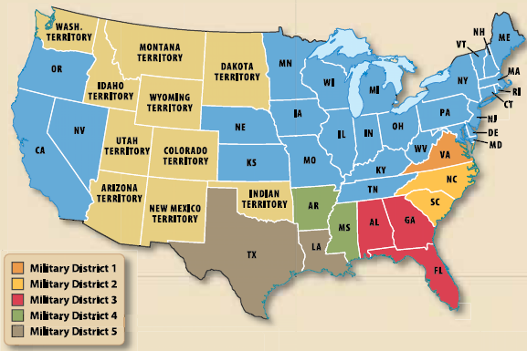
Military Reconstruction Districts

Slide 9
The Constitutional Convention of 1867
Many conservative whites boycotted the constitutional convention in Georgia.
A new Republican Party of Georgia was formed. The party included African Americans, northerners who had come South (nicknamed carpetbaggers by opponents), and some southern whites (negatively nicknamed scalawags).
The new Georgia constitution established free public schools for all of Georgia’s children and guaranteed African American men the right to vote.
In July 1868, the new Georgia legislature ratified the Fourteenth Amendment; Georgia was allowed to rejoin the Union.

Slide 10
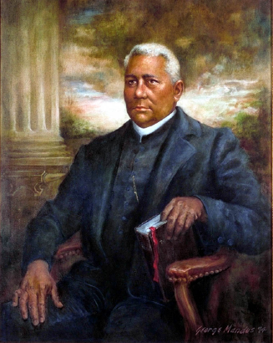
African American Legislators
Henry McNeal Turner, a minister from Macon, became the first African American chaplain in the U.S. Army.
Turner served as a delegate to the 1867 constitutional convention and later the legislature.
Black leaders felt betrayed in 1868 when Georgia’s white legislators (Democrats and some Republicans) removed African American legislators from Georgia’s General Assembly.
The black leaders were removed on grounds that the right to vote guaranteed by the Fourteenth Amendment did not give African Americans the right to hold office.
The expelled legislators founded the Civil and Political Rights Association and traveled to Washington to plead their case with members of the U.S. Congress.
Portrait of Henry McNeal Turner.
Image: Georgia Secretary of State

Slide 11
The Ku Klux Klan
The summer of 1868 and the year 1869 were periods of violence.
The Ku Klux Klan (KKK), a terrorist organization, came to Georgia to frighten those it considered enemies: carpetbaggers, scalawags, and African Americans.
The Klan worked mostly in rural areas, at the local level, and tried to defeat the Republican Party and control African Americans in work and their personal lives.
The KKK used violence and intimidation to maintain control and prevent enemies from voting.

Slide 12
Military Reconstruction Again
Congress reestablished military rule in Georgia in 1869.
The Fifteenth Amendment – the “voting rights amendment” – guaranteed that no one could be denied the right to vote based on race or color. Women were still not allowed to vote.
Georgia’s legislature was reorganized under military rule and the new legislature ratified the Fifteenth Amendment.
Georgia was the only state to have to be readmitted twice to the Union (the second time in July 1870).

Slide 13
Redeemers and Independents
Conservative white southerners of the Democratic Party regained control of Georgia’s General Assembly in 1872.
These Democrats became known as the “Redeemers” who believed they had saved Georgia from the North’s Reconstruction policies.
Political gains made by African Americans began to disappear. Fewer African Americans served in the legislature.
Some Democrats split from the party and became Independents.

Slide 14
The End of Reconstruction
Georgia established a new constitution in 1877, which increased the power of Georgia’s rural areas.
The constitution established a poll tax, a fee that had to be paid before a citizen could vote.
The poll tax made it difficult for poorer people to vote. This tax most harmed poor whites and most African Americans.
The 1875 Civil Rights Act tried to stop discrimination (unfair treatment of people because of prejudice) in public places. Enforcement in the South was very difficult.
The Compromise of 1877 removed the remaining U.S. troops in the South, ending Reconstruction.

Slide 15
Section 2: Economic and Social Reconstruction
Essential Question
How did Georgia attempt to rebuild its economy in the years following the Civil War?

Slide 16
Section 2: Economic and Social Reconstruction
What terms do I need to know?
white supremacy
Freedmen’s Bureau
tenant farming
sharecropping
crop lien
Convict Lease System
segregate

Slide 17
Economic and Social Reconstruction
Georgia and other southern states needed to rebuild their economies after the Civil War.
The slavery system had ended, but former slaves needed to earn a living.
Many businesses and factories needed to be rebuilt. Southern trade had been disrupted for years.
Most white southerners hope to maintain white supremacy. African Americans and some northern reformers hoped to create a society where there was equality for all.

Slide 18
The Freedmen’s Bureau
The Freedmen’s Bureau was an agency created in 1865 to help ex-slaves and poor whites provide for the necessities of life.
It provided rations and basic services to those it served.
The bureau set rules for written contracts and wage scales.
It helped provide hospitals for African Americans.
Education and literacy services were provided to those denied educational services before the Civil War.
Georgia had dozens of Freedmen Bureau schools.

Slide 19
Agriculture
Many former slaves left the coastal plantations for the state’s towns in search of work.
Plantation owners still had their land but little cash. They needed workers.
Tenant farming developed. The tenant usually had some agricultural equipment and farm animals; they rented land from the landowner.
Cash was scarce, so tenants often paid the landowner with a share of the crops grown (sharecropping).
Crop lien occurred as tenants bought needed supplies on credit, and when the crops didn’t produce enough cash, tenants fell into debt.

Slide 20
Notes:
This graph shows that the number of farms in Georgia grew from 1850 to 1870. Discuss and view next slide.

Slide 21
Notes:
This graph indicates that after the Civil War, the number of large farms in Georgia was reduced by half. Have students discuss the implications of these two graphs. Ask: What other data would be useful for building a more complete picture of Georgia’s farm economy during this time?

Slide 22
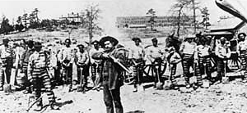
Commerce, Industry, and Transportation
Merchants, entrepreneurs, and craftsmen helped towns to grow.
Industries such as flour mills, cotton mills, and sawmills resumed.
Hundreds of miles of railroads were rebuilt or repaired.
Private companies ran many prisons, and the prisoners did the work the company needed.
The convict lease system became very brutal.
The convict lease system provided the state with much needed money. However, the conditions were very brutal for the prisoners.
Image: Georgia Secretary of State
Link: Convict Lease System

Slide 23
Religion, Education, and Culture
The Civil War had disrupted all the institutions in Georgia and the South. Those institutions included churches, schools, clubs, and other organizations.
Civil and social clubs for men did not meet.
Many schools closed, including the state’s colleges.
Churches managed to remain open to serve those who remained at home during the war.

Slide 24
Religion
The Civil War had split some church denominations. After the war, Southerners who were Methodists, Baptists, and Presbyterians stayed in their separate churches.
Some African Americans stayed with the churches they had attended before the war. The majority of those churches were Baptist and Methodist.
Churches became the first institutions to segregate as African Americans broke away to establish their own churches.
Churches became a training ground for black leaders.

Slide 25
Education
Education became a major issue after the war.
African Americans were eager to be literate. Many desired to be able to read the Bible for themselves.
The first public school system in Georgia was established in 1870, by an act of the legislature. There were separate schools for black and white children.
Only private schools provided high school education.
Private colleges served wealthy whites. Some private colleges for African Americans were founded during Reconstruction.
Several church colleges reopened when the war ended, including the colleges today known as Mercer, Shorter, Emory, Oglethorpe, and Wesleyan.

Slide 26
An Evaluation of Reconstruction
Reconstruction brought a framework for Georgia’s educational system.
African Americans had churches of their own. Former slaves were no longer burdened by the fear of forced family separation.
Efforts to separate the races emerged. Groups such as the KKK undermined short-lived political gains made by African Americans.
By 1877, southern states were controlled mainly by wealthy whites.
Poor whites and African Americans suffered under tenant farming and sharecropping.

Slide 27
Return to Main Menu

