Slide 1
How did the growing economic disparity (difference) between the North and the South impact the Civil War?

Slide 2
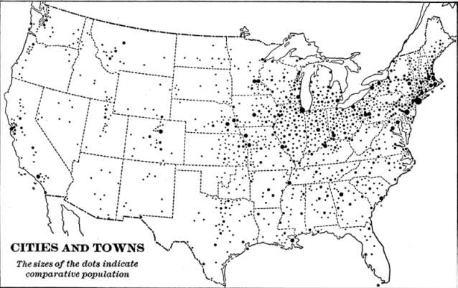
The North
Manufacturing Resources
* 92% of US Industrial Output
* Abundant resources to produce weapons, military supplies, and equipment
Food Production
*Over twice as much food production compared to the South
Employment and Property Ownership
* Many citizens owned no property and worked for someone else
* Even in large-scale farming regions, machines reduced the need for agricultural workers
Population
* 71% of US population
* Of the population in the North, 99% was free and 1% slave
* Large enough to assemble an army capable of defending the North

Slide 3
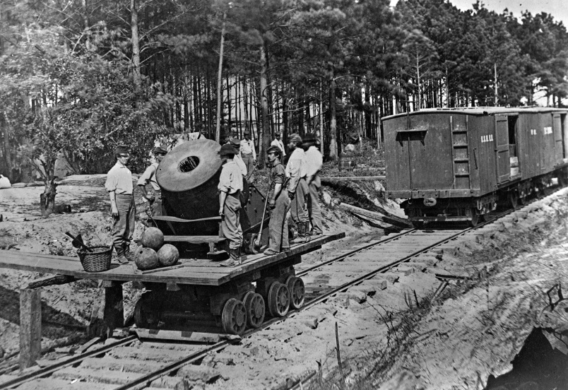
Railroads
* 71% of US railroad network
* Efficient rail transport system
* Able to transport troops, supplies, and food
* 34% of US exports
* Favored high tariffs on imported goods to protect Northern industries and workers' jobs
Exports and Views on Tariff

Slide 4
The South
Manufacturing Resources
* 8% of US Industrial Output
* Minimal resources to produce weapons
* Soldiers often fought with their personal equipment
Food Production
* Limited food production due to vast cotton cultivation
* Southern economy depended on the production of cash crops (cotton, rice, corn, and tobacco)
* Required human labor and depended on slavery
* Most farmers were small farmers and owned no slaves
Employment and Property Ownership

Slide 5
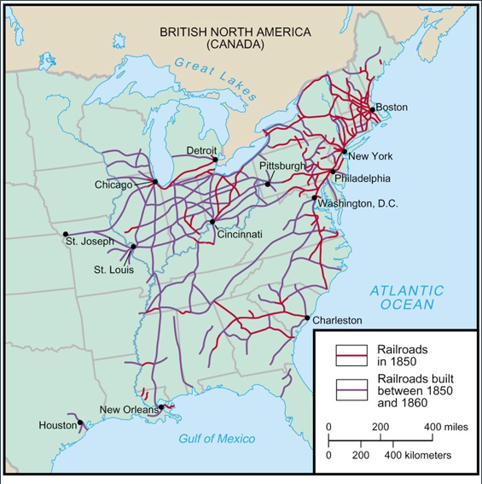
Population
* 29% of US population
* Of the population in the South, 67% free and 33% slave
* Too few free men to assemble an army capable of defending the Confederacy
* 29% of US railroad network
* Inefficient rail transport system
* Poor capacity to transport troops, supplies, and food
Railroads
Exports and Views on Tariff
* 66% of US exports (however, this cotton export was cut off by Union blockade during the war)
* Favored low (or no) tariffs on imported goods to keep the prices of manufactured goods more affordable

Slide 6
http://www.schooltube.com/video/35e969dbdbad76ac5d8d/Advantages-and-Disadvantages-of-the-Civil-War
The
Union
North
The Confederacy
South

