Slide 1
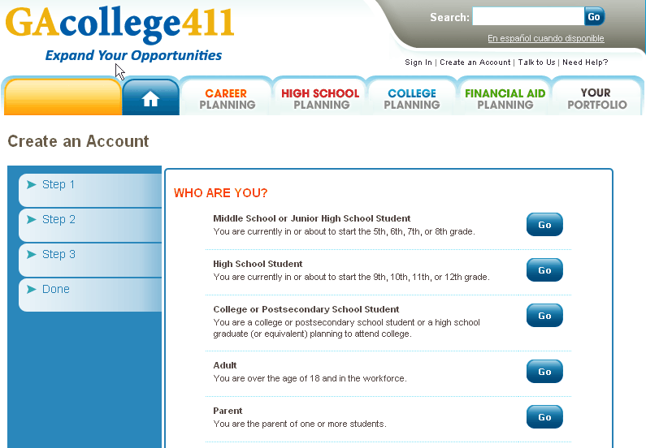
Maneuvering Through GaCollege411
Click On

Slide 2
Once you have created your account the next step is to select the Career Planning Tab.
Under the Career Planning tab you will select “Learning About Yourself”.
Click On

Slide 3
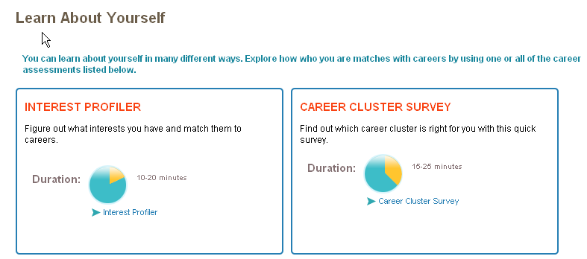
Students will complete the Interest Profile & Career Cluster Survey. Student will then save these items to their portfolios.

Slide 4
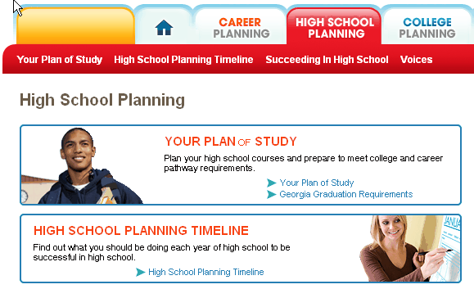
Now we will select the High School Planning Tab. From here you will select Your Plan of Study.
Click on

Slide 5
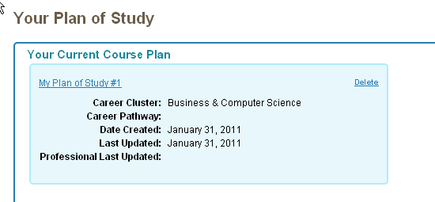
Your Career Cluster comes from your Interest Profile & Career Cluster Survey.
Click On

Slide 6
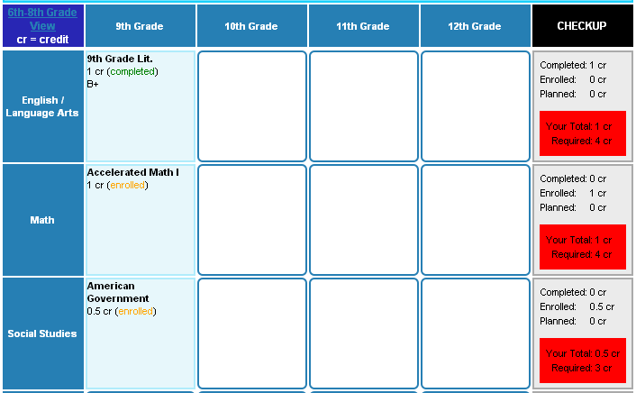

Slide 7
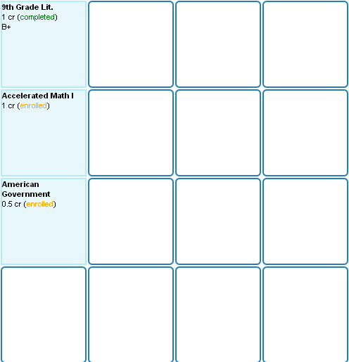
My Plan Of Study. Here you enter you course information. Click in a blank space and a drop down menu appears.
Click On

Slide 8
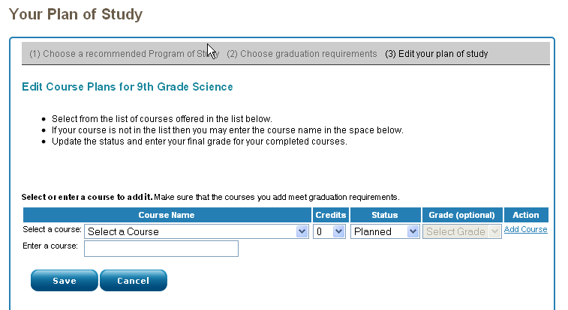
You will update your Plan of Study anytime a course is dropped/added and at the end of the year.

Slide 9
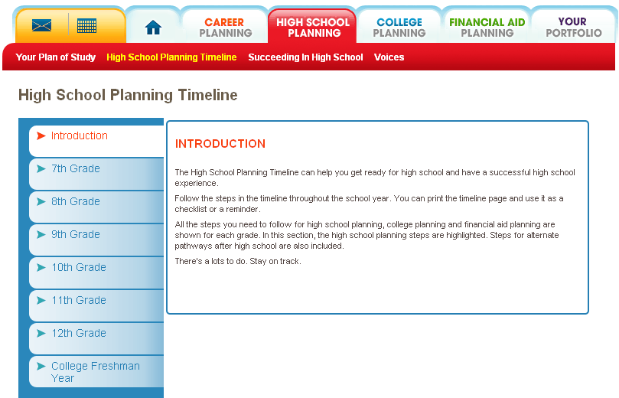
Now select the High School Planning Timeline. Here you will find a checklist of items for each grade level.

Slide 10
