Slide 1
Planning your Private Website
Notes:
Our demo is broken up into three sections and we will complete the demonstration in under 30 minutes. Before we begin just a couple of quick notes:
SCHOOLinSITES has the highest customer retention rate in the industry and
We are also have enjoyed the fastest growth among the top 5 web hosting companies. So as we go, we just want to let you know that not only do we get new customers, but we also keep our existing customers!

Slide 2
Training Resources
Notes:
As we begin let’s look at the process of building your new SCHOOLinSITES website

Slide 3
Processes and Procedures

Slide 4
Staff Resources

Slide 5
Professional Development

Slide 6
Personnel Resources

Slide 7
Help Desk

Slide 8
Paperless Board Meetings

Slide 9
Classified Ads for Staff

Slide 10
Web Resources

Slide 11
School Private Site

Slide 12
What are Your Needs?
Secure documents/files
Blogs?
FAQ’s
Paperless meetings
Cabinet/Directors resources
More?

Slide 13
Using Notify Me
Notes:
Our demo is broken up into three sections and we will complete the demonstration in under 30 minutes. Before we begin just a couple of quick notes:
SCHOOLinSITES has the highest customer retention rate in the industry and
We are also have enjoyed the fastest growth among the top 5 web hosting companies. So as we go, we just want to let you know that not only do we get new customers, but we also keep our existing customers!

Slide 14
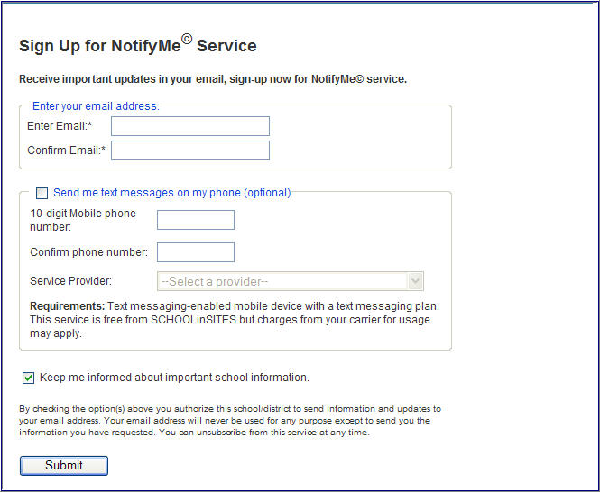
Notify Me – Signing Up School
greatparent@hotmail.com
greatparent@hotmail.com
Text Messaging Optional
Notes:
AUTOMATED
Notify Me is an opt in/opt out program that empowers anyone to be informed. It’s a great way to invite your parents, students and community to be actively involved by receiving alerts that YOU send. And note that text messaging is a valuable option.
Text messaging enhances this involvement especially in today’s busy world.

Slide 15
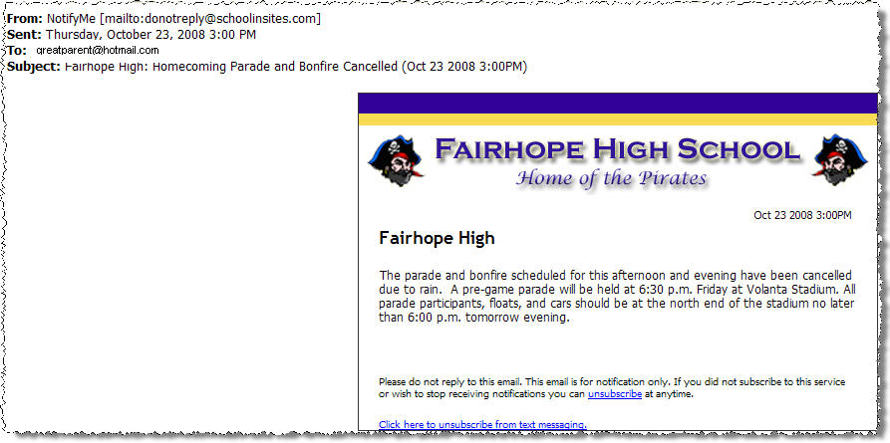
Notify Me – Receive Alerts
Notes:
[CLICK TO ADVANCE EACH SCREENSHOT]
This feature was developed in a partnership with one of our customers. Now you too can benefit from this feature which is sold by many companies as a single fee-based service. Notify Me is just another added benefit of SCHOOLinSITES. Note that this feature has been used for a recent lock-down situation and parents were kept fully informed during the day on the situation.

Slide 16
District–Custom Sign-up Groups

Slide 17
Job Alerts

Slide 18
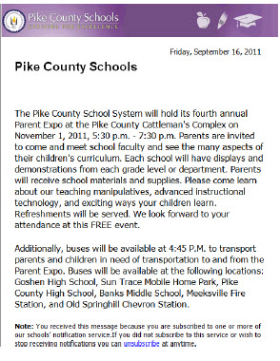
Public Notice

Slide 19
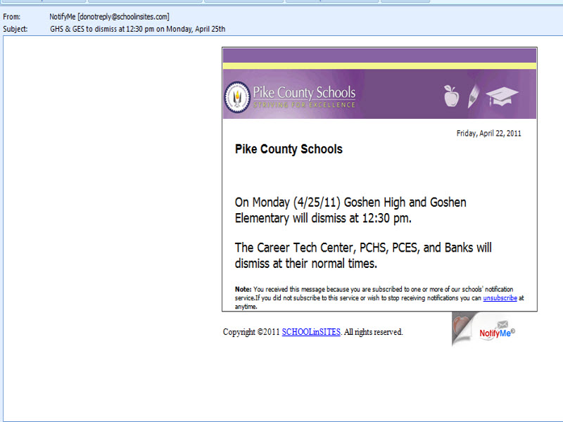
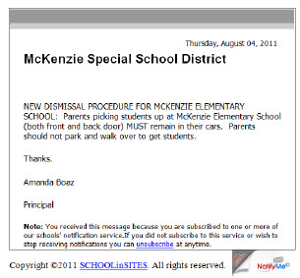
Early Dismissal / Instructions

Slide 20
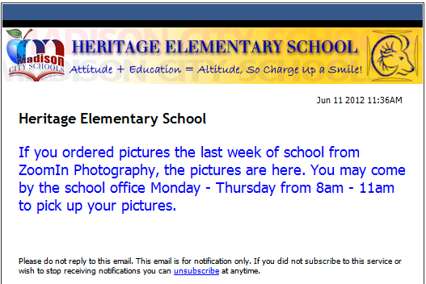
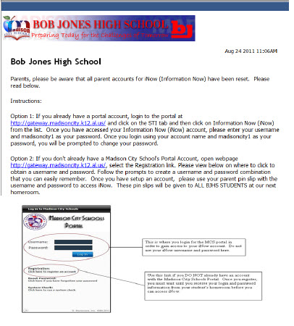
Important Information

Slide 21
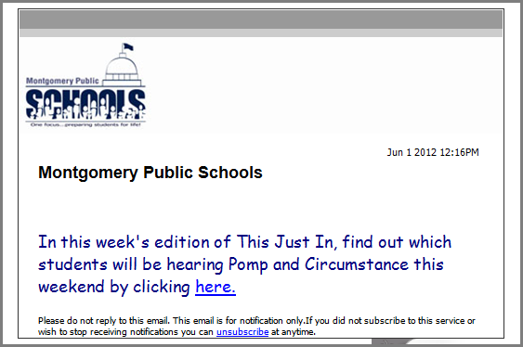
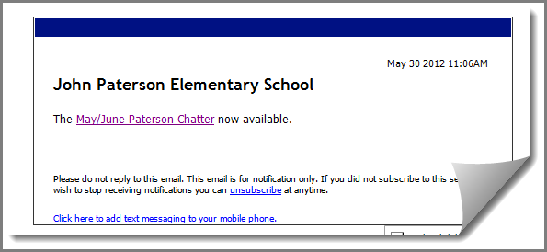
Distributing Newsletters

Slide 22
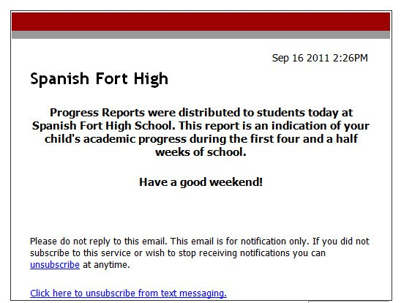
Testing Dates / Progress Reports

Slide 23
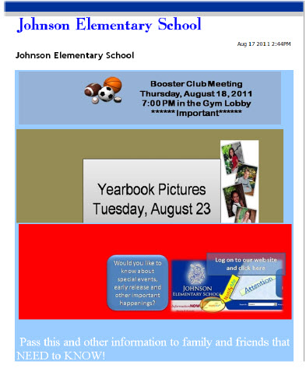
Meetings and Such

Slide 24
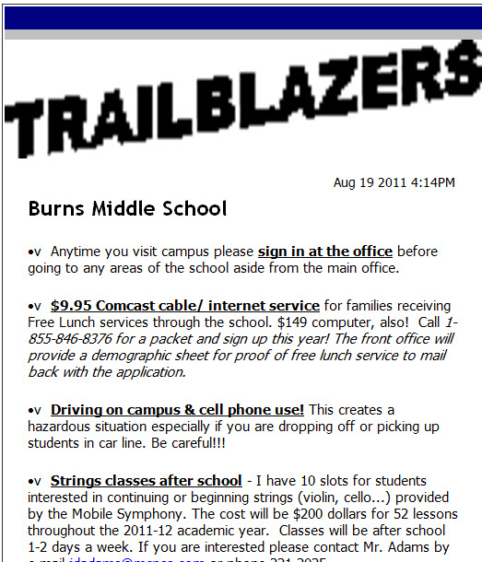
Reaching Out Weekly

Slide 25
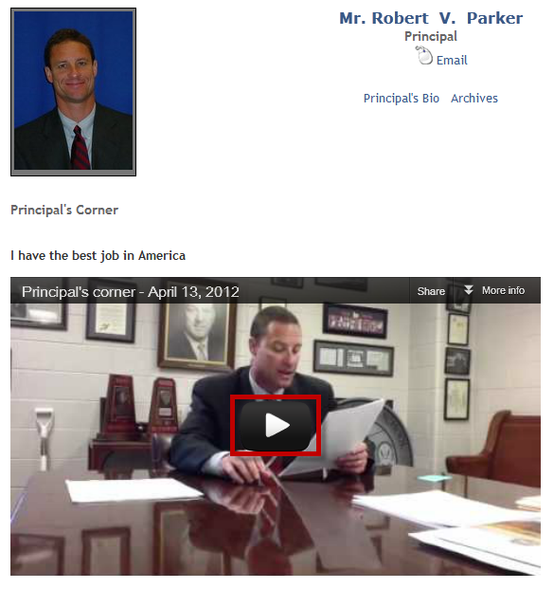
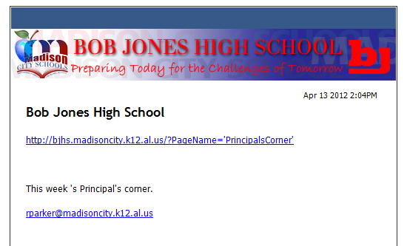
Principal’s Corner

Slide 26
How Can Notify Me Help You?
Early Dismissal / Late Start
Deadlines
Newsletters
Disseminating Documents/Videos
Deploy Surveys
Parent Meetings

Slide 27
Notes:
Do you feel that our solution exceeds your needs?
Where do you feel we should go from here?
When would you like to get started?

