Slide 1
Communication Solutions for Hamilton County Schools

Slide 2
A Little Background
In business since 1999
Serve approximately 35 Tennessee school districts
Present in almost all 50 states and US V.I.
E-rate since inception (2004)
Focus on communication (not just a website)
Constant development/improvement

Slide 3
A Few Tennessee Customers
Anderson County Schools
Greeneville City Schools
Coffee County Schools
Crockett County Schools
Lincoln County Schools
Rhea County Schools

Slide 4
First Component
Design and Create

Slide 5
97% of …
… Technology Coordinators want their district and school websites to have a professional look, up-to-date content and ease of use functionality that allows everyone who wants to participate to be able to update their portion of the websites.

Slide 6
What are your goals?
More Involvement by Everyone
Professional Design
Easier Navigation
Alert System
Surveys and Online Forms
Private Storage / Repository of Files
Teacher Websites

Slide 7
Custom Designs for Districts

Slide 8
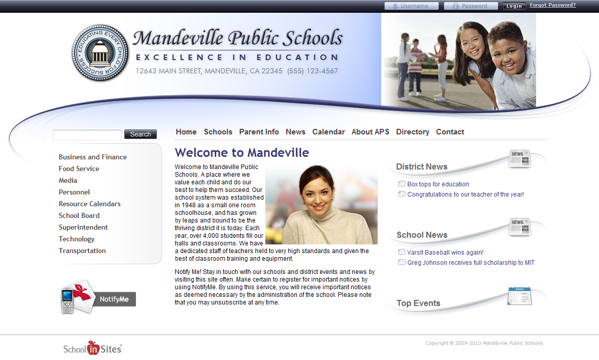
Custom Designs for Districts

Slide 9
Custom Designs for Districts

Slide 10
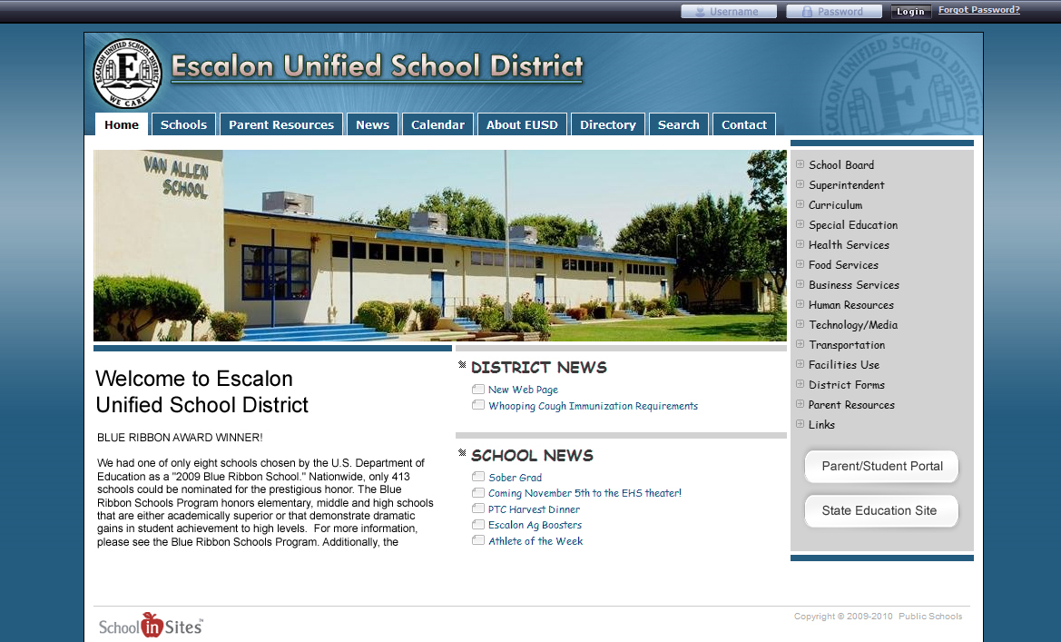
Custom Designs for Districts

Slide 11
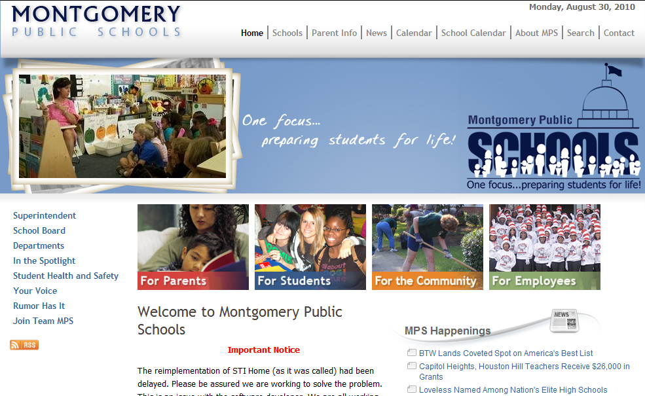
Custom Designs for Districts

Slide 12
Custom Designs for Districts

Slide 13
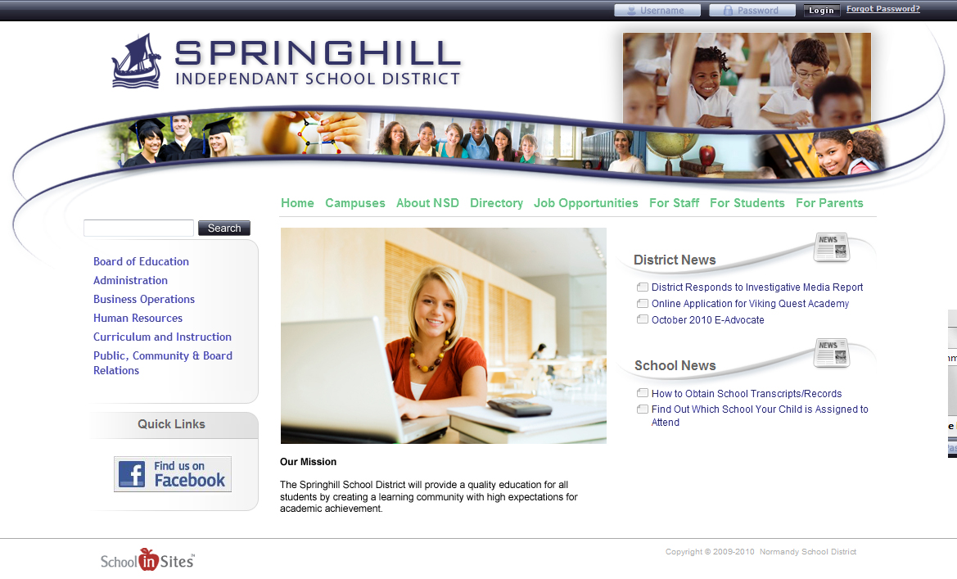
Custom Designs for Districts

Slide 14
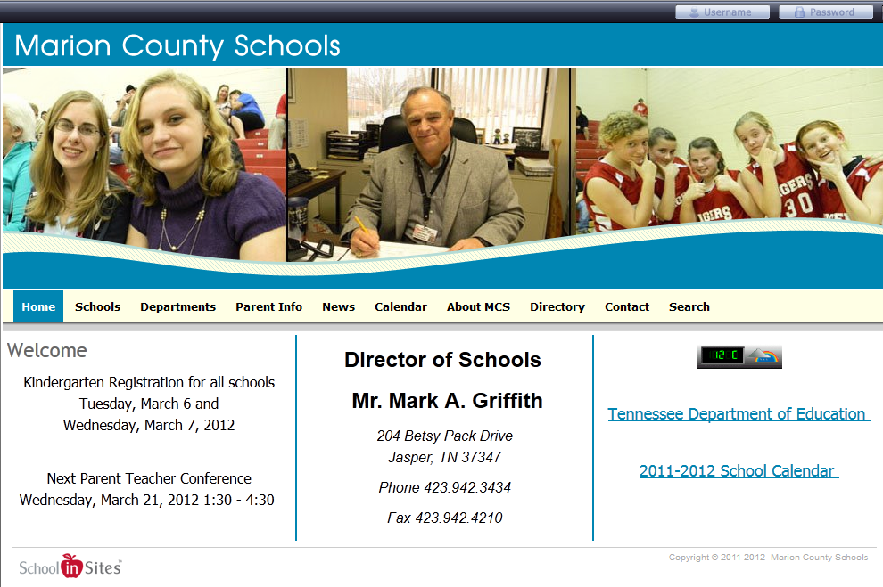
Custom Designs for Districts

Slide 15
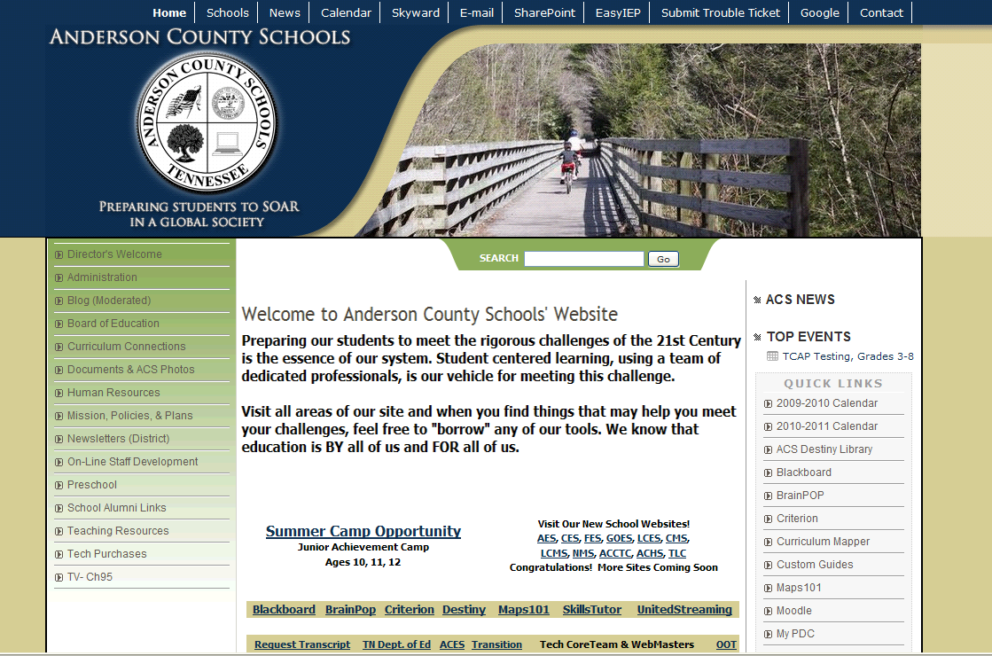
Custom Designs for Districts

Slide 16
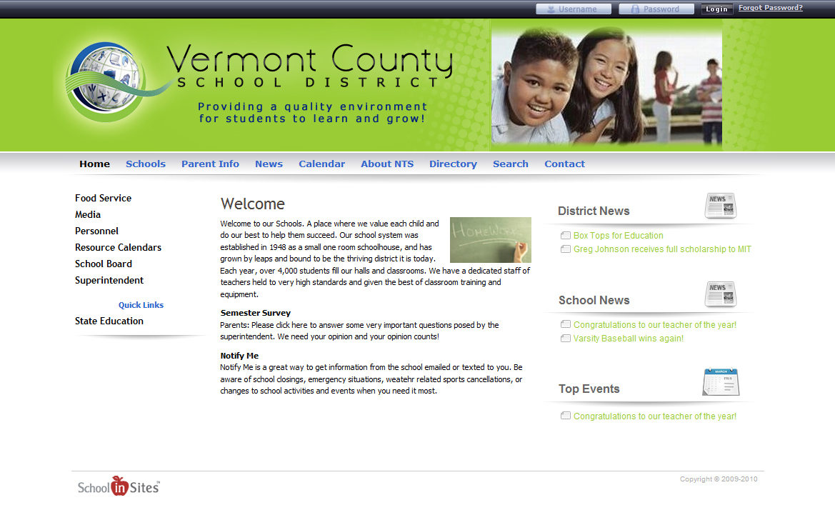
Custom Designs for Districts

Slide 17
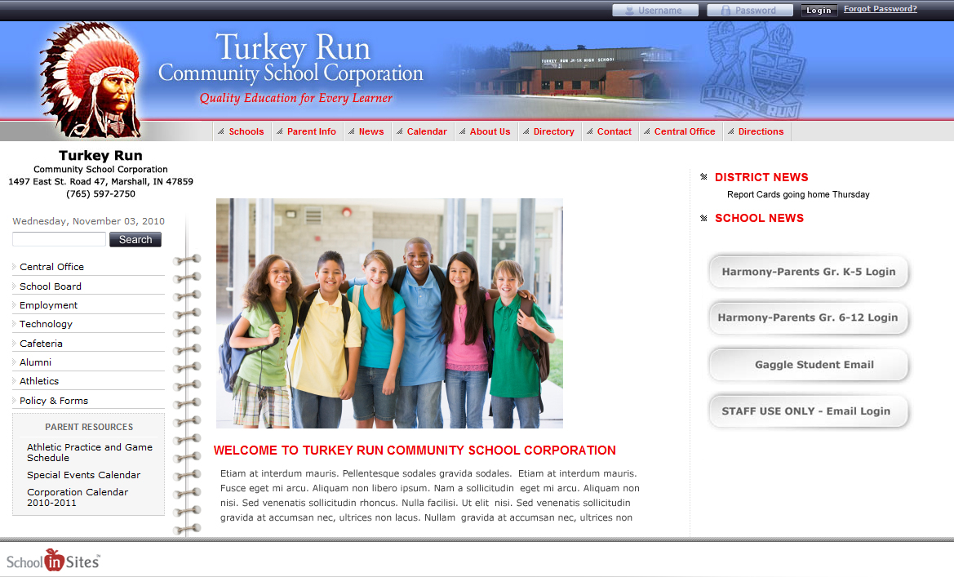
Custom Designs for Districts

Slide 18
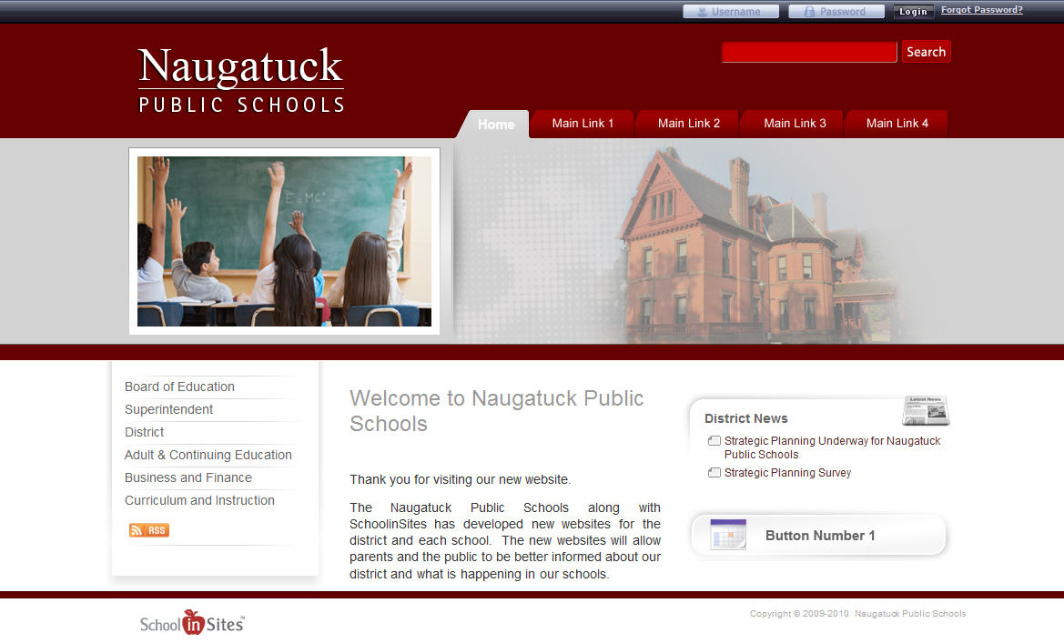
Custom Designs for Districts

Slide 19
Custom Designs for Districts

Slide 20
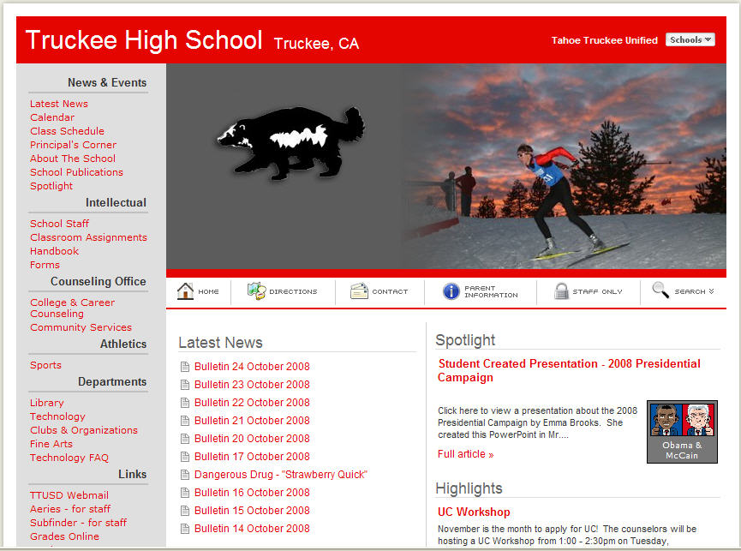
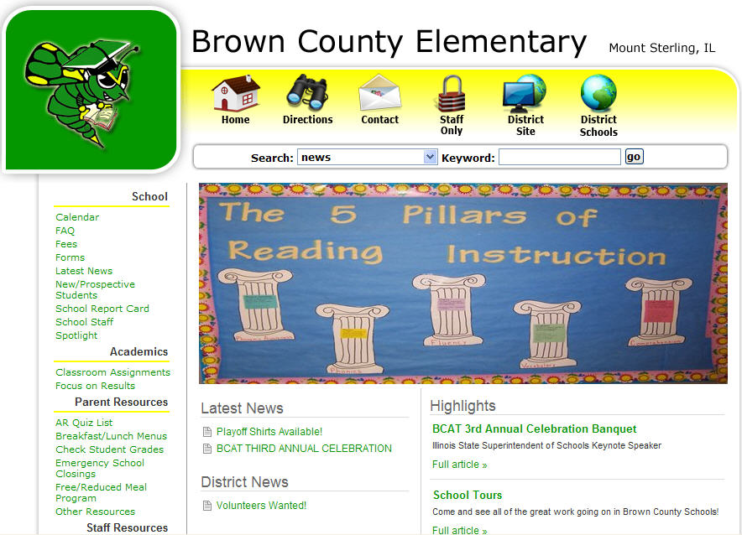
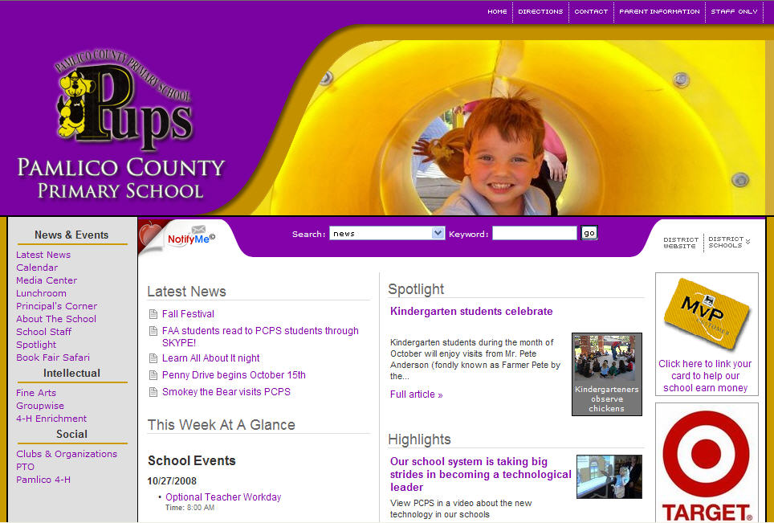
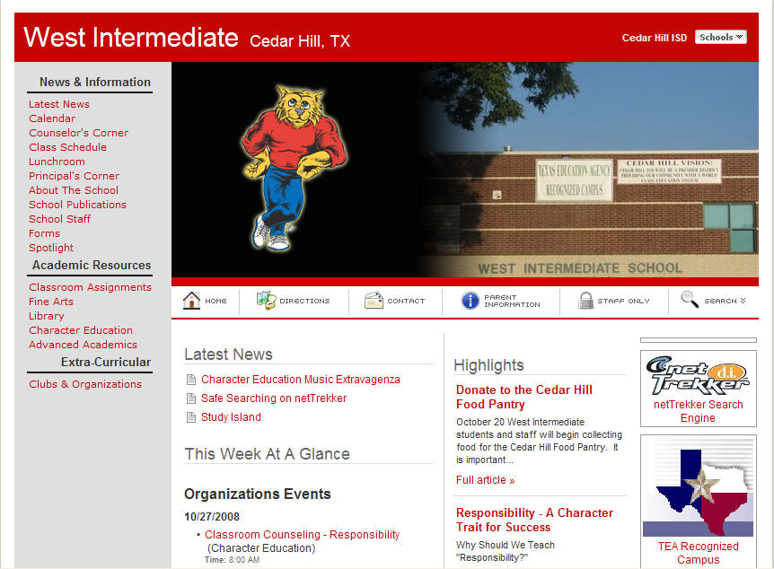
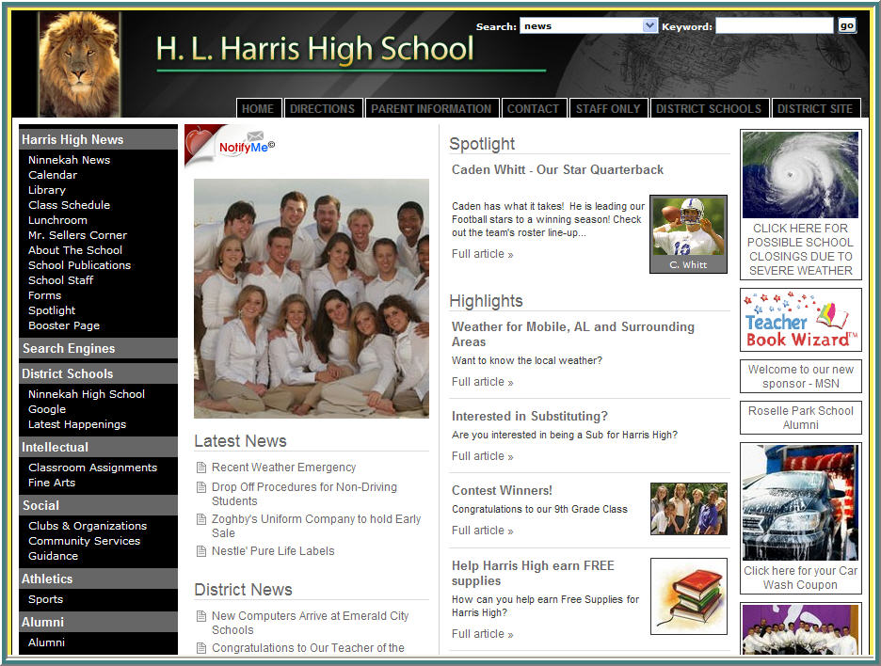
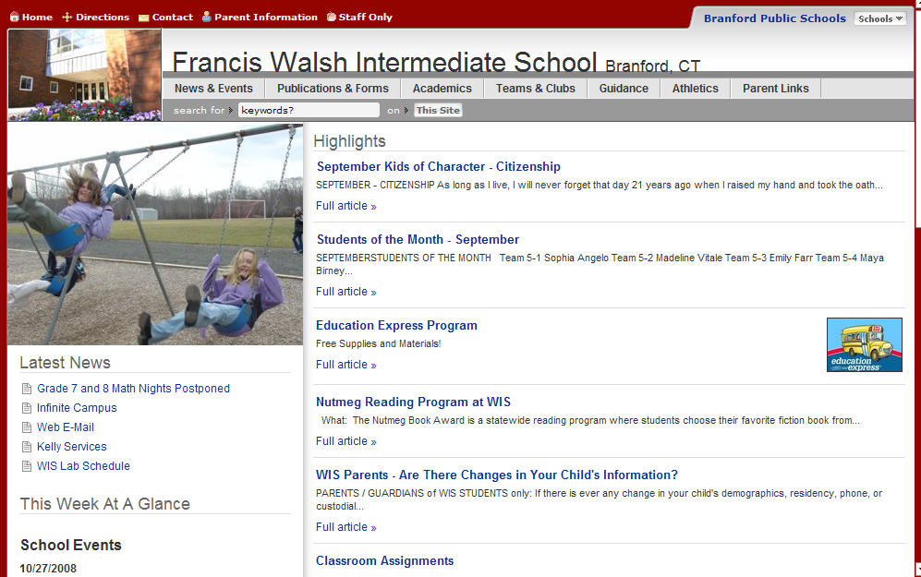
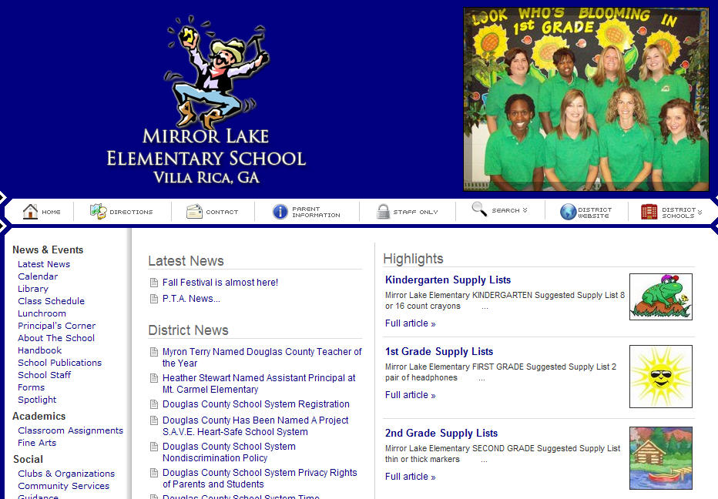
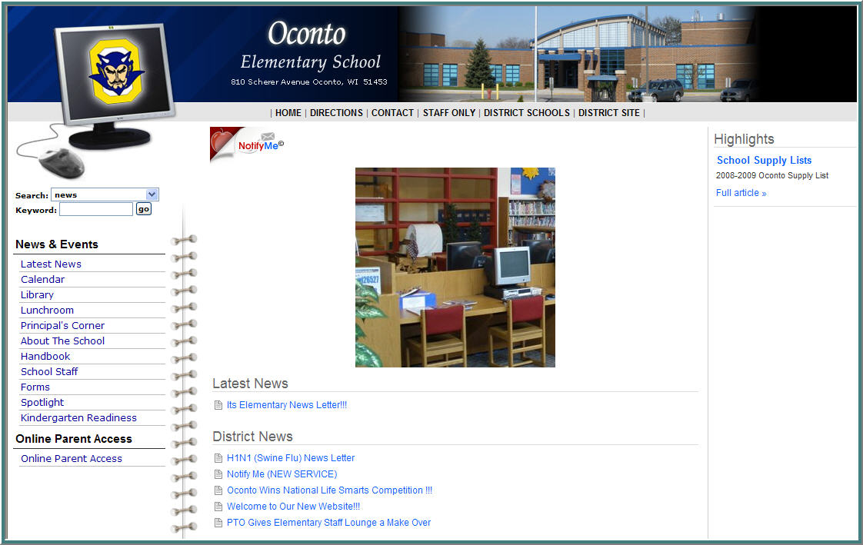
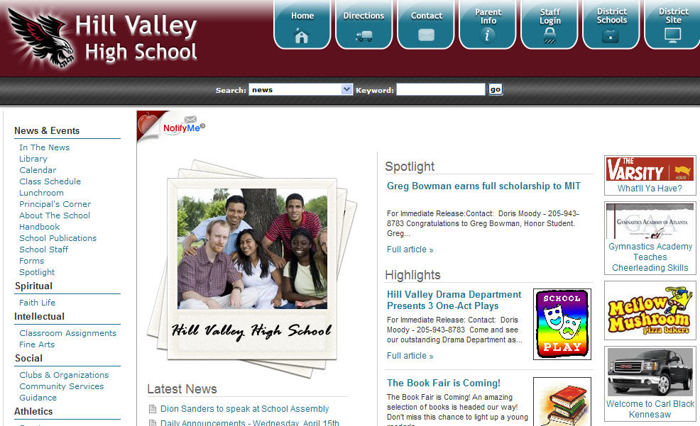
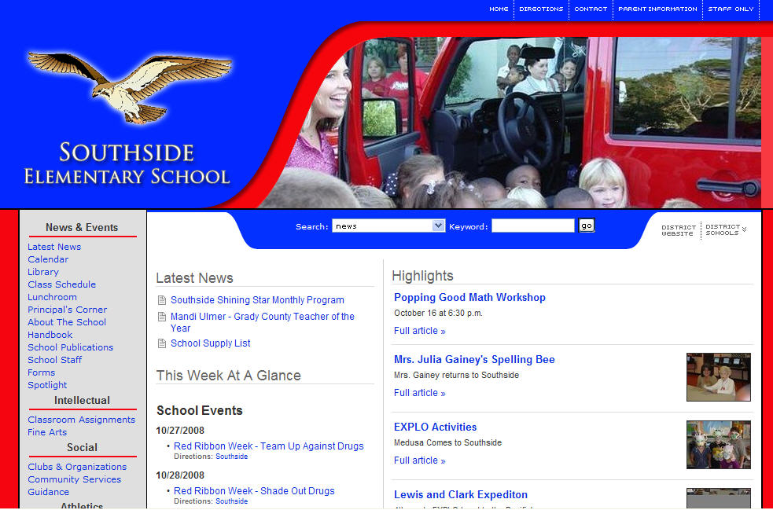
… and Schools!
Notes:
20

Slide 21
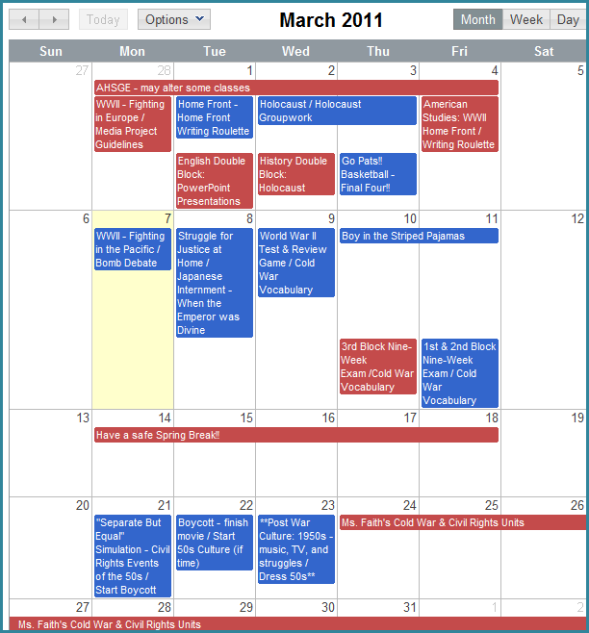
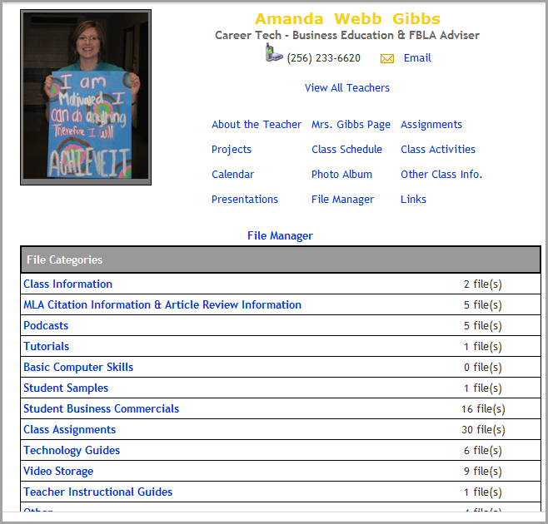
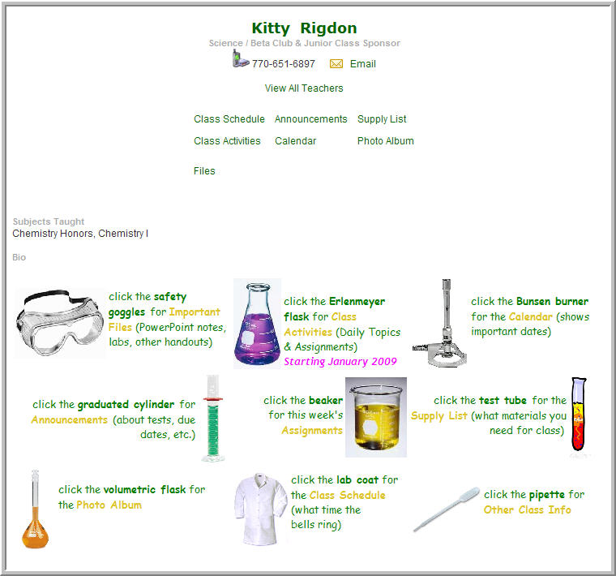
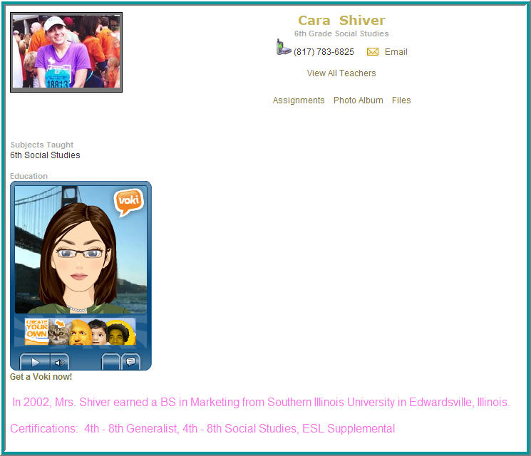
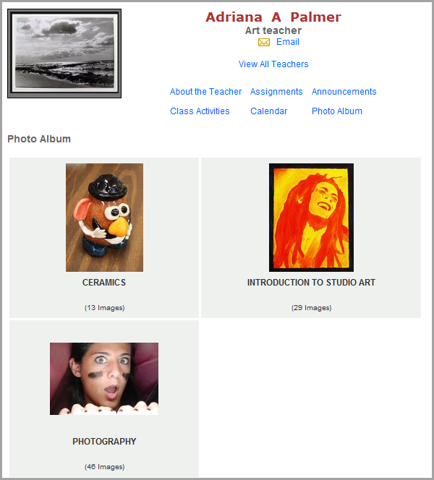
… including effective Teacher Websites

Slide 22
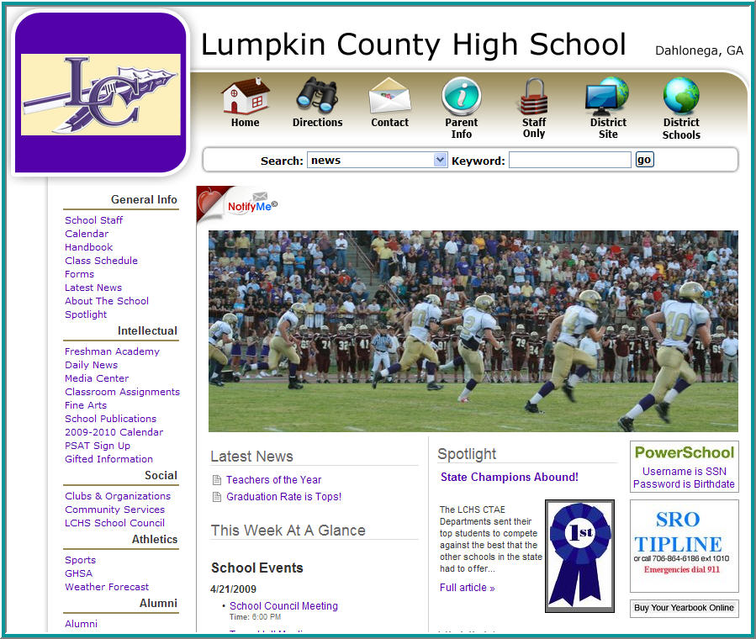
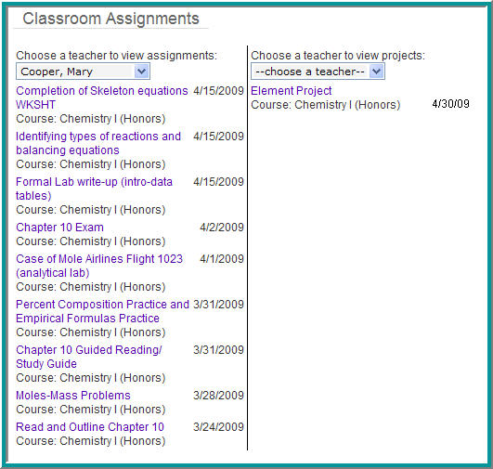
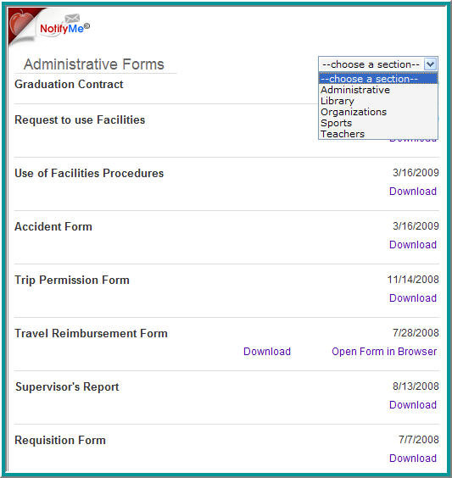
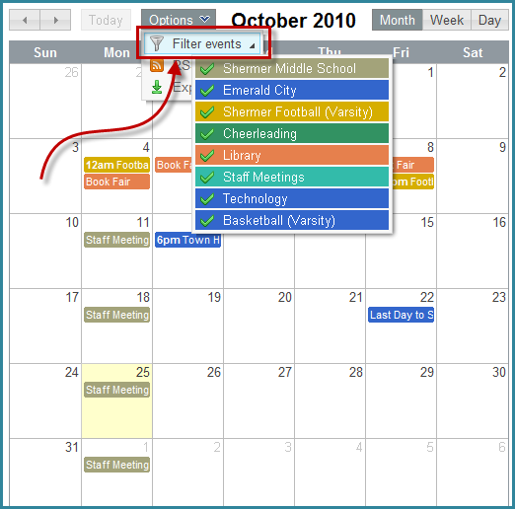
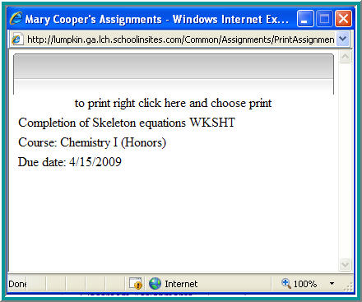
Navigation Excellence

Slide 23
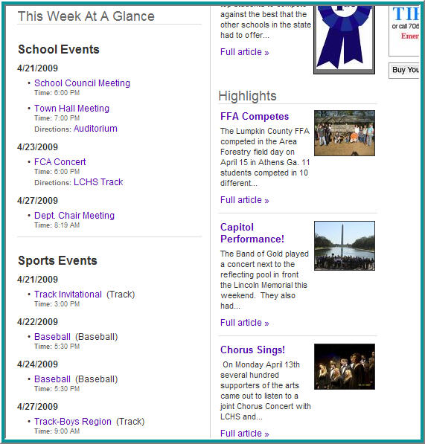
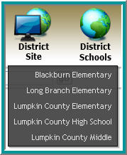
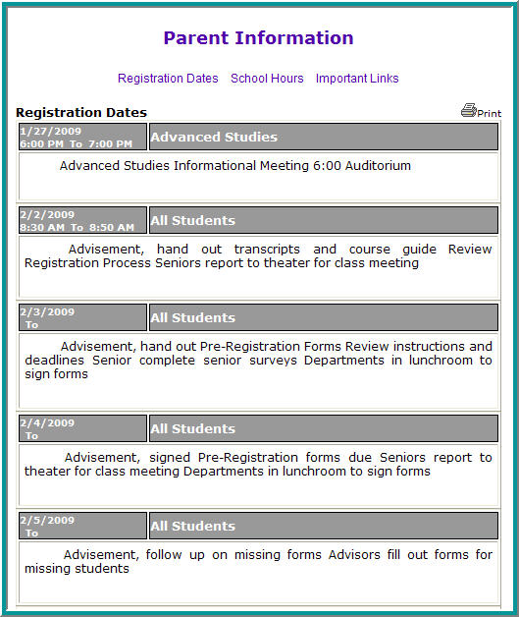
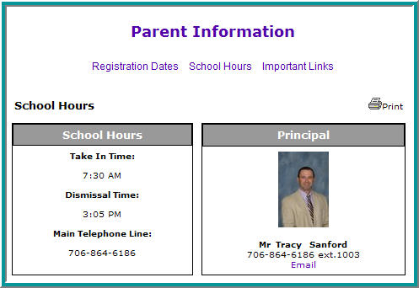
Find Important Information

Slide 24
Ease of Use
Your staff will take ownership of the website. Why? SCHOOLinSITES only requires basic computer skills.
The result?
More participation.
More information posted.
More vibrant websites.
Less work for the Technology Coordinator.

Slide 25
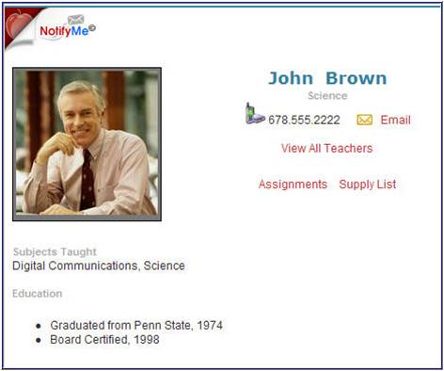
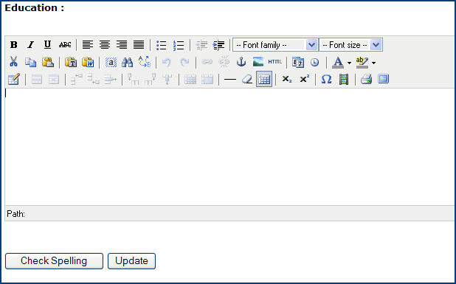
Type and Update
Graduated from Penn State, 1974
Board Certified, 1998

Slide 26
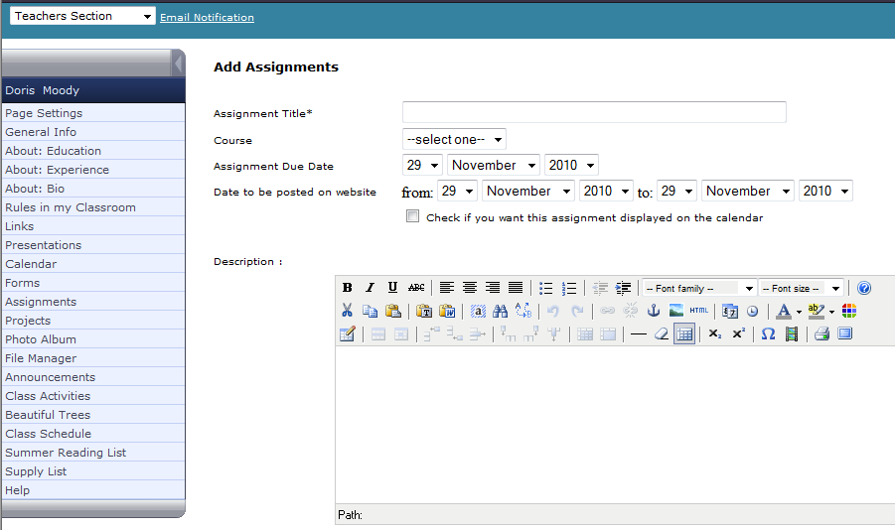
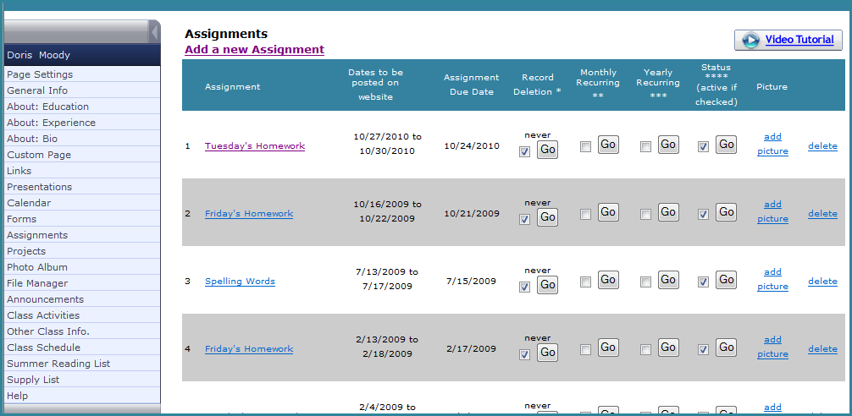
Managed Assignments
Tuesday’s Homework
Study Chapter 3.
Answer odd questions at end of chapter.

Slide 27
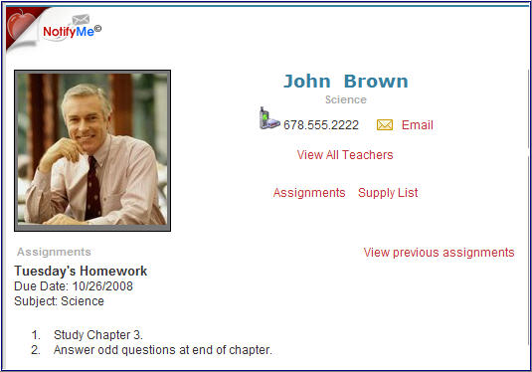
Managed Assignments
Teachers choose which areas are active

Slide 28
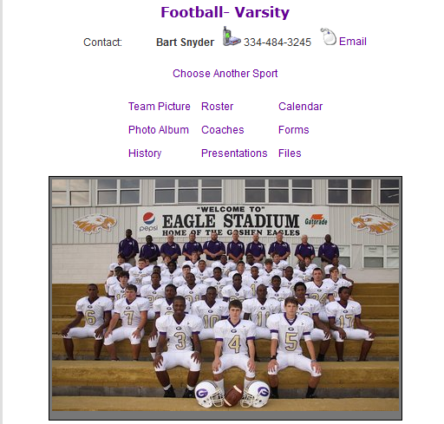
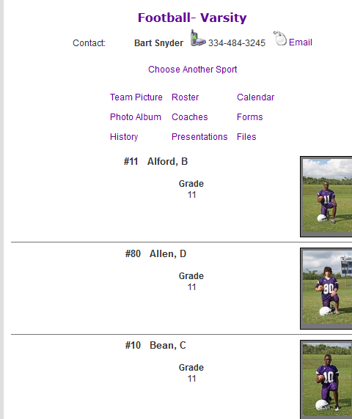
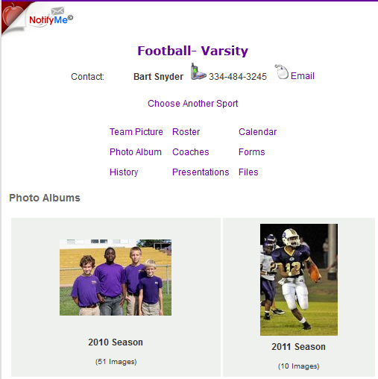
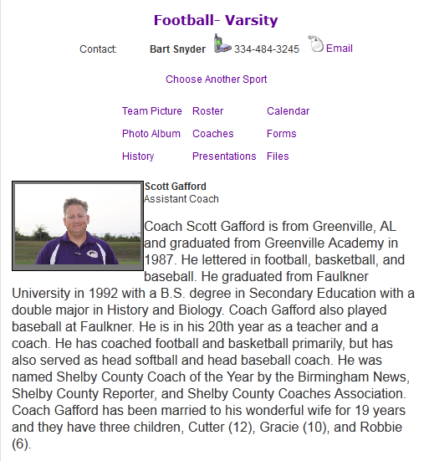
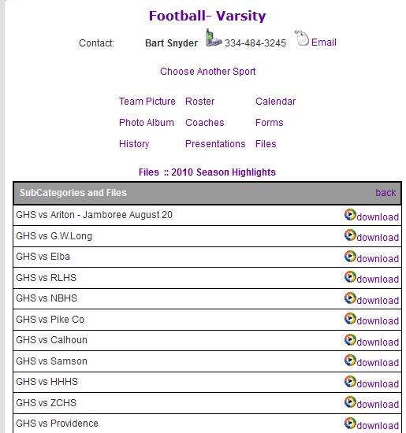
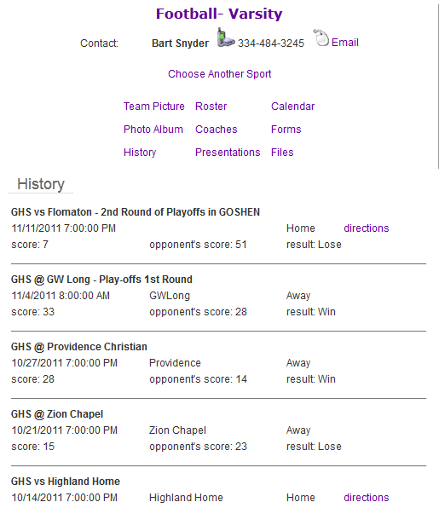
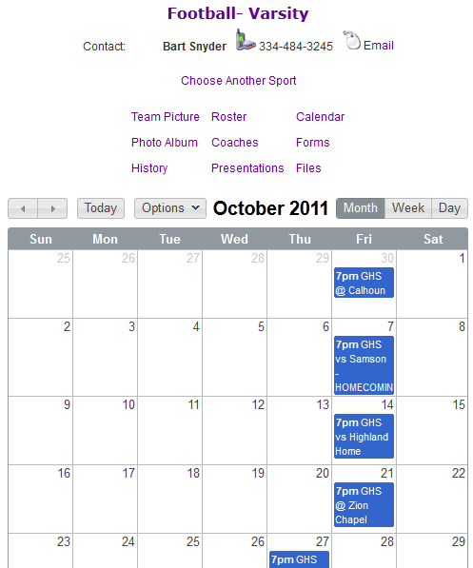
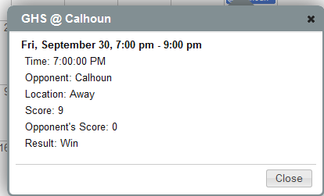
Complete Sports Information

Slide 29
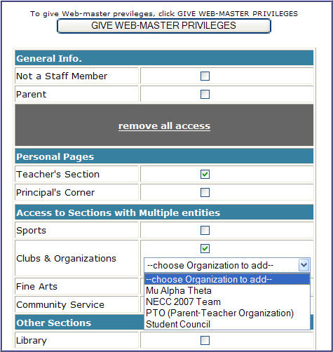
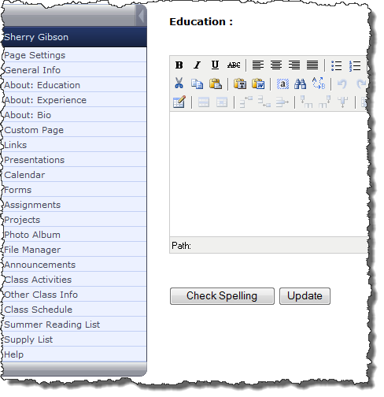
Easy to Manage Permissions
Notes:
.

Slide 30
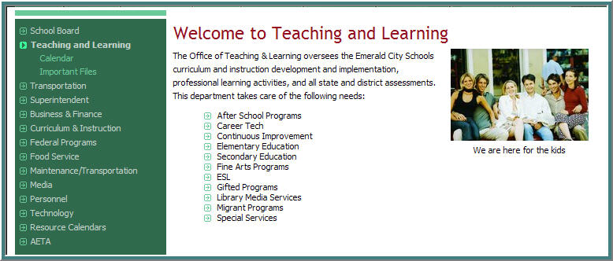
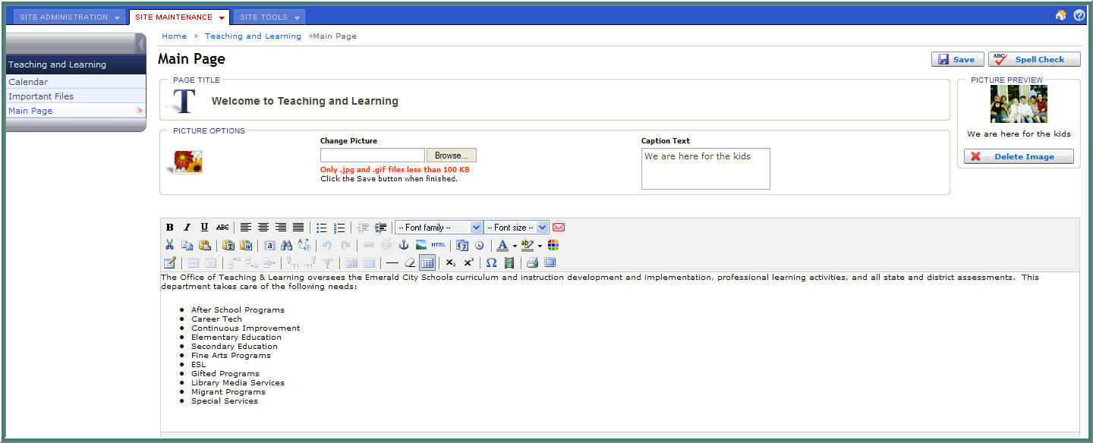
Custom build for districts
Important Files
Teaching and Learning

Slide 31
SCHOOLinSITES Exclusive Tools
Notify Me
Survey Generator
Online Forms
News Alerts (Press Releases)
The Blog
Message Tracker

Slide 32
Notify Me – Signing Up
greatparent@hotmail.com
greatparent@hotmail.com
Text Messaging Optional

Slide 33
Notify Me – Receive Alerts

Slide 34
Arrives in Inbox
Gather Data
Instant Results!
Online Forms

Slide 35
Surveys
Survey Says…

Slide 36
Extract Data

Slide 37
Board Meeting Alerts
Press Releases

Slide 38
Message Tracker
Concerned Parent
Johnny’s Progress
concernedparent@hotmail.com
I am concerned about Johnny’s progress in Social Studies. Please contact me at your earliest convenience so that we can discuss how best to handle. Thanks!

Slide 39
Second Component
Information and Communication

Slide 40
District/Schools Integration
Share News
Share Events
Share Users
Share Data
Notify Me Alerts

Slide 41
Exchange of News
School News
Becomes District News

Slide 42
Exchange of News
District News
Becomes School News

Slide 43
Share Events

Slide 44
Schools Snapshot

Slide 45
Private Network

Slide 46
The Blog

Slide 47
Notify Me – Push Alerts to All

Slide 48
Third Component
Set in Motion

Slide 49
Training and Rollout
How do you get started?
We have the plan that can get your system rolled out in just weeks.
What’s better? We take care of training your staff.
And, building your custom designs before training.

Slide 50
Our Plan + Your Team = Quick Rollout
Pre-Training Consultation
‘Train-the-Trainer’ Model
14-day rollout initiative
Site built … Content posted … Launch!
We continue to work with you and your contributors to create, breed and nurture success.

Slide 51
LDAP Connectivity
Real-time Authentication
SSL Encryption
Additional Mappings “On-the-Fly”
Authenticate Across Schools
Customizable Messages for Sign On Pages

Slide 52
Track Your Success
“If you build it, they will come…”

Slide 53
Free and Unlimited!
Unlimited size and space
Unlimited bandwidth
Unlimited users
Student e-mail
Free support to all users (toll-free number)
Free webmaster resources

Slide 54
Additional Benefits
Priority One E-rate eligible
Only company whose hosting is 100% E-rate eligible
One of the Top 5 hosting companies in the country for schools and districts
Highest customer retention in industry

Slide 55
Customer Driven
Every aspect of SCHOOLinSITES is driven by the needs of our customers. We believe this is best reflected by our customer retention rate, which offers a clear comparison between SCHOOLinSITES and our peers.

Slide 56
Customer Driven

Slide 57
Notes:
Do you feel that our solution exceeds your needs?
Where do you feel we should go from here?
When would you like to get started?

