Slide 1
AP Rhetorical Analysis

Slide 2
Précis Formula
1) Name of author, type of document, (date) “Title” argues (a description of the author’s major purpose).
2) A couple of rhetorical terms and, in brief, how they function to convey meaning.
3) Describe the organization, or structure of the speech, and explain why it is particularly effective for this audience
4) Writing with (two tone words), author’s name appeals to (a description of the two audiences and why the message appeals to them).

Slide 3
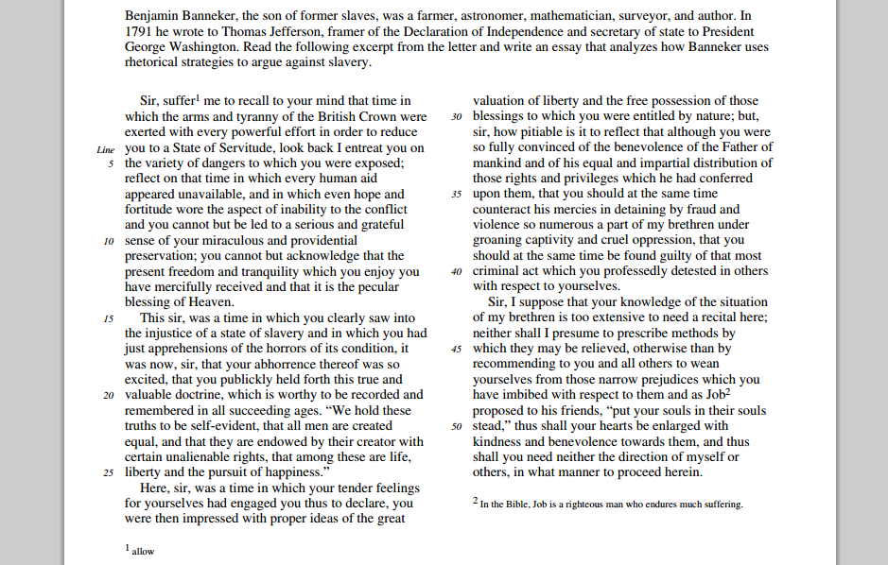
2010 AP Rhetorical Analysis Prompt

Slide 4
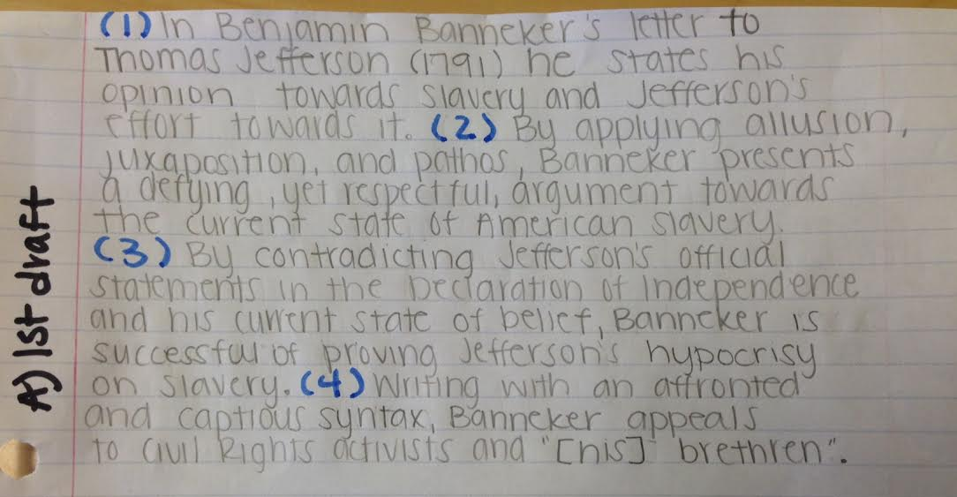
First draft!
(I am incredibly grateful for YOU and your example!)

Slide 5
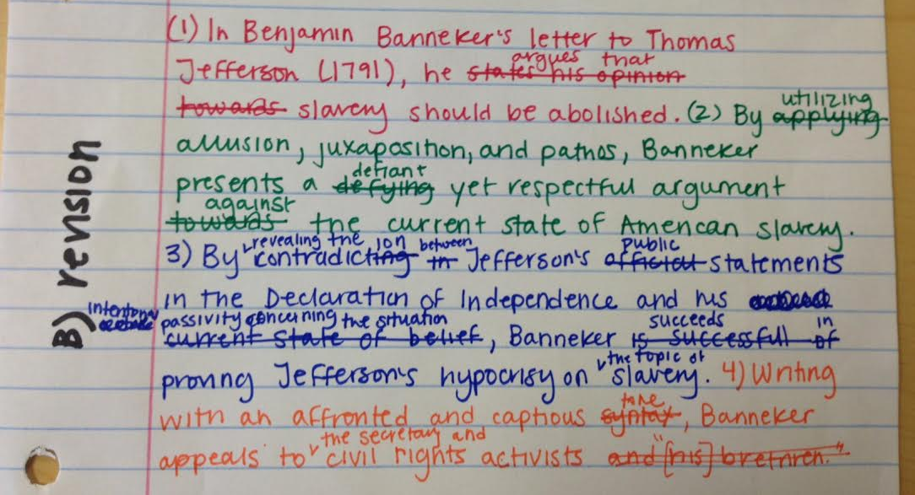
Quick revision:

Slide 6
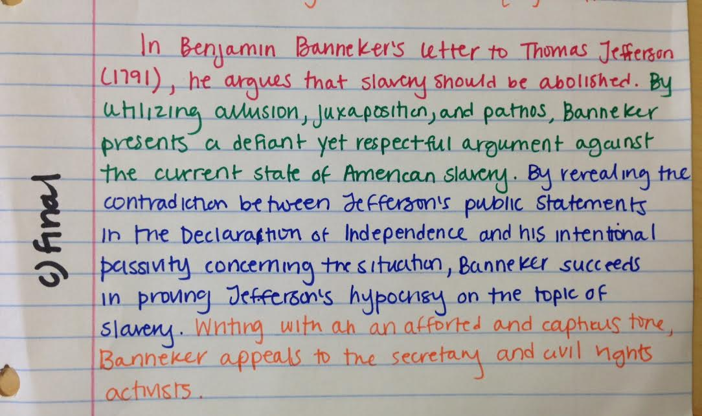
Final draft:
t
n

Slide 7
Another Banneker Précis
1)Benjamin Banneker’s persuasive letter (1791) asserts that slavery is an injustice that Thomas Jefferson should work to eradicate. 2) Banneker uses emotional diction and structured metaphors which juxtapose the condition of the slaves with the colonial opposition to a “state of servitude” under England. 3) Banneker’s command of parallelism and Biblical allusion further force Jefferson to visualize the injustice of slavery and persuade the secretary that he should free his slaves. 4) Writing with reverence, Banneker’s eloquent appeal not only reminds Jefferson of God’s watchful eyes but serves in contemporary times to remind Americans of our own shameful past.

Slide 8
Writing the essay: Chronological Order
I. Intro paragraph: You may use our précis or just start with an extended observation followed by a thesis.
II. Body paragraph: Analysis of all devices and appeals in the first 1/3 of the essay
III. Body paragraph: Analysis of all devices and appeals in the middle of the essay
IV. Body paragraph: A discussion of the end of the essay including an analysis of the conclusion.
V. Conclusion: Restate your thesis (OR bring your last paragraph to the end of the essay to make a concluding statement)

Slide 9
2013’s AP graders advice for the Rhetorical Analysis Prompt
The analysis question, provides an opportunity for students to demonstrate their practical understanding of rhetorical analysis. Like the synthesis question, the analysis question requires students to integrate reading and writing skills. Rhetorical reading entails comprehending both the meaning and purpose of an author’s argument and its intended audience(s), and students are asked to demonstrate rhetorical comprehension of a text by explaining how the author’s rhetorical decisions promote or hinder successful accomplishment of the purpose. In short, rhetorical analysis means explaining not only what writers are saying but also why and how they are saying it.

Slide 10
Rhetorical Analysis = How, Why, So What
HOW?
What techniques doe the writer choose to present the material?
WHY ?
Are the choices effective and appropriate for the intended audience?
SO WHAT?
What is accomplished or created?
Speaker
Rhetorical devices/
strategies/
E,P, and L
(how?)
Audience (why?)
Purpose (so what?)

Slide 11
EXAMPLE: In his letter to Thomas Jefferson (1791), Benjamin Banneker argues that slavery is morally wrong and that America needs to change this vile tradition. He uses juxtaposition to compare free men to slaves and uses allusion to the Bible and Americans’ religion to appeal to Jefferson’s conscience, while also intelligently using parallel syntax and polysyndeton to highlight free mens’ and slaves similar attitudes toward freedom. With desperation and passion, Banneker stresses that slavery should be abolished in hopes that whites and blacks could all be free, both in 1791 and in the future.

Slide 12
Banneker starts off his essay “entreating” Jefferson to reflect on America’s struggle for independence from the “arms and tyranny of the British Crown.” Benjamin logically asserts that if the colonists had a right to freedom, then slaves should also have the same right. He uses the phrase, “State of Servitude” to compare the colonists to slaves, purposefully capitalizing the words in order to emphasize this connection. Benjamin also alludes to “Heaven” because he wants Jefferson to realize that the slaves truly are deserving of “freedom and tranquility” which was “mercifully received” from Heaven. Slaves were taught the grace of God even back in 1791, and Banneker utilizes this to prove that slaves were allowed to receive the “blessing of Heaven” just like Americans were.

Slide 13
Banneker very astutely remarks that Jefferson understands the “injustice of the state of slavery”, continuing with his assertion that the colonists could understand the right and need for freedom. However, he now accuses Jefferson of his scandalous decree by alluding to the Declaration itself, where Jefferson himself wrote that, “all men are created equal”. This allusion very effectively points to the mistaken mindset of the colonists who refuse to acknowledge slaves’ right for freedom. Banneker impressively uses Jefferson’s own knowledge and feelings against slavery, which establishes ethos, or his credibility, not through his own knowledge, but through Jefferson’s. This witty use of ethos only strengthens Banneker’s argument because it effectively convinces all readers, including Jefferson, that slavery is logically wrong.

Slide 14
In addition, Banneker asserts that slavery is morally wrong through polysyndeton combined with strong adjectives with the purpose of appealing to all readers’ consciences. Banneker writes a long-winded sentence explaining the colonists’ realization of their rights for freedom and confirming their belief in God’s “equal and impartial distribution” of these precious rights. Since most people value freedom, it is natural to assume the readers of Banneker’s letter also value these rights of “liberty and free possession.” Therefore, Banneker’s long statement about mankind’s natural longing for freedom is extremely effective when it is juxtaposed, after a semi-colon, with his clear description of the agony, “under groaning captivity and cruel oppression” the colonists had inflicted upon the slaves. This statement by Banneker strongly convicts the reader, Jefferson especially and other colonists of the time period, the slaves’ light to light, face to face with the reader’s morals and sense of sympathy for the slaves. Banneker in the next paragraph again appeals to the reader’s “kindness and benevolence” when he asks the readers to “put [their] souls in [the slaves’] stead” both alluding to the Bible and evoking more sympathy for the slaves’ condition.

Slide 15
Banneker’s astute essay to Mr. Jefferson was extremely effective at depicting the abject conditions of the slaves while confronting the colonists’ mindset on slavery at the same time it appeals to the minds of future readers to understand past conditions and influence future events because of Banneker’s influential words.

Slide 16
Reflection
After reading the anchor papers from the College Board, the scoring commentary, and the previous slides, write down 2 things you want to remember or try to emulate in your writing and 2 things you want to avoid.
Keep these reflections together as we will add to them in the coming weeks.

