Slide 1
CCHS Academic Team
Coach Jennifer Jordan
Assistant Coach Karen Greene
Assistant Coach Jacob Frantz
$20.00 Membership Fee
Possibility of an Academic Letter (3 issued in 2014-2015)
Members of Pennyrile Academic Association and participate in Governor’s Cup
September 28th @ Russellville JV Challenge Governor’s Cup Nov 14th
October 26th @ CCHS (host) Governor’s Cup JV composition Nov 10th
November 9th @ Union County District Governor’s Cup January 30th
November 23rd @ CCHS (host) Regional Governor’s Cup February 20th State Finals March 19th – 21st Galt House

Slide 2
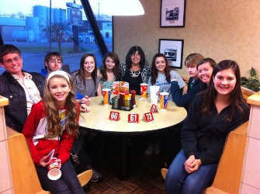
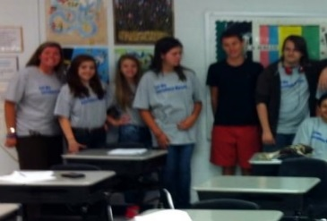
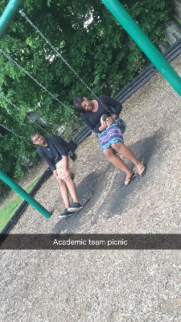
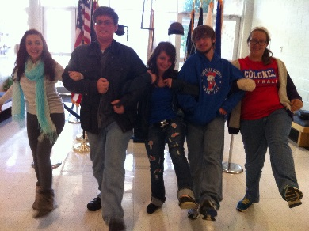
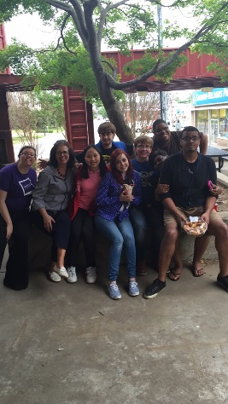
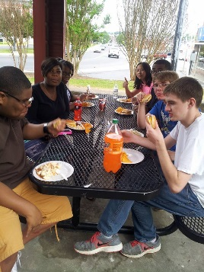
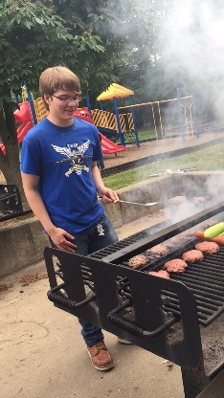
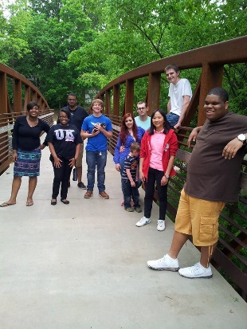
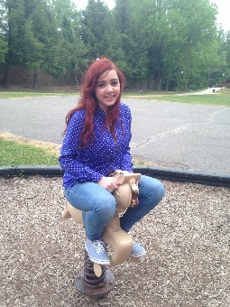
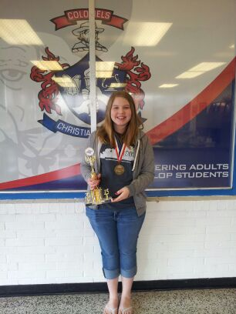
Academic Team Activities
Fundraisers
Red/White/Blue Spirit Beads
3/$1.00 at home games
Four Seasons Box Lunches for teachers twice a year

