Slide 1

A.1. Knows High Expectations
Snow Day
Materials: pencils and paper
Purpose: To allow students to continue learning from the home via technology.
Instructions: Email completed assignments and questions to steven.scudder@Christian.kyschools.us from 8-11 AM and 12-3 PM on snow days.
1. Read and interact with the slide presentation.
2. Complete the bell ringer and exit question by providing the gradecam number/letter choice (1. A, 2. B) the same as in class.
3. Answer the formative assessment questions. Example: Lab 1. The candle consumes O₂. Energy conversion 1. PE stands for potential energy. 2. KE stands for kinetic energy.

Slide 2
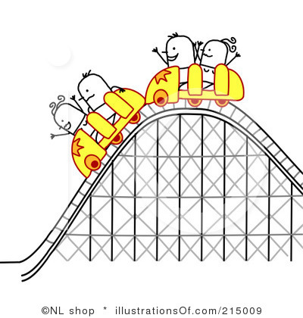
A.1. Knows High Expectations
Purpose & Life Connection
Materials: pencils and paper
No
Pass
Purpose: To describe how energy and mass are related.
Hook: A roller coaster is a train powered by gravity. An initial store of potential energy is released dramatically during the ride. When does the roller coaster have the most potential energy?

Slide 3
E.1. Individual Progress/Learning
Flashback/Formative
Materials: pencils and paper
No
Pass
3. What does the mechanical energy of an object equal?
a. chemical energy plus its nuclear energy.
b. The kinetic energy plus its potential energy.
c. nuclear energy.
d. thermal energy.

Slide 4

B.1. Knows High Expectations
Bell Ringer
Materials: pencils and paper
No
Pass
Target: I will describe (give details) the relationship (connections) between energy and mass and calculate how much energy is equivalent to a given mass.
5. Which of the following statements is a consequence of the equation E = mc²?
a. Energy is released when matter is destroyed.
b. Mass and energy are equivalent.
c. The law of conservation of energy must be modified to state that mass and energy are conserved in any process.
d. all of the above

Slide 5
A.1. Differentiated Learning Opportunities
Agenda
No
Pass
Act: Visual Vocabulary (20 min)
DI: Energy and Mass (10 min)
VFT: Physics of Fun (10 min)
Notes
What is your career pathway at CCHS?
CCHS Mission Statement
    Provide safe learning environment
    Successful students who are
      College ready
      Career ready
      Good citizens

Slide 6

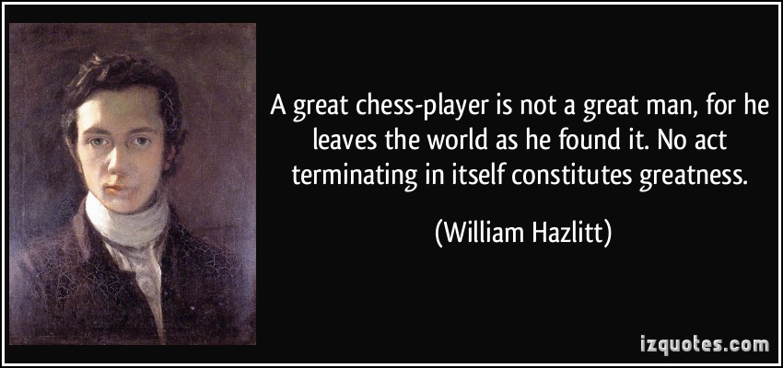
A.4. Cultural Time-Out
1 Reads, 3 Share Out
Pass
C² =3R
Colonel Climate = Respect, Restraint, Responsibility

Slide 7
B.5. Higher Order Thinking
Unit Learning Map
No Electronic Devices
Pass
Energy
Is about
The continuously changing of energy from one form to another and is classified by location or motion.
Described by
I. Energy Conversion & Conservation
3. Thermodynamics
2nd law
4. Using Heat
Understood through
E = mc²
2. Thermal Energy &
Matter

Slide 8
B.5. Higher Order Thinking
Act: Visual Vocabulary
No Electronic Devices
Pass
Purpose: To deep process the key terms allowing the student to recall the terms and meaning over time.
Read the definition provided.
Write a paraphrased definition.
Draw an image that links to the term on an individual level.
This assignment will be turned in when we return to school.

Slide 9
B.5. Higher Order Thinking
Act: Visual Vocabulary
No Electronic Devices
Pass
Energy: the ability to do work
Kinetic energy: the energy an object has due to its motion
Potential energy: energy that is stored as a result of potion or shape
Mechanical energy: the energy associated with the motion and position of everyday objects
Energy conversion: the process of changing energy from one form to another

Slide 10
B.5. Higher Order Thinking
Act: Visual Vocabulary
No Electronic Devices
Pass
Nonrenewable energy: a source of energy that exists in limited quantities and, once used, cannot be replaced except over the course of millions of years
Heat: the transfer of thermal energy from one object to another because of a difference in temperature
Radiation: the transfer of energy by waves moving through space
Central heating system: a heating system that heats many rooms form one central location
Heat pump: a device that uses work to transfer thermal energy from a colder area to a warmer area

Slide 11
B.5. Higher Order Thinking
DI: Energy and Mass
No Electronic Devices
Pass
Einstein’s equation, E = mc², says that energy and mass are equivalent and can be converted into each other.
E = energy (joules (J)), m = mass (kilograms (Kg)), c = constant/speed of light squared meters per second (m/s)
His theory of special relativity showed that energy and mass are equivalent/interchangeable.
Example: 1 gram of matter were entirely converted into energy. E = mc² = (10⁻³ kg) X (3 X 10⁸ m/s) X (3 X 10⁸ m/s)
Answer: = 9 X 10¹³ kg . m²/s² = 9 X 10¹³ J (Reminders: add/subtract exponents)

Slide 12
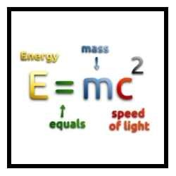
B.5. Higher Order Thinking
DI: Energy and Mass
No Electronic Devices
Pass

Slide 13
B.5. Higher Order Thinking
DI: Energy and Mass
No Electronic Devices
Pass
Assessment: Formative
(1-knowledge, 2-Skill)
What does each symbol in the special theory of relativity equation (E = mc²) represent?
How are energy and mass related?

Slide 14
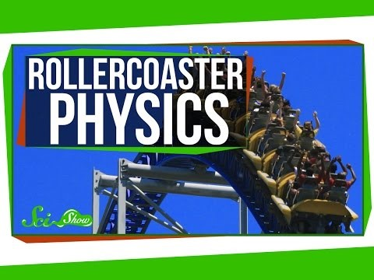
A.1. Differentiated Learning
VFT: Physics of Fun
Pass

Slide 15
A.1. Differentiated Learning
VFT: Physics of Fun
Pass
How does a roller coaster get to the top of the first hill?
How does the roller coaster continue to move after the first hill?
When does the roller coaster have the most potential energy?

Slide 16
B.5. Higher Order Thinking
DI: Energy Conversion
No Electronic Devices
No
Pass
Energy Conversions & Conservation
Understood through
1. Energy is released from matter
2. Mass and energy are equivalent
3. Law of conservation modified m and E conserved

Slide 17
E.1. Individual Progress/Learning
Exit Question
No
Pass
6. What did Einstein conclude about the relationship between energy and mass?
Einstein could not find a connection so he conclude that they were separate issues.
Einstein concluded that energy could be transformed into mass and mass into energy.
Einstein did not research energy but focused on matter.
Einstein conclude that energy was to related to mass.

