Slide 1
Unit 1: Psychology’s History and Approaches

Slide 2
What is Psychology?

Slide 3
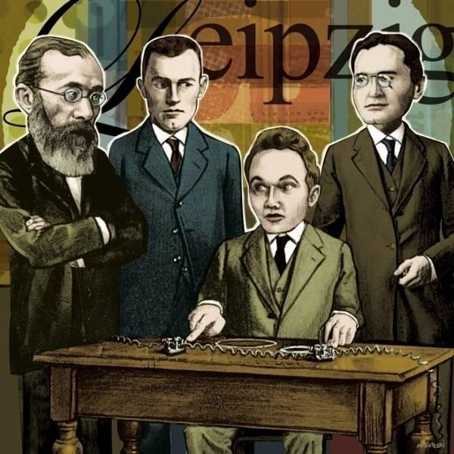
Psychology’s Roots Psychological Science is Born
Wilhelm Wundt (1879)
University of Leipzig (first lab)
Reaction time experiment
Seeking to measure what?
Introspection
Notes:
Reaction time experiment: ”Atoms of the mind”---fastest and simplest mental process
Reaction time experiment: Hearing a ball hit a platform and hitting a key (sound vs awareness)
To be aware of ones awareness takes longer
*

Slide 4
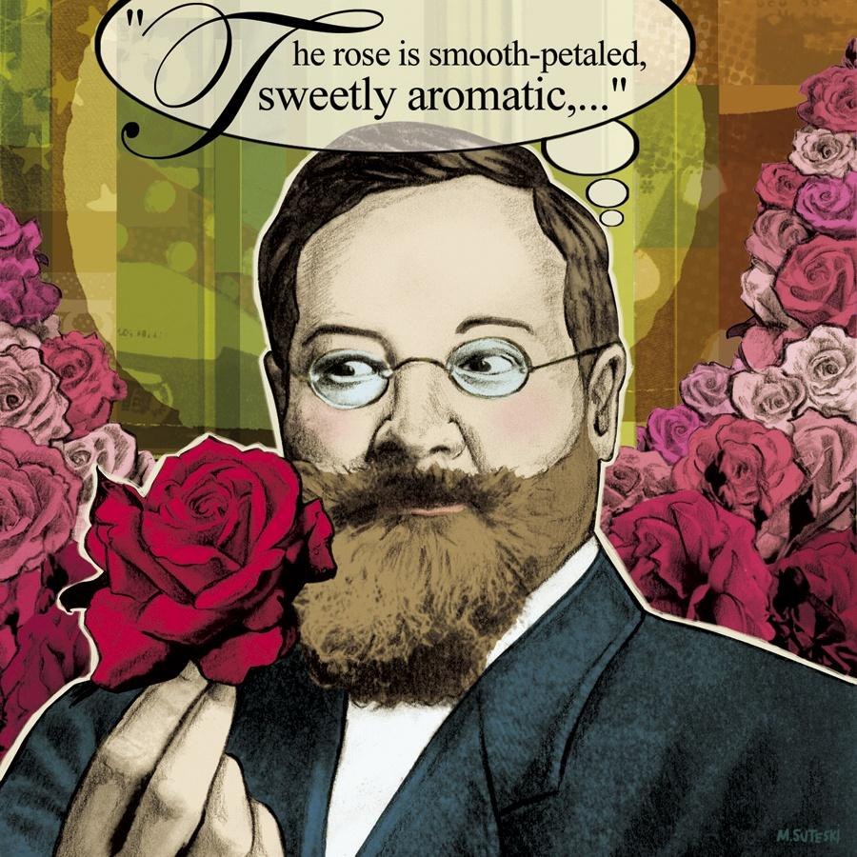
Psychology’s Roots Thinking About the Mind’s Structure
Edward Titchener
Structuralism NC
Introspection
“There is one thing, and only one in the whole universe which we know more about than we could learn from external observation. That one thing is ourselves. We have, so to speak, inside information”
Notes:
Report elements of their experience as they looked at a rose---What is your immediate sensations images, feelings
Required: smart verbal people----unreliable---results varied from person to person
*

Slide 5
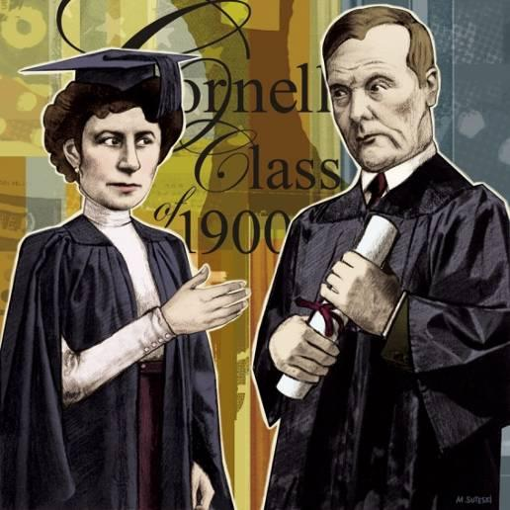
Psychology’s Roots Thinking About the Mind’s Function
William James
Functionalism NC
Mary Calkins
Margaret Floy Washburn
Experimental psychology
Notes:
William James: influenced by Darwin
Mary Calkins: James admitted her into his graduate seminar (did not have right to vote yet)---all men dropped out.///He tutored her alone—Requirements met for PHD—Harvard denied her a degree---Radcliffe offered instead-refused---Became first female pres of APA
Washburn: First PHD
Today women claim 2/3rds of PHD’s in Psych
*

Slide 6
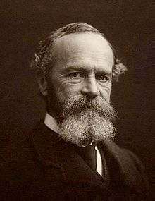
William James (1842-1910)
Published Psychology’s first textbook
The Principles of Psychology (1890)
Analysis
Introspection
Experiment
Comparison
Notes:
Focused on down to earth emotions, memories, willpower, habits and moment to moment streams of consciousness
*

Slide 7
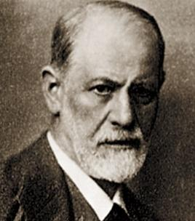
Psychological Science Develops
Wundt and Titchener: focused on inner sensations, images and feelings
James: introspection analysis of consciousness and emotion
Freud: emphasized the ways emotional responses to childhood experiences and our unconscious though processes affect our behavior
“Science of mental life”-through the 1920’s
Notes:
Science of mental life
Wundt and Titchenter:
*

Slide 8
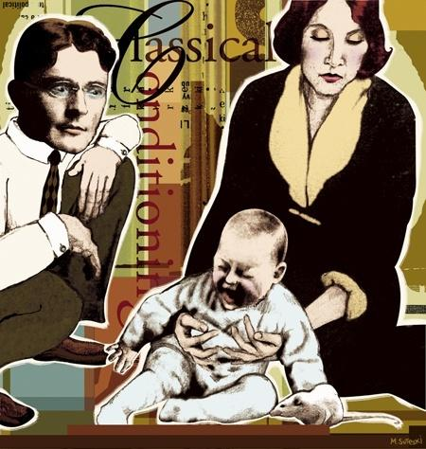
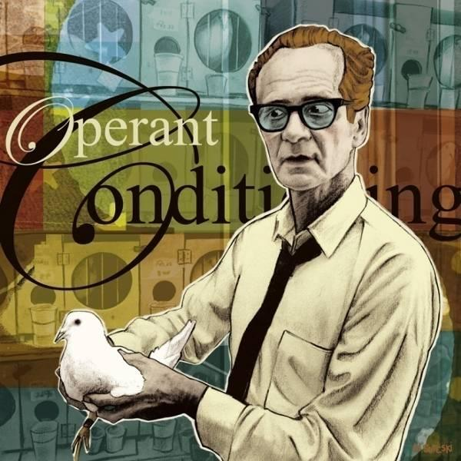
Psychological Science Develops
1920’s-1960’s
Behaviorism
John B. Watson
B.F. Skinner
“study of observable behavior”
“You can not observe a sensation, a feeling, or a thought, but you can observe and record people’s behavior as they respond to different situations.”
Notes:
Science is rooted in observation--
*

Slide 9
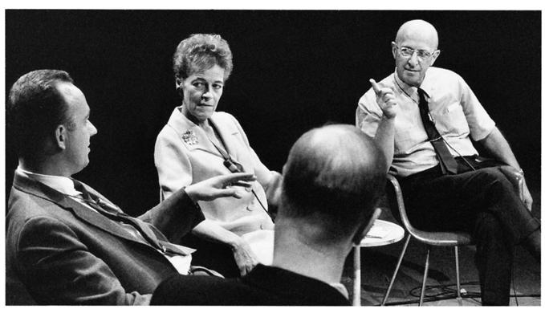
Psychological Science Develops (1960’s)
Humanistic psychology
Carl Rogers
Abraham Maslow
Cognitive Neuroscience NC
Notes:
Rebelled against behaviorism and Freudian psychology
Emphasized the importance of current enviornmental influences on our growth potential and the importance of having our needs for love and acceptance satisfied
*

Slide 10
Psychological Approaches/Perspectives (The Umbrella)
Biological psychology NC
Evolutionary psychology NC
Psychodynamic psychology NC
Behavioral psychology NC
Cognitive psychology NC
Humanistic psychology NC
Social-cultural psychology NC

Slide 11
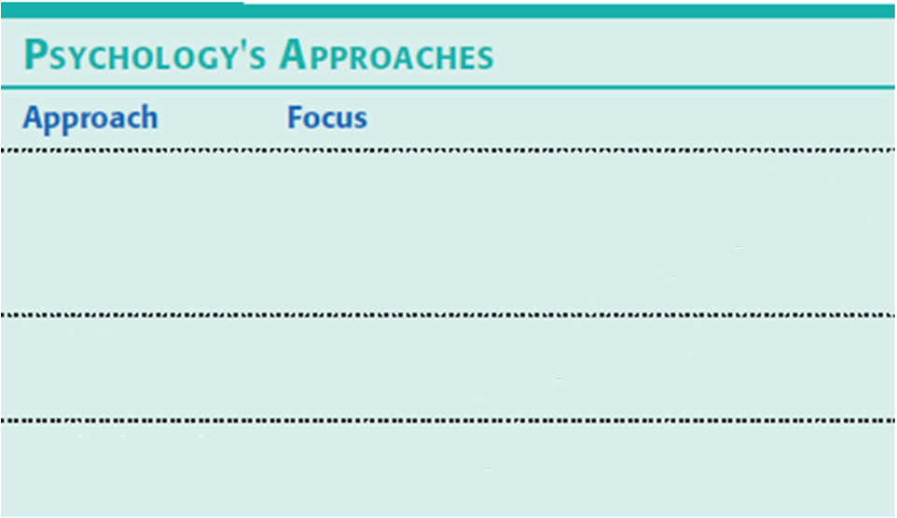
Psychological Approaches/Perspectives
Notes:
The Umbrella of the course
*

Slide 12
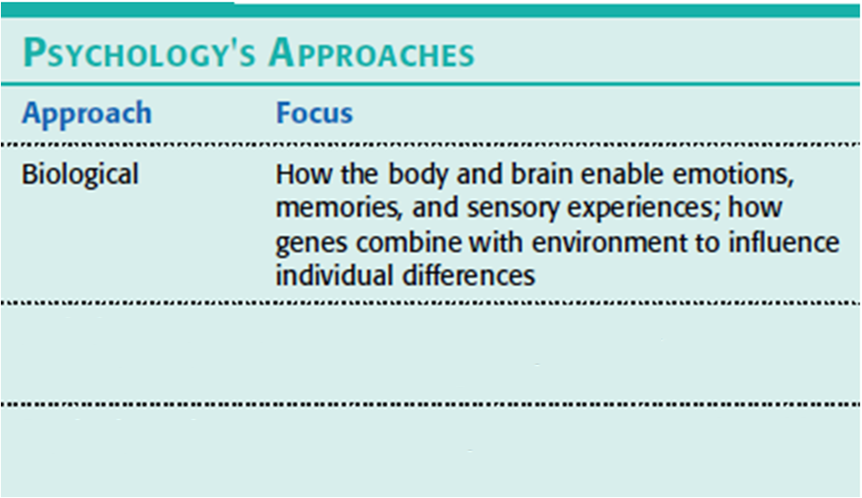
Psychological Approaches/Perspectives

Slide 13
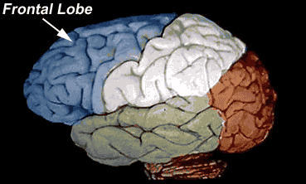
4 lobes of the brain

Slide 14
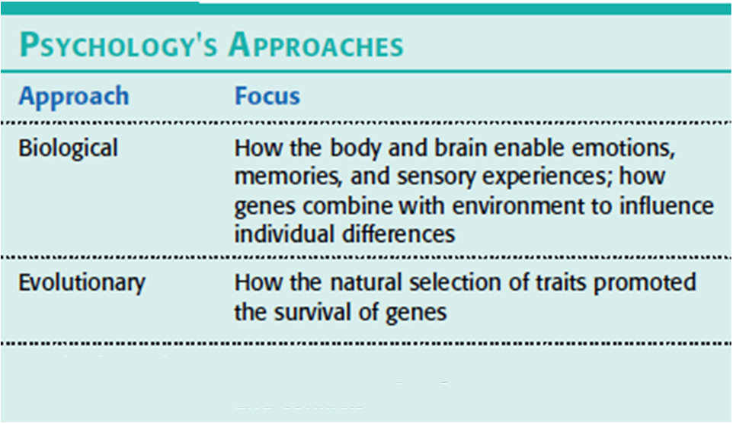
Psychological Approaches/Perspectives

Slide 15
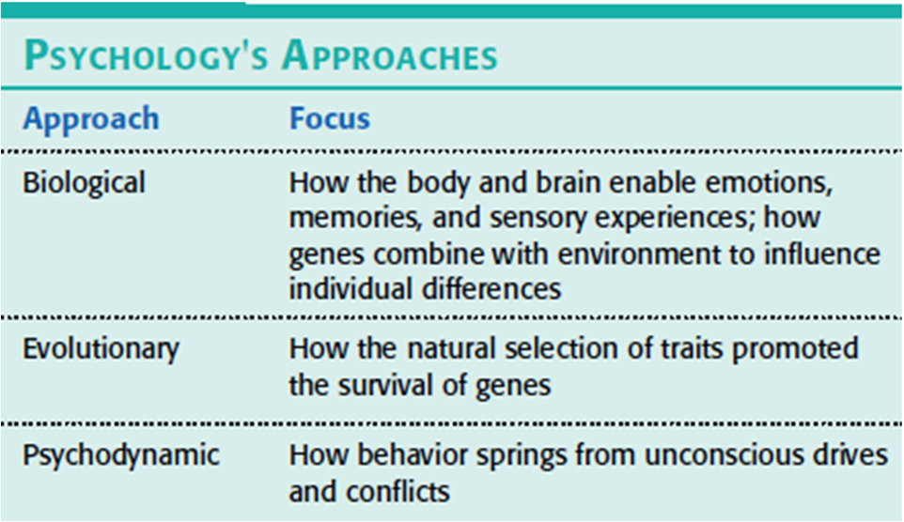
Psychological Approaches/Perspectives

Slide 16
Perspective: Psychoanalytic
How behavior springs from unconscious drives and conflicts
Analysis of personality traits and disorders in terms of sexual and aggressive drives as the disguised effects of unfulfilled wishes and childhood traumas
Unresolved complexes hidden within ones unconscious (Oedipus and Electra, Potty training)
ID, EGO, SUPEREGO
Unconscious of why we do what we do
Treatment?????

Slide 17
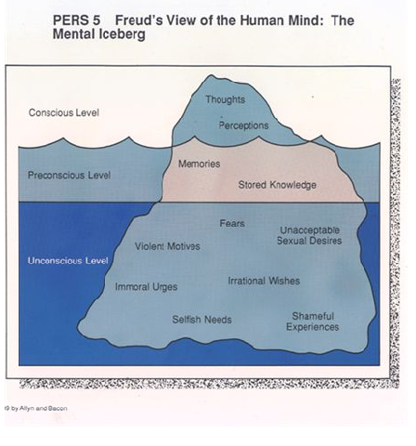

Slide 18
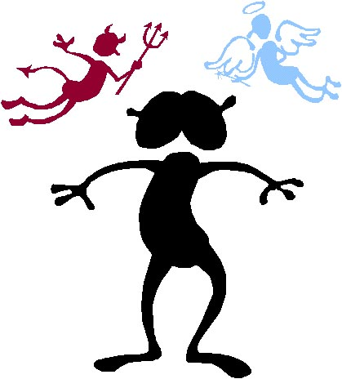
Id, Ego, Superego
Id=Pleasure principle
Ego=Reality principle
Superego=Conscience (inhibitions and moral values)
Battleground
Id, Ego, Superego

Slide 19
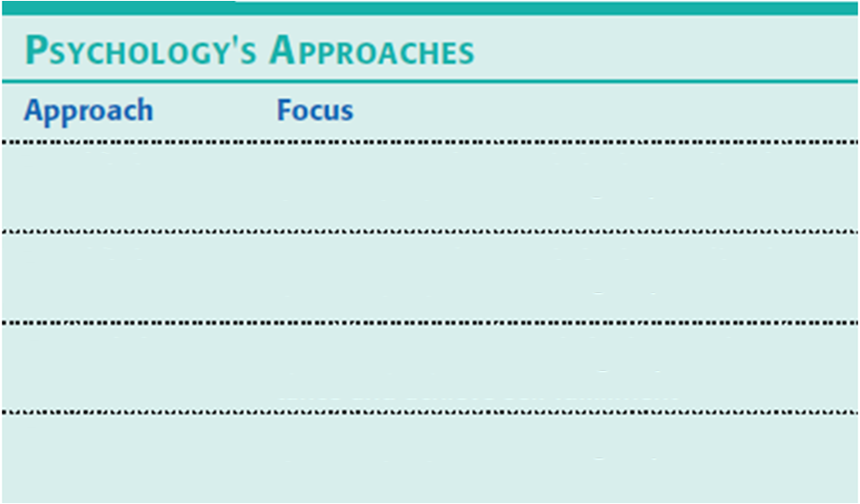
Psychological Approaches/Perspectives

Slide 20
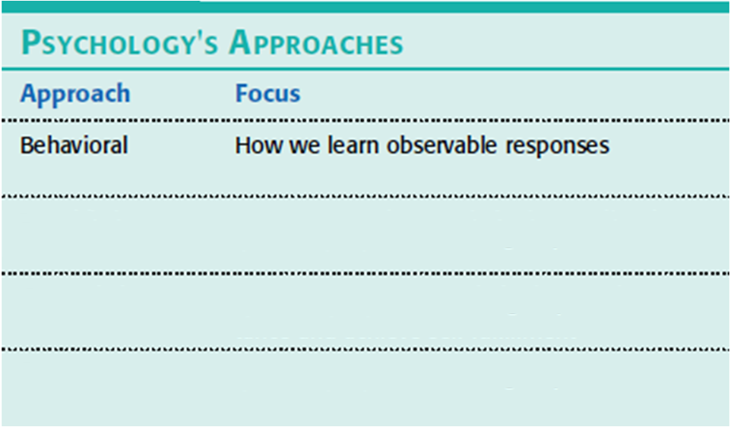
Psychological Approaches/Perspectives

Slide 21
Perspective: Behavioral (Learning)
How observable responses are acquired and changed
How we learn to fear particular objects or situations
How we most effectively alter our behavior, say, to lose weight or stop smoking.
Reinforcements and Punishments
How has ones environment shaped who they are. (Watson quote)
Personal experiences and reinforcement guide individual development
Skinner box, Pavlov's dogs, Little Albert
Treatment?

Slide 22
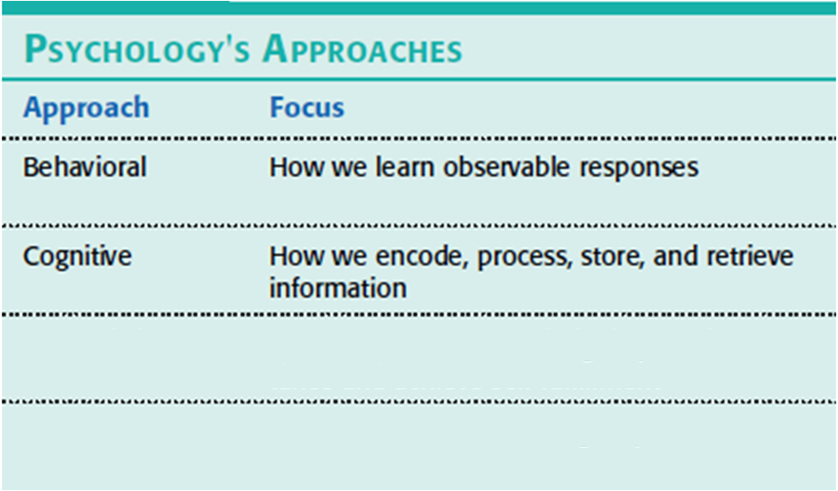
Psychological Approaches/Perspectives

Slide 23
Perspective: Cognitive
How we process, store, and retrieve information
How we use information in remembering, reasoning, and solving problems
Interpretation of mental images, thinking, and language
Memory
How would someone in this perspective treat your fear?

Slide 24
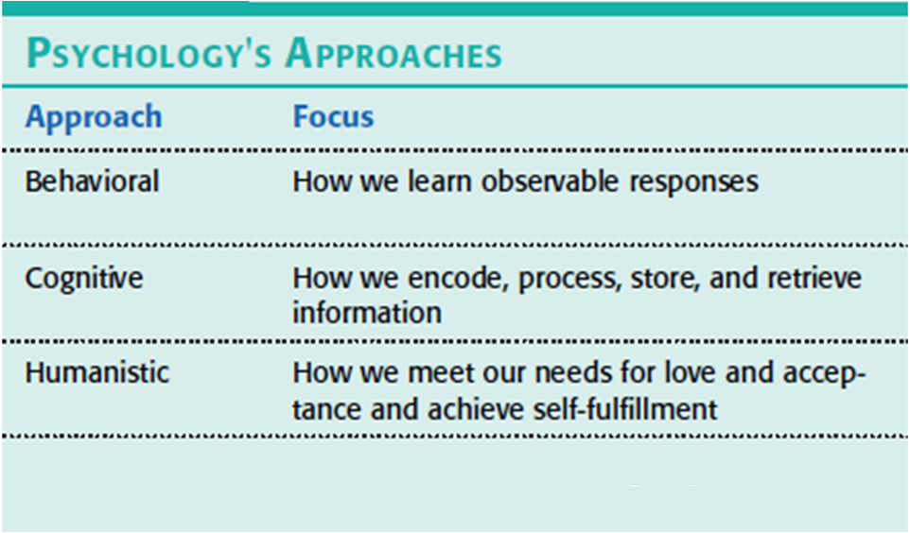
Psychological Approaches/Perspectives

Slide 25
Perspective: Humanistic
Our capacity to choose our life patterns and not just be driven by unconscious forces or shaped by the environment
A reaction to behaviorism and psychoanalysis
How we seek maturity and fulfillment
How people experience and understand their own lives
How people find meaning in life
Maslow’s Hierarchy of needs
Treatment?

Slide 26
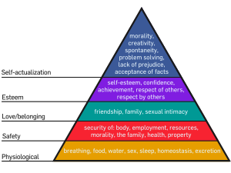

Slide 27
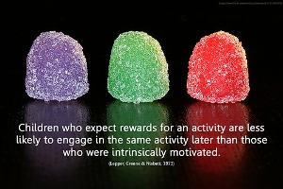

Slide 28
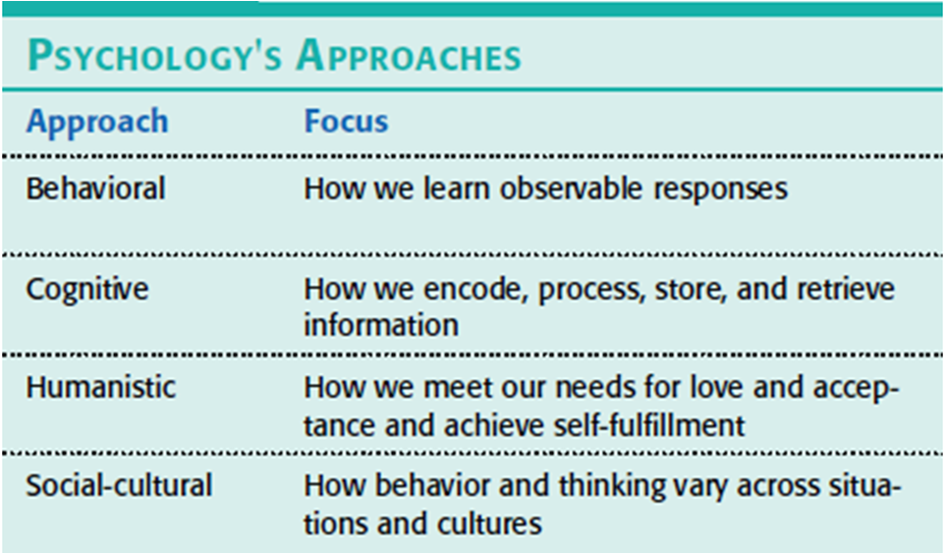
Psychological Approaches/Perspectives

Slide 29
Definition Slides

Slide 30
Structuralism
= an early school of psychology that used introspection to explore the structural elements of the human mind.

Slide 31
Functionalism
= a school of psychology that focused on how our mental and behavioral processes function – how they enable us to adapt, survive, and flourish.

Slide 32
Behaviorism
= the view that psychology (1) should be an objective science that (2) studies behavior without reference to mental processes.
Most research psychologists today agree with (1) but not with (2).

Slide 33
Humanistic Psychology
= historically significant perspective that emphasized the growth potential of healthy people and the individual’s potential for personal growth.

Slide 34
Cognitive Neuroscience
= the interdisciplinary study of the brain activity linked with cognition (including perception, thinking, memory, and language).

Slide 35
Psychology
= the science of behavior and mental processes.

Slide 36
Natural Selection
= the principle that, among the range of inherited trait variations, those contributing to reproduction and survival will most likely be passed on to succeeding generations.

Slide 37
Biological Psychology
= a branch of psychology that studies the links between biological (including neuroscience and behavior genetics) and psychological processes.

Slide 38
Evolutionary Psychology
= the study of the roots of behavior and mental processes using the principles of natural selection.

Slide 39
Psychodynamic Psychology
= a branch of psychology that studies how unconscious drives and conflicts influence behavior, and uses that information to treat people with psychological disorders.

Slide 40
Behavioral Psychology
= the scientific study of observable behavior, and its explanation by principles of learning.

Slide 41
Cognitive Psychology
= the scientific study of all the mental activities associated with thinking, knowing, remembering, and communicating.

