Slide 1
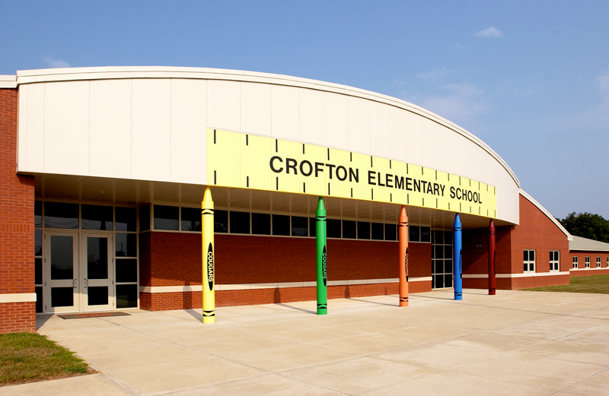
Crofton Elementary Student Technology Leadership Program STLP

Slide 2
The Mission of the Student Technology Leadership Program (STLP) is to:
advance individual capabilities of students
to motivate all students
to create leadership opportunities through the use of technology

Slide 3
Student Technology Leadership Program Goals
The STLP will develop activities to enhance the academic, social and emotional growth of the student.
The STLP will provide leadership opportunities for all students.
The STLP will experience multi-age collaboration by forming innovative learning partnerships.
The STLP will form learning partnerships between students with different technology skills.
The STLP will develop activities that benefit communities.
The STLP will develop instructional activities, which integrate technology and benefit the school and support the Kentucky Education Technology Systems (KETS).

Slide 4
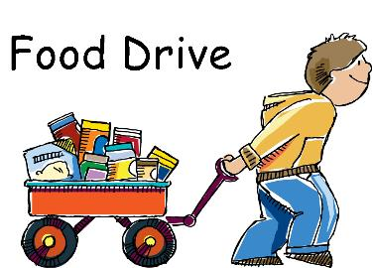
Community Service Project “Can You Do It? Cougars Can!”

Slide 5
Our Goal
To assist the North Christian County community and the students of Crofton Elementary through supporting Branch Outreach that connects with the community through empowering families though faith and education.
Pic of Branch Outreach Here

Slide 6
Why
STLP students are trying to make a difference by helping Branch Outreach support the community of North Christian County.

Slide 7
What Can We Do?
We will hold a non-perishable food drive to support the families that Branch Outreach services within the North Christian County community and students of Crofton Elementary through the Thanksgiving Holiday.
We will motivate students to bring in non-perishable foods through having classroom competition to see which classroom can bring in the most products.
Insert pic of bulletin board

Slide 8
How We Did it
STLP members collaborated to discuss and decide on a service project that they wanted to help with in their community.
STLP members collaborated with Branch Outreach a community food bank that is based on education, family, and faith.
STLP members worked with their school administration daily to make announcements for the food drive, used technology to create flyers and posters to display in the school’s hallways, posted the food drive on social media, sent home flyers to parents/guardians.
STLP members collected the non-perishable foods from all homerooms daily and recorded their collection amounts for each homeroom on the STLP bulletin board.

Slide 9
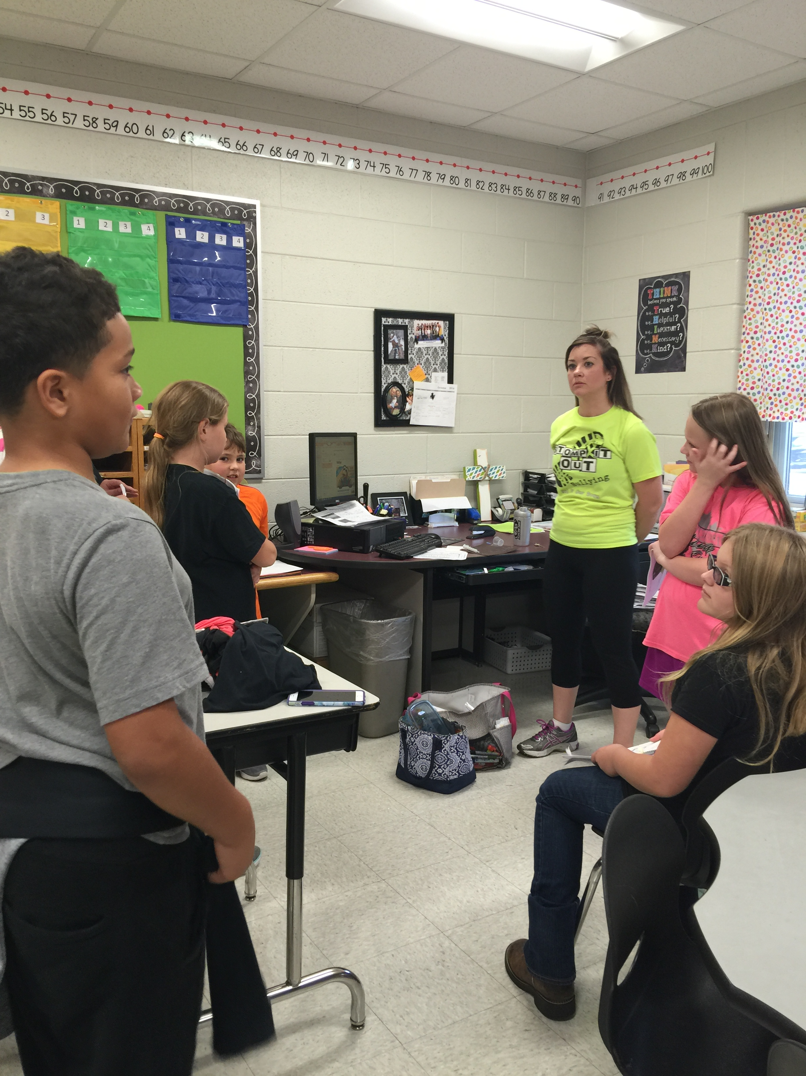
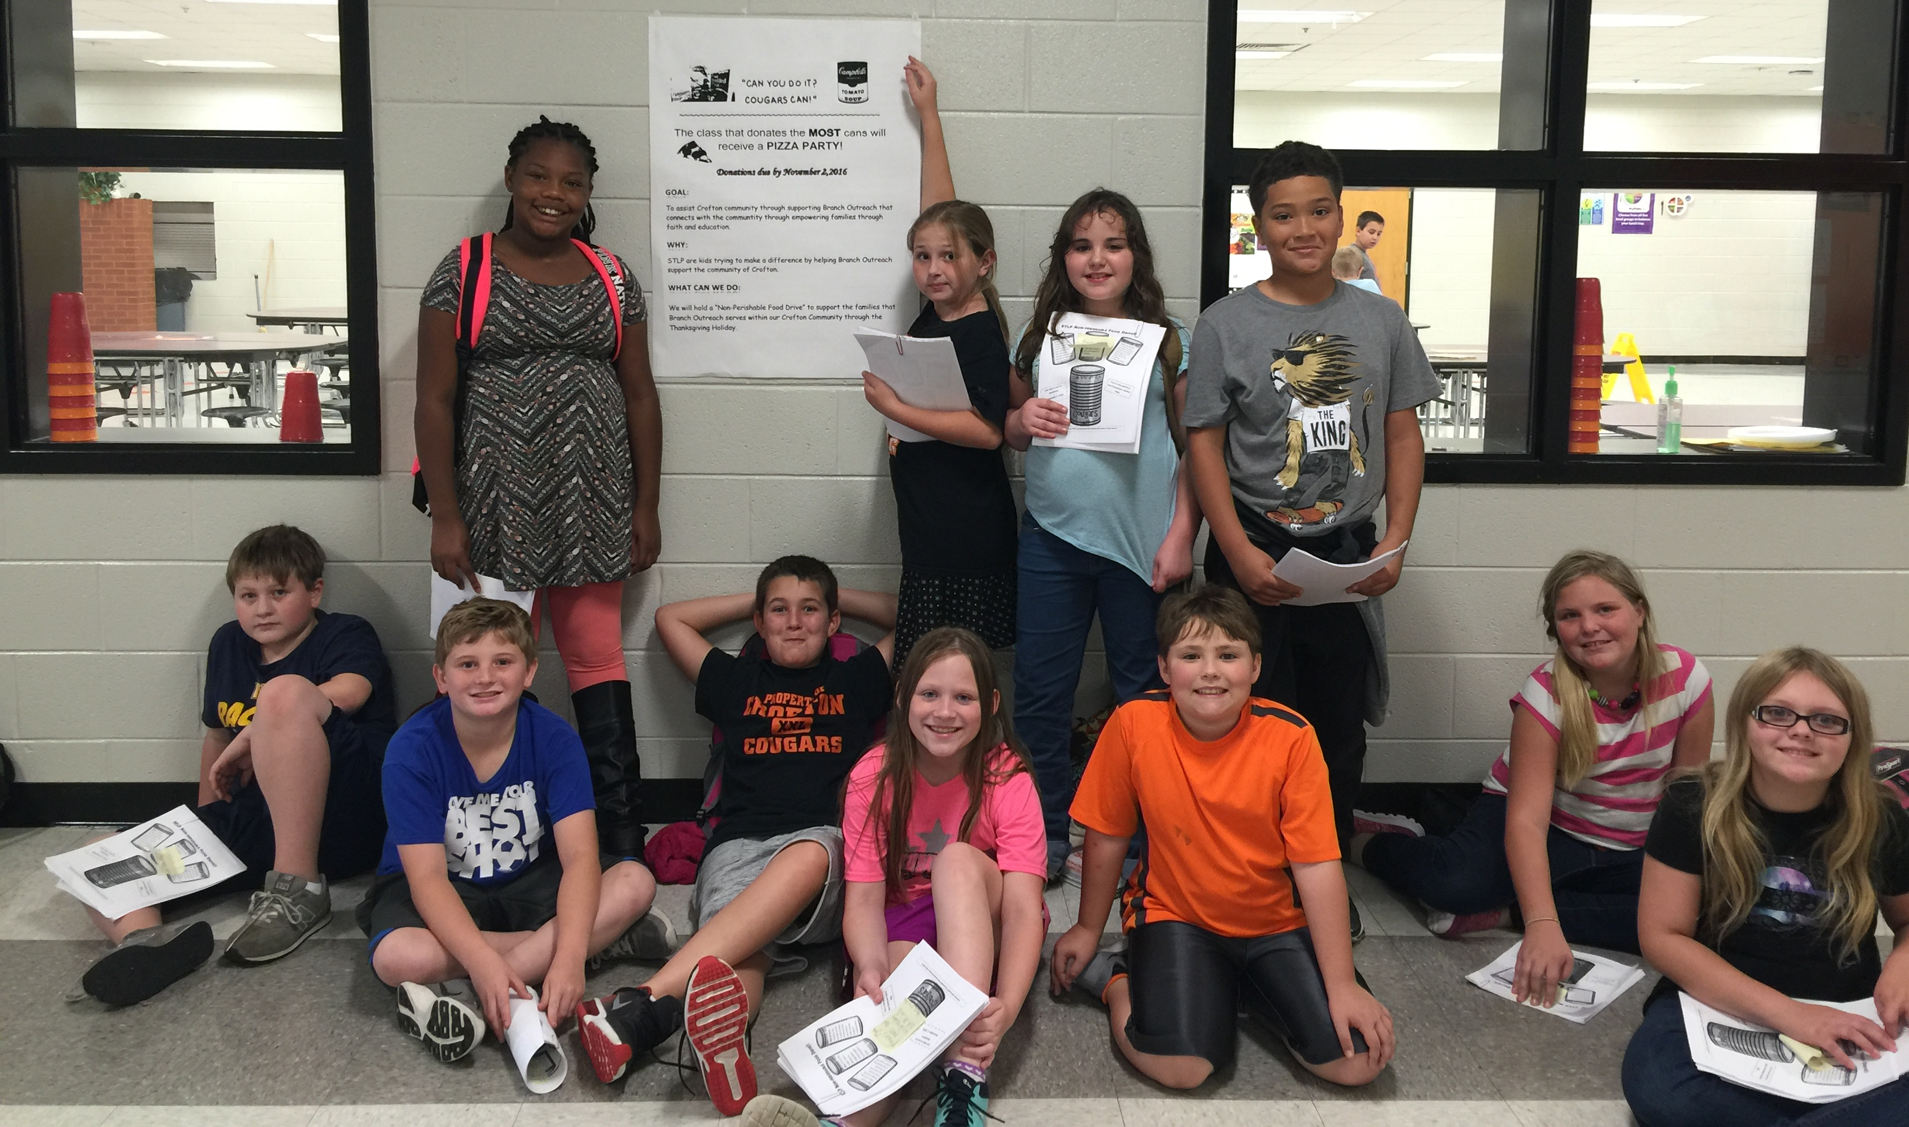
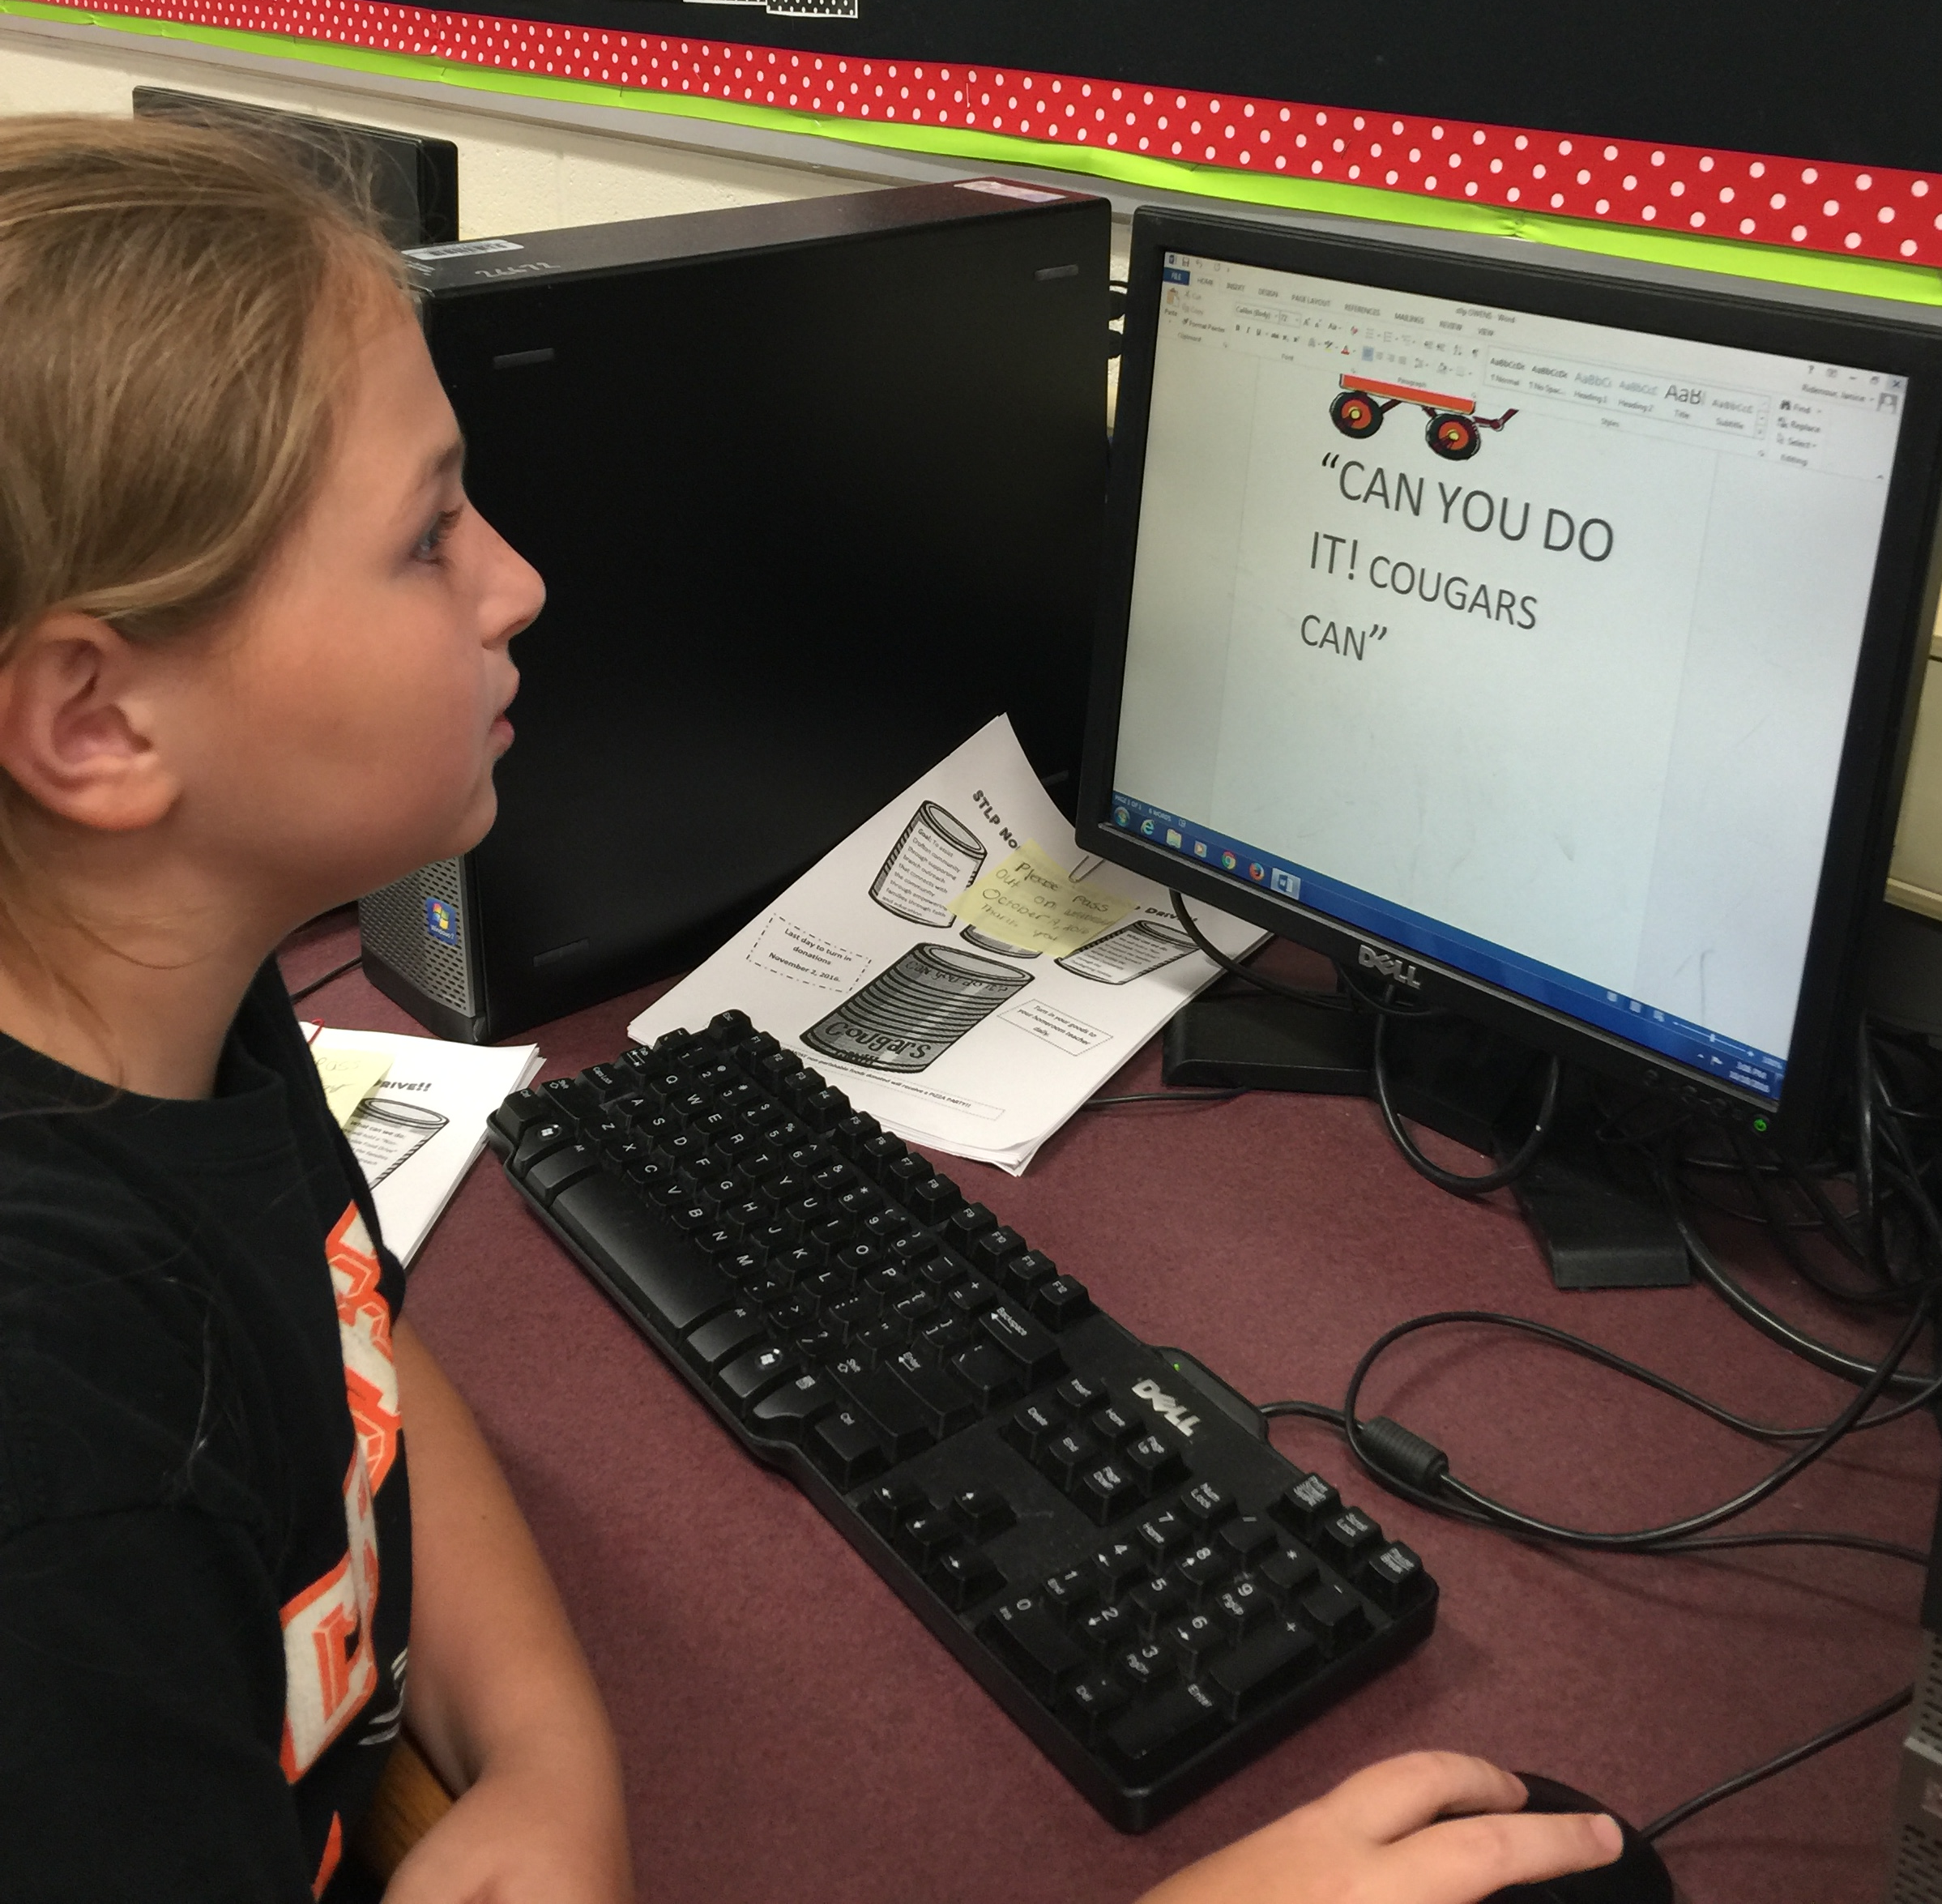
Students Busy Making a Difference
Promoting the “Food Drive” by passing out flyers and hanging posters.
Speaking to teachers to help get the word out.
Using technology to create flyers to help promote the “Food Drive”.

Slide 10
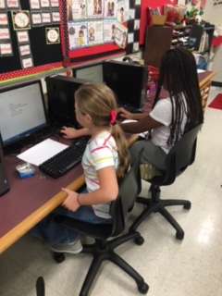
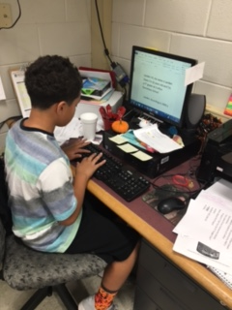
Students Busy Making a Difference
STLP Members busy planning for the “Food Drive”
STLP Members working hard to develop a plan to share the “Food Drive”
STLP Member working hard to develop a plan to share the “Food Drive”

Slide 11
Our Next Steps
STLP will deliver the non-perishable products to Branch Outreach to prepare baskets for Thanksgiving.
STLP will assist in delivering the baskets.
STLP will continue supporting the families of Northern Christian County and the students of Crofton Elementary through helping Branch Outreach by collecting hygiene products and other products through out the year.

Slide 12
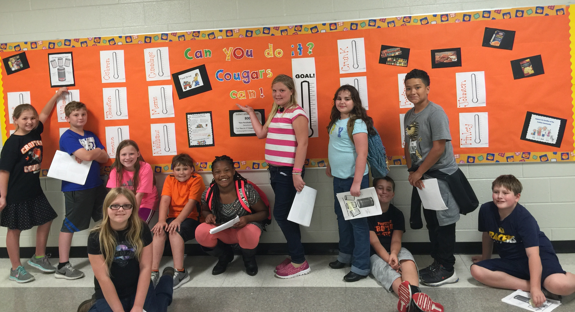
Meet our STLP Team

