Slide 1
Natural Resources
By: Tessa Farler & Nykie Morgan

Slide 2
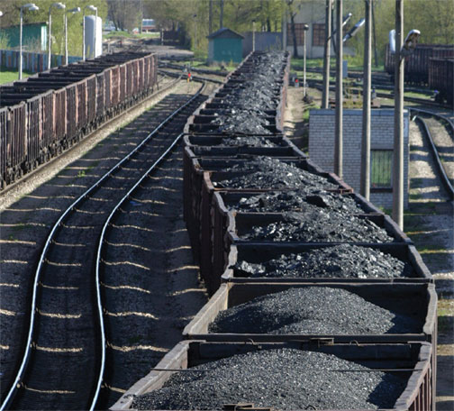
What are natural resources?
Natural resources are materials and substances found in nature that are NOT man-made. There are two different kinds of natural resources, nonrenewable and renewable.

Slide 3
What renewable resources?
Renewable resources are one of the two main kinds of natural resources. They can be put back as nearly as fast as it is used. Renewable resources can never run out, like wind, solar, and water power (also called hydroelectricity).

Slide 4
Pros and cons of renewable resources
Pros: Renewable resources save money and are “greener” (better) for the environment.
Cons: Installing wind turbines or solar panels are very costly. They are also not as efficient.

Slide 5
Fossil fuels
Fossil fuels get their name because they are made from once living organisms. They are nonrenewable resources. Even though they cannot be replaced they makeup a majority of our power.

Slide 6
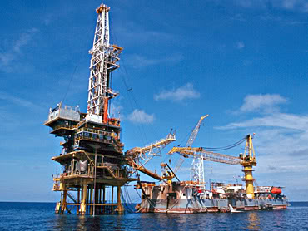
What are nonrenewable resources?
Nonrenewable resources are the second kind of natural resources. They CANNOT be replaced fast enough once they have run out. Despite this fact, most of our electricity and power (60%) is run on nonrenewable resources, such as fossil fuels. Some examples include
Petroleum, coal, and
uranium.

Slide 7
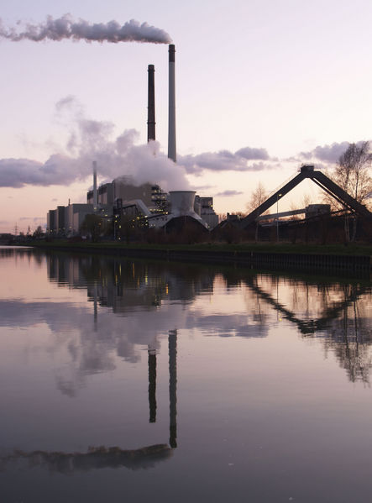
Pros and cons of nonrenewable resources
Pros: They give higher energy and are easier to use.
Cons: They will one day run out, causes pollution and destroys habitats.

Slide 8
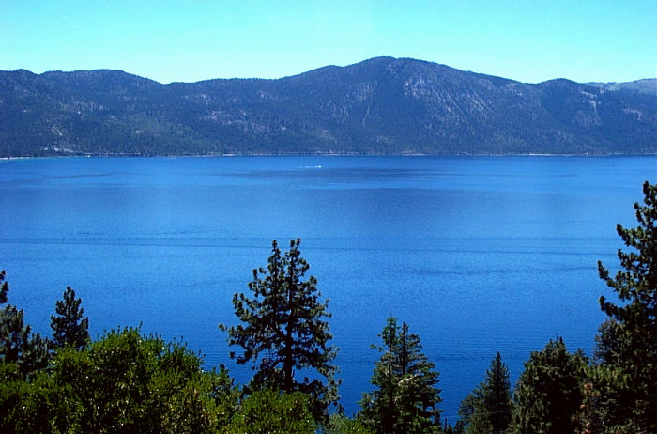
Conservation
Conservation is the wise use of resources. People try to conserve nonrenewable resources because they will one day run out. If we don’t conserve our resources, we will have to switch to wind, water, or solar energy, which are very costly.

Slide 9
Questions
What is one example of a nonrenewable resource?
Where does “fossil fuels” get there names?
What are the two different kinds of natural resource?
What is one downside to renewable resources?
Can you name a conservation organization?

Slide 10
Sources
En.wikipedia.org/
Google.com
Google images
Answers.com

