Slide 1
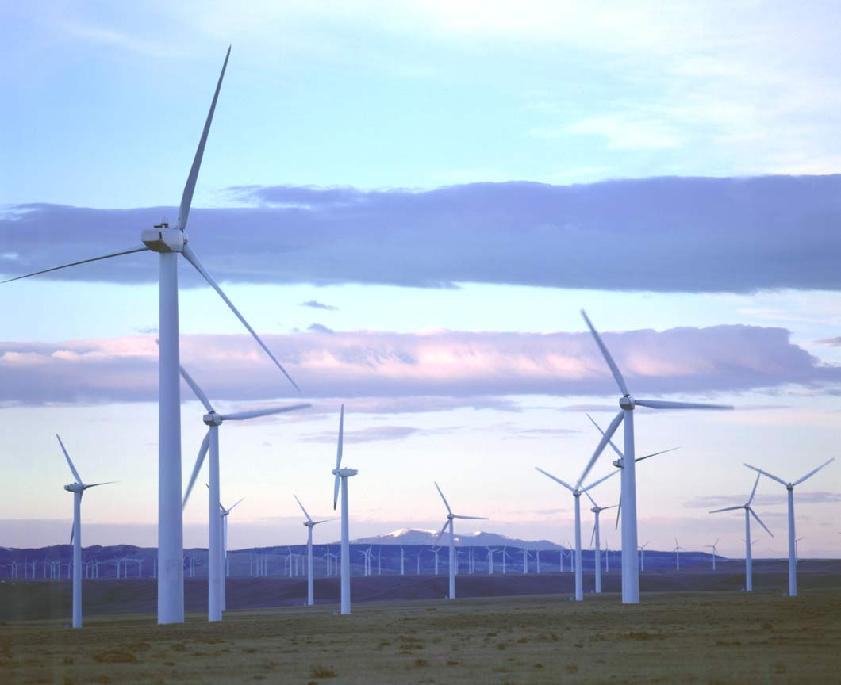
Natural
Resources
By: Kennedy Howard and Tyra Gilbert

Slide 2
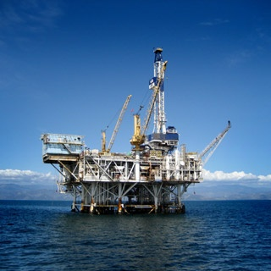
What are Natural Resources
Natural Resources
Natural Resources are resources found in nature, that are NOT man- made. The different types of natural resources are renewable and non-renewable.

Slide 3
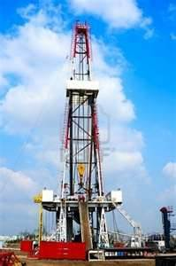
Non-Renewable Resources
Nonrenewable resources are resources that take thousands of years to replace.
Coal
Natural Gas
Petroleum / oil

Slide 4
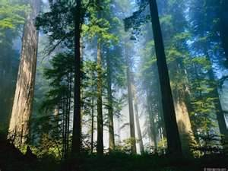
Renewable Resources
Renewable Resources are resources that can be replaced almost as fast as they are used.
Wind
Water
Oxygen
Geothermal
Sunlight (solar power)

Slide 5
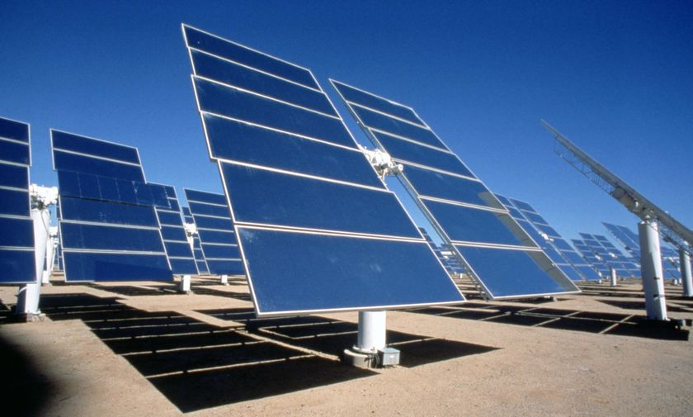
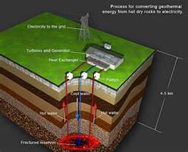
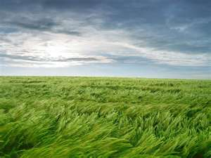
Renewable Resources
Solar Power
Geothermal Energy
Wind and Oxygen
Water

Slide 6
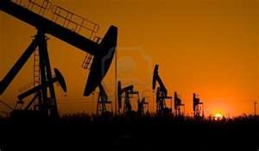
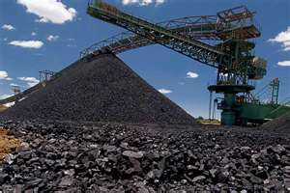
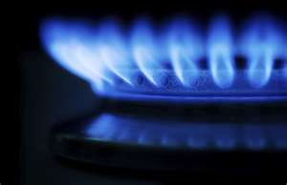
Non-Renewable resources
Oil
Coal
Natural Gas

Slide 7
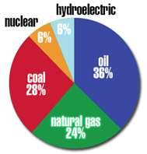
What we rely on most
This is a graph of what we rely on most. As you can see renewable resources are not used as much because they are more expensive and require a lot of hard work.

Slide 8
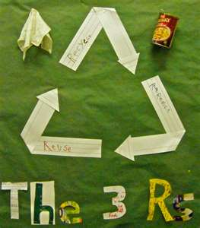
Conservation
Conservation is the smart use of natural resources. You can take part in conservation in many ways.
3 R’s- Reduce, Reuse, and Recycle.
Smart use of water (brushing teeth, showering).
Turn lights and TV off when you leave the room.

Slide 9
Questions
What are two types of Natural Resources?
What are two examples of renewable resources?-nonrenewable?
What do American rely on most?
What ways can you participate in conservation?

Slide 10
Sources
www.google.com
www.bing.com
www.yahoo.com
www.scienceonline.com

