Slide 1
Air Pressure and Wind
Chapter 19

Slide 2
19.1 Understanding Air Pressure
Don’t notice change in your day to day activities
Mostly cause-and-effect relationship
Air pressure causes wind
Wind brings change in temperature/humidity/precipitation

Slide 3
Air Pressure Defined
The pressure exerted by the weight of air above
Sea level
1kg/cm²
Consider desk measuring 50cm X 100cm
That’s 5000cm²
So pressure is 5000 kilograms
That’s equal to the mass of a 50 passenger school bus
Why doesn’t desk collapse?
Pressure is exerted in all directions
The air pushing down is balanced by air pushing up

Slide 4
Air Pressure Defined Example #2
Imagine tall aquarium with same dimensions as desk
Fill with water to 10 meters
Water pressure at bottom is 1kg/cm
If placed on desk the desk will collapse
However, if you put desk inside aquarium and let it sink to bottom desk doesn’t collapse
Why?
Water pressure is exerted in all directions, not just down

Slide 5
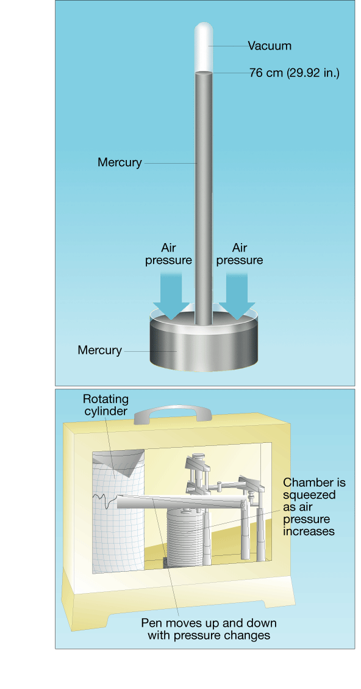
Measuring Air Pressure
Barometer
Use unit called millibar
Sea level = 1013.2 millibars
Might also hear “inches of mercury”
Toricelli
Invented mercury barometer
When air pressure increases, the
mercury in the tube rises. When air
pressure decreases, so does the height
of the mercury column.

Slide 6
Measuring Air Pressure
Aneroid Barometer
Smaller and more portable
Has metal chamber with some air removed
Container changes shape
Compresses if pressure increases
Expands if pressure decreases
Connected to recording device
Gives continuous record of pressure over time

Slide 7
Factors Affecting Wind
Wind
The result of horizontal difference in air pressure
Air flows from high to low pressure
Pressure differences cause by unequal heating of Earth’s surface – all caused by the Sun
Three factors controlling wind
Pressure Differences
Coriolis Effect
Friction

Slide 8
FAW #1 – Pressure Differences
Wind flows high to low
Big difference means greater wind speed
Pressure gradient
Change in pressure over a given distance
Isobars
Lines on a map that connect equal pressures
Close together = steep gradient/high wind
Widely spaced = weak gradient/light wind

Slide 9
Isobars

Slide 10
Isobar Activity - Objectives
You will use a black colored pencil to lightly draw lines connecting identical values of sea level pressure.
Remember, these lines, called isobars, do not cross each other. Isobars are usually drawn for every four millibars, using 1000 millibars as the starting point. Therefore, these lines will have values of 1000, 1004, 1008, 1012, 1016, 1020, 1024, etc., or 996, 992, 988, 984, 980, etc.
You will then identify a high pressure center and a low pressure center.
You will predict the location of fair weather and stormy weather.
You will identify the direction of spin around a high pressure center and a low pressure center.

Slide 11
Begin drawing from the 1024 millibars station pressure over Salt Lake City, Utah (highlighted in gray). Draw a line to the next 1024 value located to the northeast (upper right). Without lifting your pencil draw a line to the next 1024 value located to the south, then to the one located southwest, finally returning to the Salt Lake City value.
Now connect the pressure areas that are 1020 millibars.
Complete the map.

Slide 13
Labeling highs and lows
Isobars can be used to identify "Highs" and "Lows." The pressure in a high is greater than the surrounding air. The pressure in a low is lower than the surrounding air.
Label the center of the high pressure area with a large blue "H".
Label the center of the low pressure area with a large red "L".

Slide 15
Add the weather
High pressure regions are usually associated with dry weather because as the air sinks it warms and the moisture evaporates. Low pressure regions usually bring precipitation because when the air rises it cools and the water vapor condenses.
Shade, in green, the state(s) where you would expect to see rain or snow.
Shade, in yellow, the state(s) where you would expect to see clear skies.

Slide 16
Weather Rhyme
When pressure is low, expect rain or snow.
When pressure is high, look for a blue sky.

Slide 18
Put a spin on it
In the northern hemisphere the wind blows clockwise around centers of high pressure. The wind blows counterclockwise around lows.
Draw arrows around the "H" on your map to indicate the wind direction.
Draw arrows around the "L" on your map to indicate the wind direction.

Slide 20
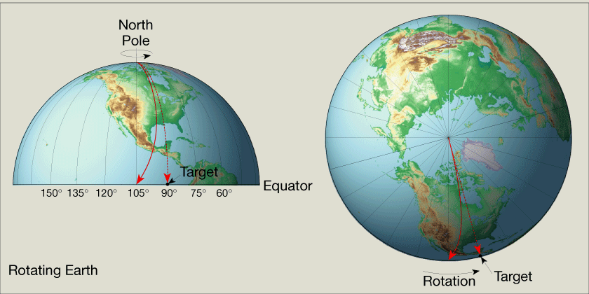
FAW #2 – The Coriolis Effect
How Earth’s rotation affects moving objects.
Northern Hemisphere – deflected to right
Southern Hemisphere – deflected to left

Slide 21
FAW #2 – The Coriolis Effect
Deflection is always directed at right angles to the direction of air flow
Affects only wind direction – not wind speed
Is affected by wind speed
Stronger wind = greater deflection
Strongest at the poles and weakens toward equator
Becomes non-existent at equator

Slide 22
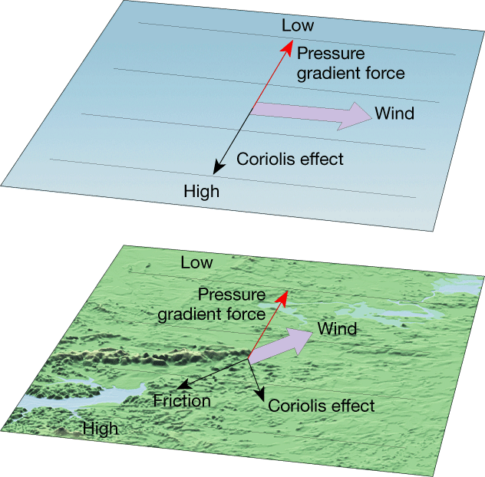
FAW #3 - Friction
Friction layer only affects first few kilometers of atmosphere
Slows air movement & affects wind direction
Jet Stream
Fast moving air near tropopause
Moves at right angle to isobars
Move 120-240km/hr from west to east
Unaffected by friction
Surface
Terrain causes wind to move slower and cross
isobars at greater angles
Decreases Coriolis effect

Slide 23
19.1 Review
Why don’t objects such as a table collapse under the weight of air above them?
Suppose the height of a column in a mercury barometer is decreasing. What is happening?
What is the ultimate energy source for most wind?
How does the Coriolis effect influence motion of free-moving objects?
Why do jet streams flow parallel to isobars?

Slide 24
19.2 Pressure Centers and Wind
Cyclones = Low Pressure Centers
Cloudy
Precipitation
Pressure decreases from outer isobars toward center
Anticyclones = High Pressure Centers
Clear skies
Fair weather
Values of isobars increase toward center

Slide 25
Cyclonic and Anticyclonic Winds
Pressure Gradient and Coriolis Effect
Cause wind to move from high to low pressure and get deflected left or right by Earth’s rotation
Northern Hemisphere
Winds blow counterclockwise and into a low
Winds blow clockwise and away from a high
These are opposite in Southern Hemisphere
Friction
In either hemisphere net flow of air is inward around a cyclone and outward around anticyclone

Slide 26
Cyclonic and Anticyclonic Winds

Slide 27
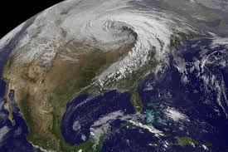
Cyclonic and Anticyclonic Winds

Slide 28
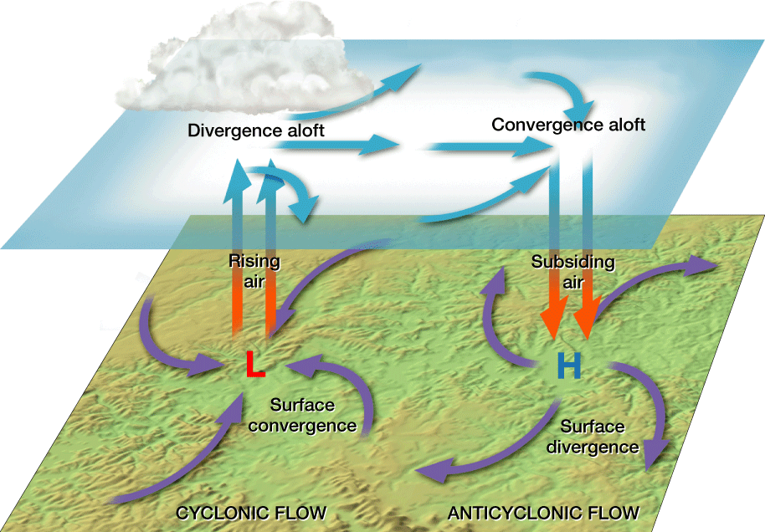
Weather and Air Pressure
Rising Air
Cloud formation
Precipitation
Sinking Air
Clear skies

Slide 29
Weather and Air Pressure
Surface Low Pressure System
Air spiraling inward
Area occupied by air mass shrinks – horizontal convergence
Air squeezing together – can’t go into ground – must go up
To maintain low pressure - air aloft must diverge
Rising air causes cloud formation and precipitation
Surface High Pressure Systems
Just the opposite
Surface divergence with convergence aloft

Slide 30
Weather Forecasting
Emphasize location and paths of cyclones and anticyclones
The weather person will say high pressure systems and low pressure systems
Usually track lows because they are the precipitation makers
Generally travel west to east
Takes a few days or even a week to make it all the way across United States
Knowing their path helps us plan outdoor activities

Slide 31
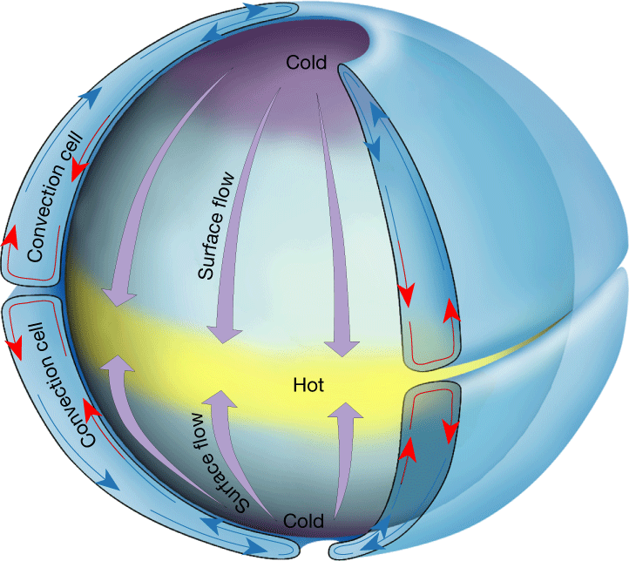
Global Winds
Non-rotating planet with smooth surface
Two convection cells would form
Sun would heat most at equator and air would rise
Air would get to Poles and cool
causing it to sink and flow
back toward equator
Air aloft moves toward poles
and surface air moves toward
equator

Slide 32
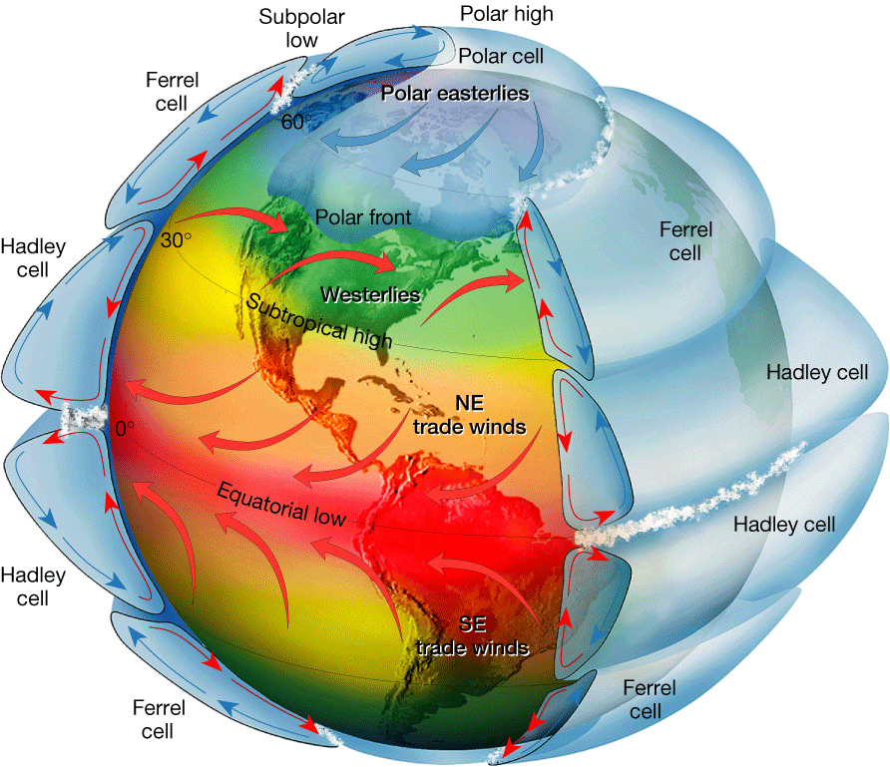
Global Winds
Rotating Earth
Two cell convection system
breaks into smaller cells
Polar and tropical cells
act like two cell
convection system
but middle latitudes
act differently

Slide 33
Global Winds
Hadley Cell
Near equator
Rising air produces equatorial low
20-30 degrees N & S
Abundant precipitation
Rain forest
Subtropical High
30 degrees N & S
Dry, sinking air
Deserts

Slide 34
Global Winds
Trade Winds
Air from subtropical high moving out
Headed toward equator
Deflected by Coriolis Effect
Blow constantly from East
Westerlies
Other half of air headed
toward equator
Deflected in West to East
motion

Slide 35
Global Winds
Polar Easterlies
Winds blown from polar
high toward subpolar low
Not as constant as
trade winds
This cold air meets warm
air from Ferrell cell
causing polar fronts

Slide 36
Global Winds
Four pressure zones
Subtropical High and Polar High
Dry sinking air
Flows outward at surface
Produces prevailing winds
Equatorial and Subpolar Lows
Air flows inward and upward
Clouds and precipitation

Slide 37
Influence of Continents
Land heats up and cools down quicker than water
When land masses are cold high pressure system develops
Causes air to move off land toward ocean
When land masses are warm low pressure develops
Air moves from ocean to land
Monsoons
Seasonal changes in wind direction

Slide 38
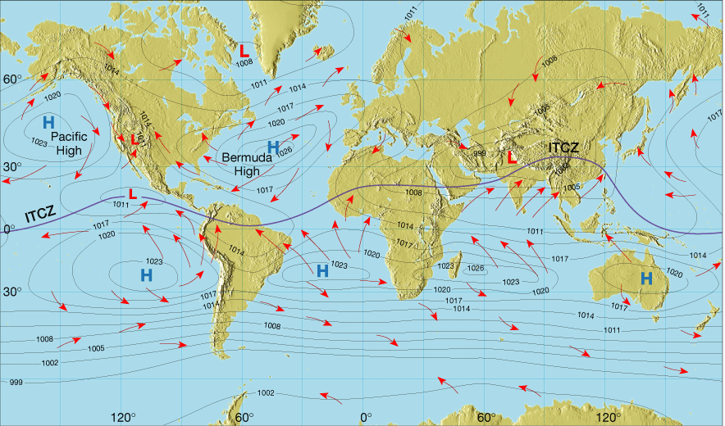
Intertropical Convergence Zone
Where the trade winds of the hemispheres meet
Average surface pressure and global circulation in July

Slide 39
19.2 Review
Describe how winds blow around pressure centers in the Northern Hemisphere.
Compare the air pressure for a cyclone with an anticyclone.
How does friction control the net flow of air around a cyclone and an anticyclone?
How does the atmosphere balance the unequal heating of the Earth’s surface?
In general, what type of weather can you expect if a low-pressure system is moving into your area?

Slide 40
Regional Wind Systems
Middle latitude circulation doesn’t fit with convection cell model
Westerlies interrupted by migrating cyclones and anticyclones
Move west to east in Northern Hemisphere

Slide 41
Local Winds
Produced by locally generated pressure gradient
Caused by topographic effects
Mountains vs Valleys
Caused by variation in surface composition
Land vs Sea

Slide 42
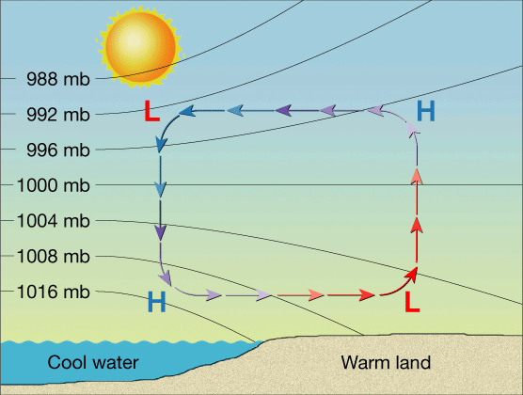
Sea Breezes
Warm summer days
Land heats more rapidly than water
Air above land heats, expands and rises
This creates low pressure system
Air over water remains at
higher pressure
Air moves high to low so
cool breeze comes in off
ocean

Slide 43
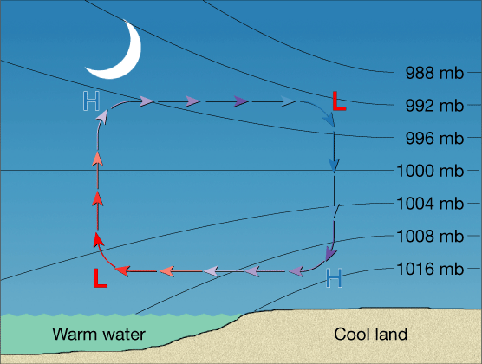
Land Breezes
At night
Land cools faster than water
Cooling air sinks causing high pressure system
Air starts moving out to ocean/lake

Slide 44
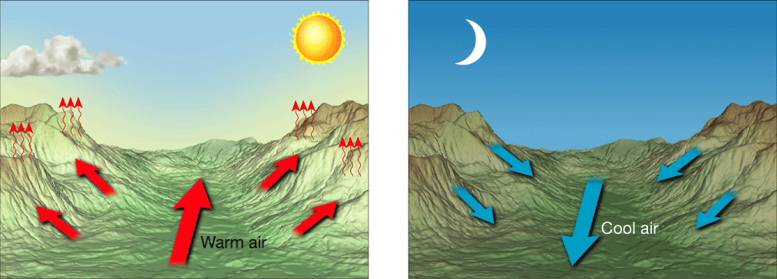
Valley Breeze
Air along slope of mountain heated more than valley floor
Air is less dense so it moves up the slope and generates valley breeze
Often causes cumulus
clouds to develop at
mountain peaks

Slide 45
Mountain Breeze
After sunset air on slopes cools quicker than valley
Causes air to sink
Most dominant in winter

Slide 46
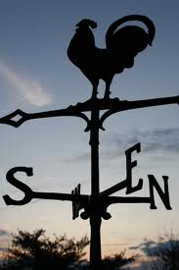
How Wind Is Measured
Direction and Speed
Labeled by direction from
which they blow
North wind blows from
north to south
East wind blows from east to west
Wind vanes point into the wind

Slide 47
Wind Direction
Prevailing wind
When wind consistently blows more often from one direction
Our wind generally moves west to east
Gets interrupted by high and low pressure systems that cause clockwise and counterclockwise flows
Direction can be reported as N, NE, S, SW, etc….
Can be reported on scale of 0⁰-360⁰
0⁰ = North
90⁰ = East
180⁰ = South
270⁰ = West

Slide 48
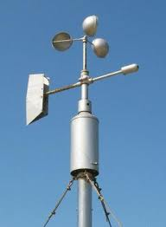
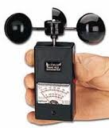
Wind Speed
Anemometer
Faster wind speed causes faster turning
Read results on dial

Slide 49
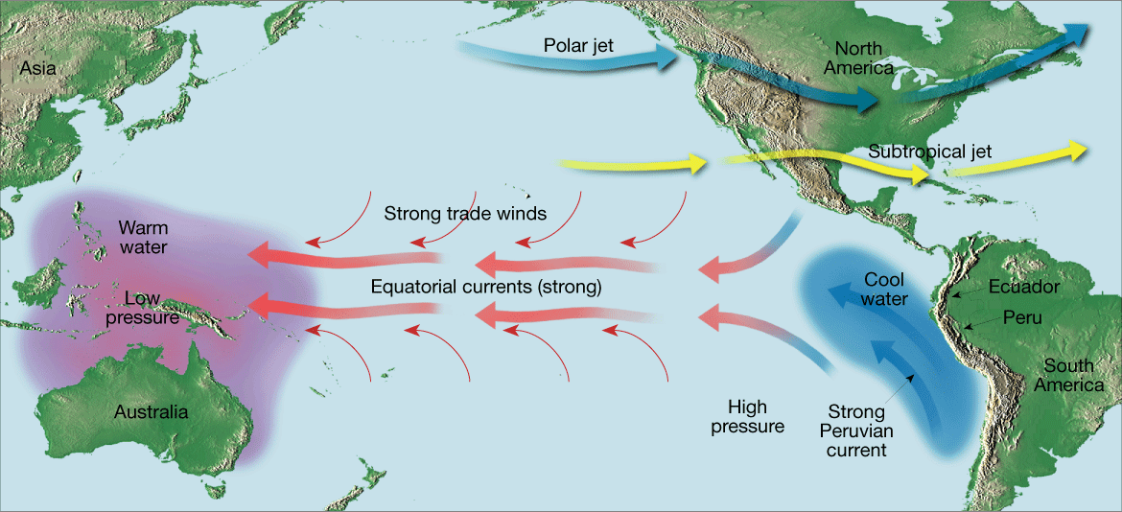
El Nino and La Nina
Cold Peruvian current gets replaced for a few weeks per year by warmer water
Named “nino” after Christ child because it happens around Christmas

Slide 50
El Nino
Every 3-7 years warm currents become unusually strong
Sets off strange weather patterns
Warm water blocks upwelling of cold, nutrient filled water
Anchovies starve, then bigger fish starve and fishing industry gets devastated
Areas where it is usually dry get a lot of rain
High crop yields

Slide 51
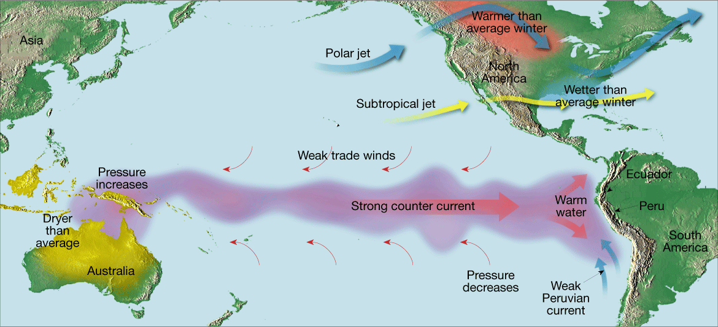
El Nino
Forecasters now predict when it’s going to happen
Golf coast will have rainy winter
Winter temperatures west of Rockies warmer

Slide 52
La Nina
Surface temperatures in Eastern Pacific colder than average
Blows colder than normal air of Pacific Northwest and Northern Great Plains
Precipitation in Northwest is greater than normal
Rest of the United States is warm
Hurricanes stronger during La Nina
Cost of hurricane damage during La Nina years are 20 times greater than in El Nino years.

Slide 53
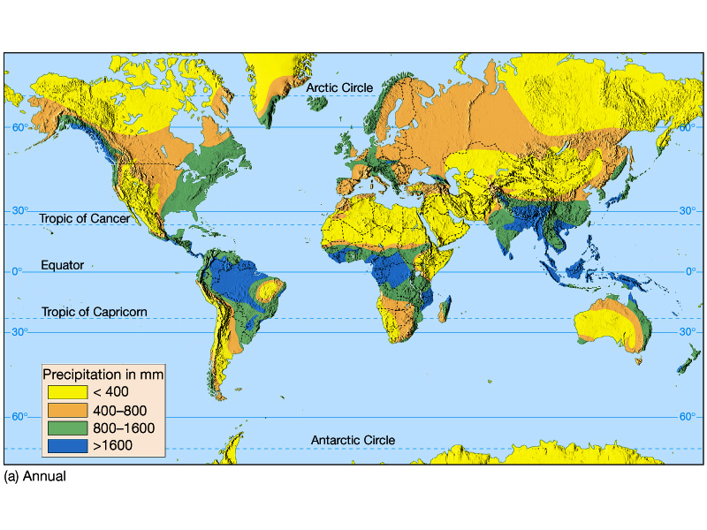
Global Distribution of Precipitation
Equatorial lows = precipitation
Rainforests
Sub-tropical highs = deserts
Land masses = decreased precipitation

Slide 54
19.3 Review
What are local winds and how are the caused?
Describe the general movement of weather in the United States.
What happens when strong, warm countercurrents flow along the coasts of Ecuador and Peru?
How is a La Nina event recognized?
What two factors mainly influence global precipitation?

