Slide 1
Replication, transcription and translation
Chapters 12 & 13

Slide 2
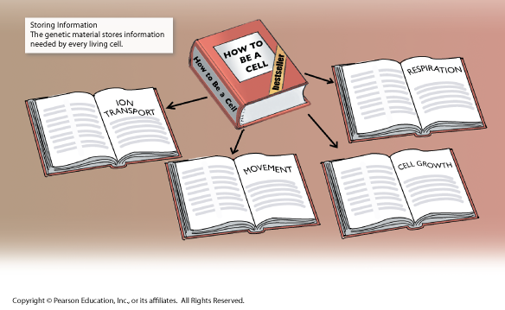
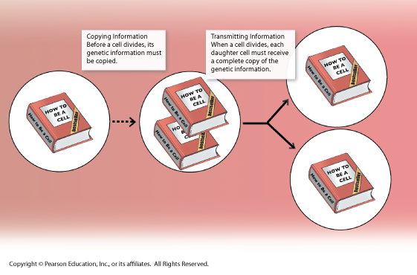
The Role of dna
Stores Information
Keeps the instructions that make you look and act the way you do
Copies Information
During cell division you have to copy the DNA before the cell can split
Transmits Information
When a cell divides, each daughter cell must receive a complete copy of the genetic information

Slide 3
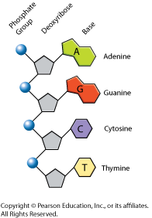
The components of dna
DNA is a nucleic acid made up of nucleotides joined into long strands or chains by covalent bonds
Nucleotide
Made of three basic parts
5 carbon sugar – deoxyribose
Phosphate group
Nitrogenous base

Slide 4
The components of dna
Nitrogenous bases
Adenine
Guanine
Cytosine
Thymine
These four bases can be strung together in many different sequences
These sequences are your genetic code

Slide 5
Chargaff’s rules
Adenine = Thymine
A = T
Guanine = Cytosine
G = C
These rules apply not only to humans, but for all living things including the most primitive bacteria

Slide 6
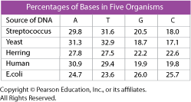
In your notebook
Page 345
Answer the questions in your notebook

Slide 7
Rosalind Franklin
1950s
Used X-Ray Diffraction
X shaped pattern showed DNA strands are twisted around each other like a spring
This shape is called a helix
Angle of X suggests there are two strands

Slide 8
Watson and crick
They were the first to build an actual model
Looked at Franklin’s x-rays and realized it was a double helix
Like a ladder that has been twisted
Sides of ladder made of phosphate and sugar
Rungs of ladder made of nitrogenous bases
Held together by hydrogen bonds

Slide 9
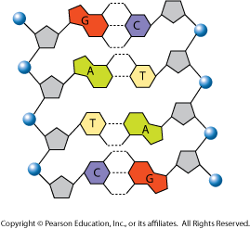
The double helix model
Antiparallel Strands
Strands run in opposite directions
Hydrogen Bonds
Relatively weak – but strong enough to hold base pairs together
Allows for easy separation during replication
A & T have 2 bonds
C & G have 3 bonds

Slide 10
In your notebook
List the three things DNA is made of.
Why are hydrogen bonds so essential to the structure of DNA?
You have been given a sample of DNA and were told that it was 30% Adenine. What are the percentages of Cytosine, Thymine and Guanine?

Slide 11
12.3 replication
Replication = DNA to DNA
Base pairing explains how DNA can be copied
Each base only pairs with one other base on the other strand
So, each strand can be used to reconstruct the other
Strands are complimentary

Slide 12
The replication process
Double helix is “unzipped” by an enzyme that breaks the hydrogen bonds
Each strand is now template for the attachment of complementary bases
DNA polymerase – enzyme that joins individual nucleotides to produce new double strand
It’s the “glue” that joins nucleotides
DNA polymerase – also proofreads to make sure everything is matched correctly

Slide 13
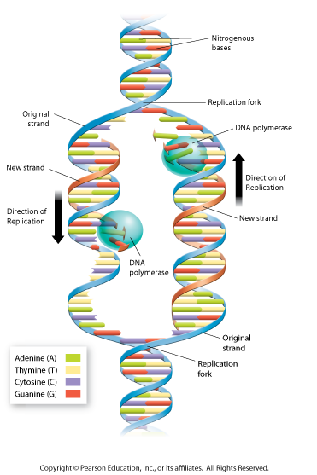
The replication process
Not linear – can happen at several places on DNA strand at the same time
Replication fork
Area where DNA is split apart

Slide 14
In your notebook
Complete the following sentences:
During replication, DNA polymerase……..
At the replication fork,………….
During replication, each original DNA strand………

Slide 15
telomeres
The ends of the chromosome
Hard to copy
Over time the DNA located here gets lost
Telomerase
Enzyme that compensates for this loss by adding short, repeated DNA sequences
This adds length to the DNA so the “important” parts don’t get cut off during replication

Slide 16
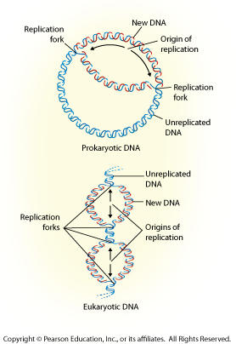
Prokaryotic replication
Starts from single point and proceeds in two directions until entire chromosome is copied

Slide 17
Eukaryotic replication
May begin at dozens or even hundreds of places on the DNA molecule, proceeding in both directions until each chromosome is completely copied

Slide 18
In your notebook
Make a Venn Diagram that compares the process of DNA replication in prokaryotes and eukaryotes.
Compare the location, steps, and end products of the process in each kind of cell.

