Slide 1
Ecosystems and Communities
Chapter 4

Slide 2
Chapter Mystery The Wolf Effect
Read the chapter mystery on Page 95
Answer the following in your notebook:
Explain why scientists predicted that reintroducing wolves to Yellowstone National Park would lead to a decline in the number
of elk in the park.
Predict how fewer elk might affect
other organisms in the park.

Slide 3
Weather and Climate
Partly cloudy, high of 84, low 62,
30% chance of rain in the evening,
winds SE 4mph, pressure 31.2in and falling.
Winters are bitterly cold, summers
are mild and long enough to allow
the ground to thaw.

Slide 4
Weather and Climate
Weather – the day to day conditions of the earth’s atmosphere
Climate – year after year patterns of temperature and precipitation
Microclimate – difference within
small region.
South vs North facing trees.

Slide 5
Factors that affect climate
Solar energy trapped in the biosphere
Latitude
Transport of heat by winds and ocean currents.
In Your Notebook:
Describe the climate where you live.
What factors influence it?

Slide 6
The Greenhouse Effect
Balance between heat that stays in biosphere and heat lost to space determines earth’s average temperature.
Controlled by concentration of
Carbon dioxide
Methane
Water vapor
a.k.a. – the greenhouse gases

Slide 7
The Greenhouse Effect

Slide 8
The Greenhouse Effect
Gases are like the glass of the greenhouse – light gets in – then gets trapped
What happens if gas concentration rises?
Without gases – earth would be
30 degrees Celsius cooler

Slide 9
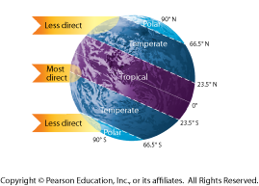
Latitude
Climate zones are produced by unequal distribution of sun’s heat
Polar regions get less
Equator gets most intense
Tilt of earth determines temperate regions

Slide 10
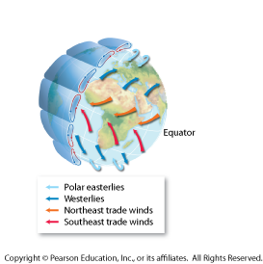
Heat transport in biosphere
Wind and ocean currents caused by unequal distribution of heat by sun
Warm air rises
Cold air sinks
Earth’s rotation causes wind to blow

Slide 11
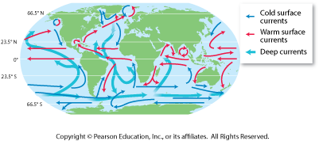
Heat transport in biosphere
Ocean currents can transport heat
Cold water sinks and moves along floor
Rises when passes warm area - upwelling

Slide 12
Section 4.1 Review
Answer the following in your notebook:
What are the main factors that determine climate?
Explain what would likely happen to global climate if there was a dramatic
decrease in greenhouse gases
trapped in the atmosphere.

Slide 13
Niches and Community Interactions
Organisms not only live together in ecological communities, but they also constantly interact with one another. These interactions help shape the ecosystem in which they live. Some organisms are predators, while others are prey. Some organisms compete with each other
for resources. Some organisms are
parasites on others. For each organism,
all of its interactions with other
organisms and with nonliving things
define its role within its ecosystem.

Slide 14
Niches and Community Interactions
Describe the living and non-living things that define the area in which you live.
What might happen if you suddenly move to an area with a very different temperature range?
Based on your experiences,
define predation. Give an
example.

Slide 15
Niches and Community Interactions
Based on your experiences, define competition. Give an example.
Name an organism that can be a parasite on humans. What effect does this organism have on the human?

Slide 16
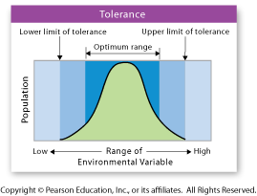
Tolerance
The ability to survive and reproduce under a range of environmental circumstances.

Slide 17
Habitat vs. Niche
Habitat – a species’ address – the general place where it lives.
Also need to know its occupation
Where and how it makes a living
Niche – the range of physical and biological conditions in which a
species lives and the way the
species obtains what it needs
to survive and reproduce.

Slide 18
3 Parts of the Niche
Resources – necessities of life
Water, nutrients, light, food or space
Physical Aspects – abiotic factors
Amphibians need moisture, stable temperatures
Biological Aspects – biotic factors
When it reproduces, are predators
around, feeding area

Slide 19
Competition
Usually, more than one organism needs various essential resources.
Forests – plant roots compete for water and nutrients in the soil.
Animals compete for food, mates and
places to live and raise their young.
Intra = within
Inter = between

Slide 20
Competition
In Your Notebook:
Look at the beetles in Figure 4-5 on page 100.
Is this an example of intraspecific or interspecific competition?
How do you know?

Slide 21
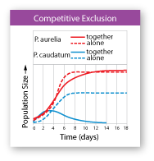
The Competitive Exclusion Principle
No two species can occupy exactly the same niche in exactly the same habitat at exactly the same time.
Someone always wins and someone always loses

Slide 22
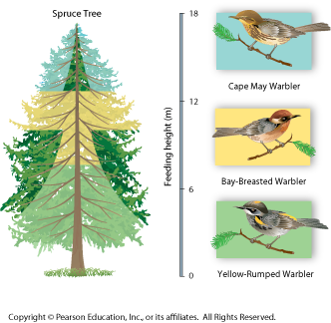
Dividing Resources
By causing species to divide resources, competition helps determine the number and kinds of species in a community and the niche each species occupies.

Slide 23
Dividing Resources
Answer the following In Your Notebook:
What would happen if two of the warbler species tried to occupy the same niche
in the same tree at the same time?
Explain your answer.

Slide 24
Predation and Herbivory
Predator – the eater
Prey – the eaten
Predators affect the size of prey populations in a community and determine the places prey can live and feed.
Herbivores can affect both the size
and distribution of plant populations
in a community and determine
the places certain plants can
survive and grow

Slide 25
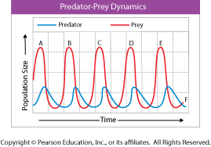
Predation and Herbivory
In Your Notebook:
Answer the questions about Predator-Prey Dynamics on Page 102

Slide 26
Keystone Species
A single species that is not usually abundant in a community yet exerts strong control on the structure of the community.
Pacific coast – sea otters eat sea urchins. Urchins are herbivores that eat kelp.
When sea otters were eliminated by hunting the kelp forest vanished. Why?

Slide 27
Keystone Species
In Your Notebook:
Not all keystone-species effects are due to predation. Describe the dramatic effects that the dam-building activities of beavers, a keystone species, might have on
other types of organisms.

Slide 28
Mystery Clue
Answer the following in your notebook:
One of the favorite prey species of the wolves in Yellowstone is elk.
How do you think this relationship
could affect the ability of certain
plants to grow in Yellowstone?

Slide 29
Symbioses
Any relationship in which two species live closely together.
Three types
Mutualism
Parasitism
Commensalism

Slide 30
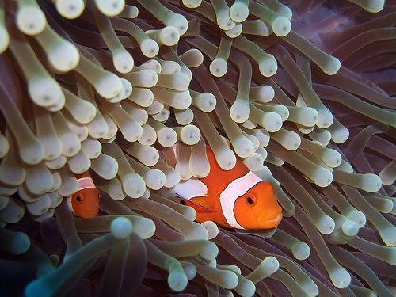
Mutualism
Both species benefit

Slide 31
Parasitism
One is hurt – the other is helped

Slide 32
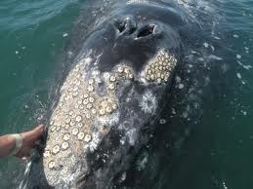
Commensalism
One is helped the other is unaffected

Slide 33
4.2 Review
Answer the following In Your Notebook:
What is the difference between a habitat and a niche?
Bacteria living in a cow’s stomach
help the cow break down the
cellulose in grass, gaining nutrients
in the process. Is the an example
of commensalism or mutualism?
Explain.

Slide 34
4.3 Introduction
The same natural disasters known for having devastating impacts on human homes and communities can also affect natural ecosystems.
These disturbances can wipe out many individuals of some species, which
can drastically alter the interactions
that occur between organisms in
an ecosystem.

Slide 35
In Your Notebook
List three natural disasters that have affected the community in which you live or you have learned about in the news.
Choose one type of natural disaster and describe how it may alter the ecosystem where it strikes.
What happens in human communities after a natural disaster?
What happens in natural
ecosystems?

Slide 36
Succession
Ecological succession – a series of more-or-less predictable changes that occur in a community over time.
Ecosystems change over time, especially after disturbances, as some species die out and new species move in.

Slide 37
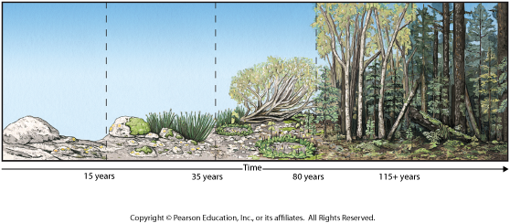
Primary Succession
Succession that begins in an area with no remnants of an older community.
Volcanic eruptions, glacier retreat
Pioneer species – the first to colonize barren areas.
Lichen, some grasses

Slide 38
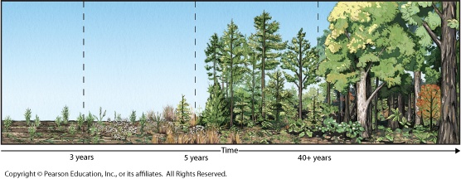
Secondary Succession
Existing community not completed destroyed – just altered – soil and possibly a few plants remain.
Forest fires, logging, farming
Quicker recovery time

Slide 39
Why does succession occur?
Every organism changes the environment it lives in.
As one species alters environment another species finds it easy to live there.
Lichens add organic matter and form soil
so grasses can now live there.
Trees grow branches that shade the
ground underneath so new plants
can grow in the cooler temps.

Slide 40
In Your Notebook
Summarize what happens in primary and secondary succession. How are they alike and how are they different?

Slide 41
Climax Communities
Do ecosystems return to “normal” following a disturbance?
We used to think yes, but recent studies show succession doesn’t always follow the same path.
Which species colonize which areas
are often due to chance.

Slide 42
Succession after Natural Disturbances
Secondary succession in healthy ecosystems following natural disturbances often reproduces the original climax community.
So everything returns to “normal”

Slide 43
Succession after Humans
Ecosystems may or may not recover from extensive human-caused disturbances.
Cutting down tropical rain forests changes soil composition, timing of rainfall, breeding of animals before and right after disturbance.

Slide 44
4.3 Review
In your notebook – write a short story about an ecosystem that is disturbed and undergoes either primary or secondary succession.
Write about both biotic and abiotic factors.

Slide 45
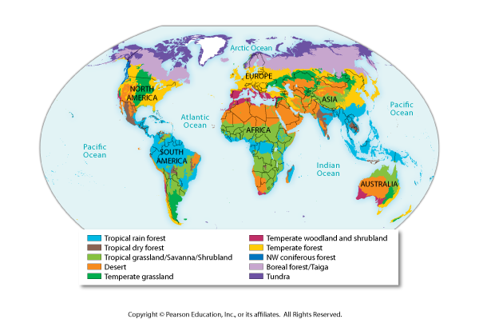
In Your Notebook
Describe the climate in which you live.
On the biome map, locate the place where you live.
Which biome do you live in? (Pg 111)
Does your climate description match the description of the biome on found on pg 112-114?

Slide 46
Understanding Biomes
Lesson 1 told us global climate was affected by latitude and heat transported by winds.
Oregon, Montana and Vermont all have similar latitude and the wind always blows from east to west, so why are their climates different?

Slide 47
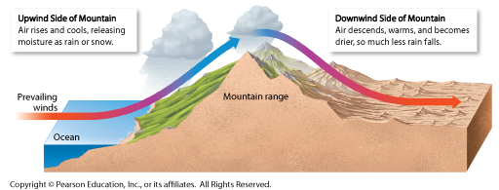
Understanding Biomes
There are other factors at work.
Proximity to ocean
Mountain ranges
Elevation

Slide 48
Defining Biomes
Abiotic factors
Climate – seasonal patterns of temperature and precipitation
Soil type
Biotic factors
Plant life
Animal life – organisms are characterized
by adaptations that enable them to
live and reproduce successfully in
the given environment.

Slide 49
Climate Diagram

Slide 50
In Your Notebook
Answer the questions in the analyzing data section on page 115.

Slide 51
Other Land Areas
Not easily defined in terms of a typical community of plants and animals.
Mountain Ranges
Conditions vary with elevation
Polar Ice Caps
Too cold
Very few plants
Many areas covered with ice

Slide 52
Mystery Clue
Answer the following In Your Notebook:
Yellowstone has high mountain slopes and valleys with streams. Can you think of any reason why moose and elk might prefer to graze in one of those places rather than the other? How do you think their preference might affect Yellowstone’s plant communities?

Slide 53
Biome Acrostic
Biotic factor in tropical dry forests include oak trees and lilacs.
I
O
M
E
F
A
C
Temperate forests have soil rich in humus.
S

Slide 54
Aquatic Ecosystems
The marine ecosystem that is exposed to regular and extreme changes in its surroundings is the intertidal zone. During high tide, the intertidal zone is covered by seawater. During low tide, this area is exposed to air, sunlight, and heat.

Slide 55
Aquatic Ecosystems
What types of organisms would you expect to find living in the intertidal zone?
What characteristics do you think these organisms have that enable them to live in this zone?
What effect do waves have on the intertidal zone?

Slide 56
Underwater Conditions
Aquatic organisms are affected primarily by:
the water’s depth
temperature
flow
amount of dissolved nutrients.

Slide 57
Underwater Conditions
Water Depth
Photic Zone
sunlit region near the surface
Photosynthesis occurs here
Phytoplankton makes food and is eaten by zooplankton – start of many food chains
Aphotic Zone
No sun
No photosynthesis
Benthic Zone
Aquatic organisms (benthos) living on
or in rocks and sediments on bottom
of lakes, streams and oceans.

Slide 58
Underwater Conditions

Slide 59
Underwater Conditions
Temperature and Currents
Warmer near equator
Colder toward poles
Vary with depth
Nutrient Availability
Need oxygen, nitrogen, potassium and phosphorus.
Different bodies of water have different amounts

Slide 60
Mystery Clue
Answer the following In Your Notebook:
What is one way in which life in Yellowstone's streams might be affected by the presence or absence of plants along stream banks?

Slide 61
Freshwater Ecosystems
Only 3% of earth’s water is freshwater.
Possible for chains of streams, lakes and rivers to begin in interior of continent and flow through several biomes on way to the sea.
Three categories:
Rivers and streams
Lakes and ponds
Freshwater wetlands

Slide 62
Freshwater Ecosystems
Rivers and streams
Originate underground or in mountains
Near source
Plenty of oxygen
Little plant life
Downstream
Sediments build up
Plants established
Farther downstream
Water meanders through flat areas

Slide 63
Freshwater Ecosystems
Lakes and Ponds
Food webs based on presence of phytoplankton and zooplankton
Water flows in and out
Circulates between the surface and benthos
Circulation distributes heat, oxygen and nutrients

Slide 64
Freshwater Ecosystems
Freshwater Wetlands
Water covers soil or is at least present at or near surface for part of the year
Water may flow or stay in place
Nutrient rich
Highly productive
Breeding grounds
Purify water and prevent flooding
Three types
Bogs, marshes and swamps

Slide 65
In Your Notebook
What kinds of adaptations would you expect in organisms living in a fast-flowing river or stream?

Slide 66
Estuaries
Special wetland where river meets sea
Mix of fresh and saltwater
Affected by rise and fall of ocean tides
Many are shallow
Allows for photosynthesis
Spawning and nursery grounds for important fish and shellfish species
Two types
Salt marsh
Mangrove swamp

Slide 67
Marine Ecosystems
Based on depth and distance from shore
Divided into three categories:
Intertidal Zone
Coastal Zone
Open Ocean

Slide 68
In Your Notebook
How would you expect communities of organisms in the open ocean to differ from those along the coast?

Slide 69
Intertidal Zone
Submerged during high tide
Exposed during low tide
Subjected to extreme temperature changes
Battered by waves and currents
Barnacles and seaweed live here

Slide 70
Coastal Ocean
Extends from low-tide mark to edge of continental shelf
Water
Brightly lit
Full of nutrients from land runoff
Highly productive
Examples
Kelp forests
Coral reefs

Slide 71
Open Ocean
Begins at continental shelf
90% of ocean
Two zones
Open Ocean Photic Zone
Low nutrient levels but due to sheer size most of the photosynthesis on earth occurs here
Open Ocean Aphotic Zone
Permanently dark
Depends on dead things falling from above or chemosynthesis
High pressure
Frigid temperatures

Slide 72
Ocean Zones

Slide 73
4.5 Review
What are some ways in which life in an aphotic zone might differ from life in a photic zone?
Why are wetlands important?
How might a dam upriver affect
an estuary at the river’s mouth?

