Slide 1
From Colonies to an Independent Nation

Slide 2
From Colonies to an Independent Nation
The Colonial Experience
Trouble Brewing-French and Indian War
Turmoil over Taxation
The American Revolution
A Loose Confederation
Creating the Constitution

Slide 3
From Colonies to an Independent Nation
The Colonial Experience

Slide 4
The New Colonists
Settlers from Spain, France, Sweden, Holland, and England claimed land beginning in the 17th century.
The struggle for control of this land would continue for more than a hundred years.
The first colonies in North America were along the eastern coast.
A colony is a territory controlled by people from a foreign land.
The first permanent settlement in North America was the English colony at Jamestown in 1607, in what is now Virginia.
The Pilgrims followed, in 1620, and set up a colony at Plymouth, in what is now Massachusetts.

Slide 5
The Slave Trade
Starting in 1619, enslaved Africans were brought to north America, South America, and the West Indies.
The brutal traffic of human beings was part of a network called triangular trade.
Included in the network were England, West Africa, and the American Colonies.

Slide 6
The Slave Trade
Raw materials to be used in order to manufacture products flowed from North America and the West Indies to England.
England in turn sent the manufactured goods to Africa.
There traders exchanged the English products for slaves.
These slaves were then bought to the colonies in North America, South America, and the West Indies.
When slaves arrived in the colonies, most of the Africans faced a very harsh life.

Slide 7
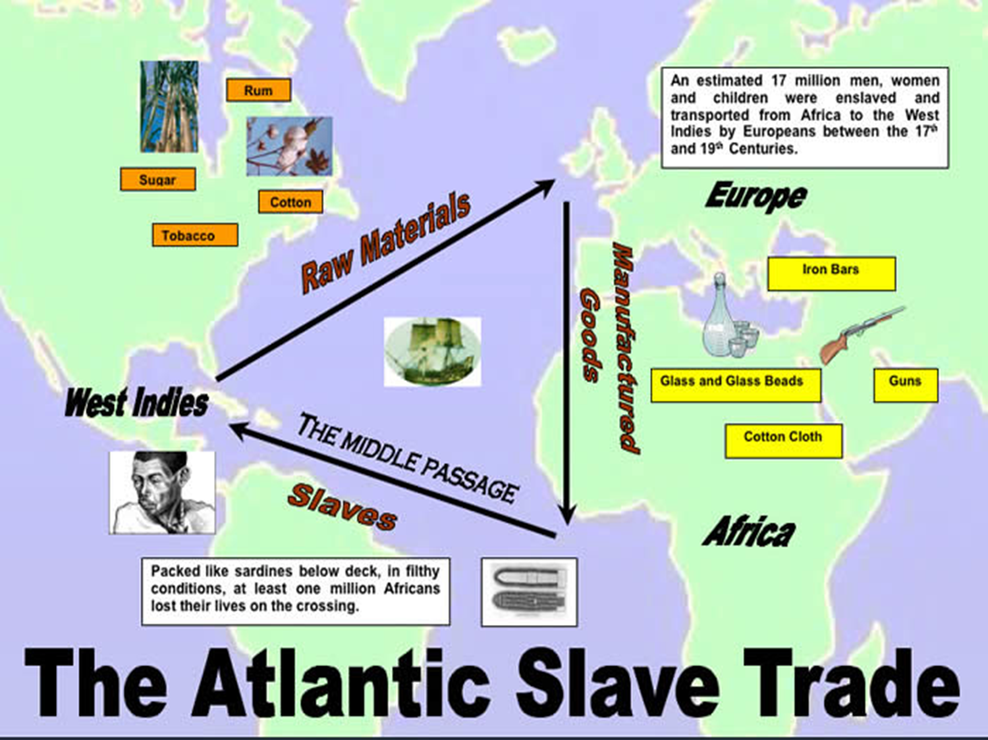

Slide 8
Life In the Colonies
By the mid-1700s, many British subjects lived in the 13 colonies along the Atlantic coast.
Some came in search of wealth while others came seeking religious freedom.
Settlers had also come from Scotland, Ireland, Germany, France and other countries.
Many families worked small farms.

Slide 9
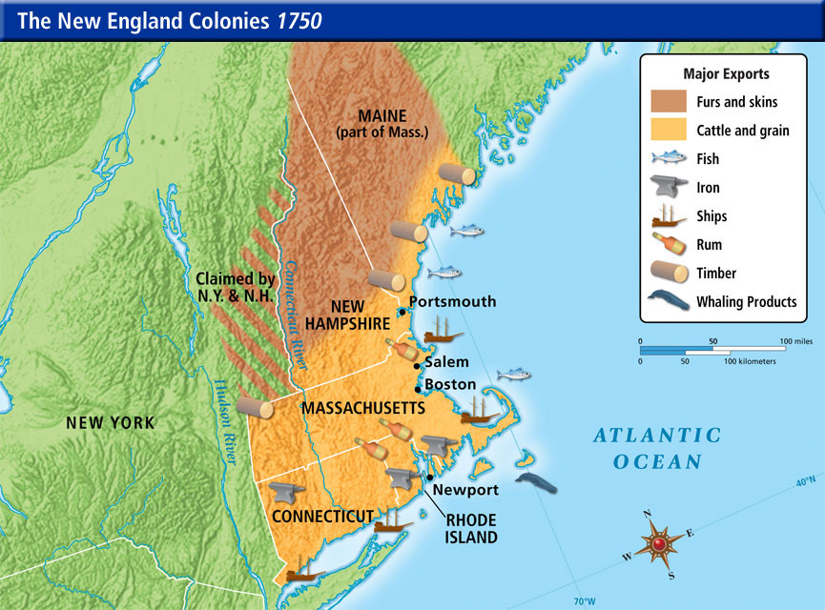
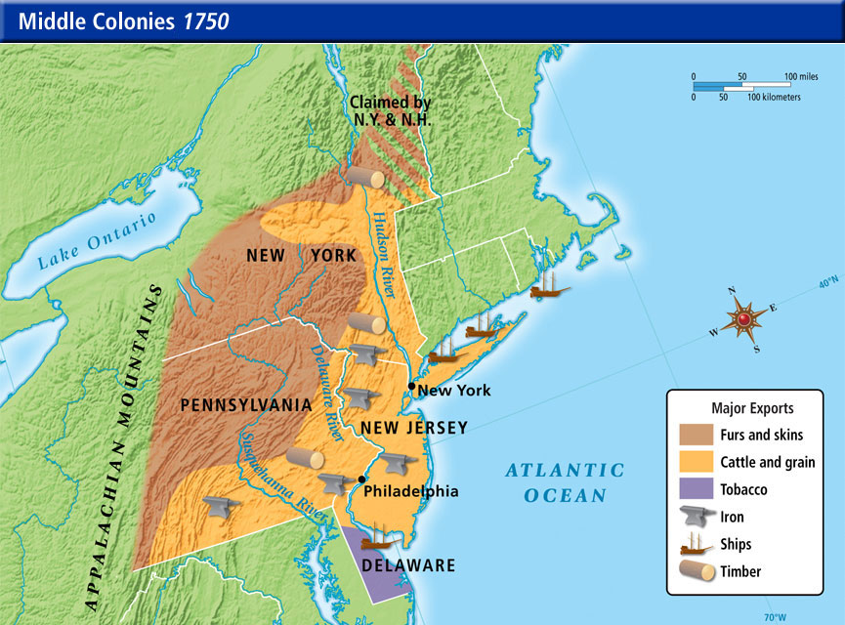
Life In the Colonies
New England and Middle Colonies
  Became centers for trade, shipbuilding, and fishing.
  Craftworkers such as blacksmiths contributed to the economy.
  Boston and New York were major seaports.

Slide 10
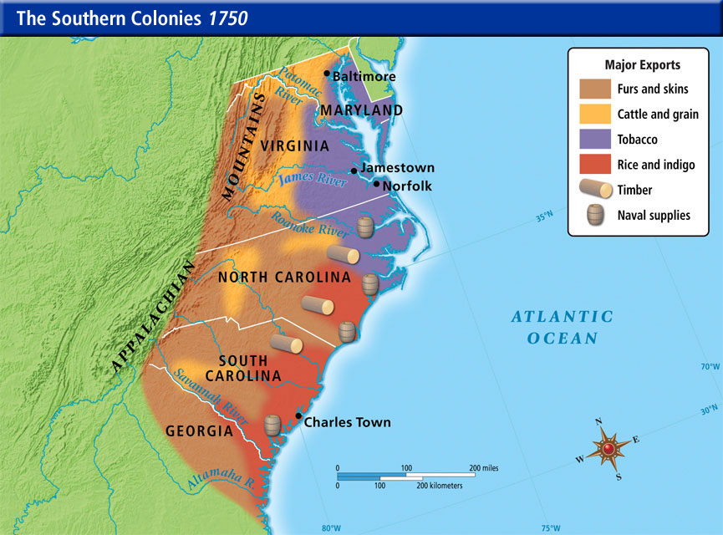
Life In the Colonies
Southern Colonies
  Plantations were common in the southern colonies because of the area’s rich soil and climate.
  Cotton and tobacco were the main plantation crops.
  Most slaves worked in the southern colonies on plantations.

Slide 11
Life In the Colonies
Most of the people who came to America settled along the coast.
As these areas became more crowded, people moved to the frontier.
The frontier referred to lands west of the colonies that weren’t yet settled by Europeans.
These lands, however, were not empty because they were Indian lands.

Slide 12
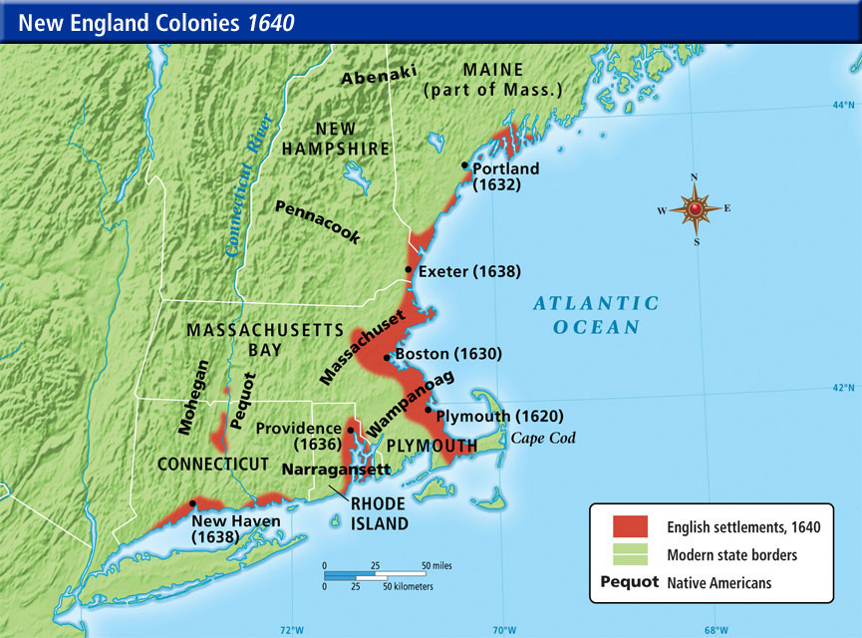
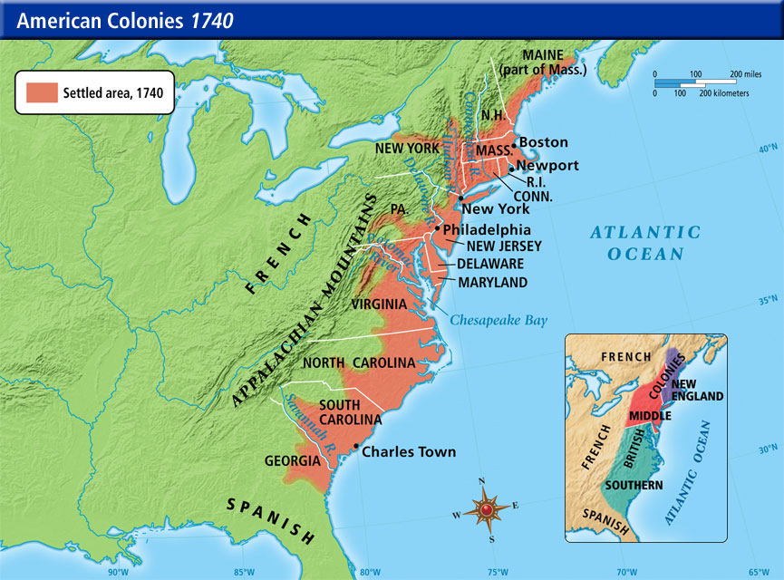
Life In the Colonies
Compare the size of the colonies in 1740 to the first English settlements in 1640 in the box below.

Slide 13
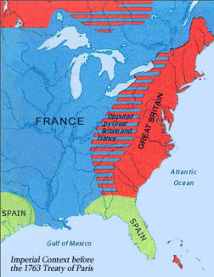
Life In the Colonies
The British weren’t the only ones to take over Indian lands. The French and Spanish also claimed lands that had long been home to American Indians. The French had established a fur-trading business with some Indians. Many Indian tribes remained French allies for years.

Slide 14
From Colonies to an Independent Nation
Trouble Brewing-French and Indian War

Slide 15
Trouble Brewing-French and Indian War
By 1740s English traders were crossing the Appalachian Mountains in search of furs.
Pushing into the Ohio Valley, they tried to take over the profitable French trade with the Indians.
France was determined to stop the English from expanding westward.
Most Indians sided with France because they did not destroy Indian hunting grounds.
Also, many French trappers were married to Native American women and adopted their ways.
On the other hand, English settlers were farmers so they ignored Indian rights by cutting trees and clearing farmland.

Slide 16
Trouble Brewing-French and Indian War
A bold young leader, Major George Washington was sent to make the French leave the disputed territory in the Ohio River Valley. Washington was the man who struck the first blow.
The French and Indian War, a conflict between France and Britain for control of the Ohio River Valley, lasted from 1754-1763.
The British suffered a string of defeats at first.
In 1757, William Pitt became the new head of the British government and made his first priority to win the war. He accomplished this by doing the following:
  Sent his best generals to North America
  Increased the number of British troops
  Encourage colonist to support the war by promising large payments for military service and supplies
  Used the British navy to set up a naval blockade along the Atlantic Coast
Under Pitt’s leadership, the British won the war and the Treaty of Paris was signed by Britain and France in 1763.

Slide 17
Trouble Brewing-French and Indian War
The Treaty of Paris marked the end of French power in North America.
Britain gained Canada and all French lands east of the Mississippi River except New Orleans.
Spain, which entered the war on the French side in 1762, gave up Florida to Britain.
In return, Spain received all French land west of the Mississippi and the vital Port of New Orleans.
Spain retained control of its vast empire in Central and South America.

Slide 18
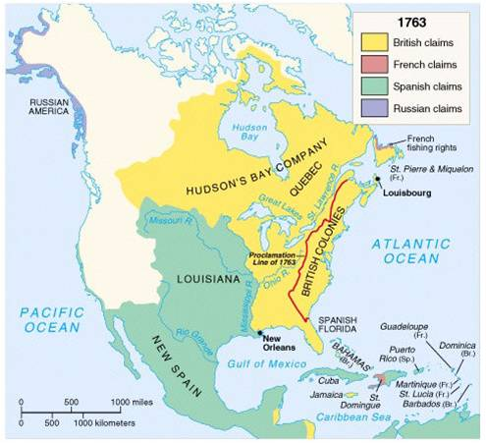
North America In 1763

Slide 19
From Colonies to an Independent Nation
Turmoil Over Taxation

Slide 20
Turmoil Over Taxation
Great Britain had won the French and Indian War but it cost a great deal of money.
As a result, taxes paid by British citizens rose sharply.
Parliament decided that the colonist in North America should help share the burden.
Parliament would place new restrictions on the colonists and create new taxes.
Many colonist protested saying that Parliament had no right to tax them without the consent of their own colonial assemblies.
They called the British policies “taxation without representation.”

Slide 21
Turmoil Over Taxation
A series of taxes were passed by Parliament.
  Sugar Act-Put a new tax on molasses
  Stamp Act-Placed new duties on legal documents such as wills, diplomas, and marriage papers. It also taxed newspapers, almanacs, playing cards, and even dice
  Townshend Acts-Taxed goods such as glass, paper, paint, lead, and tea
  Intolerable Acts-Parliament’s way of punishing the colonist for their behavior against Britain
    Under this act, Parliament passed the Quartering Act which forced colonist to house British soldiers in there homes when no other housing was available.

Slide 22
Turmoil Over Taxation
Parliament sent British soldiers to Boston to control the protest over the various acts passed.
Each British act only made the colonists angrier and more determined to work together.
The 13 colonies were starting to become united.
In 1774, 12 colonies sent representatives to the First Continental Congress.
The Congress pledged to stop trade with Britain until the colonies gained representation in Parliament.

Slide 23
The American Revolution
British troops tried to seize guns and gun powder from the colonist.
At Lexington and Concord, near Boston, the British met armed resistance from the colonist.
As a result British soldiers and Americans died in the fighting.
This marks the start of the Revolutionary War.

Slide 24
The American Revolution
In July 1776, the Continental Congress adopted the Declaration of Independence.
Thomas Jefferson was the Declaration’s main author.
The Declaration of Independence was influenced by Enlightenment Thinkers and included the ideas of popular sovereignty.

Slide 25
The American Revolution
At first, the Americans suffered tough defeats at the hands of the British.
1778, the French formed an alliance with the Americans.
alliance-an agreement made to help both partners.
By helping the Americans, France hoped to weaken its long time enemy, Britain.
In 1781, American forces under the command of General George Washington and their French allies defeated the British army.
The Americans won the Revolutionary War and peace terms were reached in the Treaty of Paris in 1783.
Britain recognized the new American nation and all land east of the Mississippi now belonged to what would soon become the United States of America.

Slide 26
From Colonies to an Independent Nation
A Loose Confederation

Slide 27
A Loose Confederation
In 1777, the Americans adopted a plan of government called the Articles of Confederation.
Because many Americans didn’t trust a central government to protect individual rights and liberties fought for during the revolution, the Articles set up a central government that was weak on purpose.
What made the Articles of Confederation weak?
  Congress could not raise taxes.
  Congress could not raise money.
  Congress could not regulate trade.
  Congress could not raise an army

Slide 28
From Colonies To An Independent Nation
Creating the Constitution

Slide 29
Creating the Constitution
In May 1787, delegates from all the states met at a convention in Philadelphia to revise the Articles of Confederation.
After recognizing that changes would not be enough, they decided to write a new constitution.
This constitutional convention was presided over by George Washington.
The delegates set up a federal system of government which was given several basic powers.
  Raise taxes
  Declare war
  Raise armies
  Make treaties
  Coin money
  Regulate trade with other countries
The states and the people keep most other powers.
The new federal government has three branches (legislative, executive, and judicial).
Each branch acts as a check on the power of the others.

Slide 30
Questions

