Slide 1
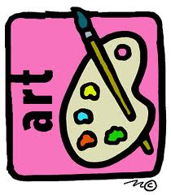
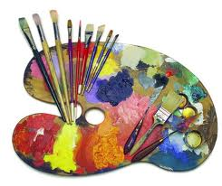
Mrs. Haynie Presents:Art Students’ Projects
By: Aliyah Trice & Ben Strickland

Slide 2
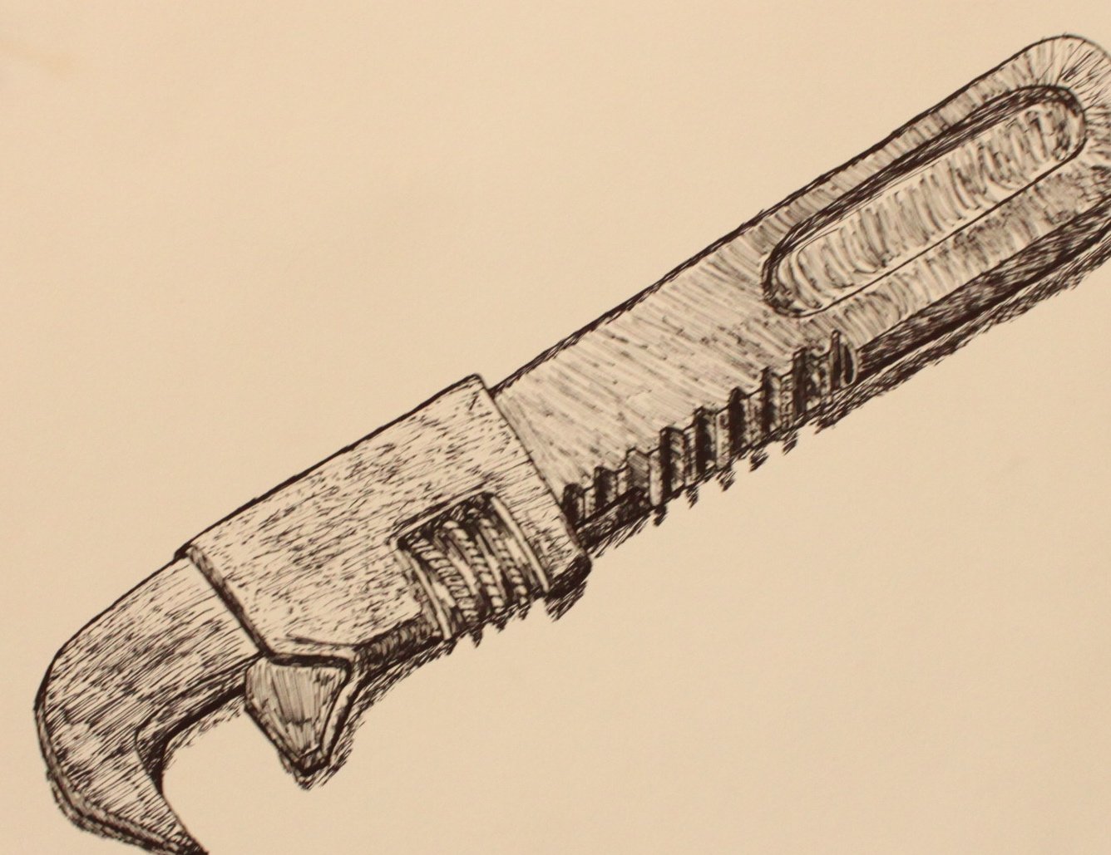
Creativity is allowing yourself to make mistakes. Art is knowing which ones to keep. — Scott Adams

Slide 3
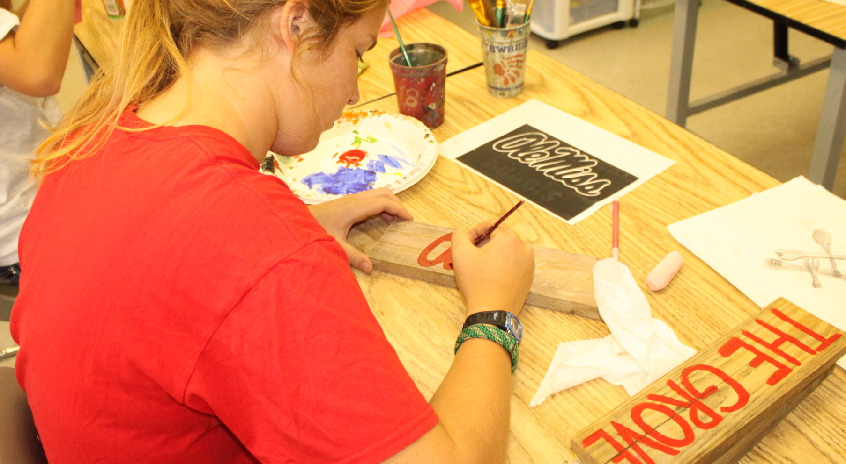
Design creates culture. Culture shapes values. Values determine the future. — Robert L. Peters

Slide 4
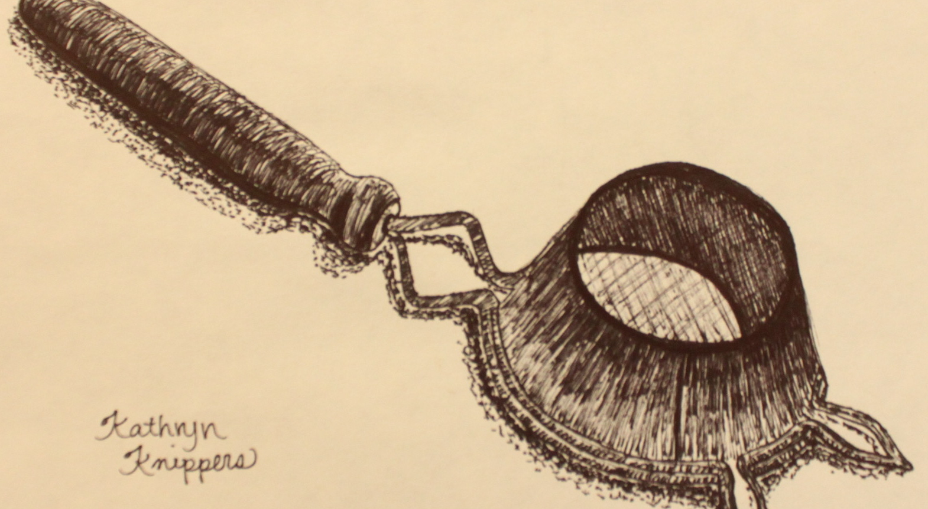
Art is not what you see, but what you make others see. Edgar Degas

Slide 5
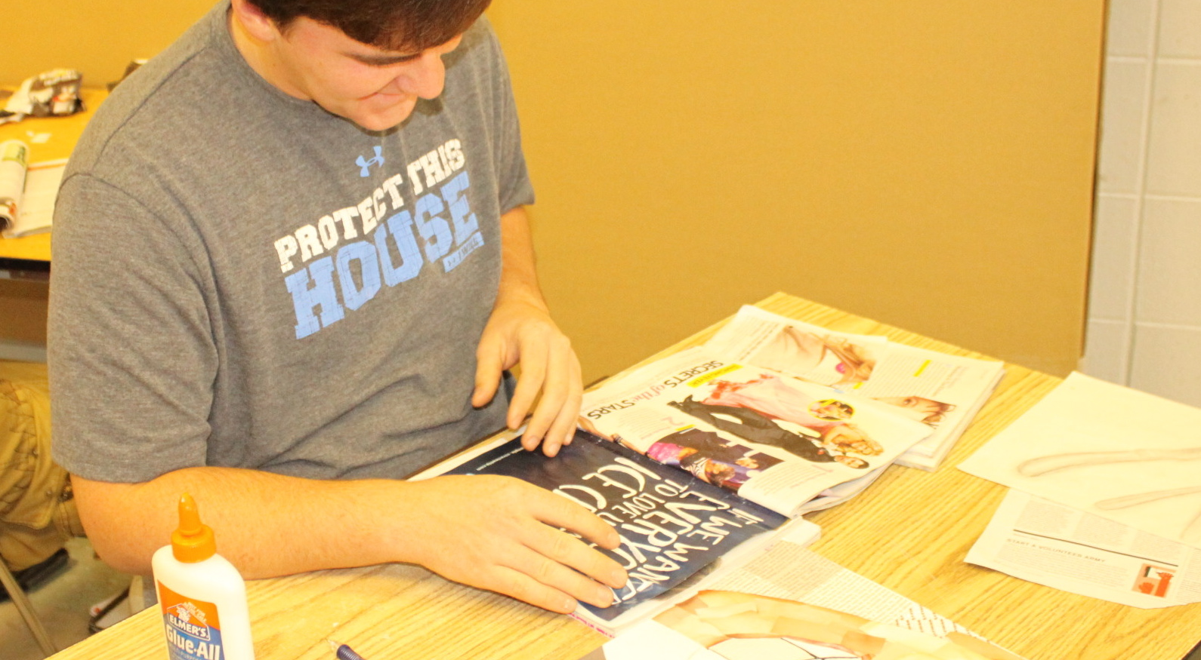
Every child is an artist. The problem is how to remain an artist once we grow up. — Pablo Picasso

Slide 6
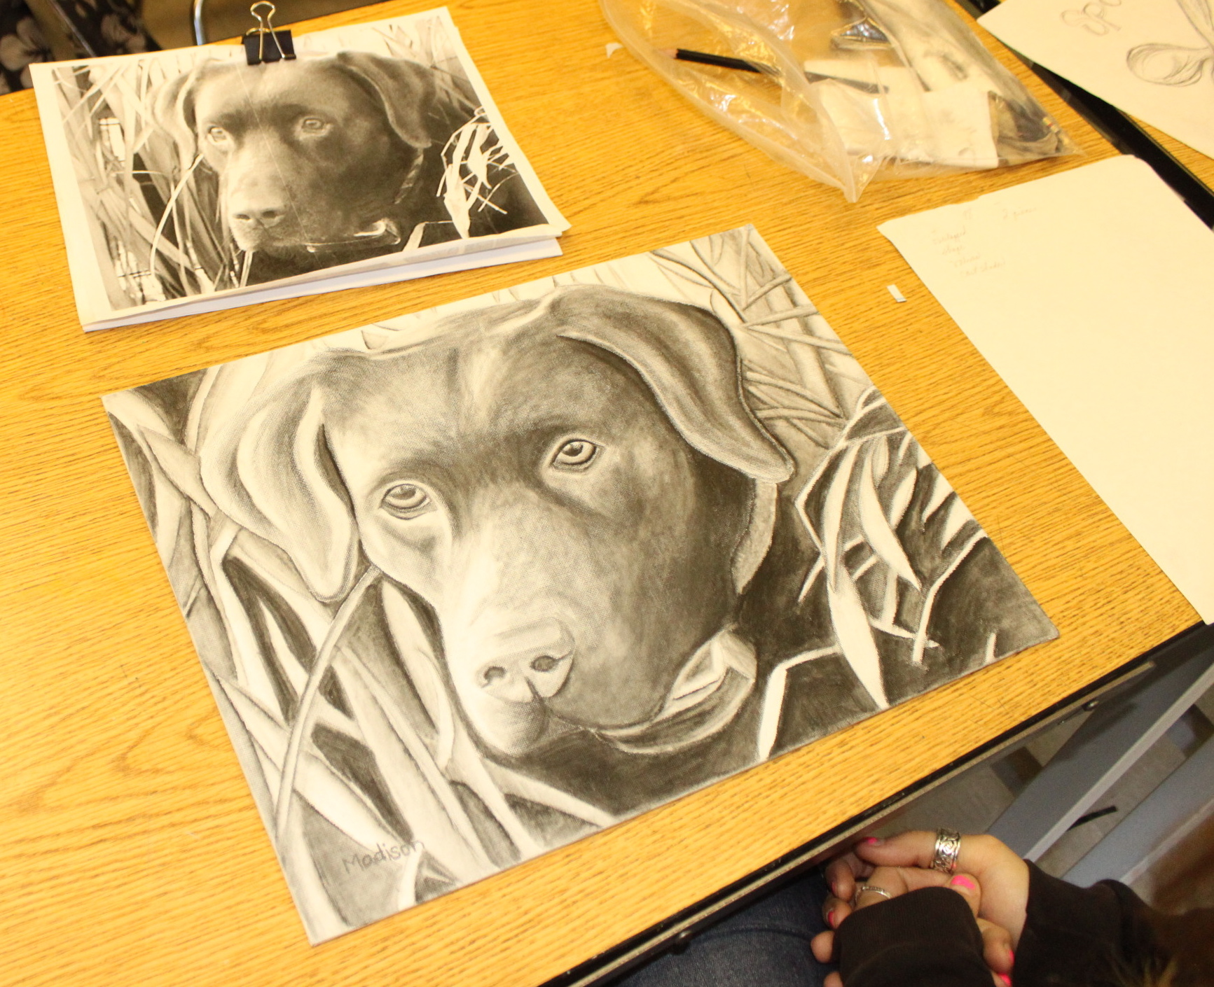
Art is the only way to run away without leaving home. — Twyla Tharp

Slide 7
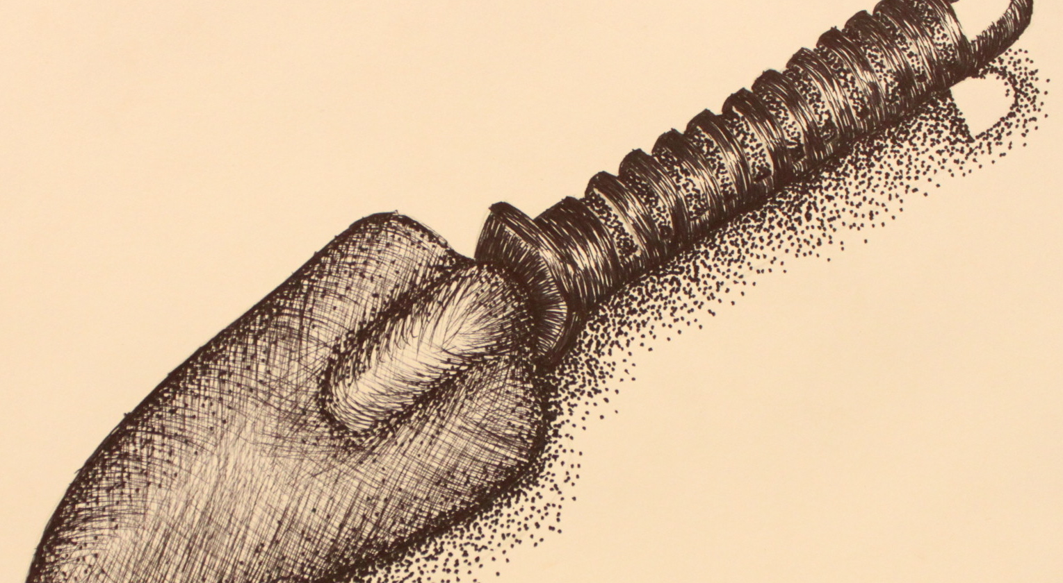
Creative without strategy is called 'art'. Creative with strategy is called 'advertising'. — Jef I. Richards

Slide 8
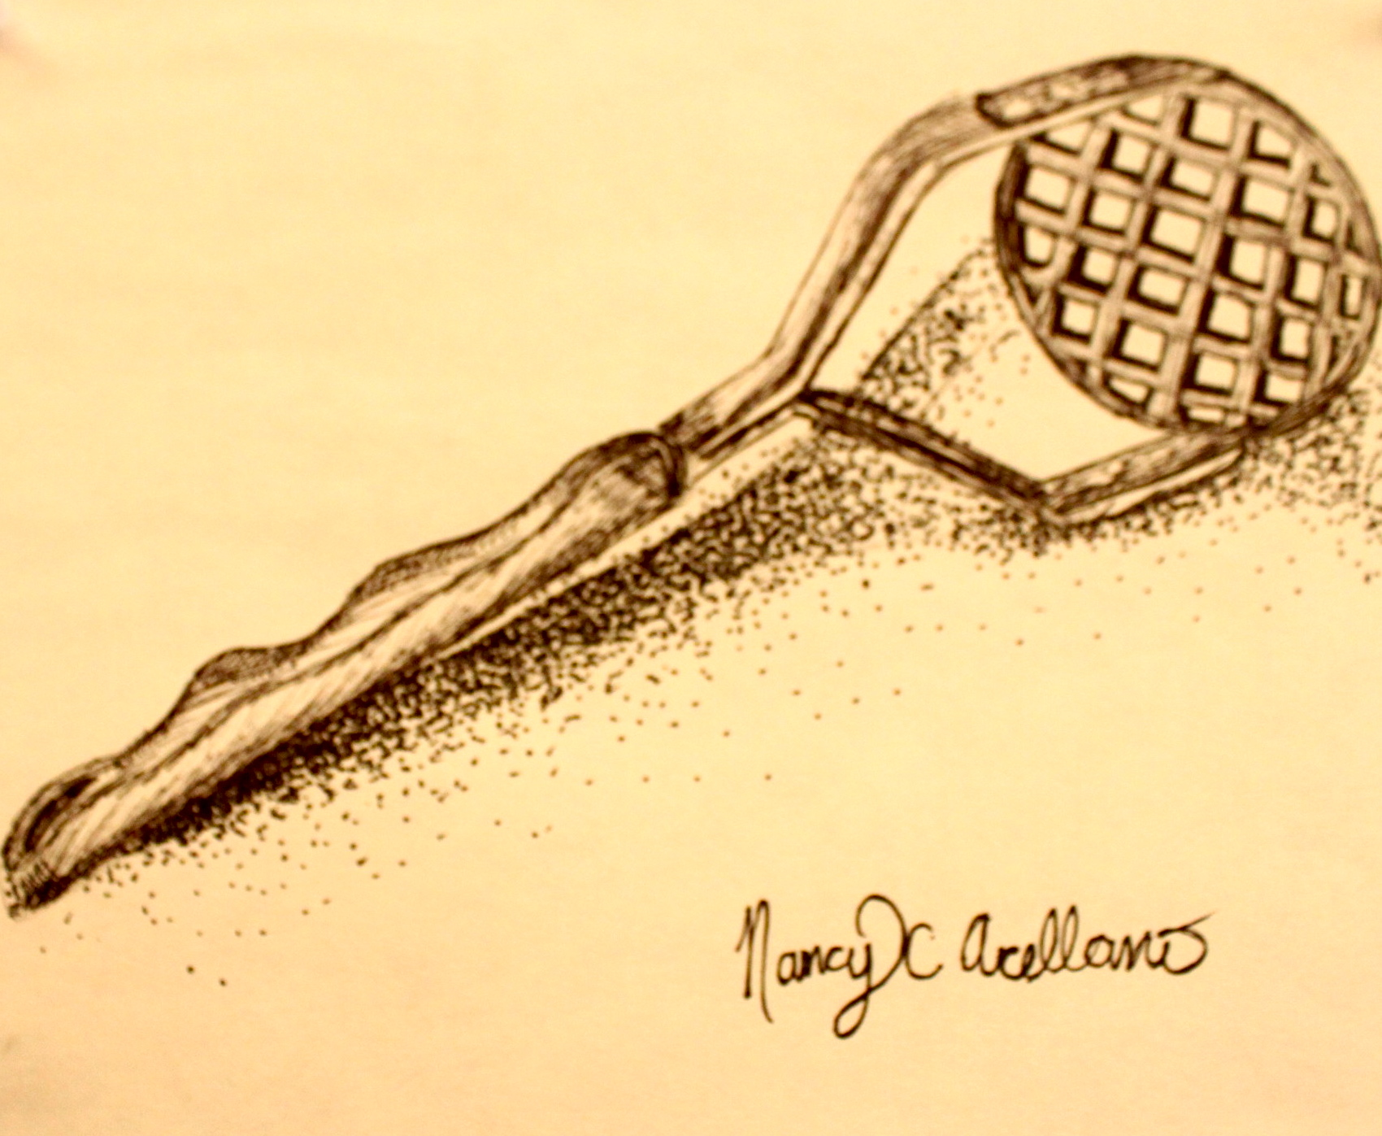
An artist cannot fail; it is a success to be one. — Charles Horton Cooley

Slide 9
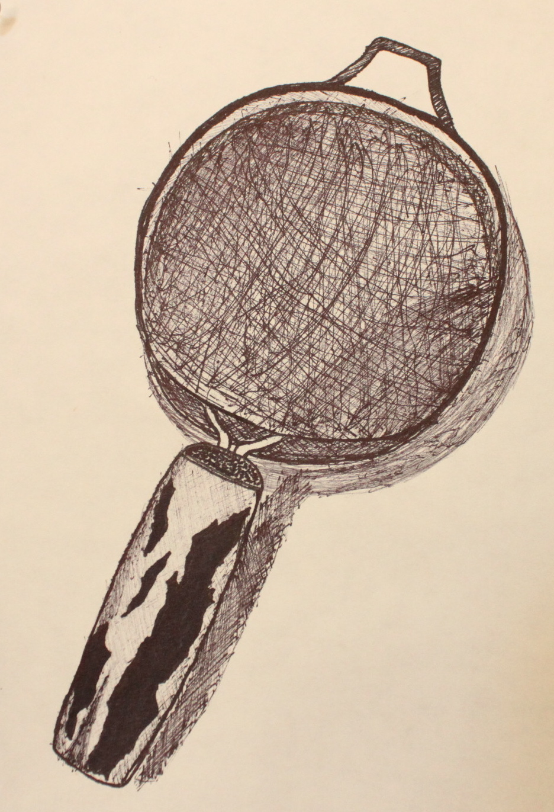
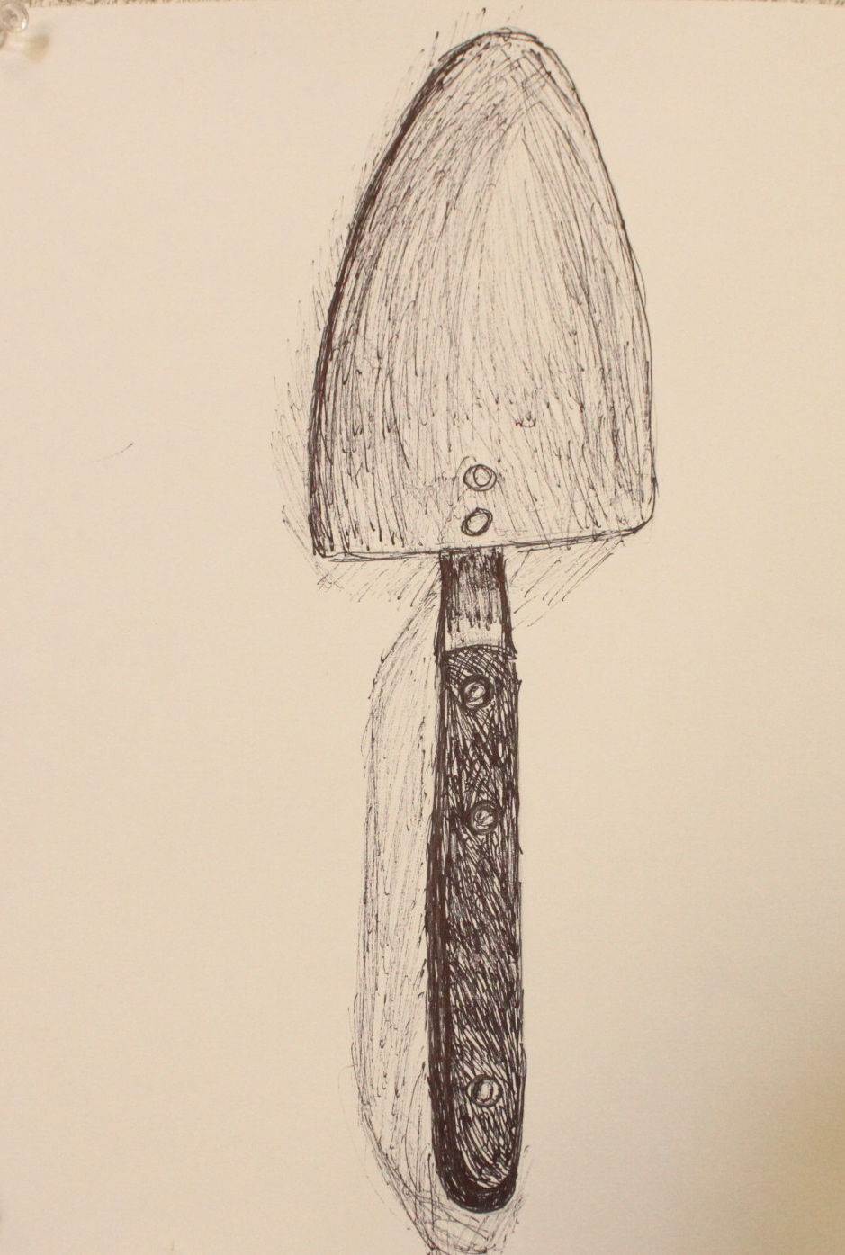
I saw the angel in the marble and carved until I set him free — Michelangelo

