Slide 1
Chapter 6.4
Graphs of Sine and Cosine Functions

Slide 2
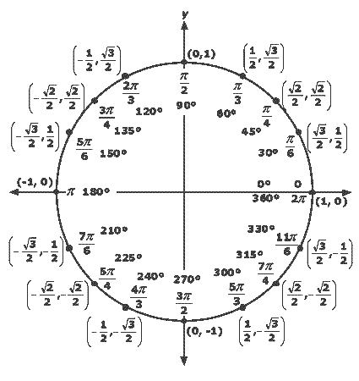
Graph of Sine and Cosine Functions: Transform a graph from the unit circle to an xy- plane.
y = sin x
y = cos x
Link : http://upload.wikimedia.org/wikipedia/commons/7/7d/Sin_drawing_process.gif

Slide 3
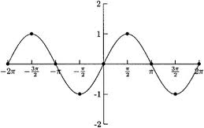
Graph of Sine Function:
y = sin x
(π/2, 1)
(angle, y-value on unit circle)
*because we are
graphing sine!
(π, 0)
(0, 0)
(2π, 0)
(3π/2, -1)
(π/2, 1)
(0, 0)
(π, 0)
(2π, 0)
(3π/2, -1)

Slide 4
Graph of Sine Function. y = sin x
period from 0 to 2π

Slide 5
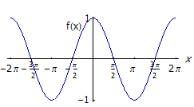
Graph of Cosine Function:
y = cos x
(π/2, 0)
(angle, x-value on unit circle)
*because we are
graphing cosine!
(π, -1)
(0, 1)
(2π, 1)
(3π/2, 0)
(0, 1)
(2π, 1)
(π/2,0)
(3π/2, 0)
(π, -1)

Slide 6
Graph of Cosine Function. y = cos x
period from 0 to 2π

Slide 7
Properties of Sine and Cosine graphs
The domain is the set of real numbers
The range is set of “y” values such that -1≤ y ≤1
The maximum value is 1 and the minimum value is -1
The graph is a smooth curve
Each function cycles through all the values of the range over an x interval or 2π
The cycle repeats itself identically in both direction of the x-axis
7

Slide 8
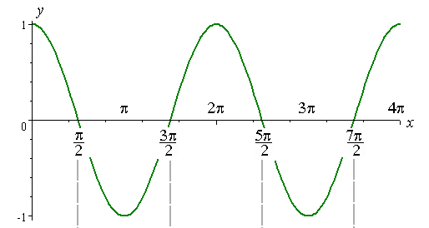
y = sin x
y = cos x

Slide 9
Graphing Trigonometric Functions using Transformations
Example: Graph y = 2 sin x
Step 1: Graph a basic graph of y = sin x
Step 2: Add the transformation of 2 sin x
2
1
π/2
π
3π/2
2π
-1
-2

Slide 10
Example: Graph y = 2 cos x
Step 1: Graph a basic graph of y = cos x
Step 2: Add the transformation of 2 cos x
2
1
π/2
π
3π/2
2π
-1
-2

