Slide 1
Chapter 12.5
The Binomial
Theorem

Slide 2
This symbol is read "n taken j at a time"

Slide 3
Let's work a couple of these:

Slide 4
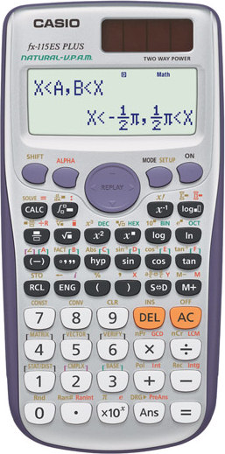
Your calculator can compute these as well. For the following problem……
12C9
220
Type 12 shift ÷ (For nCr) 9 =

Slide 5
***FYI….By Rule
For example:

Slide 6
Arrange the various values in a triangular display.
This is called the Pascal triangle.

Slide 7
Let’s replace each ( ) with a single number.
1
1 1
1 2 1
1 3 3 1
1 4 6 4 1
1 5 10 10 5 1

Slide 8
Pascal’s Triangle
1
0th row
1 1
1st row
1 + 2 = 3
1 2 1
2nd row
1 3 3 1
3rd row
6 + 4 = 10
1 4 6 4 1
4th row
1 5 10 10 5 1
5th row
1 6 15 20 15 6 1
Guess the 6th row.
Each number in the interior of the triangle is the sum of the two numbers immediately above it.
The numbers in the n^{th} row of Pascal’s Triangle are the binomial coefficients for (x + y)^{n} .

Slide 9
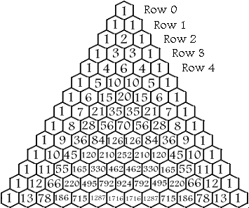
The Sums of the Rows
The sum of the numbers in any row is equal to 2 to the n^{th} power or 2^{n}, when n is the number of the row. For example:
2⁰ = 1 2¹ = 1+1 = 2 2² = 1+2+1 = 4 2³ = 1+3+3+1 = 8 2⁴ = 1+4+6+4+1 = 16

Slide 10
Prime Numbers
If the 1st element in a row is a prime number (remember, the 0th element of every row is 1), all the numbers in that row (excluding the 1's) are divisible by it. For example, in row 7 (1 7 21 35 35 21 7 1) 7, 21, and 35 are all divisible by 7.

Slide 11
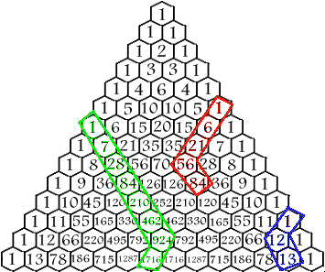
Hockey Stick Pattern
If a diagonal of numbers of any length is selected starting at any of the 1's bordering the sides of the triangle and ending on any number inside the triangle on that diagonal, the sum of the numbers inside the selection is equal to the number below the end of the selection that is not on the same diagonal itself. If you don't understand that, look at the drawing. 1+6+21+56 = 84 1+7+28+84+210+462+924 = 1716 1+12 = 13

Slide 12
Magic 11's
If a row is made into a single number by using each element as a digit of the number (carrying over when an element itself has more than one digit), the number is equal to 11 to the n^{th} power or 11^{n} when n is the number of the row the multi-digit number was taken from.
Row # | Formula | = | Multi-Digit number | Actual Row
Row 0 | 11⁰ | = | 1 | 1
Row 1 | 11¹ | = | 11 | 1 1
Row 2 | 11² | = | 121 | 1 2 1
Row 3 | 11³ | = | 1331 | 1 3 3 1
Row 4 | 11⁴ | = | 14641 | 1 4 6 4 1
Row 5 | 11⁵ | = | 161051 | 1 5 10 10 5 1
Row 6 | 11⁶ | = | 1771561 | 1 6 15 20 15 6 1
Row 7 | 11⁷ | = | 19487171 | 1 7 21 35 35 21 7 1
Row 8 | 11⁸ | = | 214358881 | 1 8 28 56 70 56 28 8 1

Slide 13
Square Numbers
Starting at row 3 and going diagonally, you will see the square numbers. A Square Number is the sum of the two numbers in any circled area in the diagram.

Slide 14
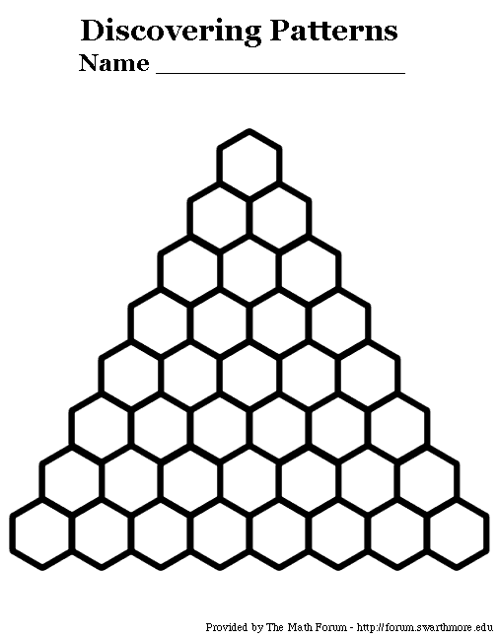

Slide 15
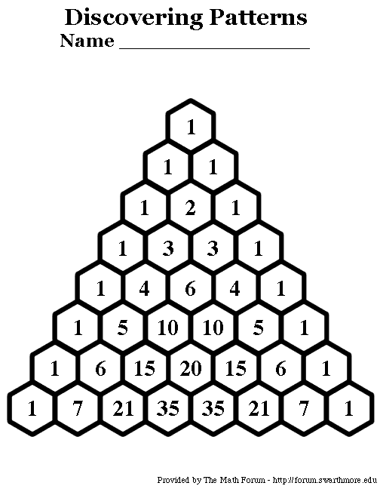

Slide 16
A binomial is a polynomial with two terms such as x + a. Often we need to raise a binomial to a power. In this section we'll explore a way to do just that without lengthy multiplication.
Can you see a pattern?
Can you make a guess what the next one would be?
We can easily see the pattern on the x's and the a's. But what about the coefficients? Make a guess and then as we go we'll see how you did.

Slide 17
Let's list all of the coefficients on the x's and the a's and look for a pattern.
1
1 1
1 2 1
1 3 3 1
1 4 6 4 1
+
+
+
+
+
+
+
+
+
+
1 5 10 10 5 1
Can you guess the next row?

Slide 18
The Binomial Theorem
The x's start out to the nth power and decrease by 1 in power each term. The a's start out to the 0 power and increase by 1 in power each term. The binomial coefficients are found by computing the combination symbol.

Slide 19
Expand

Slide 20
Expand

Slide 21
Expand

Slide 22
Finding the indicated coefficient or term.
Find the 5th term of (x + a)¹²
1 less than term number
5th term will have a⁴ (power on a is 1 less than term number)
So we'll have x⁸ (sum of two powers is 12)
Find the 7th term of (x + a)¹⁰
1 less than term number
7th term will have a⁶ (power on a is 1 less than term number)
So we'll have x⁴ (sum of two powers is 10)

Slide 23
Finding the indicated coefficient or term.

Slide 24
Finding the indicated coefficient or term.

