Slide 1
The English Restoration and Later Theatre

Slide 2
Restoration
For 18 years theatre stayed in hibernation under the rule of the Puritan leader.
When Charles II was restored to the throne, theatre was once again made legal and with it came important innovations.
Thomas Killigrew and William Davenant were assigned to supervise the “fresh start” of theatre.

Slide 3
Killigrew and Davenant
Both were experienced playwrights
Davenant was rumored to be Shakespeare’s son by a mistress.
He is also attributed with what could be called the first English opera

Slide 4
The English Royal Patent of 1662
Mandated women perform female roles
Endorsed theatre as “useful and instructive”
Only 2 theatres received official sanction
Drury Lane
Covent Garden
Other small theatres popped up but only those with the official sanction were considered legitimate.

Slide 5
Archetecture
Roofs were closed in
This allowed for more elaborate scenery and stage mechanics
Stage was lit with elaborate chandeliers
Orchestra moved to the front of the stage
The back wall was replaced with shutters that rolled back and forth in grooves
This allowed for multiple scene changes
Audience sat on level floors to help them see the actors
Stage was tilted slightly toward audience
Actors had to now move “up” and “down”
Terms upstage and downstage

Slide 6
Some of the most famous Writers of the time
William Wycherly (1640-1716)
The Country Wife
Known for being a comic trendsetter
William Congreve (1670-1729)
Love for Love
The way of the World
Considered a master of comedy
George Farquhar (1678-1707)
The Beaux’ Stratagem

Slide 7
Actors
David Garrick
Greatest actor of the Restoration
Was good at both comedy and tragedy
His natural movement and line delivery set him apart from the previously stiff style
Wrote plays and made important innovation in stage lighting
Hid the lighting fixtures from the audiences view
Peg Woffington
One of the most famous actresses of the time
Garrick’s mistress for many years
Rebelled against the gender-biased Elizabethans by successfully portraying men’s roles

Slide 8
Drury Lane and Covent Garden
Within 5 months of each other in 1808 and 1809, both burned to the ground
This symbolized the end of an era
When new building were built to replace them, a new period of theatre emerged

Slide 9
Playwrights
Teetering between the Restoration and the period to follow were
Richard Brinsley Sheridan (1751-1816)
School for Scandal
The Rivals
Oliver Goldsmith (1728-1774)
“One hit wonder”
She Stoops to Conquer

Slide 10
LATER
Gilbert and Sullivan produced famous operas
The Mikado
The Pirates of Penzance
H.M.S. Pinafore
All of theses are still extremely popular today
Oscar Wilde
The Importance of Being Earnest
George Bernard Shaw (1856-1950)
Dominated the late 19th and early 20th centuries
Ranked next to Shakespeare as one of England’s greatest playwrights
Used his writings as a vehicle to voice his theories on humanity and intellect
Arms and the Man
Saint Joan
Pygmalion (musical version My Fair Lady)

Slide 11
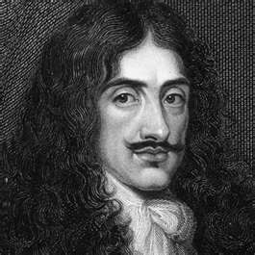
Charles II

Slide 12
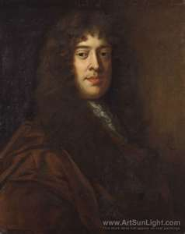
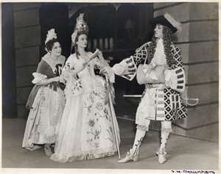
William Wycherly

Slide 13
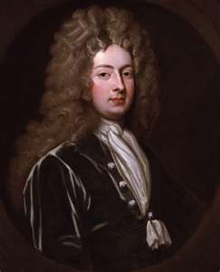
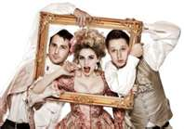
William Congreve

Slide 14
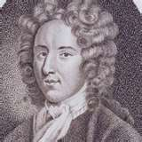
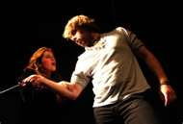
George Farquhar

Slide 15
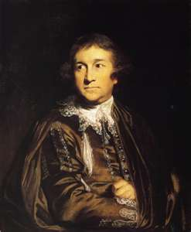
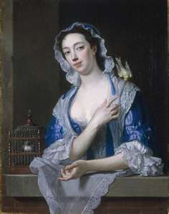
David Garrick and Peg Woffington

Slide 16
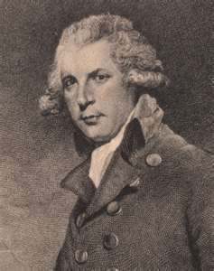
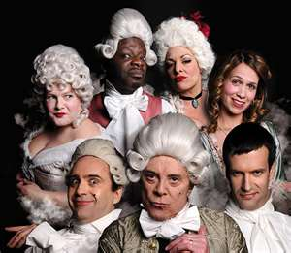
Richard Brinsley Sheridan

Slide 17
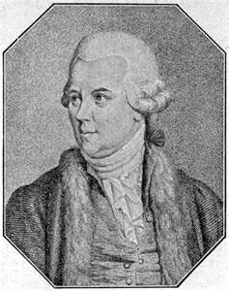
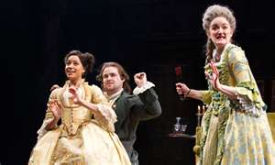
Oliver Goldsmith

Slide 18
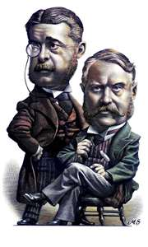
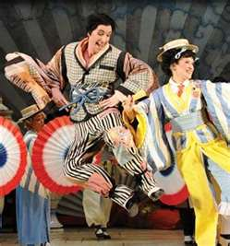
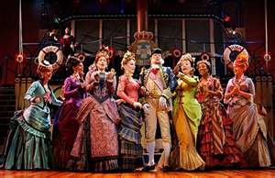
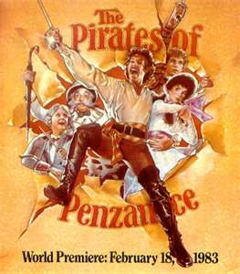
Gilbert and Sullivan

Slide 19
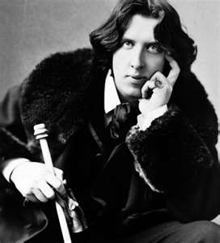
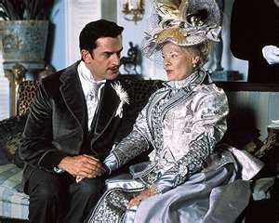
Oscar Wilde

Slide 20
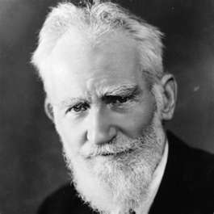
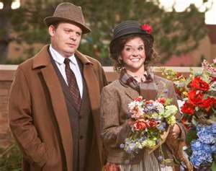
George Bernard Shaw

