Slide 1
Technological Innovations
By Kevin Tram

Slide 2
1752 Lightning Rod Benjamin Franklin
1776 Submarine David Bushnell's "Turtle"
1794 Cotton Gin Eli Whitney
1797 Interchangeable Parts Eli Whitney

Slide 3
1806 Coffee Pot Benjamin Thompson, Count Rumford
1807 Steamboat Robert Fulton
1813 Armored Warship Robert Fulton's "Demolos"
1814 Plough John Jethro Woods

Slide 4
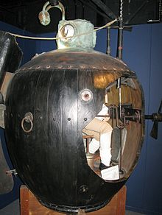
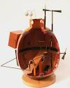
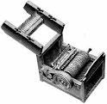

Slide 5
1817 Erie Canal
1831 Reaping Machine McCormick
1833 Sewing Machine Walter Hunt
1834 Threshing Machine John A. and Hiram Abial Pitts

Slide 6
1836 Revolver Samuel Colt
1840 Paint Tube John Rand
1843 Vulcanized Rubber Charles Goodyear
1844 Telegraph Samuel F.B. Morse

Slide 7
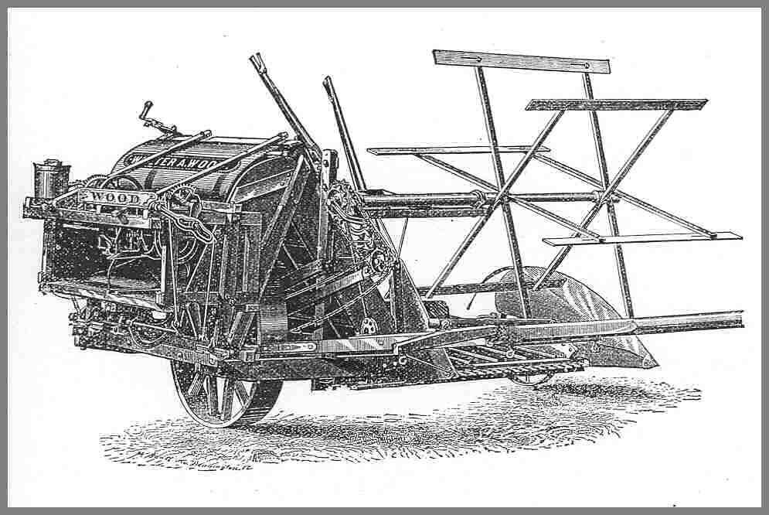
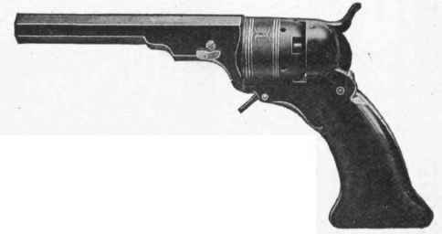
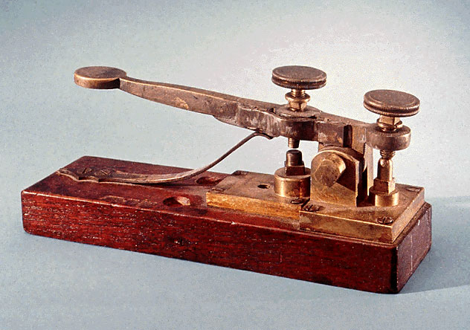
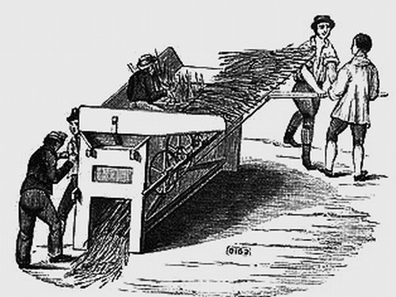

Slide 8
1845 False Teeth Cladius Ash
1846 Cylinder Printing Press Richard M. Hoe
1857 Passenger Elevator Elisha Graves Otis
1858 Burglar Alarm Edwin T. Holmes

Slide 9
1859 Oil Well Edwin Drake
1860 Repeating Rifle B. Tyler Henry
1862 Battle of the Ironclads John Ericsson
1863 Roller Skates James Plimpton

Slide 10
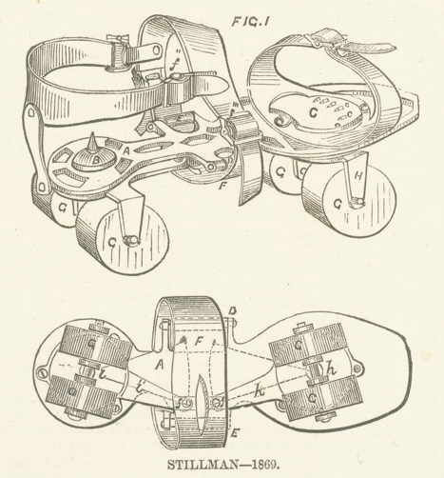
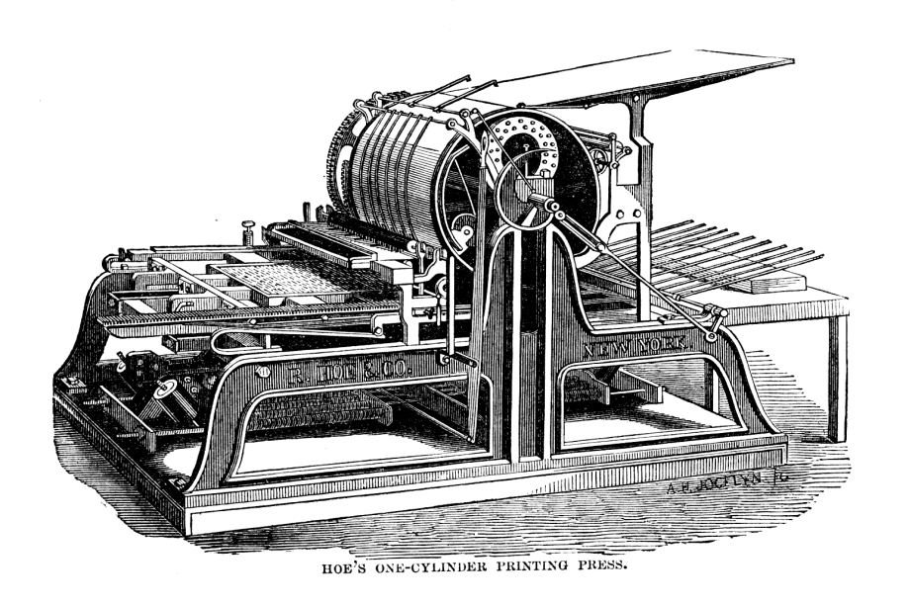
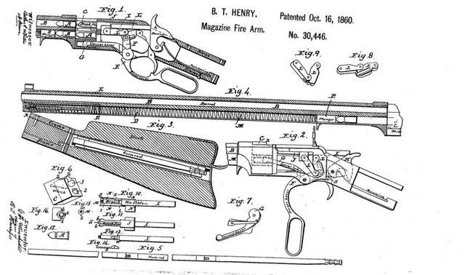
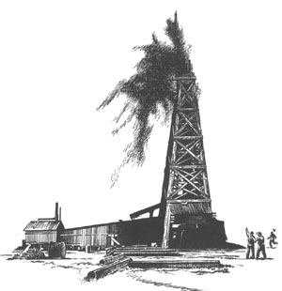

Slide 11
1865 Web Offset Printing William Bullock
1867 Barbed Wire Lucien B. Smith
1870 Pneumatic Subway Alfred Ely Beach
1873 Typewriter Christopher Latham Sholes

Slide 12
1876 Telephone Alexander Graham Bell
1877 Phonograph Thomas Alva Edison
1879 Incandescent Light Bulb Thomas Alva Edison
1882 Electric Fan Dr. Schuyler Skaats Wheeler

Slide 13
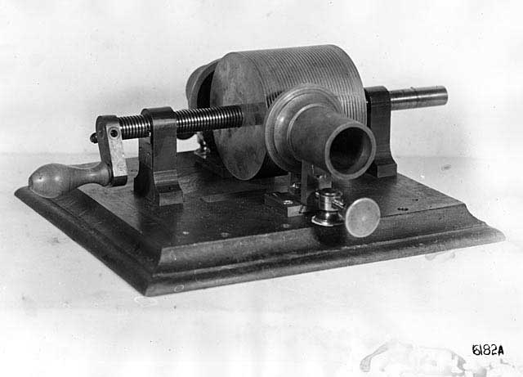
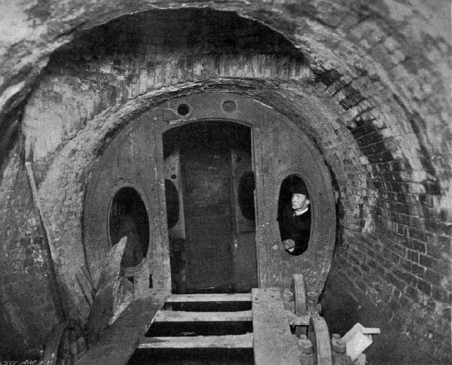
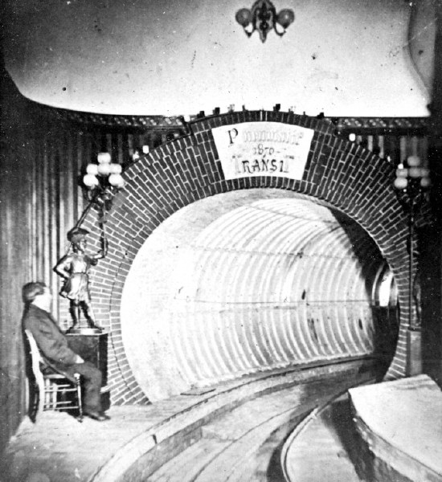
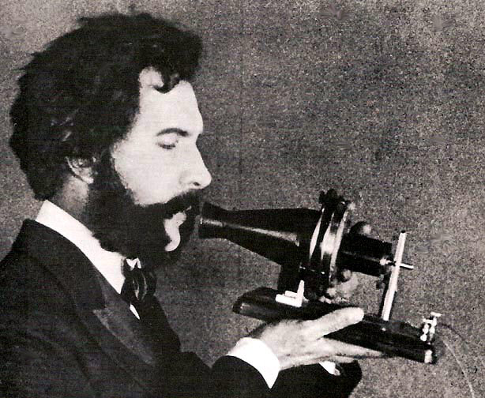

Slide 14
1885 Skyscraper William Le Baron Jenney
1888 Kodak Camera George Eastman
1889 Dishwasher Mrs. WA Cockran
1891 Peep Show (Prototype Movies) Thomas A. Edison and William Dickson

Slide 15
1891 Escalator Jesse W. Reno
1892 Gasoline-powered Car Frank and Charles Duryea
1893 Zipper Whitcomb L. Judson
1902 Air Conditioning Willis H. Carrier

Slide 16
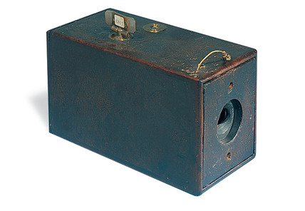
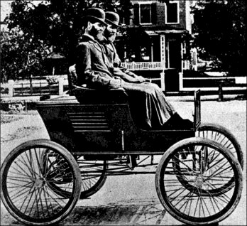

Slide 17
1903 Airplane Orville and Wilbur Wright
1908 Model T Henry Ford
1914 Panama Canal
1919 Hydrofoil Alexander Grahams Bell

Slide 18
1924 Execution State of Nevada gas chamber
1926 Rocket Robert H. Goddard
1927 Television Philo Farnsworth
1929 Frozen Food Clarence Birdseye

Slide 19
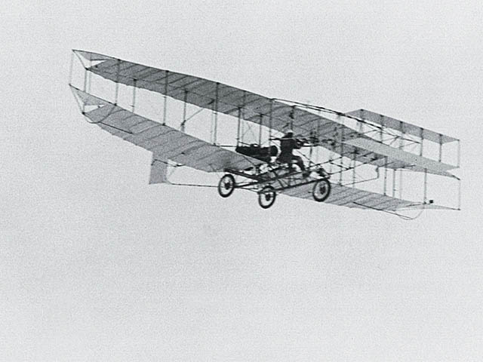
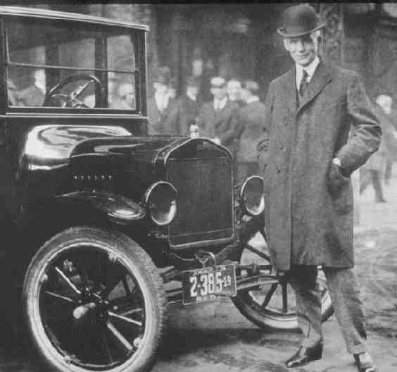
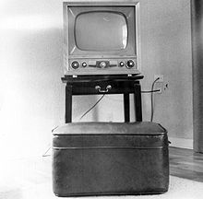

Slide 20
1932 Defibrillator Dr. William Bennett Kouwenhoven
1937 Chair Lift
1939 Digital Computer John Atanasoff and Clifford Berry
1940 Jeep Karl K. Pabst

Slide 21
1945 Atomic Bomb
1947 Polaroid Camera Dr. Edwin H. Land
1948 Electric Guitar Leo Fender
1953 Heart-lung Machine Dr. John H. Gibbon

Slide 22
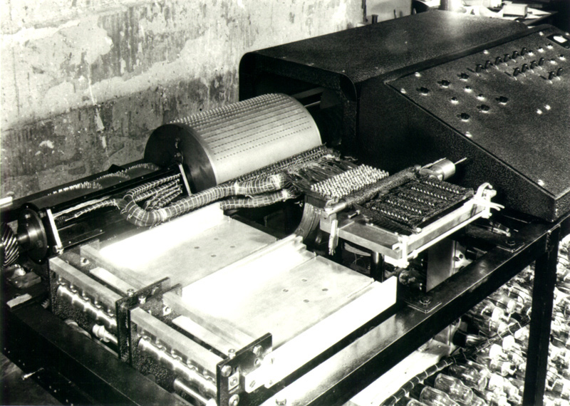
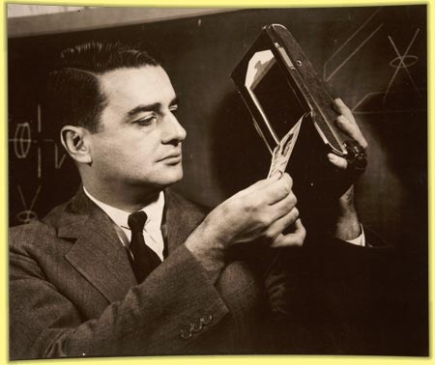

Slide 23
1955 Nuclear Submarine The Nautilus
1957 Polio Vaccine Dr. Albert Sabin
1958 Explorer I
1960 Laser Theodore H. Maiman

Slide 24
1969 Moon Landing
1970 Optical Fiber Corning Glass
1972 Video Game Pong Noland Bushnell
1974 Barcode

Slide 25
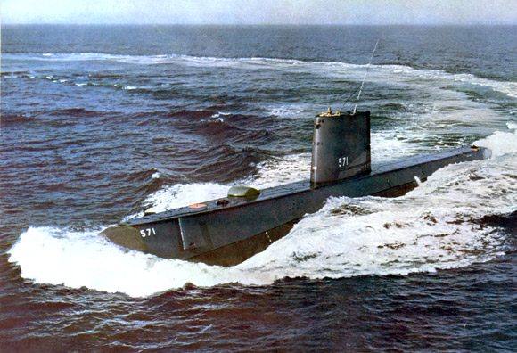
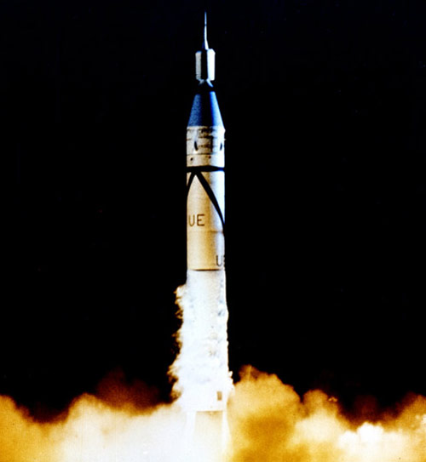
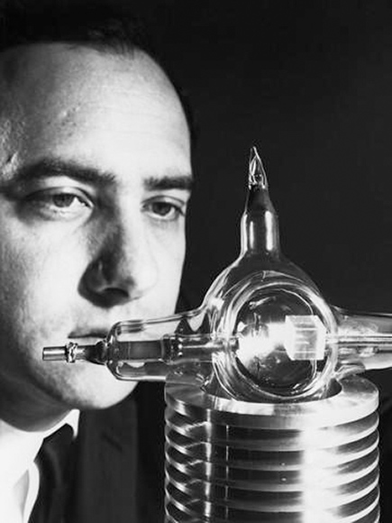

Slide 26
1975 Microsoft Bill Gates and Paul Allen
1976 Super Computer Cray Research
1979 Human-Powered Flight Byron Allen
1981 Space Shuttle

Slide 27
1981 Laptop (Osborne 1) Adam Osborne
1982 Artificial Heart Dr. Robert Jarvik
1990 Hubble Telescope
2000 iPod

Slide 28
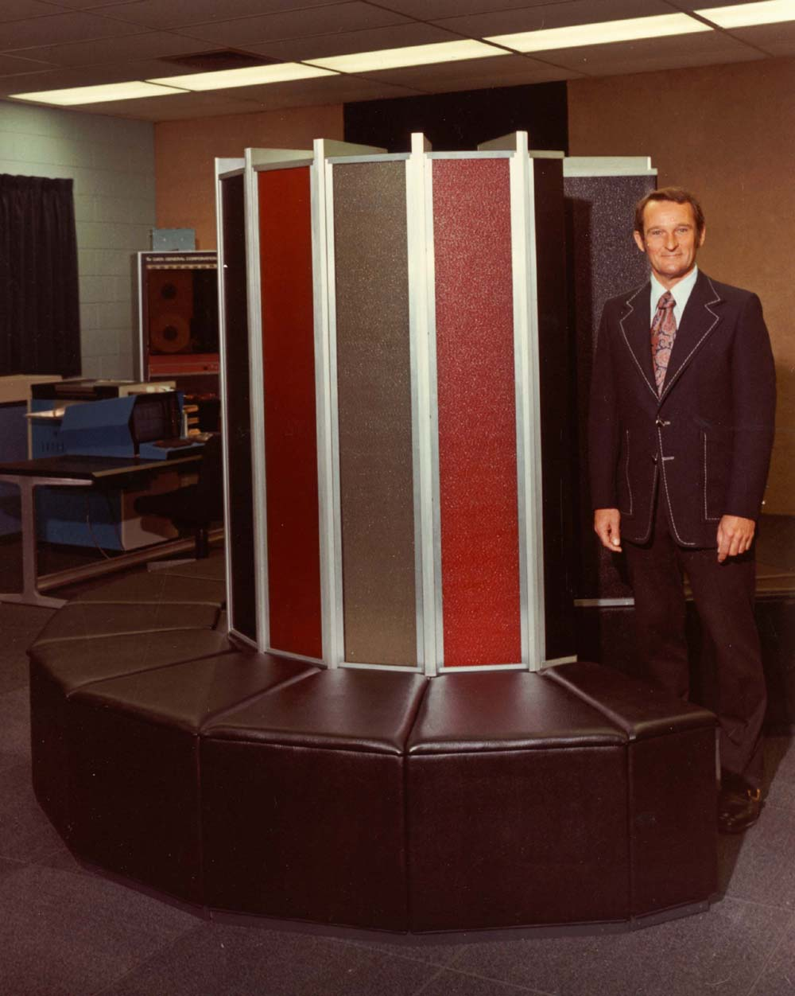
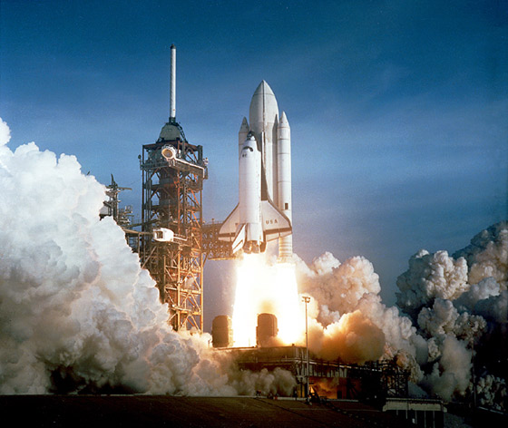
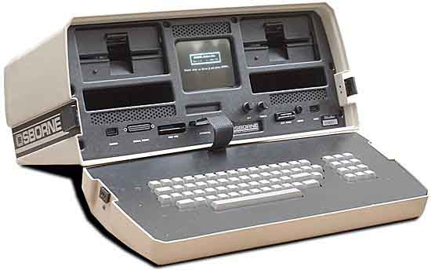
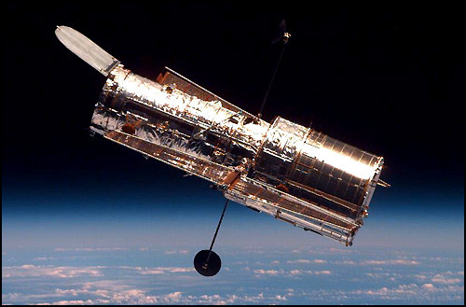

Slide 29
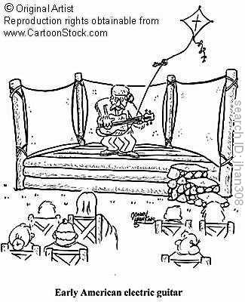

Slide 30
The system of slavery was dramatically affected by the introduction of the cotton gin because
A most enslaved Africans then took jobs in Southern factories
B farming had almost died out in the South by 1800
C it led to a shorter work day for all laborers
D the increase in cotton production required a larger labor force

Slide 31
The most important form of technology in the information revolution of the 1990s was the
A computer
B cellular telephone
C television
D laser

