Slide 1
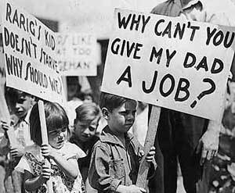
The Great Depression
Jelesha Murphy
Mrs. Dirks

Slide 2
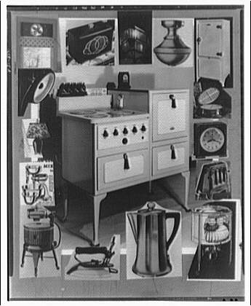
The Early 1920’s
Economy was booming by 1921
American manufacturing industry grew
Auto mobiles
Consumer goods
Radios
Vacuum cleaners
Washing machines
Near the end of the decade, things began to turn sour

Slide 3
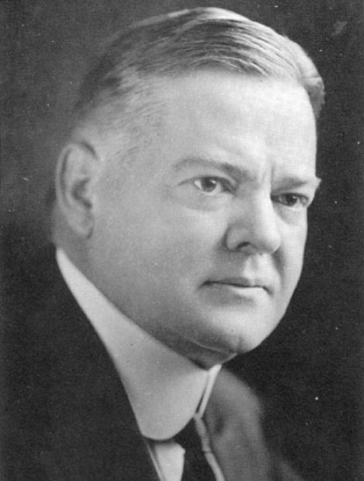
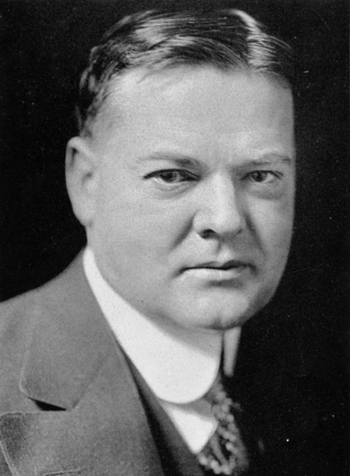
Election of 1928
Republican Herbert Hoover ran against Democrat Alfred E Smith
Hoover won the election

Slide 4
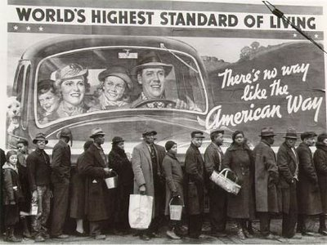
The Beginning of the End
The Great Depression began a little after WWI ended
Due to the expenses of the War and the Stock Market crash, America fell into great debt.

Slide 5
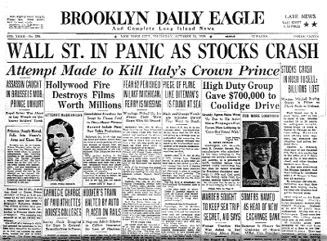
The Stock market
Extremely popular in the 1920’s
The Stock market crashed October 29, 1929 formerly known as Black Tuesday
The stock market crash set in motion a series of events that led to the Great Depression

Slide 6
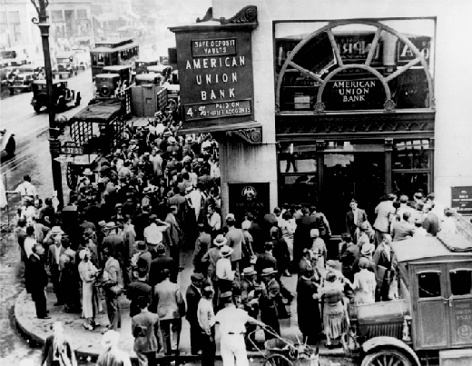
Bank Failures
With no money to lend, loans failing, businesses and farmers failing, the Banking crisis deepened
In the late 1930’s of December almost 350 banks closed including the BUS

Slide 8
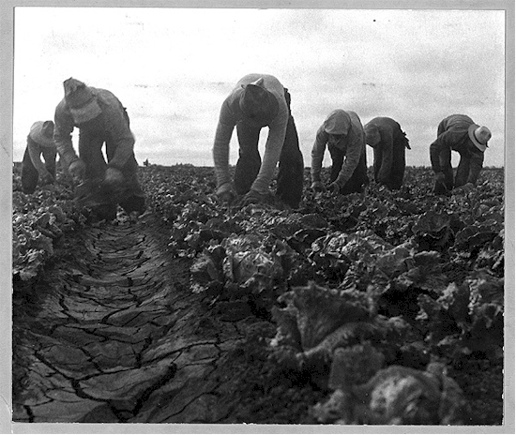
Farm Failures
Hard times for farmers only worsened
Jobless American striped of the ability to buy food
Farmers produced more food than they could sell, and farm prices sank
In 1933 about 364,000 farmers went bankrupt or suffered foreclosure .

Slide 9
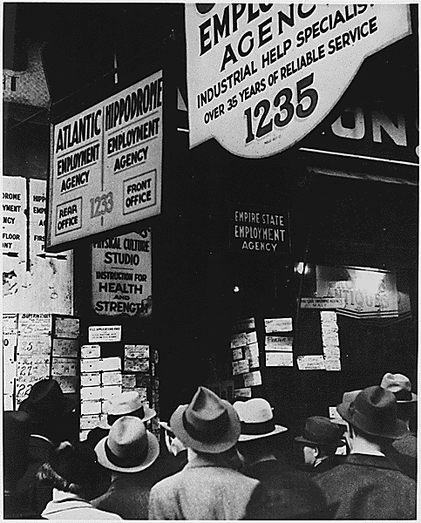
Unemployment
Once the stock market crashed, unemployment began to rise
By 1932 unemployment reached 25%

Slide 10
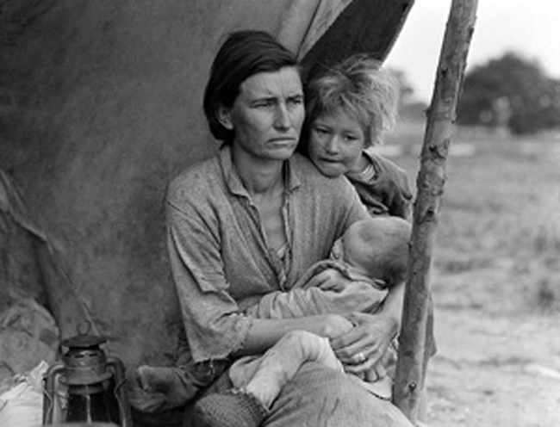
Other Causes of the Great Depression
Buying on Margin
Supply and Demand
Buying on Credit

Slide 11
Buying on Margin
In the 1920s more people invested in the stock market than ever.
Buying on margin was one of the reasons that the Stock Market began to boom!
Many stocks went up faster than the value of the company the stocks represented
This would result in DISASTER!

Slide 12
Supply and Demand
Farmers and Factories produced large amounts of products
Everyone's wages didn’t increase and the price for products steadily rose!
As Farmers and Factories noticed that people weren't buying the products they had to cutback on production and began laying people off!

Slide 13
Buying on Credit
The early 1920’s was a period of economic boom.
People began to buy cars, refrigerators etc., with money they did not have
Installment buying is what this system was called.

Slide 14
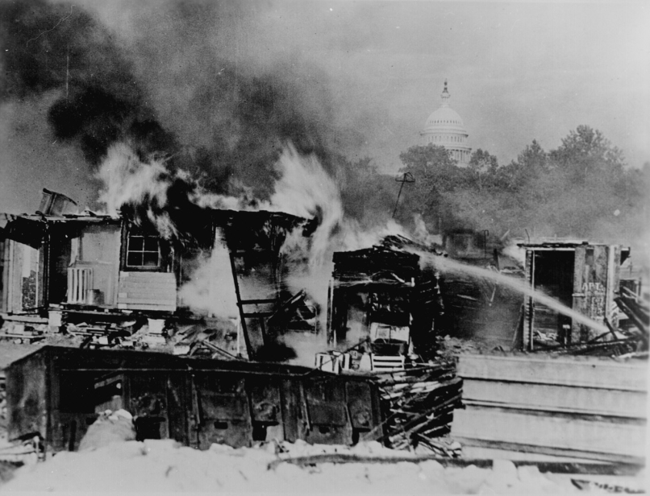
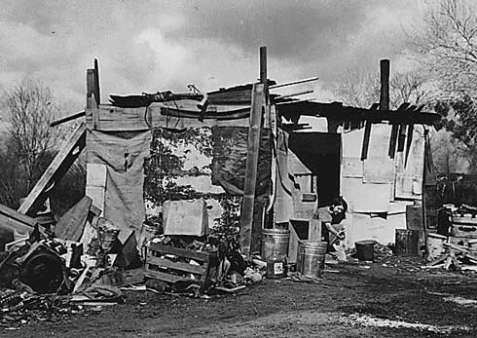
Hoovervilles
Hoovervilles were shanty towns built by homeless people , they were named after the Herbert Hoover who was president at the time
Hoovervilles had no running water and electricity, and were usually thrown together by whatever building material scraps they could find.

Slide 15
Dust Bowl
Known as “Black Sunday”
April 14, 1935, a day when winds reached top speeds of 60 miles per hour, prompted an AP reporter to coin the term “dust bowl” for the first time.
This hurt the farmers of Oklahoma and Arkansas
The dust killed the crops and covered farm equipment.

Slide 16
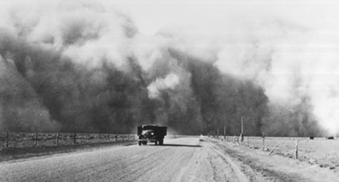
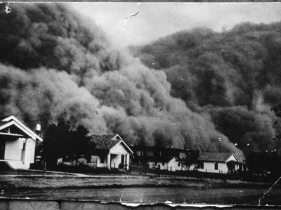
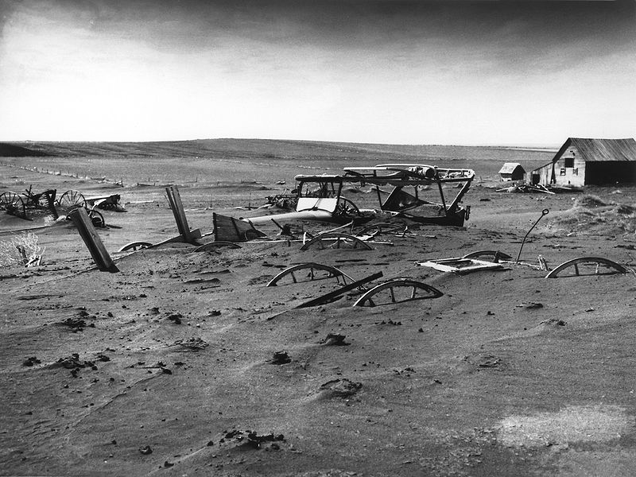
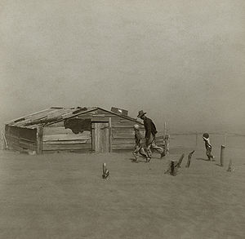

Slide 17
Hoovers Response
Hoover believed in getting people back to work instead of providing instant relief
In 1932 he urged Congress to create RFC, RFC would loan money to banks, railroads, and insurance companies in an effort to stimulate the depressed economy and save the entities from bankruptcy
Hoover soon began to be blamed for the Great Depression

Slide 18
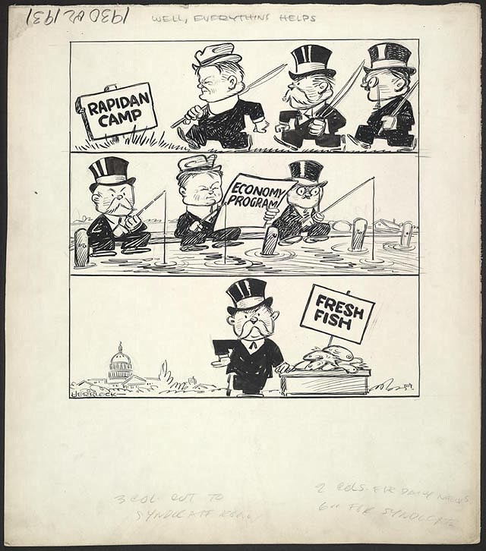
Well Everything Helps
Hoover took working vacations at his fishing camp on the Rapidan River.

Slide 19
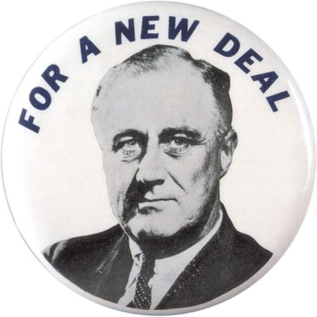
Roosevelt Steps Up
Immediate relief, recovery from economic collapse became Roosevelt’s main goal when he became President
The term “New Deal” was first used in President Roosevelt acceptance nomination speech

Slide 20
What is the “New Deal”
The New Deal was an economic measures that involved a massive public works program, complemented by the large-scale granting of loans, and succeeded in reducing unemployment
Within 100 Roosevelt proposed many programs to reform and recover the economy such as:
Emergency Banking Act (March 9)
Economy Act (March 20)
Beer-Wine Revenue Act (March 22)
Civilian Conservation Corps Act (March 31)
Federal Emergency Relief Act(May 12)
Agricultural Adjustment Act(May 12)
Tennessee Valley Authority Act(May 18)
Federal Securities Act (May 27),

Slide 21
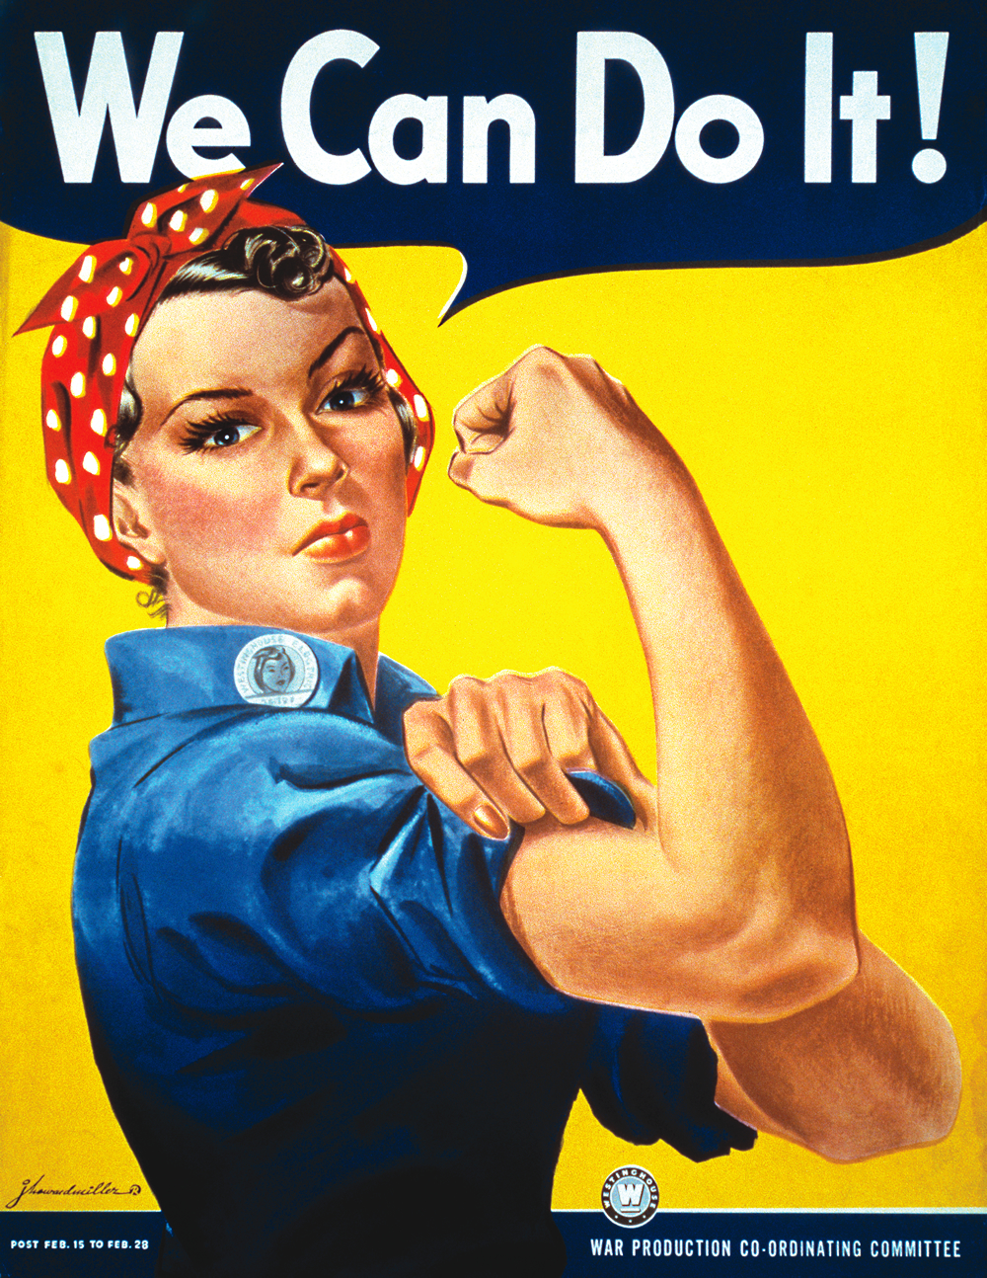
The End
At the start of WWII the American economy was given a boost when the fighting countries needed supplies and looked to America to make them
The desperate need for soldiers, pilots, and workers to make ammunition, weapons, and air/sea craft all contributed to the end of the Great Depression

