Slide 1
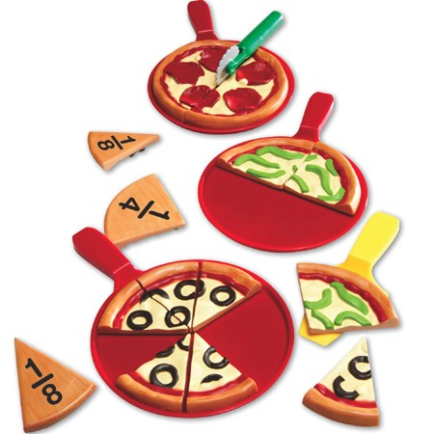
Comparing & Ordering Fractions

Slide 2
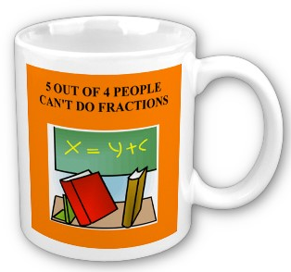
Comparing & Ordering Fractions
Please
do not
be these people!

Slide 3
Comparing & Ordering Fractions
Objective:
7.1.02
Essential Questions:
How can I compare and order fractions?

Slide 4
Comparing & Ordering Fractions
Lets talk about pizza…
How much pizza did I eat?

Slide 5
Comparing & Ordering Fractions
Lets talk about pizza…
How much pizza did I eat?
¼ of the entire pizza
How did you know that?

Slide 6
Comparing & Ordering Fractions
Lets talk about pizza…
How much pizza did I eat?

Slide 7
Comparing & Ordering Fractions
Lets talk about pizza…
How much pizza did I eat?
½ of the entire pizza
How did you know that?

Slide 8
Comparing & Ordering Fractions
Visually we can see that if we eat ½ of the pizza we are eating more than if we had eaten ¼ of the pizza.
But the question remains - How do we know a fraction like 1/2 is more than 1/4 because they have different denominators?

Slide 9
Comparing & Ordering Fractions
Examples: Replace each □ with <, >, or = to make a true sentence.
a) 1/2 □ 3/8
b) 3/9 □ 1/3
c) 1/4 □ 4/12

Slide 10
Comparing & Ordering Fractions
In order to determine which symbol goes in the box, we need to either find the LCD and then rewrite the fraction using equivalent denominators or use the BOWTIE method.
a) 1/2 □ 3/8
→ since 2 x 4 = 8, multiply num. and den. by 4 and get 4/8
4/8 > 3/8

Slide 11
Comparing & Ordering Fractions
In order to determine which symbol goes in the box, we need to either find the LCD and then rewrite the fraction using equivalent denominators or use the BOWTIE method.
b) 3/9 □ 1/3
→ since 3 x 3 = 9, multiply num. and den. by 4 and get 4/8
3/9 = 3/9

Slide 12
Comparing & Ordering Fractions
In order to determine which symbol goes in the box, we need to either find the LCD and then rewrite the fraction using equivalent denominators or use the BOWTIE method.
c) 1/4 □ 4/12
→ since 4 x 3 = 12, multiply num. and den. by 4 and get 4/8
3/12 < 4/12

Slide 13
Comparing & Ordering Fractions
Extension: Find the LCM of 168 and 180.
Extension: Find the LCD of 9/36a²b and 16/27ab²

Slide 14
Comparing & Ordering Fractions
Examples: Replace each □ with <, >, or = to make a true sentence.
a) 2/3 □ 4/7
b) 1/7 □ 5/6
c) 3/4 □ 4/6

Slide 15
Comparing & Ordering Fractions
Examples: Replace each □ with <, >, or = to make a true sentence.
a) 2/3 □ 4/7 a) >
b) 1/7 □ 5/6 b) <
c) 3/4 □ 4/6 c) >

Slide 16
Comparing & Ordering Fractions
Another important idea from this section is ordering fraction in descending or ascending order, so here is another example.
Example: Order the fractions from least to greatest.
3/4, 2/5, 5/8, 1/2

Slide 17
Comparing & Ordering Fractions
To solve problems like this it helps to know our divisibility rules because they provide clues to when different numbers might have multiples in common.

Slide 18
Comparing & Ordering Fractions
For instance, we do not have to worry about multiples of 2 and 4 because we know every multiple of 8 is a multiple of 2 and 4. Therefore we only have to find a multiple for 5 and 8. If we list the multiples of 5 and 8 we get the following:
5: 5, 10, 15, 20, 25, 30, 35, 40, 45, 50…
8: 8, 16, 24, 32, 40, 48, 56…

Slide 19
Comparing & Ordering Fractions
We should note that 40 happens to be equal to 5 x 8, because we know we can always find a common denominator of a number by multiplying the denominators (but it MAY NOT BE the Least Common Denominator)

Slide 20
Comparing & Ordering Fractions
Now we can turn the fractions with unlike denominators into fractions with one common denominator:
3/4 x 10/10 = 30/40
2/5 x 8/8 = 16/40
5/8 x 5/5 = 25/40
1/2 x 20/20 = 20/40

Slide 21
Comparing & Ordering Fractions
So now we can order the fractions form least to greatest:
2/5, 1/2, 5/8, 3/4

Slide 22
Comparing & Ordering Fractions
Examples: Order the fractions from least to greatest.
2/3, 2/9, 5/6, 11/18

Slide 23
Comparing & Ordering Fractions
Examples: Order the fractions from least to greatest.
2/3, 2/9, 5/6, 11/18
2/9, 11/18, 2/3, 5/6

Slide 24
Comparing & Ordering Fractions
Homework

