Slide 1
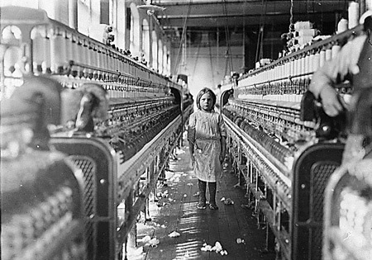
Child Labor
During the Industrial Revolution

Slide 2
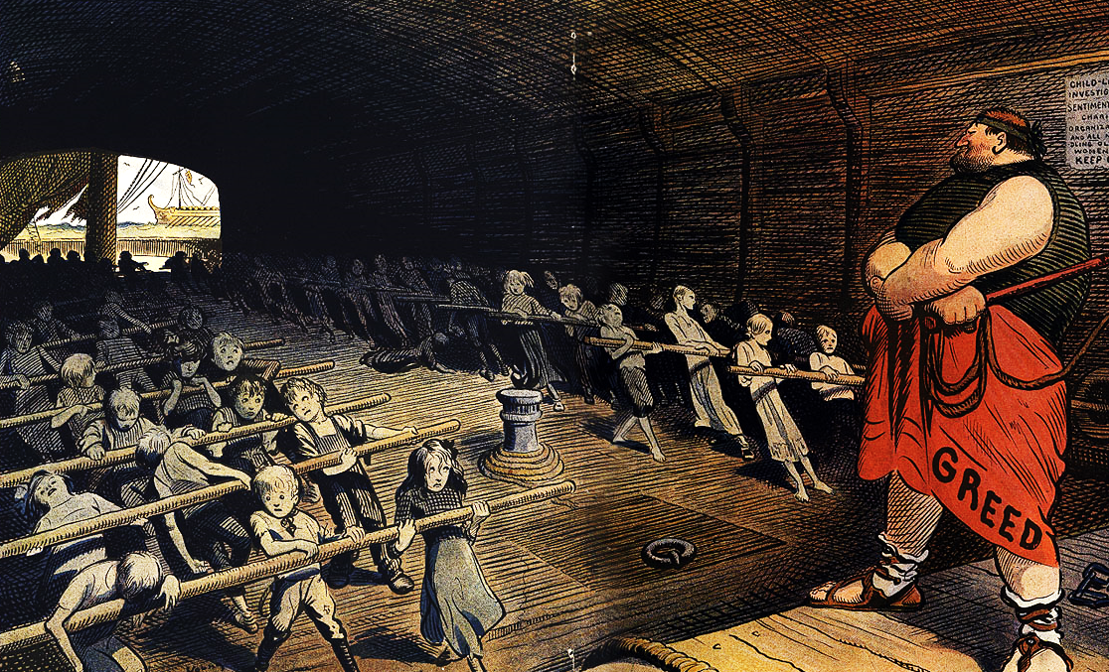
Were children who worked during the Industrial Revolution used unfairly (exploited) or were they provided an opportunity to help their families?

Slide 3
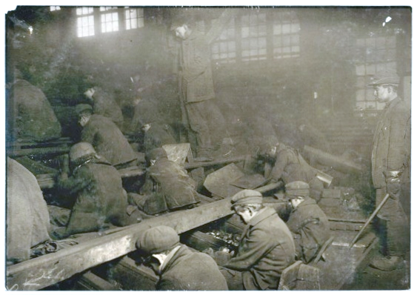
These young boys worked inside a factory building in 1911, processing the impurities from the coal by hand. The dust was so thick at times that many of the photographer’s shots didn’t come out at all, yet none of the boys were given protective gear. In fact, they were instead beaten and kicked by their overseers if they didn’t seem to be working fast enough.

Slide 4
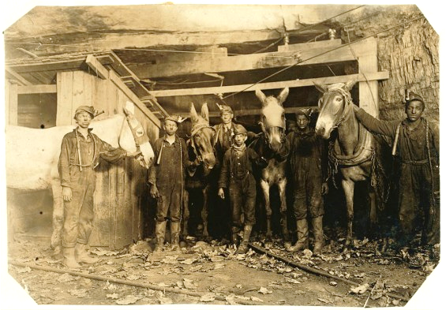
Coal miners have always faced a lot of work hazards. Back before these types of jobs were regulated, employees were given little, if any, protective clothing and forced to work ten or twelve hour shifts. These boys, photographed in 1908, stayed underground all day from 7 am to 5 pm. The youngest boys at the company would be hired as "trappers," sent to open up the trap doors to allow the drivers through with their coal loads.

Slide 5
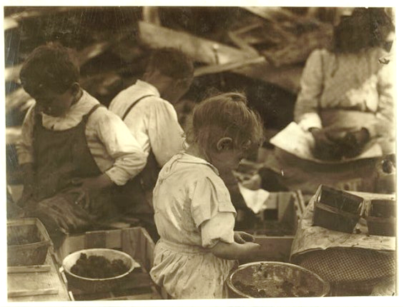
These two berry hullers were only two and three years old, but they worked long,
twelve hour shifts, just like the rest of their family members. Hullers at the company
would earn two cents per quart of berries finished, but there is no indication of
how many quarts would typically be completed in a day.

Slide 6
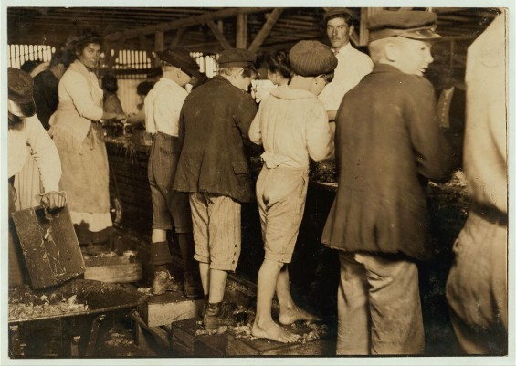
While there are quite a few children in this image of shrimp pickers, the youngest is eight years old and, while not pictured in this photo, the youngest boys employed by the company were only five. These employees would stand over a trough all day shelling shrimp until their fingers bled, and of course the acid and salt water only worsened the pain.

Slide 7
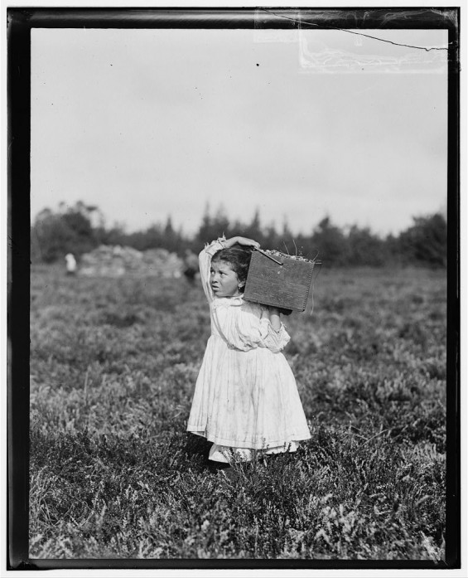
This eight-year-old girl, working
at a cranberry farm, was kept from school until the harvest was over. Work was so constant that her father even scolded her for pausing so that the photographer could take this image – hence her look of worry.

Slide 8
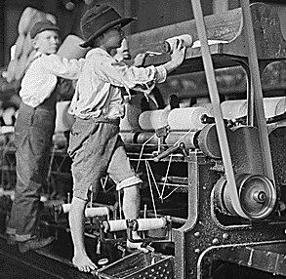
How Many Children Worked in the British Mills During the Industrial Revolution?
children under 13 comprised roughly 10 to 20 % of the work forces in the cotton, wool, flax, and silk mills in 1833
while only 4.5% of the cotton workers were under 10, 54.5% were under the age of 19
there were still 58,900 boys and 82,600 girls under 15 employed in textiles and dyeing in 1881

Slide 9
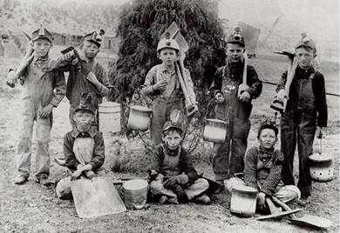
How Many Children Worked in the British Mines During the Industrial Revolution?
in 1842, the proportion of the work forces that were children and youth in coal and metal mines ranged from 19 to 40%
in 1851 children and youth (under 20) comprised 30% of the total population of coal miners in Great Britain
by 1881 there were 30,400 boys under 15 still employed and 500 girls under 15

Slide 10
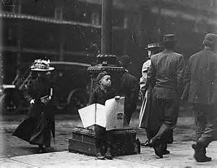
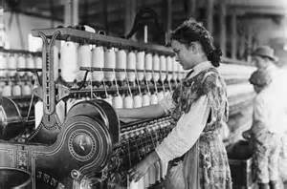
Take a moment and think about the photos showing child labor during the Industrial Revolution. In your small group, answer these questions:
Give three reasons why you think business owners wanted to use children for labor.
Give two reasons why you think a child would want to go to work at a young age.
Do you think it was fair for business owners to use children for labor? Why or why not?
Make a list of 5 working conditions that were unreasonable for children. Put a star beside the working condition that you feel was the worst.
Write 3 reforms, or changes, that you would have made to improve children’s working conditions during the Industrial Revolution.

Slide 11
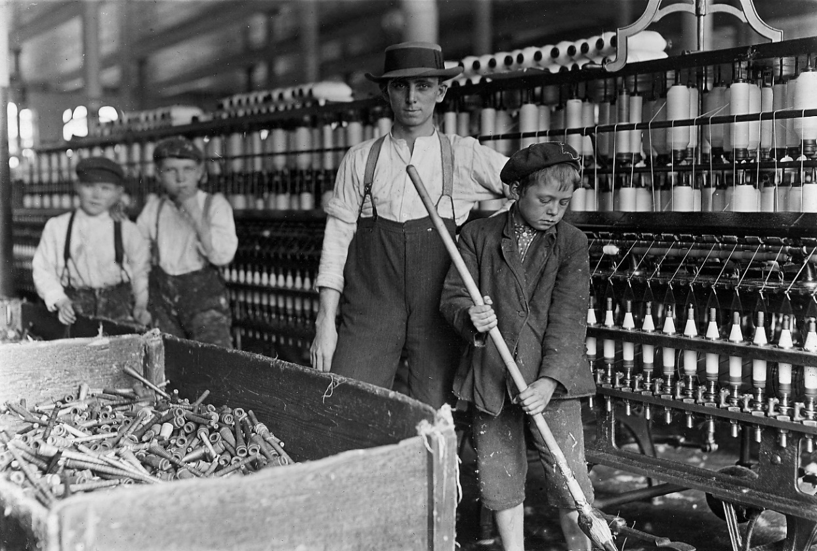
Advantages of Child Labor
employing children was necessary for production to run smoothly
children could be paid much less than adults
the children earned money for their families
children were more obedient and submissive to the foreman
children were unlikely to form unions to ask for higher wages and better working conditions
children’s small hands were perfect for working on the machines and their small bodies could fit into small holes in the mines
child labor was a means to keep children out of trouble
working hours and conditions had been just as bad in the older domestic industries or on the farm as they were in the industrial factories

Slide 12
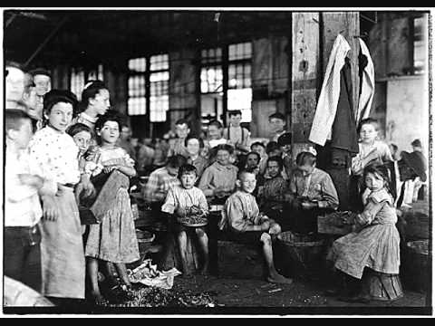
Disadvantages of Child Labor
children made very little money to help their families
children would get hurt, sometimes losing fingers or limbs, get serious illnesses such as tuberculosis, or even die
children were often beaten or tortured
12-16 hour work days with no breaks except for lunch
lunch was often inedible and offered little or no nutrition
hot, stuffy, poorly lit conditions
only one day off per week
children could not attend school

Slide 13
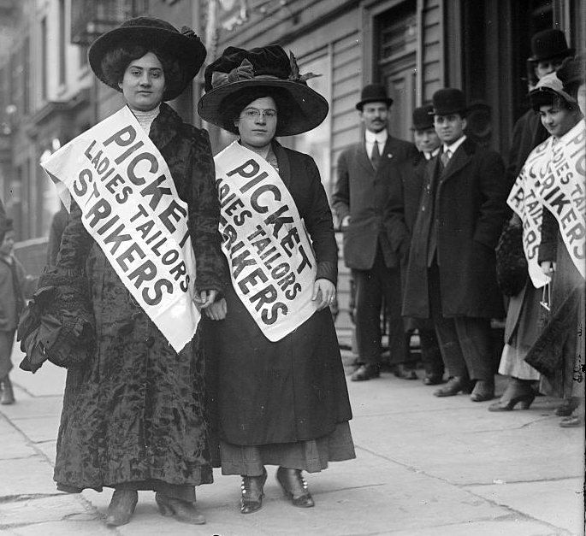
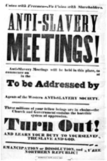
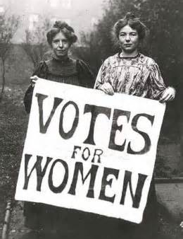
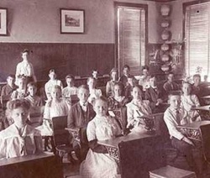
It’s Time for Reform!
Beginning in the 1800s, the Social Reform Movement rose awareness about many social issues, including :
labor rights
slavery
women’s suffrage
free public education
food safety
help for the poor
Laws were passed that reformed, or changed, the lives of all classes of people, including children. These laws improved the lives of many people.

Slide 14

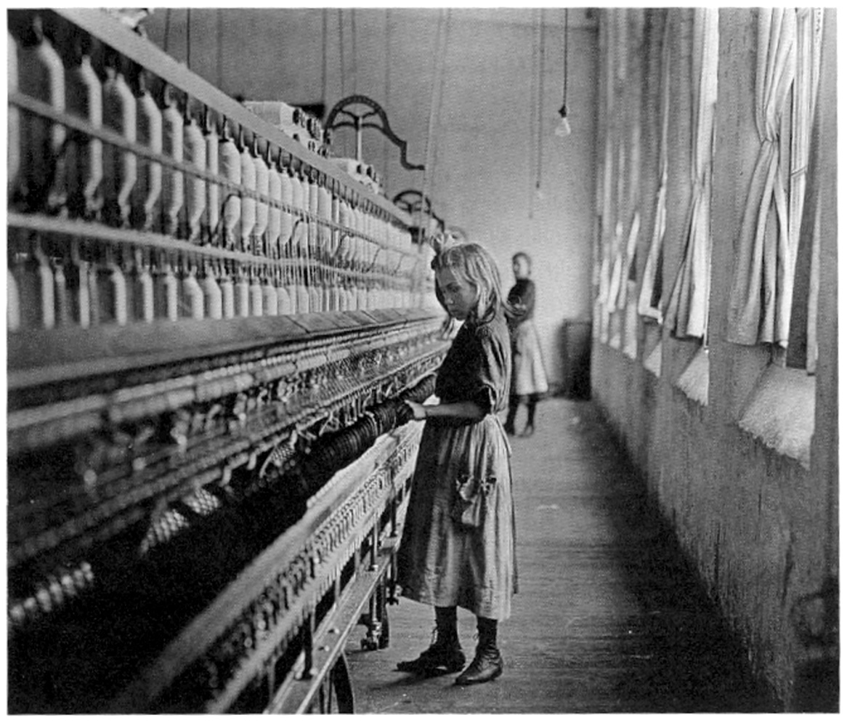
Now read the statements of supporters and opponents of child labor reforms during the Industrial Revolution. Answer the questions in your small groups.

Slide 15
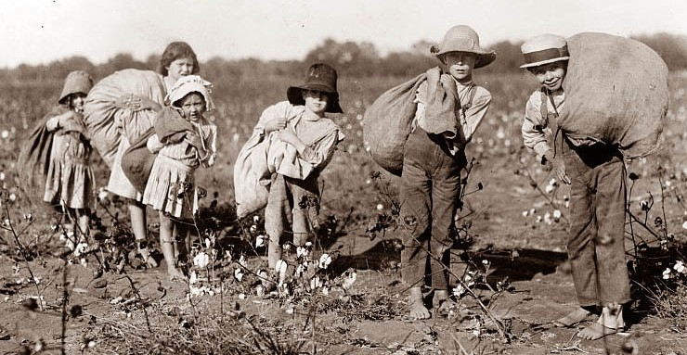
British Laws that Improved Child Labor Conditions
Cotton Factories Regulation Act of 1819 - set the minimum working age at 9 and maximum working hours at 12
Regulation of Child Labor Law of 1833 - established paid inspectors to enforce the laws
Ten Hours Bill of 1847 - limited working hours to 10 for children and women
Mining Act of 1842 - prohibited girls and women from working in mines

Slide 16
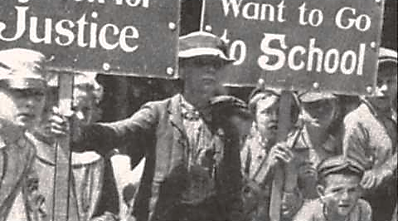
Other Factors that Led to the Decline of Child Labor
the rise of the idea that the father was the breadwinner and the mother was the housewife spread from the upper and middle classes to the working-class
the rise in the standard of living that accompanied the Industrial Revolution allowed parents to keep their children home
families started showing an interest in education and began sending their children to school voluntarily
advances in technology and the new heavier and more complicated machinery required the strength of skilled adult males
during the Great Depression, available jobs went to adults, not children

Slide 17
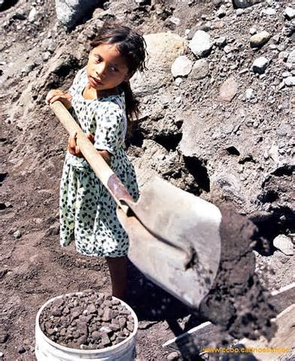
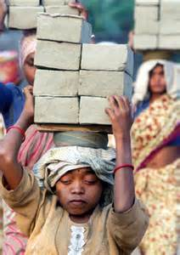
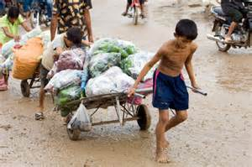
Questions to Ponder
Do children work in the modern world? If so, what kinds of jobs do they do?
Do children work under unfair conditions today?
Should children have protected human rights? If so, what rights should they be?
What is the best way we can protect the rights of children?

