Slide 1
Mid Term Review
English III Honors

Slide 2
Ethan Frome
Use of light/dark imagery to contrast Zeena and Mattie
Who was a possible suitor for Mattie?
How long ago did the accident occur?
What are some symbols in this “framed” novel?

Slide 3

Contrasts between Zeena and Mattie?
Hair
Personality
Health
Age
Attitude regarding Ethan
Zest for life

Slide 4
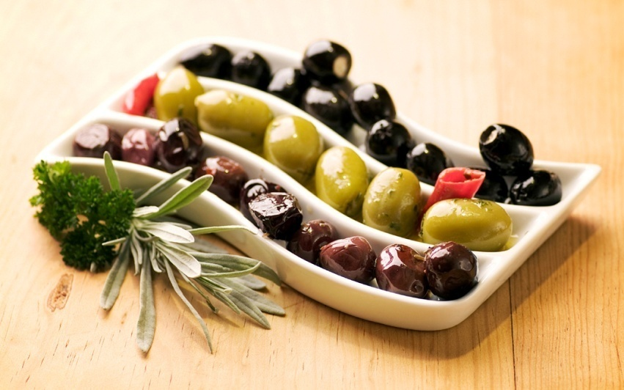
Important Symbols
Pickel dish
Graves of Ethan’s ancestors
Zeena’s empty rocking chair

Slide 5
What kind of writer would best describe Edith Wharton?
Naturalistic: Her characters are like pawns being moved around on a chess board. They have little free will and their fate is determined by external circumstances.

Slide 6
The form of language spoken by people in a particular region is ???
DIALECT

Slide 7
What subject did Ethan used to study?
Engineering

Slide 8
Death of a Salesman
Who are the character foils?
Bernard and Biff
Willy and Ben

Slide 9
What musical instrument represents Willy’s past?
Flute

Slide 10

Which character refers to Willy as a “prince”?
Biff

Slide 11
How does Miller use juxtaposition in the play?
He overlaps Willy’s flashback of the past with his present life.

Slide 12
What are some of the play’s themes?
Longing for the past
Appearance vs. reality
Need for space
Disillusionment with the American Dream

Slide 13
The Scarlet Letter
Define tone.
What is Hawthorne’s tone towards the Puritan society?

Slide 14
What is the setting of the novel?
Boston, 1692

Slide 15
Symbols in the novel
The “Black Man”
Letter A
Scaffold
Rose bush
Hester’s hair
Sunshine (light/dark imagery)

Slide 16
How does the meaning of the letter change throughout the novel?
Adulterer
Anguish
Alienation
Angel of mercy
Able
Arthur

Slide 17
Significance of Characters’ Names
Hester
Chillingworth
Pearl
Dimmesdale

Slide 18

Hawthorne’s Writing Style
Descriptive, lengthy sentences
Ambiguity
Obvious symbolism
Use of irony
Character development

Slide 19
The Great Gatsby
Nick- lives on West Egg
Juxtaposition of the two parties (Gatsby’s and Tom’s)
Jordan-influential over Nick?
Owl Eyes= the Eyes of Dr. Eckleburg

Slide 20
Through which character does Fitzgerald allow the reader to learn about Gatsby’s past with Daisy?
Jordan Baker

Slide 21


How does Fitzgerald use setting symbolically?
East Egg vs. West Egg

Slide 22
The American Dream
Fitzgerald equates Americans’ quest for the New World with Gatsby’s quest for Daisy
http://www.youtube.com/watch?v=-fE8bsci4AI&feature=related

Slide 23

What arrangements did Gatsby make prior to his reunion with Daisy?
Lawn was cut
Silver tea set
Yellow flowers
White, flannel suit and tie
12 lemon cakes

Slide 24
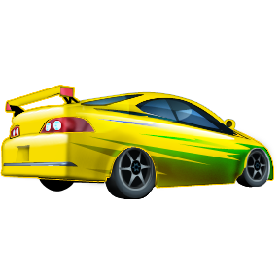
Symbolism in Gatsby
Car
Eyes of Eckleberg
Valley of ashes
Colors-green and blue
Wolfsheim’s cuff buttons

Slide 25
The Grapes of Wrath
What are some of the major themes of the novel?
Need for companionship/brotherhood
Universal Oversoul
American Dream
Good emerging from struggle or conflict
http://www.youtube.com/watch?v=1DEtA5fhk4k&featu
re=related

Slide 26

How does Jim Casy serve as a Biblical figure?
Martyr
Belief in Universal Oversoul
Same initials
Preacher

Slide 27
Tom Serves as Casy’s “Disciple”
Continues Casy’s belief in the Universal Oversoul
http://www.youtube.com/watch?v=qM0rb_kT9yE&NR=1

Slide 28
Symbolism
Grapes
Turtle
Rose of Sharon’s stillborn baby

Slide 29
What is the function of the inter chapters?
They serve to enhance the theme and
provide background for the plot

Slide 30

Transcendentalism
Places great emphasis on nature and the divinity of all people
Philosophical and literary movement

Slide 31
The Old Man and the Sea
Earned Hemingway the Nobel Prize in 1954
Novella- short piece of literature with a pointed and compact plot
Parable- teaches a moral or religious lesson

Slide 32
Qualities of a Hemingway Hero?
How is Santiago a Hemingway hero?

Slide 33
Santiago
How does Santiago feel about relying on LUCK during a challenging period?

Slide 34
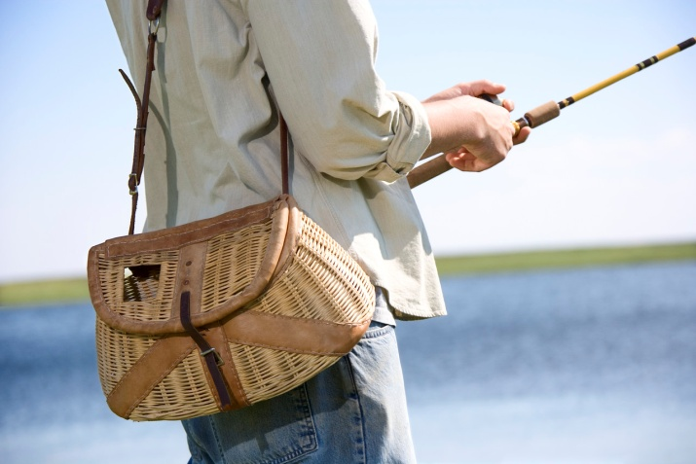
Why did Santiago admire Joe DiMaggio?
His father was a fisherman.
He perfected a particular skill.
He was humble, not conceited.
He fought off pain bravely.

Slide 35
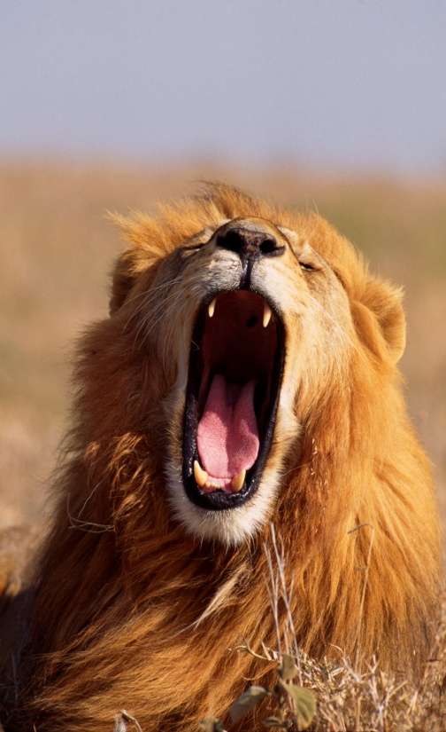
Symbolism
Biblical parallels
Lions roaming the beach in Africa

Slide 36
How does Hemingway juxtapose Manolin’s father and Santiago?
Santiago can still see well
Santiago allows Manolin to carry equipment
Santiago builds Manolin’s self esteem

Slide 37
Important terms
Transcendentalism
Naturalism
Realism
Allusions (types of)
Irony
Imagery
atmosphere

Slide 38
hyperbole
A huge exaggeration for an effect

Slide 39
Imagery
Appeals to one or more of the five senses

Slide 40

Review figures of speech
Simile
Metaphor
Oxymoron
Hyperbole
personification

Slide 41
Vocabulary Words!!!
Approbation
Lassitude
Commiserate
Drivel
seditious

Slide 42
Study Vocabulary
Hackneyed
Occult
Assuage
Intercede
Unctuous
permeate

Slide 43
Form study groups to review
Contrive
Flout
Expiate
Expedite
Tenuous
Permeate
aggrandize

Slide 44
Pronoun/antecedent agreement
Review list of singular antecedents:
Anyone
No one
Anybody
Either
Neither
each

Slide 45
Persuasive Essay
Five paragraphs or more
Solid, specific examples
References to text
Transitions/transitional sentences
Semicolons
Precise, exciting diction
Introductory participial phrases

Slide 46
Review Use of Who and Whom
She is the girl (who, whom) I spoke to.
John is the boy (who, whom) has the blue backpack.
For (who, whom) is that package?

Slide 47

Review Rubric of answering open ended questions
READER

Slide 48
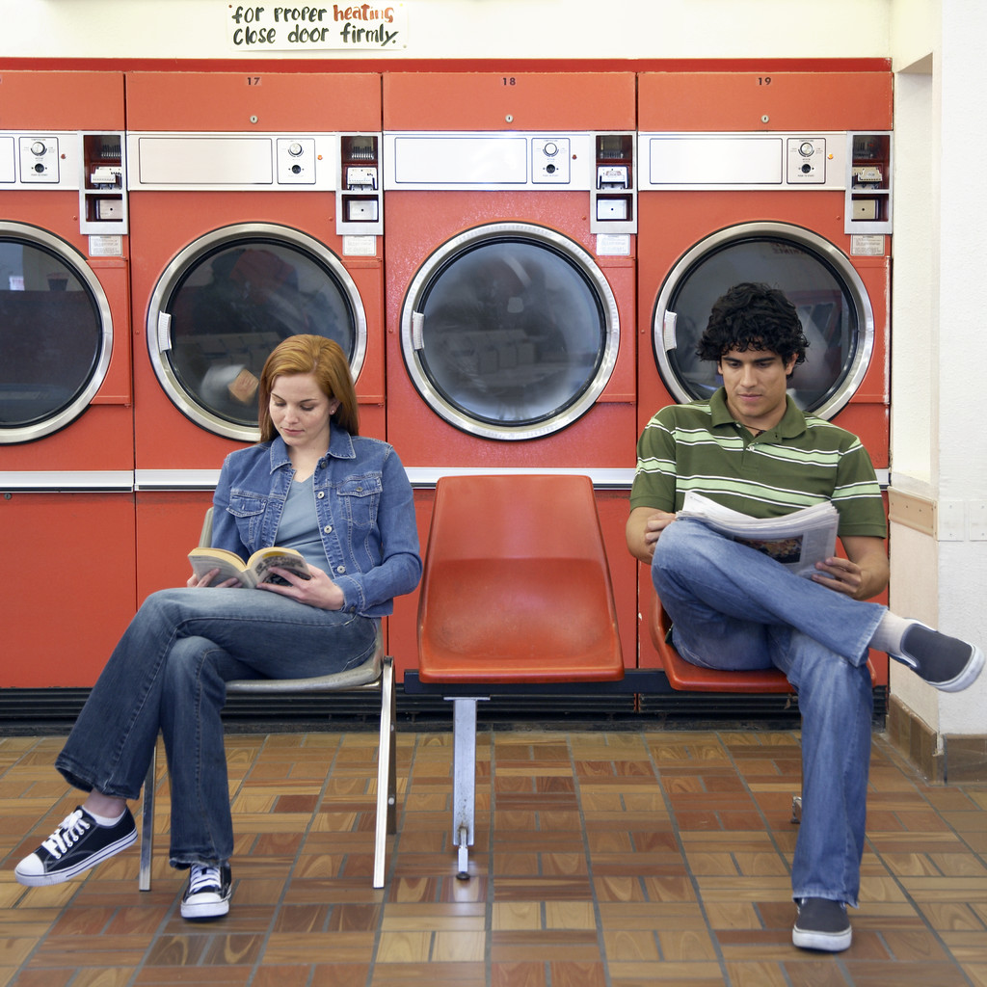
Study Everywhere You Can!
Intrinsic
Callow
Sleazy
Fractious
Aspersion
Callow
exhort

Slide 49
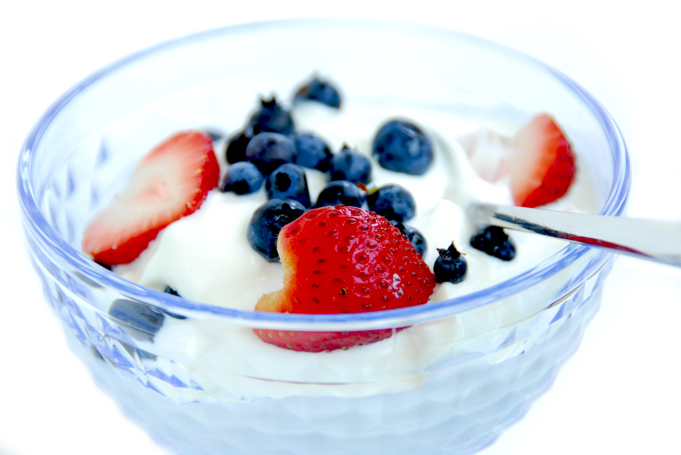
Get plenty of rest and a good breakfast!
Scurrilous
Brusque
Affable
Remonstrate
Erudite
Resilient
aura

Slide 50

Good Luck!!!!

